Slide 1
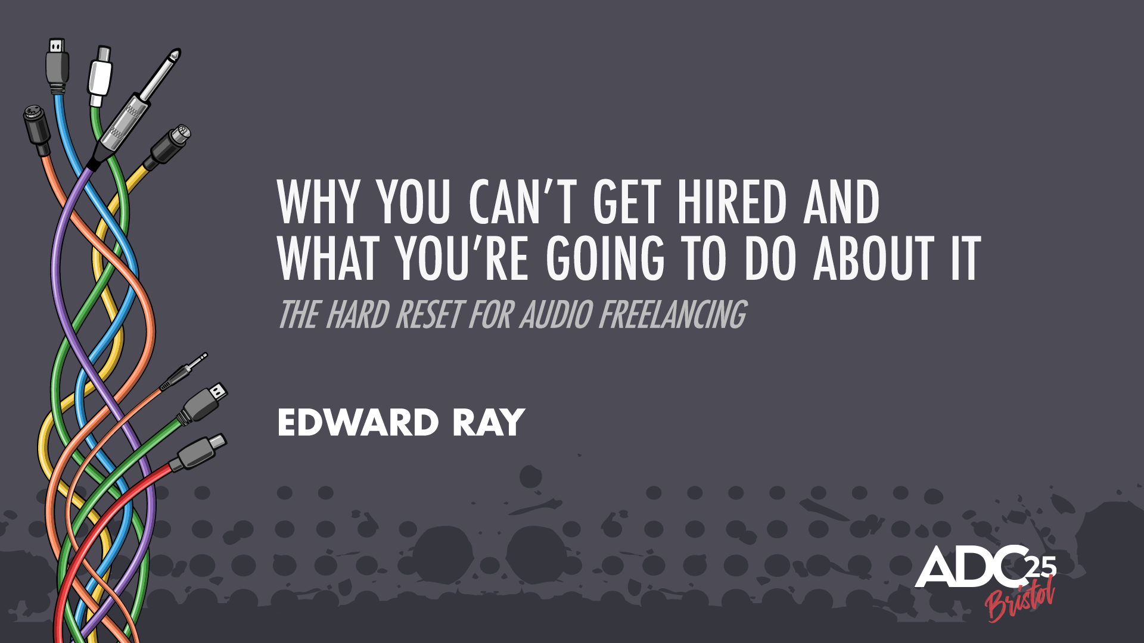

Slide 2
There are people twice as talented as you, or I
… who never get hired.
And people half as talented…
who consistently do.

Slide 3
You don’t know who I am…

Slide 4
No show of hands.

Slide 5
“80% of Freelancers don’t earn more than minimum wage.”
- Someone at some point

Slide 6
Step One:
Confidence through Clarity.

Slide 7
“I’m a passionate composer with experience in orchestral, ambient, and electronic styles.
Would love to be involved.”
“Flexible on rates,
just excited to work on something cool!”
“Here’s my reel, it features tracks from my latest EP and some redesigns I did for fun.”

Slide 8
“Totally understand if this isn’t the right fit, no worries either way!”
“My style’s super flexible - happy to adapt to whatever you need!”
“Most of my work has been remote and self-directed, so I’m used to taking initiative, but of course
I’m also happy to just follow your lead.”
“Even just getting to apply means a lot.”
“Even if I’m not the right fit, I’ll be cheering on the project from the sidelines!”

Slide 9
“...the way we present ourselves has a measurable effect on how capable we’re perceived to be…”
Adapted from research in social perception and communication theory (Harvard, Columbia)
See: Language and Social Behavior (Columbia) | Language Expectancy Theory (Burgoon et al.)

Slide 10
You’re broadcasting your self-belief.

Slide 11
They don’t hire Talent.
They hire Clarity.

Slide 12
❌I’d love to be involved if there’s any opportunity.
✓ Your project hinges on atmosphere. That’s my domain. Here’s how I’d handle it.

Slide 13
❌Genre Menu.
✓ The world THEY are building.
✓ Lead with certainty.
❌Hedge = Liability.
Clarity = Competence.
Competence reduces Risk.

Slide 14
The Psychology of Risk Reduction: The Ambiguity Effect.
❌ Lack Clarity = Unknown Quantity.
❌Vague = Invisible.
❌Bundle of loose potential.
✓ Answer to a problem.
Certainty > Ambiguity.

Slide 15
The Psychology of Risk Reduction: The Ambiguity Effect.
❌I’m an audio professional with experience across music, sound design and implementation.
✓ I help teams build cohesive, memorable soundscapes, fast and without friction.
❌Let me know if you’d like to chat!
✓ If the project is still taking shape, I can build a short audio sketch this week, to show you how I’d approach it.

Slide 16
Step Two:
Being Divisive is a By-product.
Being Forgettable is the Cardinal Sin.

Slide 17
“Multi-genre composer”
“Passionate about storytelling”
“Flexible on style”
“Always looking to grow”

Slide 18

The Von Restorff Effect

Slide 19
❌“Here’s my general reel. Let me know what stands out!”
✓ “Here’s a 90-second cut I built specifically for dark narrative games. It’s slow-burn, cinematic, and ends with a thematic gut punch. Let me know if that’s what you’re after.”

Slide 20
❌“I’m a flexible composer who can adapt to any style!”
✓ “I have analysed the brief. Here is what is working. Here is what isn’t. Here is how I would solve that problem.”

Slide 21
Step Three:
Putting it All Together:
Double Down.

Slide 22
Memorable ≠ Agreeable.
Referable ≠ Technically Clean.
You Instilled Confidence.
Your Positioning = Clear.
Your Taste = Unmistakable.
Your Presence Sharpened the Room.

Slide 23
Most Skilled ≠ First Choice.
Clear. Bold. Distinct.
Not Remembered = Not Hired.
Can’t Describe You = No Returns. No Referrals.
If your portfolio doesn’t provoke
conversation, it dies in silence.

Slide 24
The One thing…
Don’t Act. Double down.
Then Act.

Slide 25
A level of alignment between your values, your work, and your delivery that can’t be faked and cannot be ignored.

Slide 26
What “Luck” really means.

Slide 27
The Final Shift.

Slide 28
You might do everything right and still not succeed.

Slide 29
Thank you.

