Slide 1
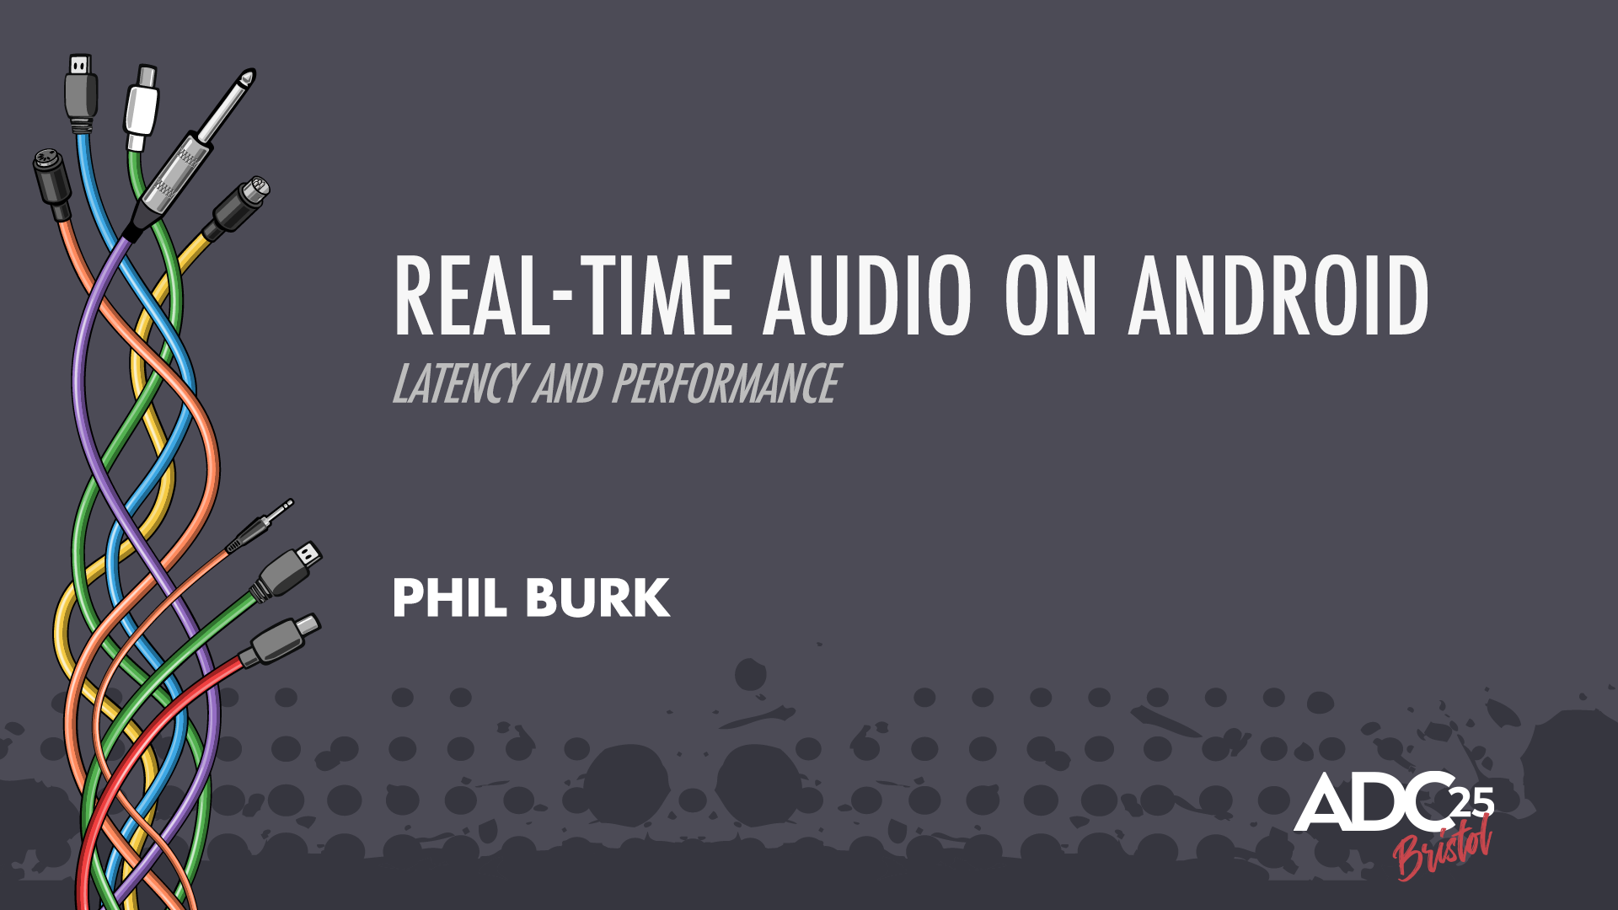

Slide 2
Worked on Android Audio for 12 years at Google.
Focussed on Latency and Real-time Performance.
Developed AAudio and Oboe.

Slide 3
No Confidential Information
Android, AAudio are open source (AOSP)
Oboe on GitHub
Vendor docs and CDD are online
Test tools for latency and CPU are on GitHub and on Play Store

Slide 4
What is “Real-Time” Audio?
Audio changes quickly in response to user input or other information.
YES: games, musical instruments, UI sounds, hearing assistance, VR
NO: streaming audio and video

Slide 5
Two Main Issues
Getting Few Small Buffers
Reliable CPU Performance
Good News: Apps with low CPU load work great!
Eg. Drum Pads

Slide 6
Audio Latency

Slide 7
Latency = time from Input to Output
Mic
Audio Input
Finger
Touch Input
App
Audio Output
Speaker
MIDI
Time

Slide 8
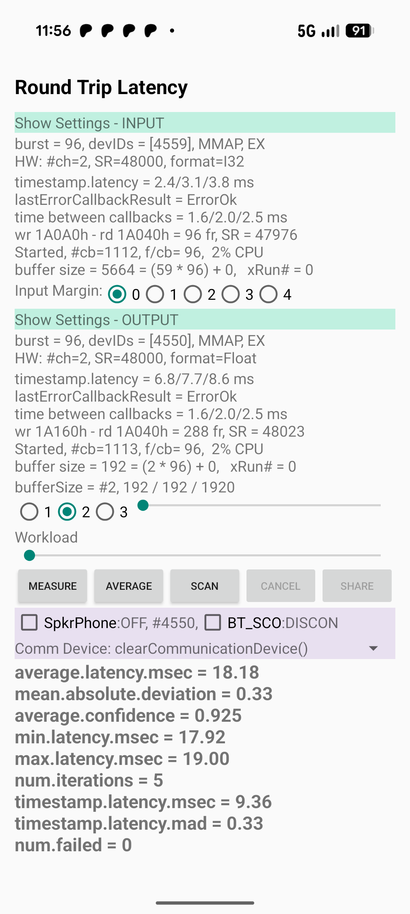
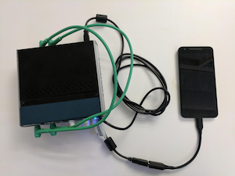
Use OboeTester to Measure Latency
Change settings/path
Measure speaker/mic, USB, 3.5mm
Same algorithm used in CTS Verifier
On GitHub and Play Store

Slide 9
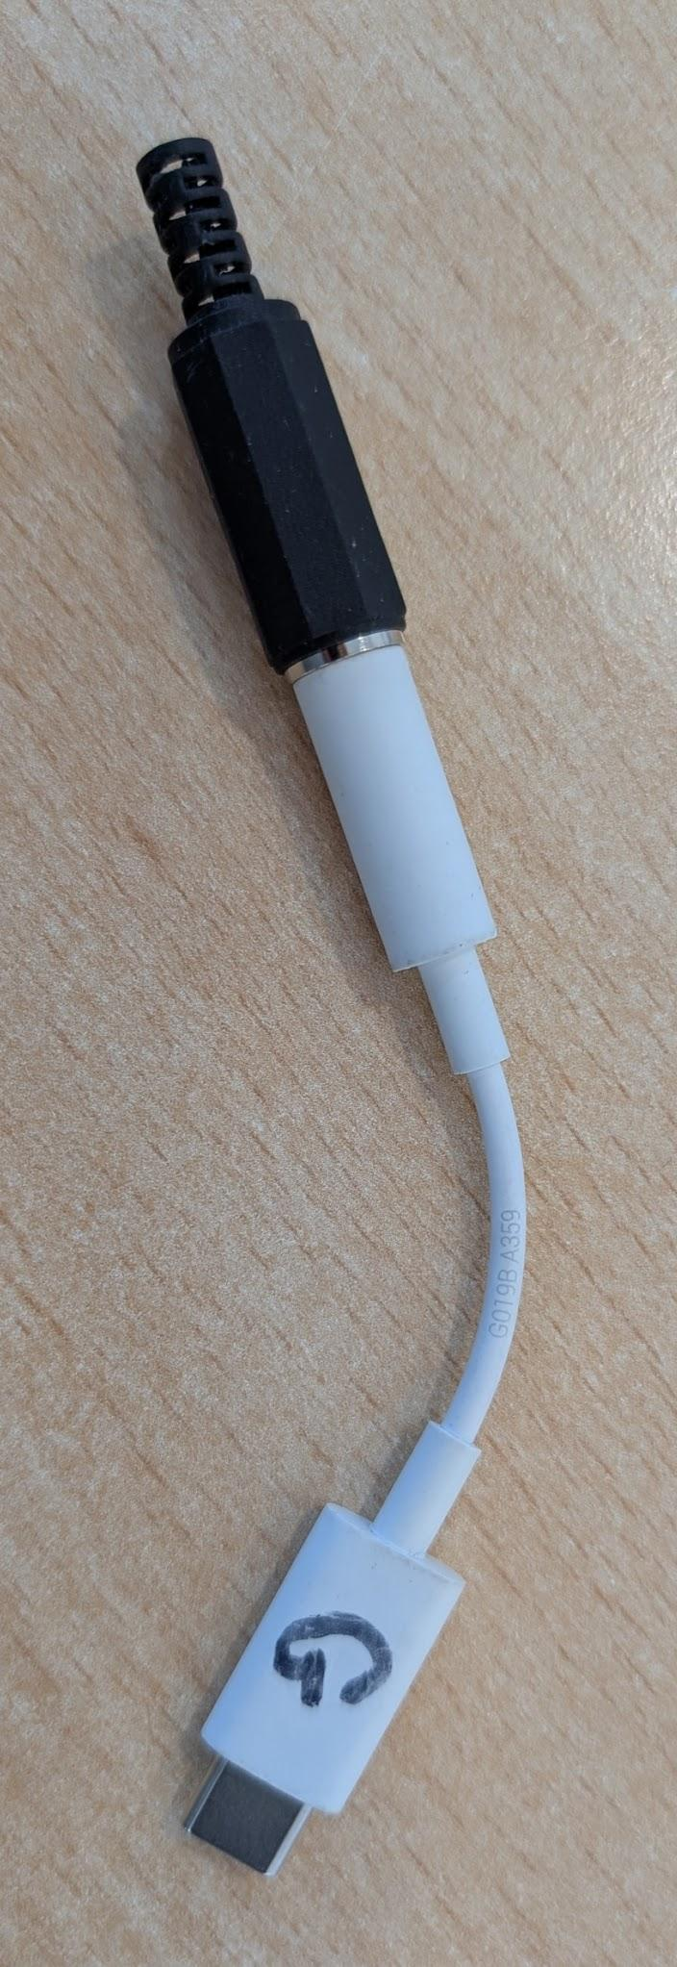
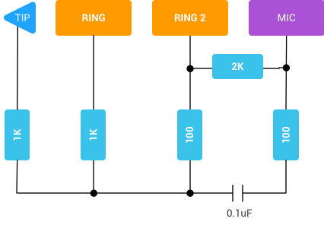
Audio Loopback Hardware - Output to Input
Most USB Adapters add 40-60 msec latency! Use Moshi or Xumee adapters.

Slide 10
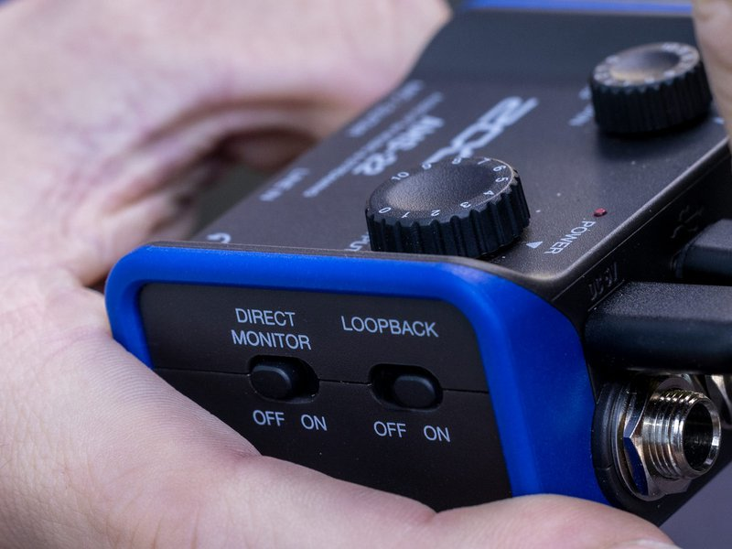
Zoom AMS-22 USB has a “Loopback” switch!

Slide 11
Oldest Latency Measurement Technique
Rick O’Rang app used Larsen Effect
problems with loop gain sensitivity
does not work with speaker/mic
Hello - Hello - Hello - Hello
Hello - Hello - Hello - Hello

Slide 12
Latency Measurement - Sine Burst
less immune to volume issues
broad correlation peak, octave errors
sine waves blocked by some speaker protection code!

Slide 13
Latency Measurement - random bits
Manchester encoding of a random bit stream
Very high correlation peak, very accurate
data smeared on tablet with multiple speaker-mic path lengths
tablet
Mic

Slide 14
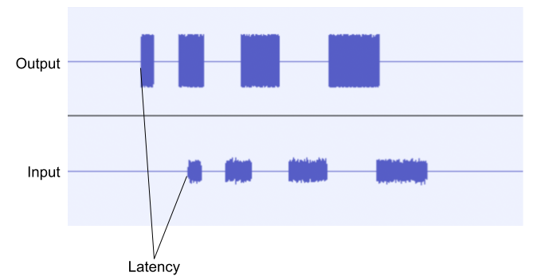
Latency Measurement - noise modulated pulses
use envelope follower
pulse spacing to avoid ambiguity
cross correlation
first pass at low sample rate
second pass for sample accuracy

Slide 15
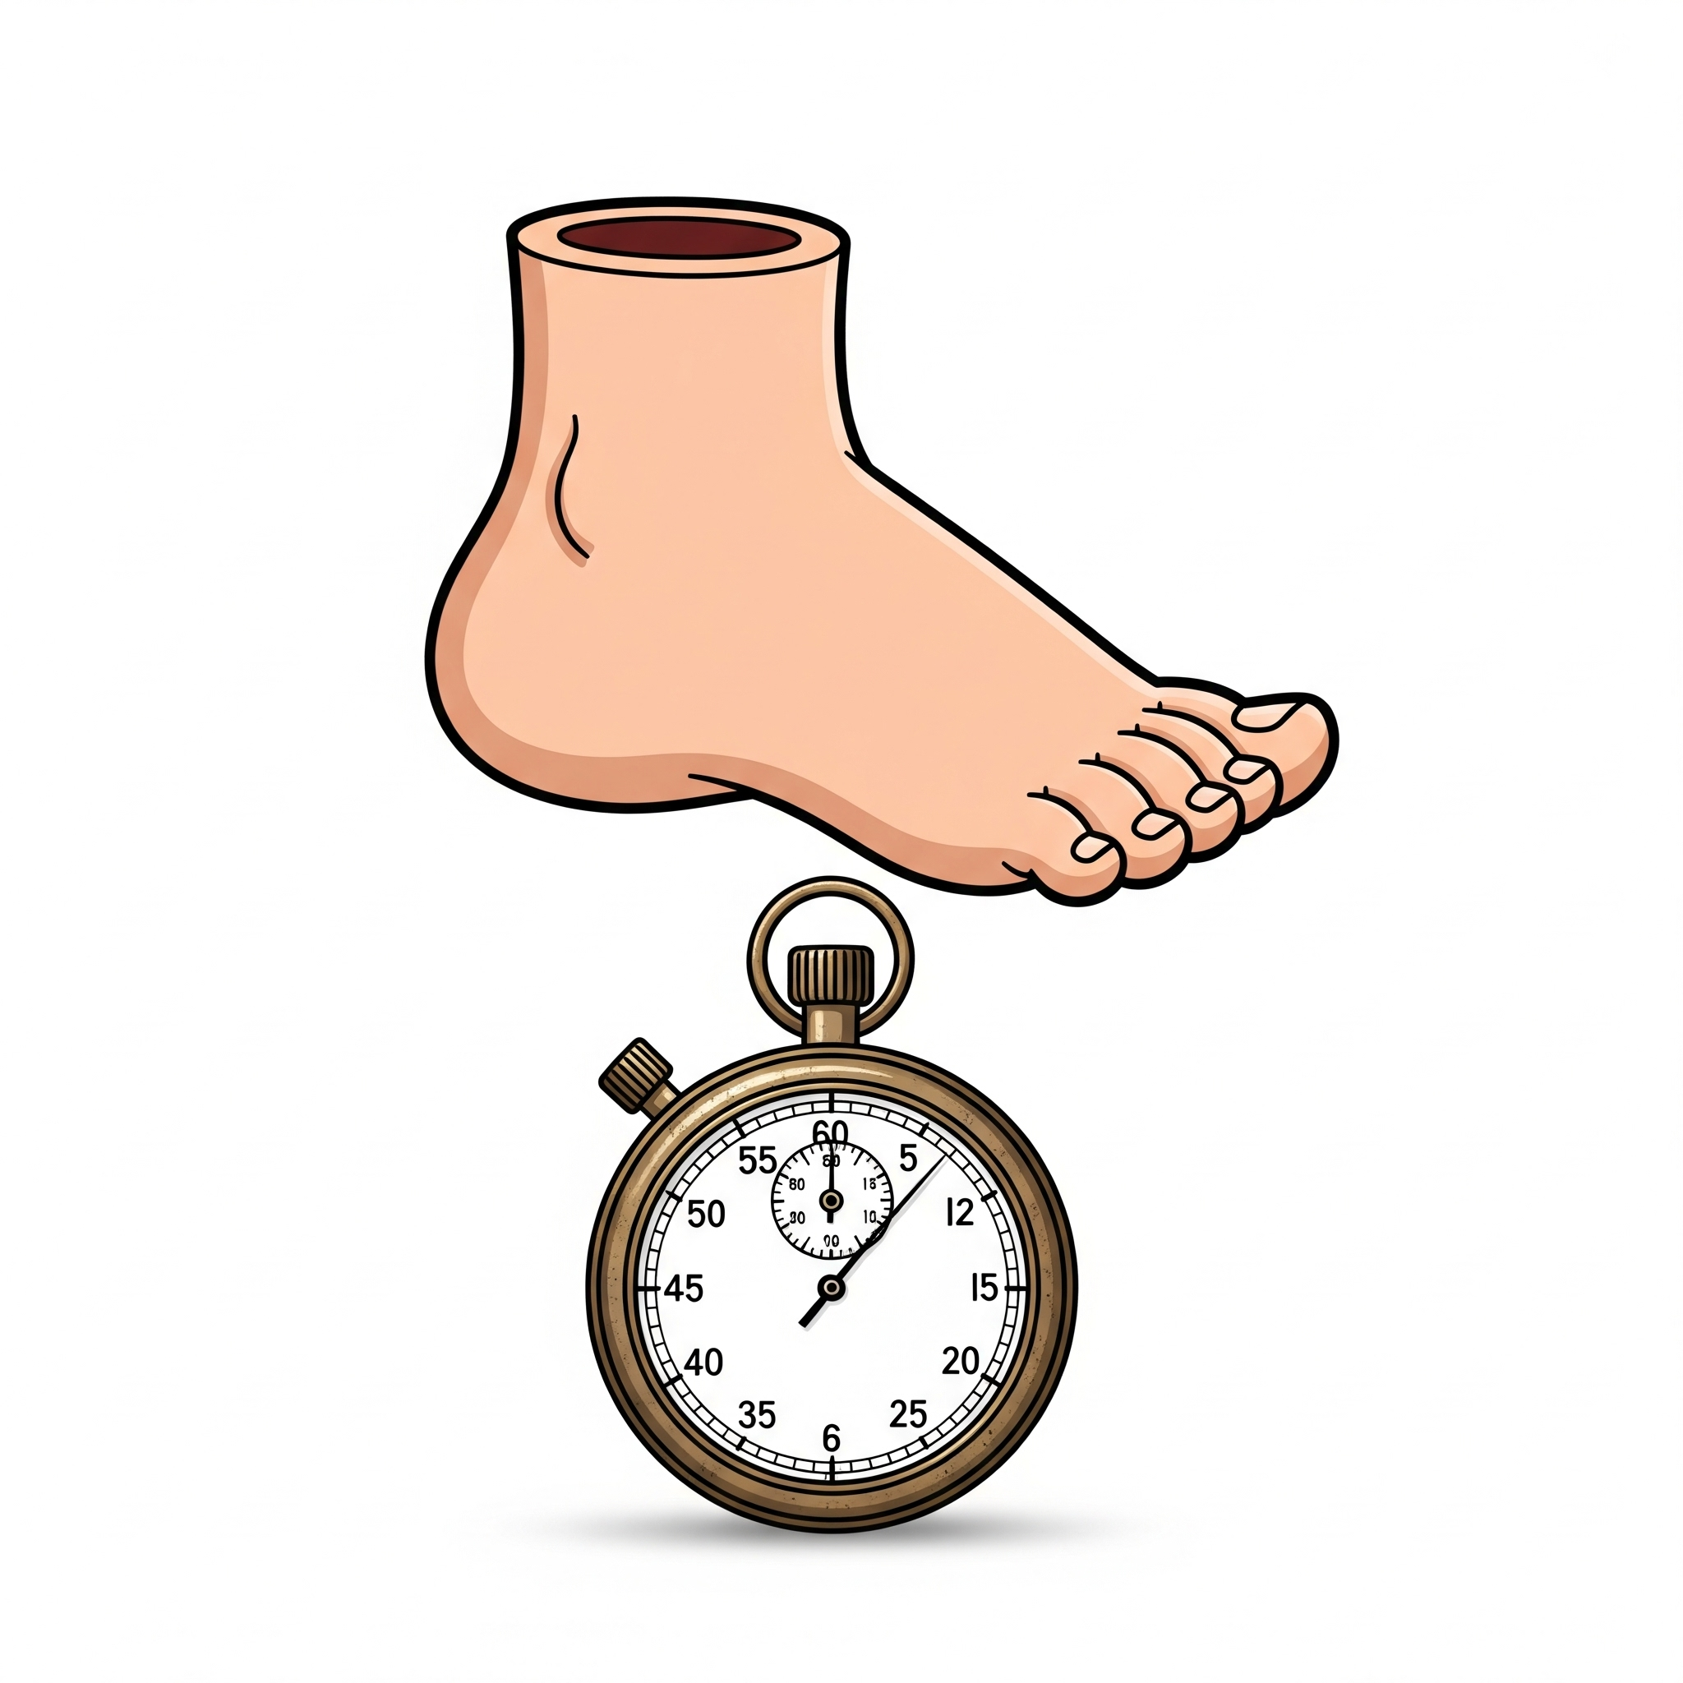
Sound travels one foot (34 cm) per millisecond.

Slide 16
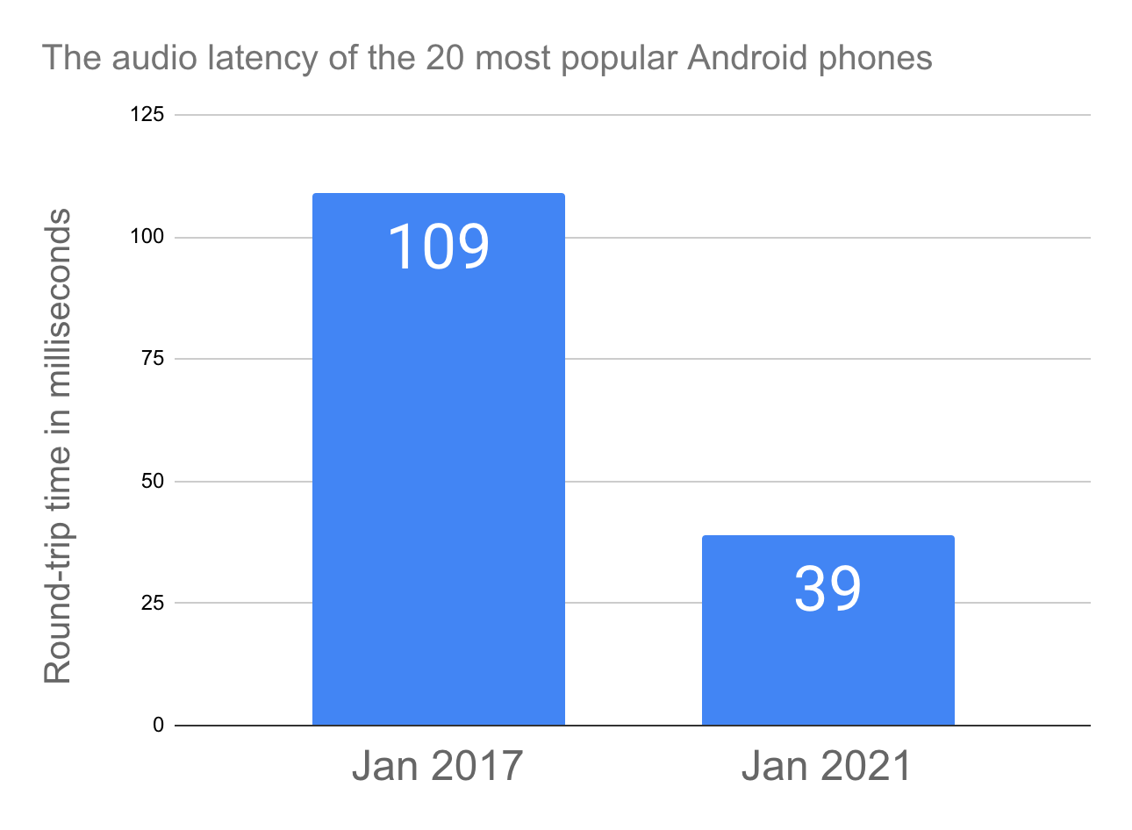
From Android Developer Blog

Slide 17
Android CDD defines max round-trip latency
Forces manufacturers to measure and report latency.
Most devices are much lower latency.
Android SDK | max RT Latency (msec)
12 (2021) | 800
13 (2022) | 500
14 (2023) | 300
15 (2024) | 250
16 (2025) | 200

Slide 18
Majority of Android Devices now under 30 msec
round-trip latency.
Some below 10 msec.

Slide 19
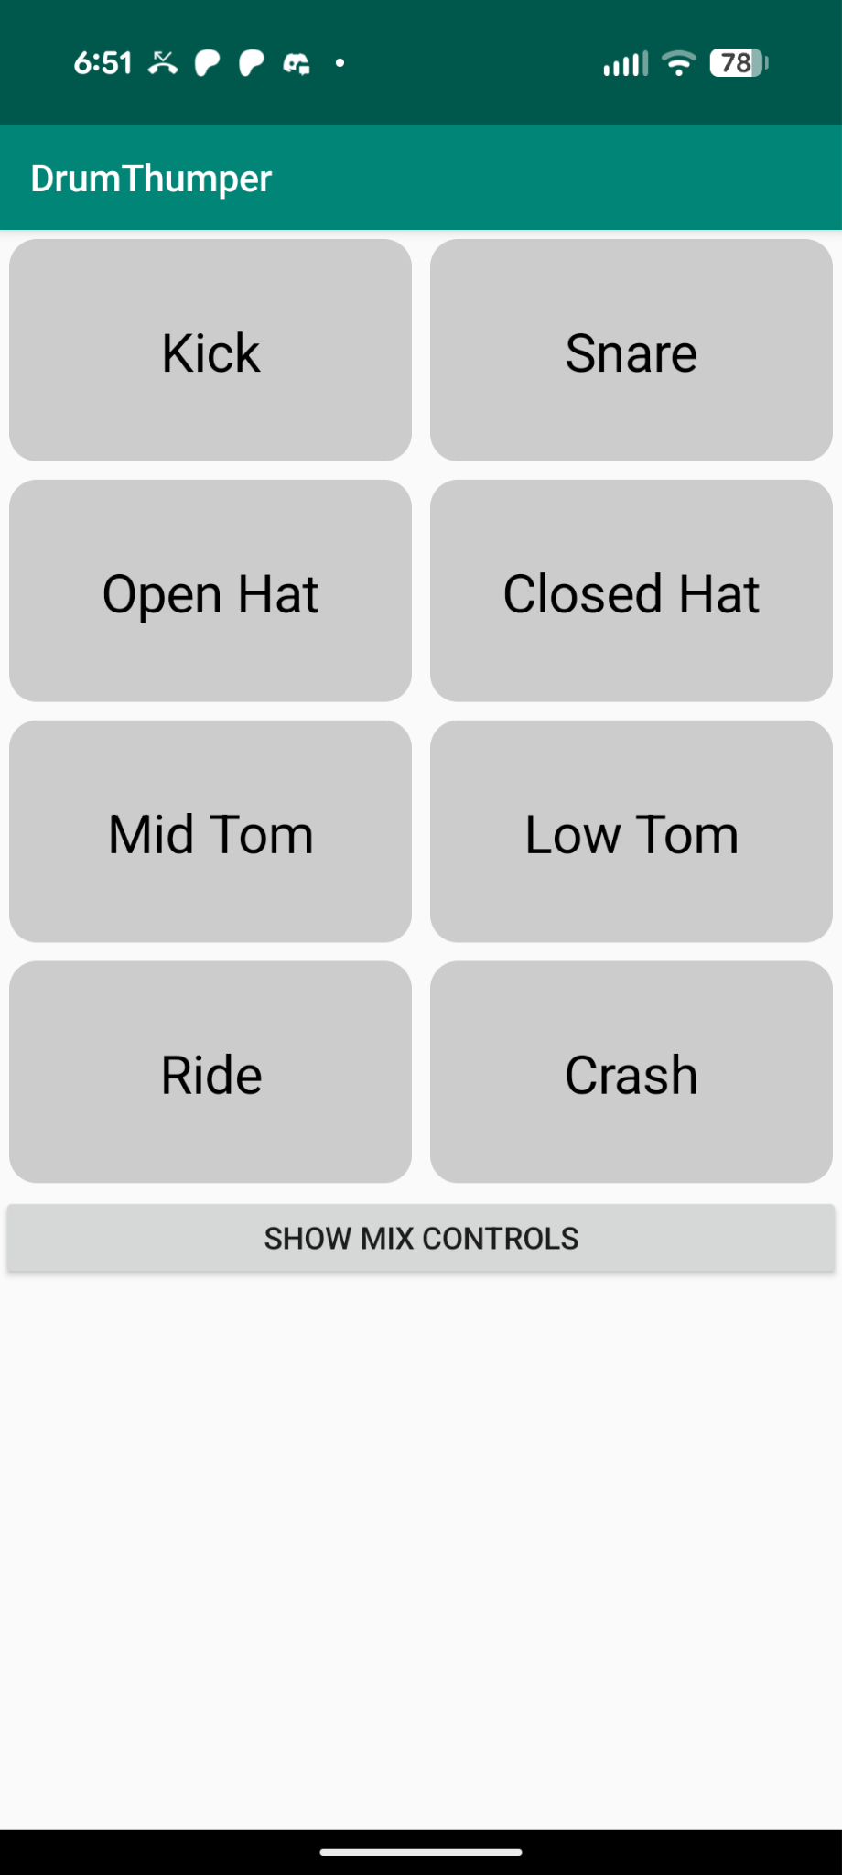
Latency problem solved for interactive apps with low CPU workload,
eg. DrumThumper by Paul Mclean

Slide 20
AAudio Exclusive Mode
App
AAudio
FIFO
shared memory
DSP

Slide 21
Checklist for Low Latency
https://developer.android.com/games/sdk/oboe/low-latency-audio
Use Oboe and C++, QuirkManager, other tools
Request performance mode "low latency"
Request sharing mode "exclusive", save 4+ msec
Use 48000 Hz or the Oboe sample rate converter
Set usage to AAUDIO_USAGE_GAME, (BT)
Use data callbacks, not blocking writes
Tune buffer size to "double buffer"

Slide 22
Dynamic Latency Tuning
if (getXRunCount() > previous)
then
setBufferSizeInFrames(burst * n);
“burst”
“bufferSize”
“bufferCapacity” = allocated memory

Slide 23
CPU Performance

Slide 24
Good and Bad
SynthMark “Voice” = one note on a virtual analog Mini Moog
Good News: Can calculate over 700 voices on some phones
Bad News: Energy Aware CPU Scheduler limits performance to save battery
Responds too slowly to changing workloads
Core Migration “not optimal”

Slide 25
Dynamic Voltage Frequency Scaling (DVFS)
Scheduler
V
“race to idle”
CPU frequency

Slide 26
Slow Response to Changing Workload
Max Workload based on CPU Frequency
Current Workload
100 msec
time

Slide 27
Use Perfetto to see timing
adb shell perfetto --out /data/misc/perfetto-traces/my_audio.pftrace \
--time 20s audio sched cpu freq
adb pull /data/misc/perfetto-traces/my_audio.pftrace ~/.
https://ui.perfetto.dev/
“Open trace file”
Look for app traces, eg. com.mobileer.oboetester
aaRdy is data ready in buffer

Slide 28
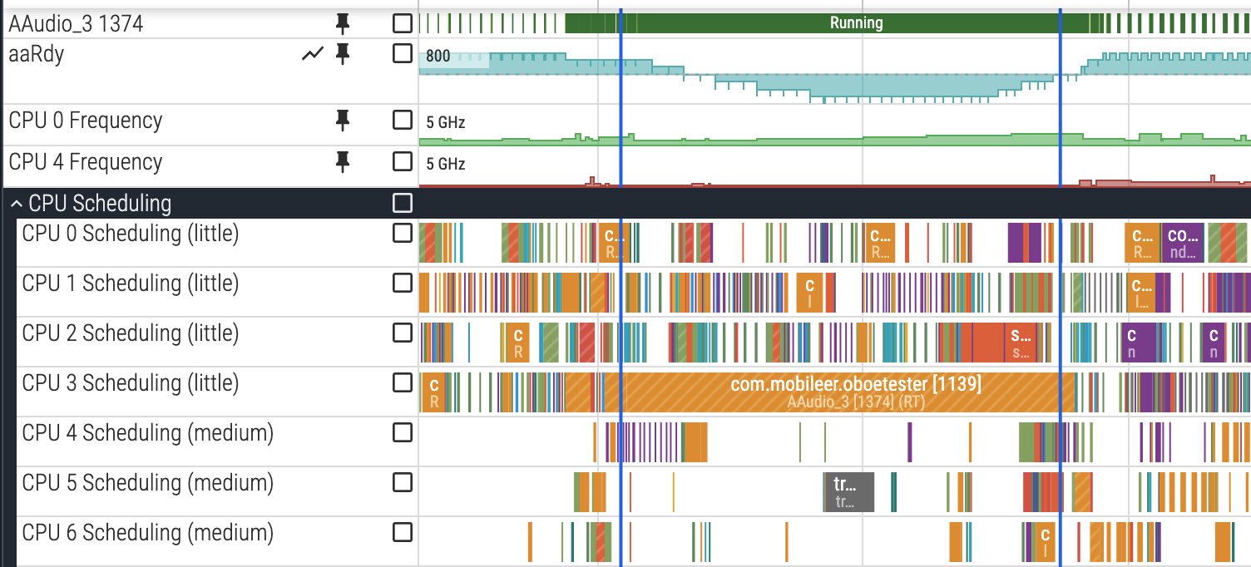
Slow Response to Increased Workload
Measure time to predict completion of callback
Stop processing when at 95% to avoid underrun but still push CPU
Report to ADPF the full predicted duration
Ramp down (20 msec) from last value of each voice. Sum before ramping.
Downside may turn off too many notes

Slide 29
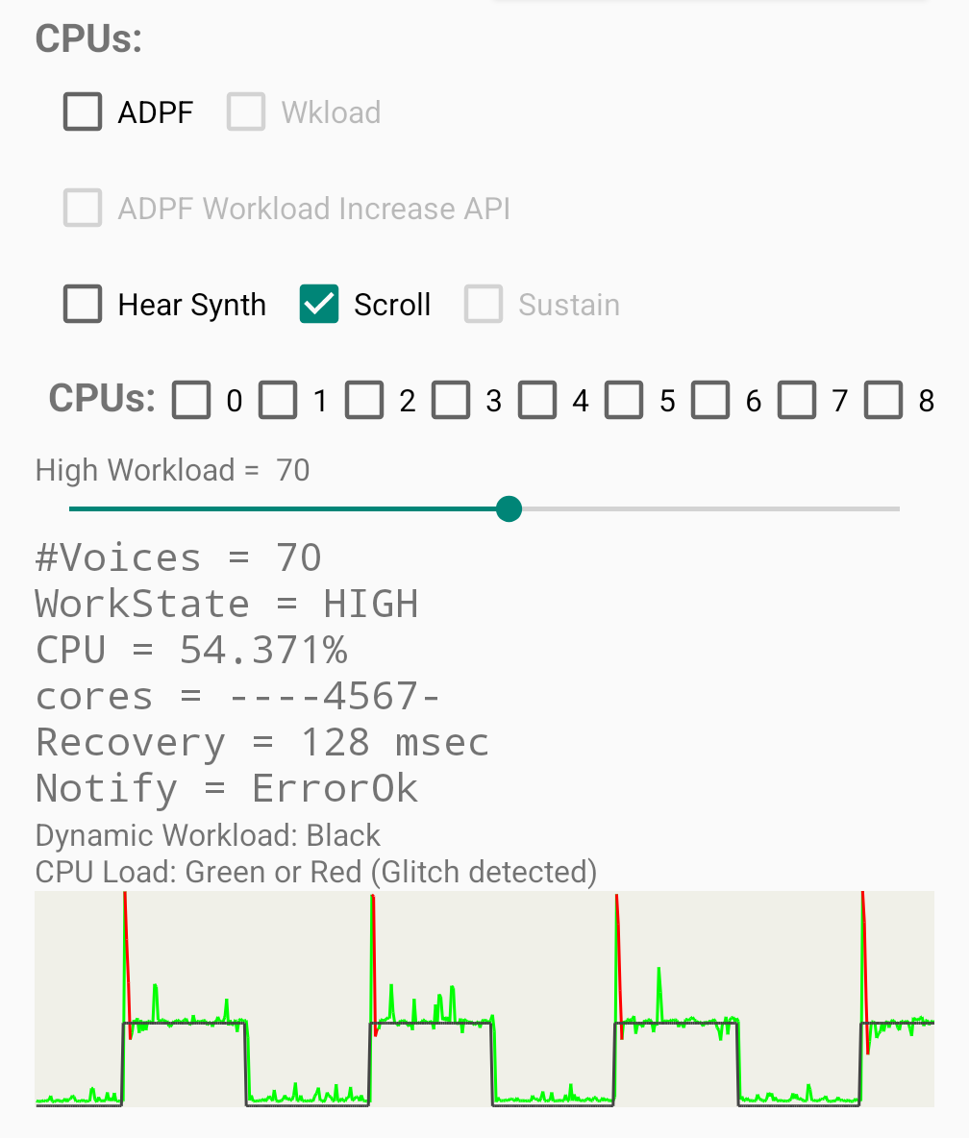
OboeTester can demonstrate slow response
OboeTester >> Extras >> CPU Load
Alternate between 1 to N (70) voices
Note glitch (underrun) at rising edge.
Utilization = render_time / burst_period
Frequency changing
Some phones have no problems

Slide 30
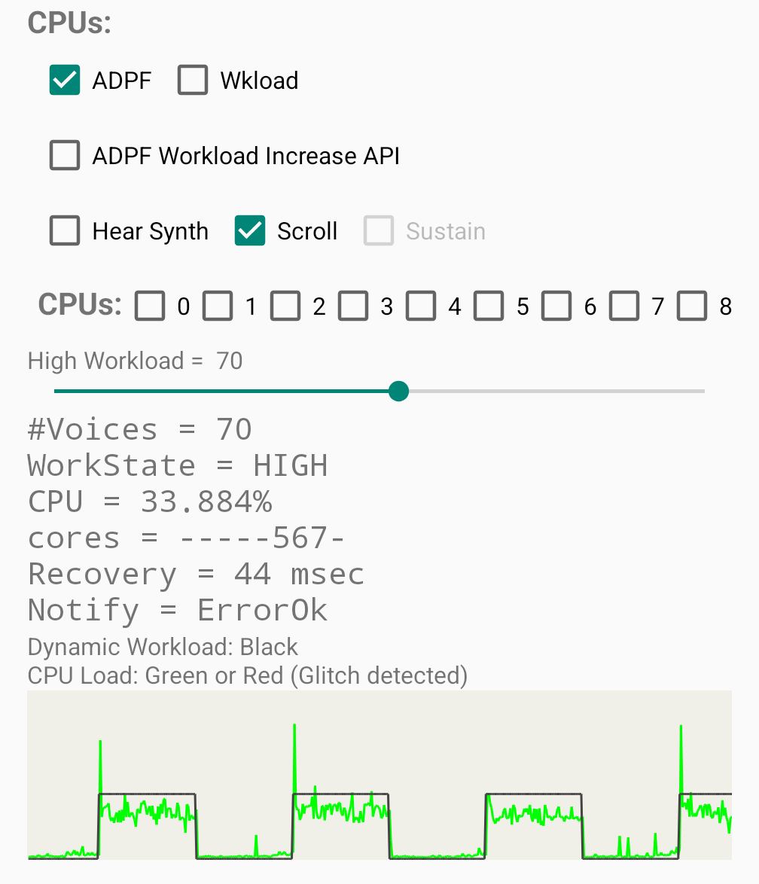
OboeTester ADPF may boost performance
Still a spike
No underruns
Performance Boost
vendor specific, results vary

Slide 31
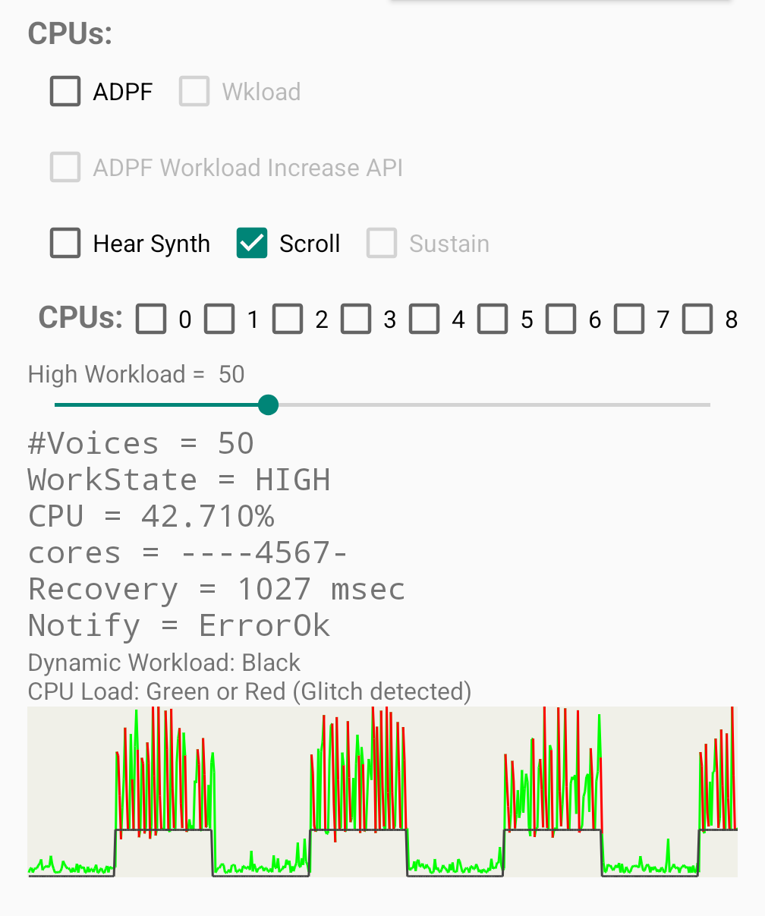
Core Migration Problems
Moves to a core that cannot handle the load
Drops CPU load statistics, goes to minimum frequency

Slide 32
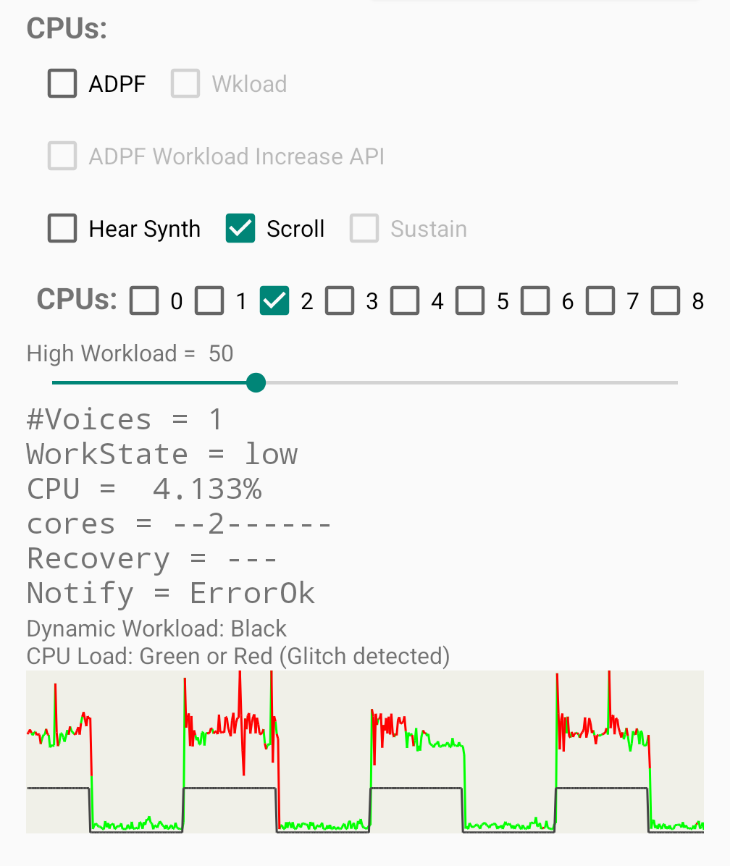
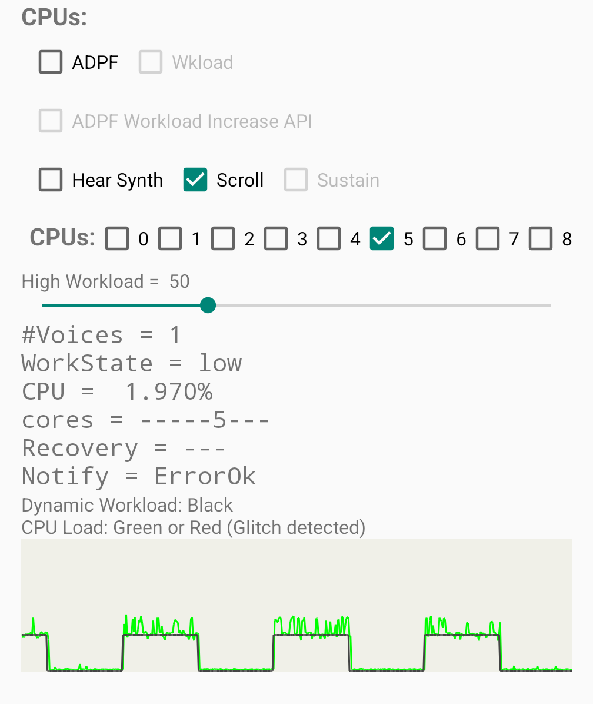
Core Migration Verified by Setting CPU Affinity
CPU#2
too small
CPU#5
OK

Slide 33
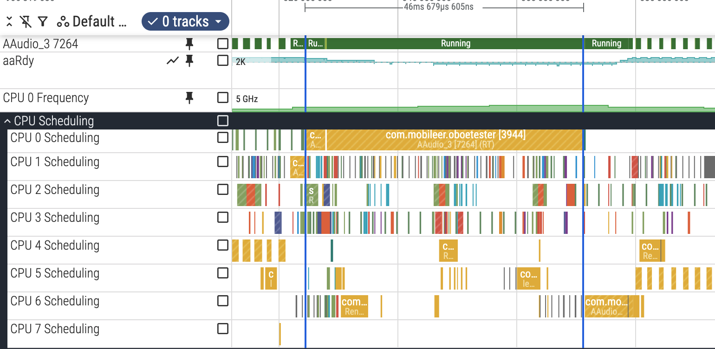
Core Migration: 4 to 0 to 6,5
underrun

Slide 34
Checklist for Good CPU Performance
Avoid blocking operations in the callback, malloc, networking
Use dynamic buffer size, +12 msec may be enough
Optimize, -Ofast, NEON (SIMD)
Use ADPF
CPU Affinity, only if needed
Adaptive polyphony

Slide 35
Android Dynamic Performance Framework (ADPF)
Easy to use AdpfWrapper in Oboe
#include "common/AdpfWrapper.h"
// Open the ADPF session for this thread.
mAdpfWrapper.open(gettid(), targetDurationNanos);
mAdpfWrapper.onBeginCallback();
// render audio
mAdpfWrapper.onEndCallback(1.0);
mAdpfWrapper.close();

Slide 36
ADPF - Advance Warning to Scheduler
Callback generally knows workload at beginning. Don’t wait for underflow.
Predict using previous duration and new workload
// Read MIDI input, how many voices?
// Calculate duration assuming frequency and CPU have not changed.
int64_t predictedDurationNanos = previousDurationNanos *
currentNumVoices / previousNumVoices;
mAdpfWrapper.reportActualDuration(predictedDurationNanos);
// API level 36+
mAdpfWrapper.notifyWorkloadIncrease(true /* cpu */,
false /* gpu */, "add_voice");

Slide 37
Docs and User Guide for ADPF on Wiki at
https://github.com/google/oboe/wiki

Slide 38

No longer recommend “Steady Load”
Technique: calculate max voices all the time.
Wastes power.
Works if slow ramp only problem.
Core Migration worse with higher load.
CPU Frequency can drop any time!

Slide 39
Adaptive Polyphony
Monitor CPU Usage
Adjust polyphony based on device capabilities
Save as an on-device preference

Slide 40
Adaptive CPU Affinity - “last resort”
Keep track of each CPUs ability to render load N.
Only set CPU affinity if getting underruns.
Prevents core migration.
Can interfere with other tasks!
7
4
5
6
0
1
2
3

Slide 41
FullDuplexStream class in Oboe
Open
Streams
Output
Balance
Buffers
Input
Combined
Callback
read()
callback

Slide 42
Docs and User Guide for FullDuplexStream on Wiki at
https://github.com/google/oboe/wiki
Implement callback:
oboe::DataCallbackResult onBothStreamsReady(
const void *inputData,
int numInputFrames,
void *outputData,
int numOutputFrames);

Slide 43
Android supports real-time audio, so
“go write some apps”!

Slide 44
Q&A

Slide 45
Links
https://play.google.com/store/apps/details?id=com.mobileer.oboetester
https://source.android.com/docs/compatibility/cts/usb-audio#usb-audio-adapter-recommendations
https://developer.android.com/games/sdk/oboe/low-latency-audio
https://android-developers.googleblog.com/2021/03/an-update-on-androids-audio-latency.html
https://source.android.com/docs/compatibility/cts/usb-audio#usb-audio-adapter-recommendations

Slide 46
Previous ADC Talks on YouTube
2015 - Developing Android Apps with High Performance Audio
2016 - What’s New In Android Audio
2017 - Build a synth for Android
2018 - Winning on Android - optimizing audio apps
2019 - Real-time processing on Android

