Slide 1

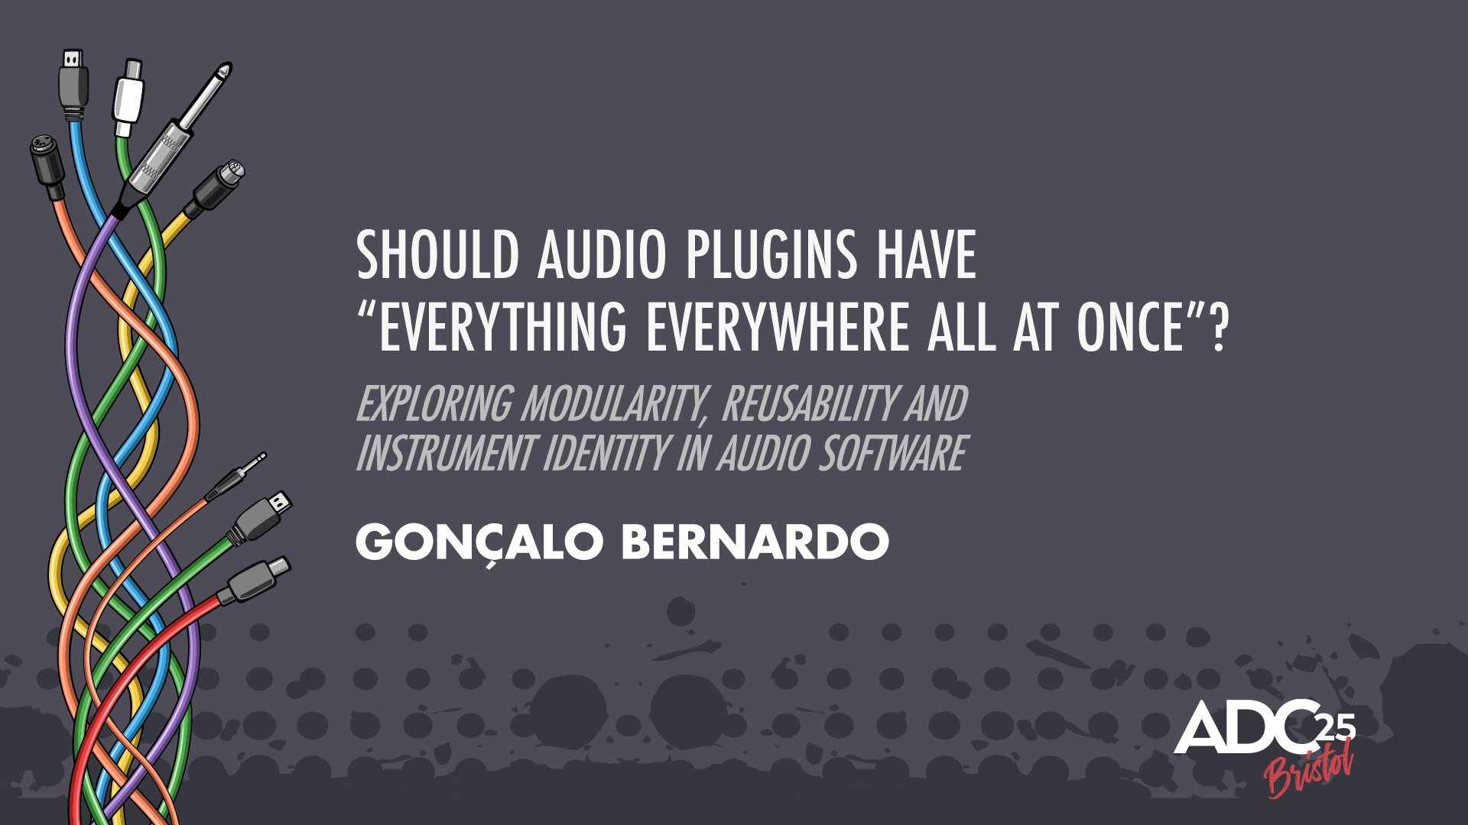
Should
Audio Plugins
have “EVERYTHING EVERYWHERE
ALL AT ONCE?”
Gonçalo Bernardo
ADC25, Bristol
Notes:
Hi everyone, and welcome.
My talk is titled 'Should Audio Plugins have "Everything Everywhere All At Once"?'
This talk is a case study about that exact battle. It's about the technical, architectural, and product decisions we have to navigate when a 'secret sauce' feature is asked to become a global SDK module
I would like to start off by saying that, in a world of clickbait,

Slide 2
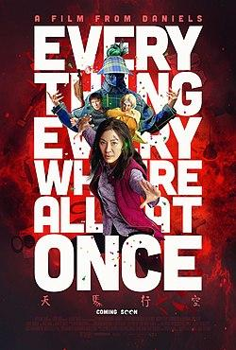
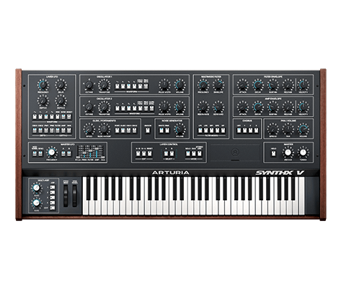
Notes:
This is not a talk about embedding the movie “Everthing Everywhere All At Once” into an audio plugin, apologies in advance.

Slide 3
_1 Hello!
_7 Utility vs. Identity
_2 The Core Conflict
_8 The Architectural Shift
_3 Origin Story
_9 Solution?
_3 Balancing the Books
_10 Conclusions
_4 The “Everything” & the pros of modularity
_5 The “Everywhere” tension
_6 The “All At Once” challenge
Notes:
So going through quickly on all of these topics, I should first introduce myself

Slide 4

/01
_Hello!

Slide 5

_Gonçalo Bernardo, born in Azores, Portugal
_audio software engineer @ ARTURIA
_background on dev audio plugins, core audio components & spatial audio tools
_investigator on generative ambient systems
_digital media and sound artist alias
“ÇALO DO MAR E DA TERRA” working on movement and immersive audio
Notes:
(INTRODUCTION)
I’ve just come out of an arts biennial and the end result is really fun, I dare you take a look after.

Slide 6
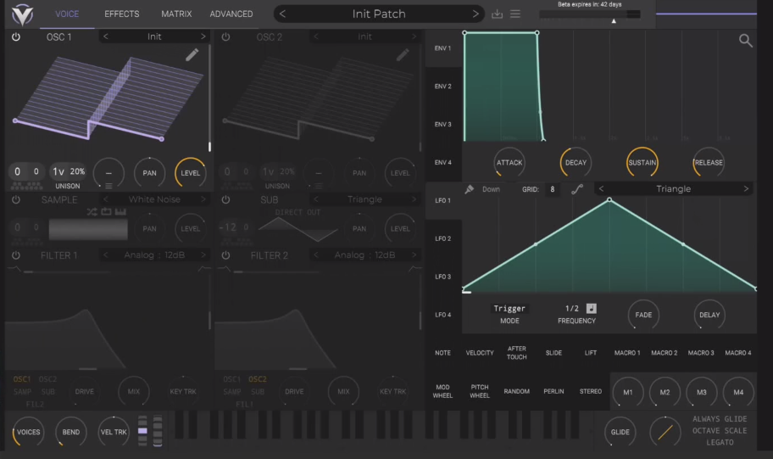
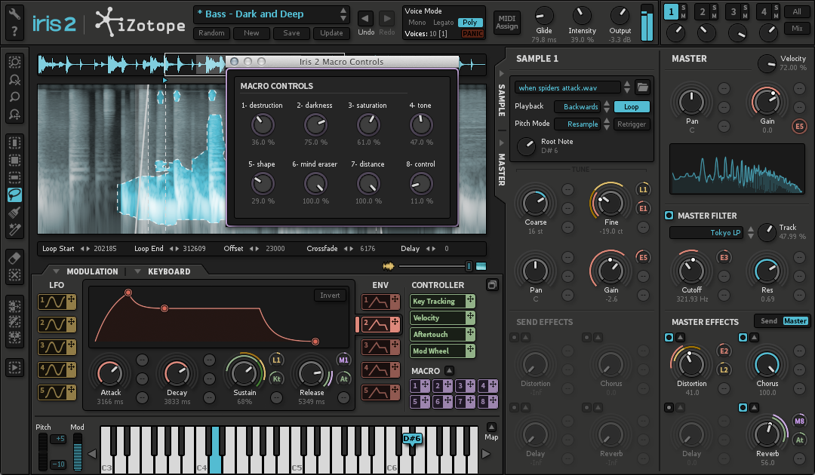
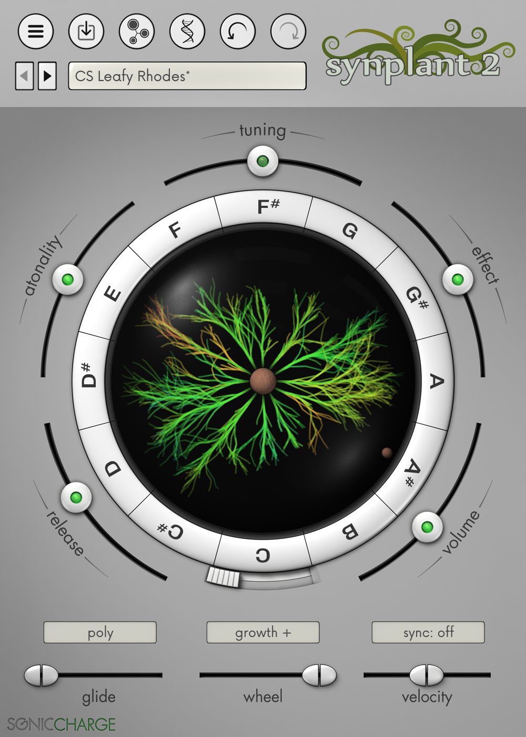
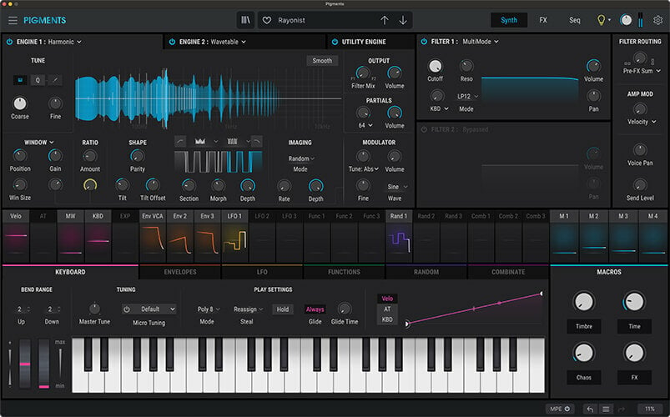
_The Core Conflict
-> Vital, Synplant2, Pigments, Iris 2 ->
Notes:
Let’s dive into the Core conflict of this talk
Taking a look here, these are the products that are often creatively inspiring. They're highly specialized, they possess a strong, unique identity, and they many particular creative problems perfectly

Slide 7
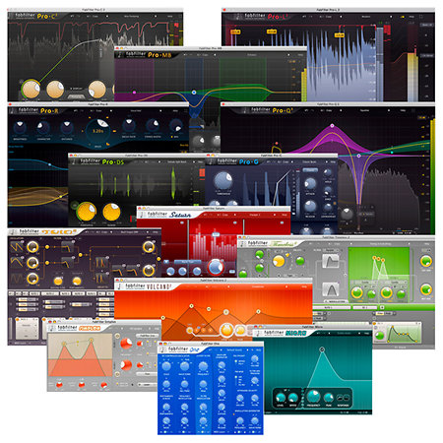
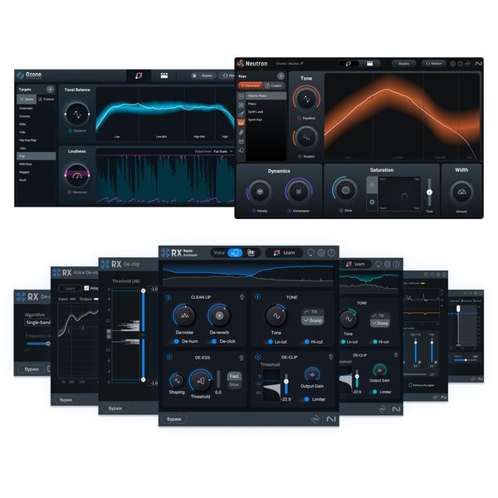
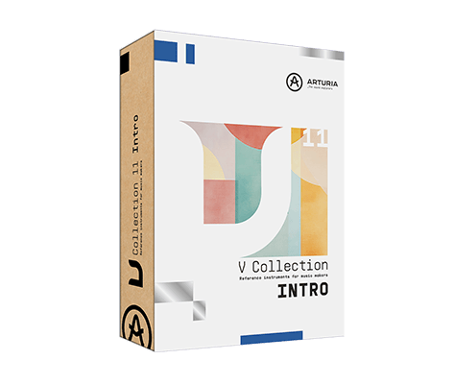
_The Core Conflict
-> Fabfilter Bundle, VCollection, Izotope Bundle ->
Notes:
On the other hand, (point to right), we have our 'Product Lines.' To efficiently build and maintain an ecosystem of related plugins—like the V Collection or a complete mixing suite— in which there seems to be Shared SDK.
This model is powerful on the product line's development velocity, ensures stability across the entire suite, and provides a consistent, predictable user experience—all of which are major engineering and product wins.

Slide 8
_The Core Conflict
-> Vital, Synplant2, Pigments, Iris 2 ->
-> Fabfilter Bundle, VCollection, Izotope Bundle ->
Notes:
As audio developers, we are constantly navigating a fundamental dichotomy.
On one hand, (point to left), we're driven to build the 'Boutique' plugins. These can go through significant architectural challenges with each update. It often results in a maintenance overhead, maybe some technical debt.
On the other hand, (point to right), for this line of production tools, there is its own trade-off. It creates a Framework Trap. that when applied universally, our creative tools can become standardized where it can lead to product homogenization - so the user interface although stable and consistent, risks flattening the unique character of an instrument and can lead to a homogenized product line.
In the end as a development team, our goal is to ship stable, high-quality products.
This talk is about finding the strategic and architectural balance between these two approaches, based on a very specific feature I worked on.

Slide 9
_Origin Story

Slide 10
_Origin Story
_The “Secret Sauce”
Notes:
Or as I’m calling it, “The Secret sauce”

Slide 11
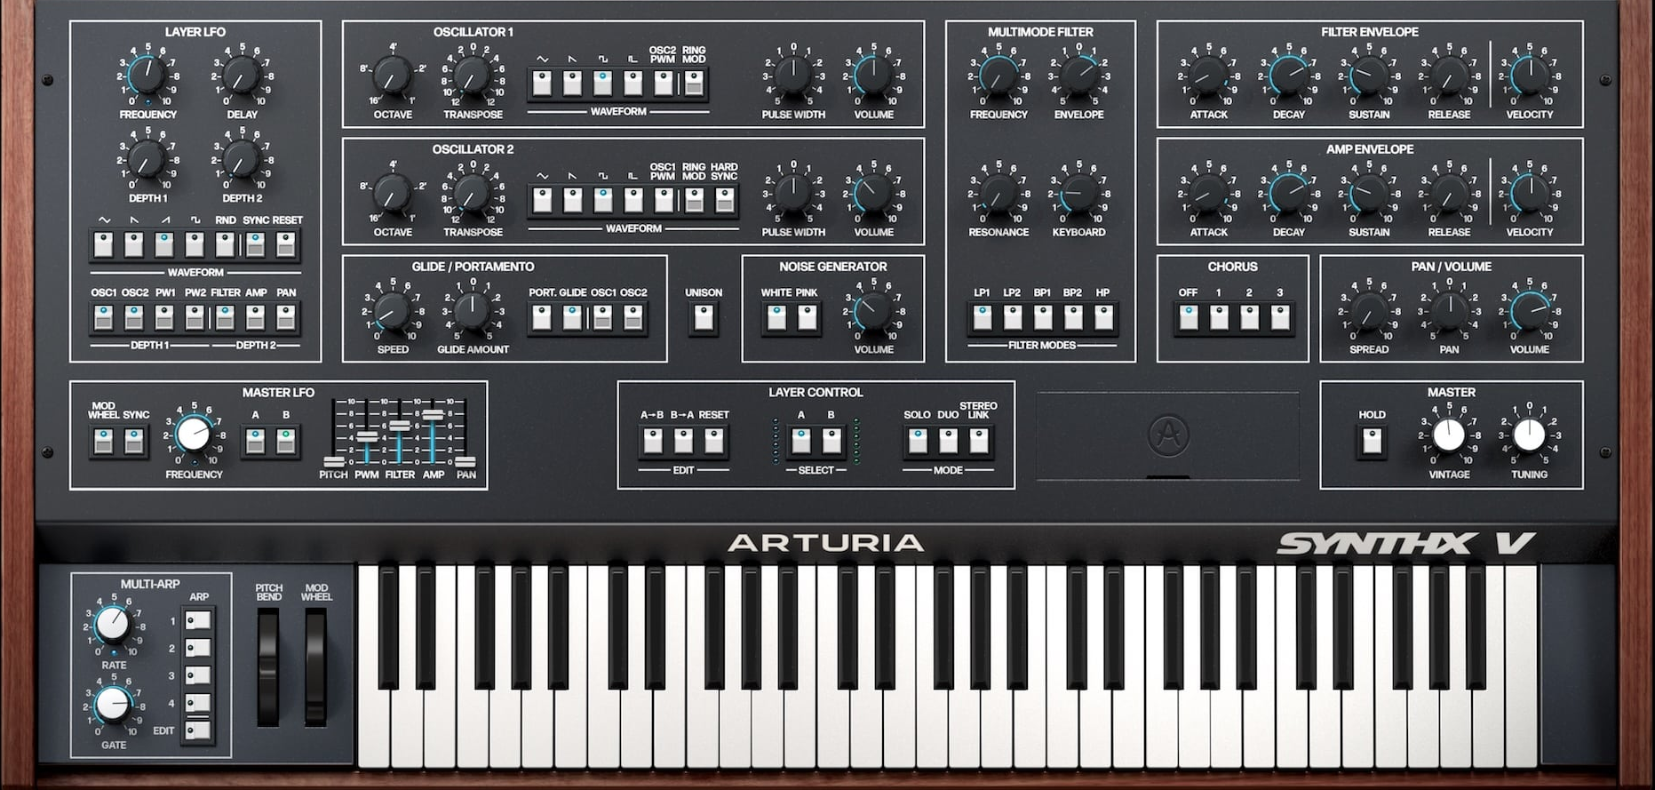
_The “Secret Sauce”
SYNTHEX V
Notes:
This entire dilemma began for me with the Arturia Synthex V.

Slide 12
_The “Secret Sauce”
SYNTHEX V
Notes:
And more specifically this section right here

Slide 13
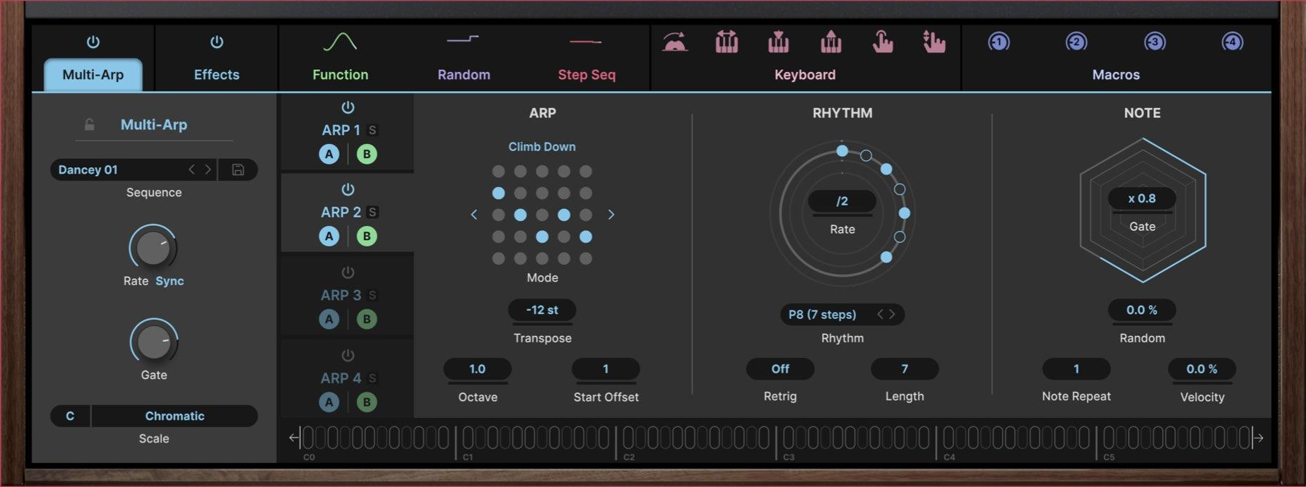
_The “Secret Sauce”
SYNTHEX V
Notes:
(Point to the UI) The Multi Arp, which isn't just an arpeggiator. It's an innovative 4-layer engine, a core part of the product's identity, designed to create sophisticated fractal melodies and complex polyrhythmic sounds. And so you can configure each arpeggiator and target each of the timbral layers of the Synthex V.

Slide 14
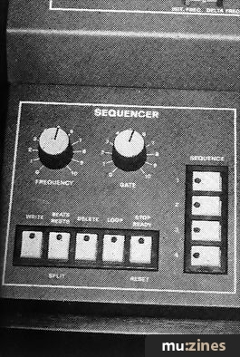
_The “Secret Sauce”
Notes:
The original Elka Synthex had a basic 4-track sequencer. For the VST, we wanted to create something truly special, a modern enhancement that would define this product. So, we designed the 'Multi-Arp'.
This was our 'secret sauce.' It was the 'wow' feature - and so this was shipped.

Slide 15
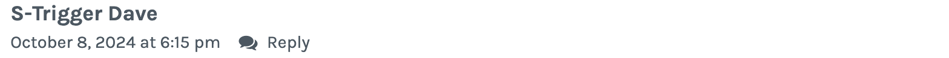

_The “Secret Sauce”
Notes:
So, the 'Multi-Arp' was a huge hit on the Synthex V. (Point to BEFORE diagram) As a team, we were proud, but from an engineering standpoint, we also knew this was a bespoke and was deeply integrated and not reusable at the exact moment.

Slide 16
_The Dreaded Question…
Notes:
And sure enough, the requests started coming. Not just from users saying 'I want this everywhere, but from Product Owners.
And for the next months we were raised a big, dangerous question for the whole development team...

Slide 17
_The Dreaded Question…
“_Can we please refactor this for the next plugin?”

Slide 18
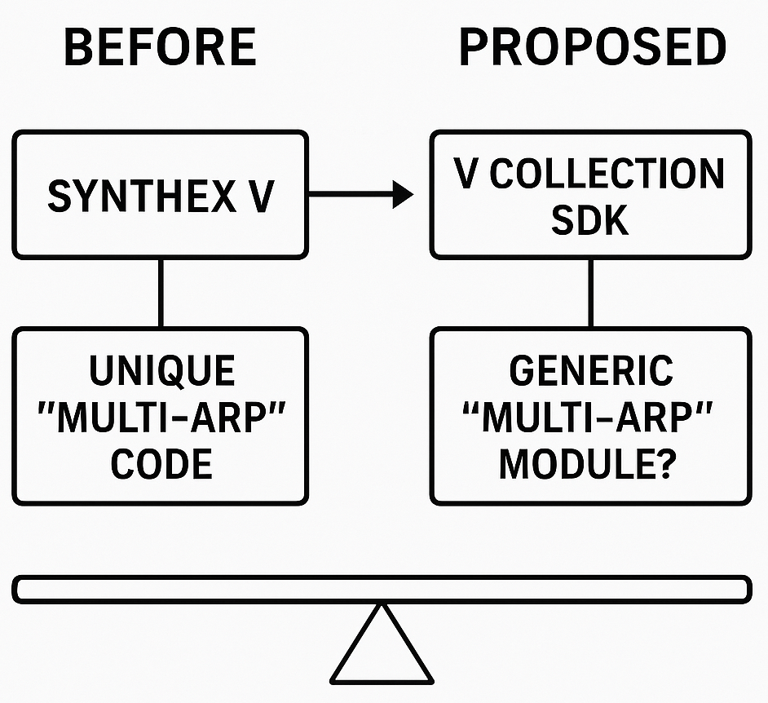
_The Dreaded Question…
“_Can we please refactor this for the next plugin?”
Notes:
And so taking into consideration a certain development timing, the proposition ended up in transforming the multi arp module into a generic asset, in order to keep this for any other plugin iterations.

Slide 19
_Balancing the Books:
Dev Costs vs. User Value
Notes:
So, when the Product team asked us to standardize, this is the internal balancing act we had to perform.

Slide 20
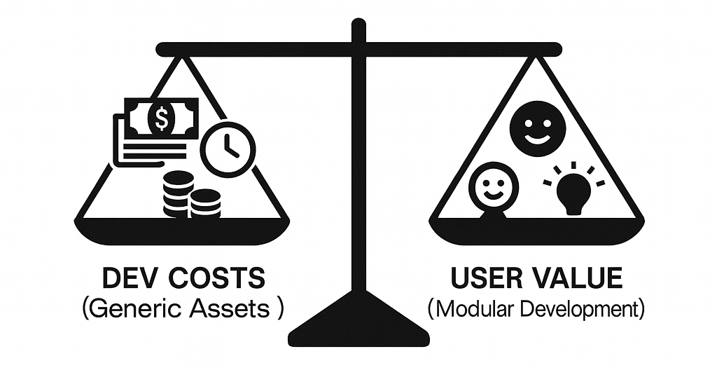
_Balancing the Books:
Dev Costs vs. User Value
Notes:
(Point to Left Pan) On one side, you have the DEV COSTS of building a truly generic asset. Yes, the 'DRY' principle—'Don't Repeat Yourself'—is gospel for developers. But for the 'Multi-Arp', this meant a upfront investment: some significant time of dedicated refactoring, building a robust C++ API, and extensive testing for cross-product compatibility. That's a cost. The question is: 'What's the real cost of 'DRY'?'
(Point to Right Pan) On the other side, you have USER VALUE. Modular development can create immense value: a consistent experience, fewer bugs, and new creative possibilities. But we also have to ask: 'Whose 'value' are we optimizing for?' Is it the power user who wants the 'Multi-Arp' on every synth, or the vintage purist who just wants an authentic experience?
Making an asset generic for the sake of modularity is never free. It's a calculated risk, weighing significant development costs against the perceived value for both us and our users.

Slide 21
_Balancing the Books:
Dev Costs vs. User Value
_what's the real cost of 'DRY'? (Don’t Repeat Yourself)
_does the SDK make us faster or slower?
_whose 'value' are we optimizing for?
Notes:
Product and Engineering can the global asset idea. They said: 'This is a huge win for maintainability. We'll fix a bug once, and it's fixed everywhere. This is "Don't Repeat Yourself." This will accelerate our entire roadmap!'
But the Senior Devs said: 'Wait. First, you're asking for a massive let’s say 3-month refactor. That's not copy-paste.
And most importantly, This is one of the secret sauces of the Synthex V! If you give its best feature to every other synth, you've flattening one of the identities of the very product that made it famous.'

Slide 22



_The "Everything":
The Pros of Modularity
_1 Development Velocity
_2 Consistent User Experience
_3 Stability & Maintenance
Notes:
So, the decision was made to invest some months, build the generic 'Multi-Arp' module, and absorb the cost.
And immediately, i believe this approach delivered on all its promises. This is the 'Everything' upside—the dream of modular development.
First: Development Velocity. (Point to Icon 1) Our ability to iterate on the product line accelerated dramatically. We could now drop this mature, complex, let’s say three-month feature into a new instrument in a matter of days. It became a powerful asset in our toolkit, which also increases the time-to-market for future products.
Second: Consistent User Experience. (Point to Icon 2) This was a huge win for our users. They learned this deep, powerful 'Multi-Arp' once, and they could instantly apply that knowledge across the entire V Collection. This consistent UX is incredibly valuable. It builds user confidence and removes the friction of re-learning a different sequencer for every single synth.
Third: Stability & Maintenance. (Point to Icon 3) From an engineering perspective, this was the biggest win. If we are to find a subtle bug on a sequencer's timing- we fix it once in the central SDK module, rebuilt, and all products that used the module are instantly patched. This is the power of a 'DRY'—Don't Repeat Yourself—architecture.
So, from a technical and velocity standpoint, the decision was a success.

Slide 23
_The "Everywhere" tension:
Notes:
Going for the Everwhere tension…

Slide 24
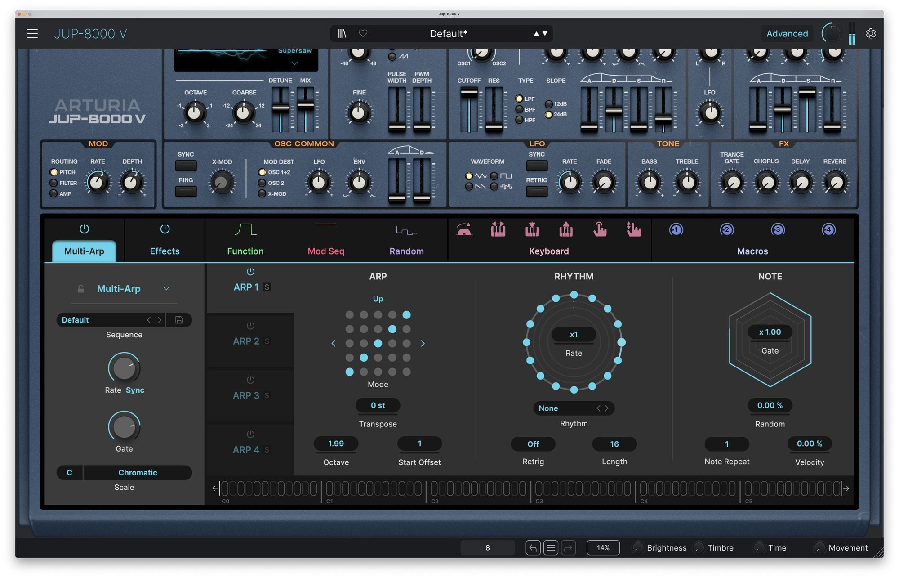
_The "Everywhere" tension:
Identity
JUP8000 V
Notes:
We speak about Identity. And we can look at an iteration of JUP-8000 V with the newly implemented generic “Multi-Arp” asset.

Slide 25
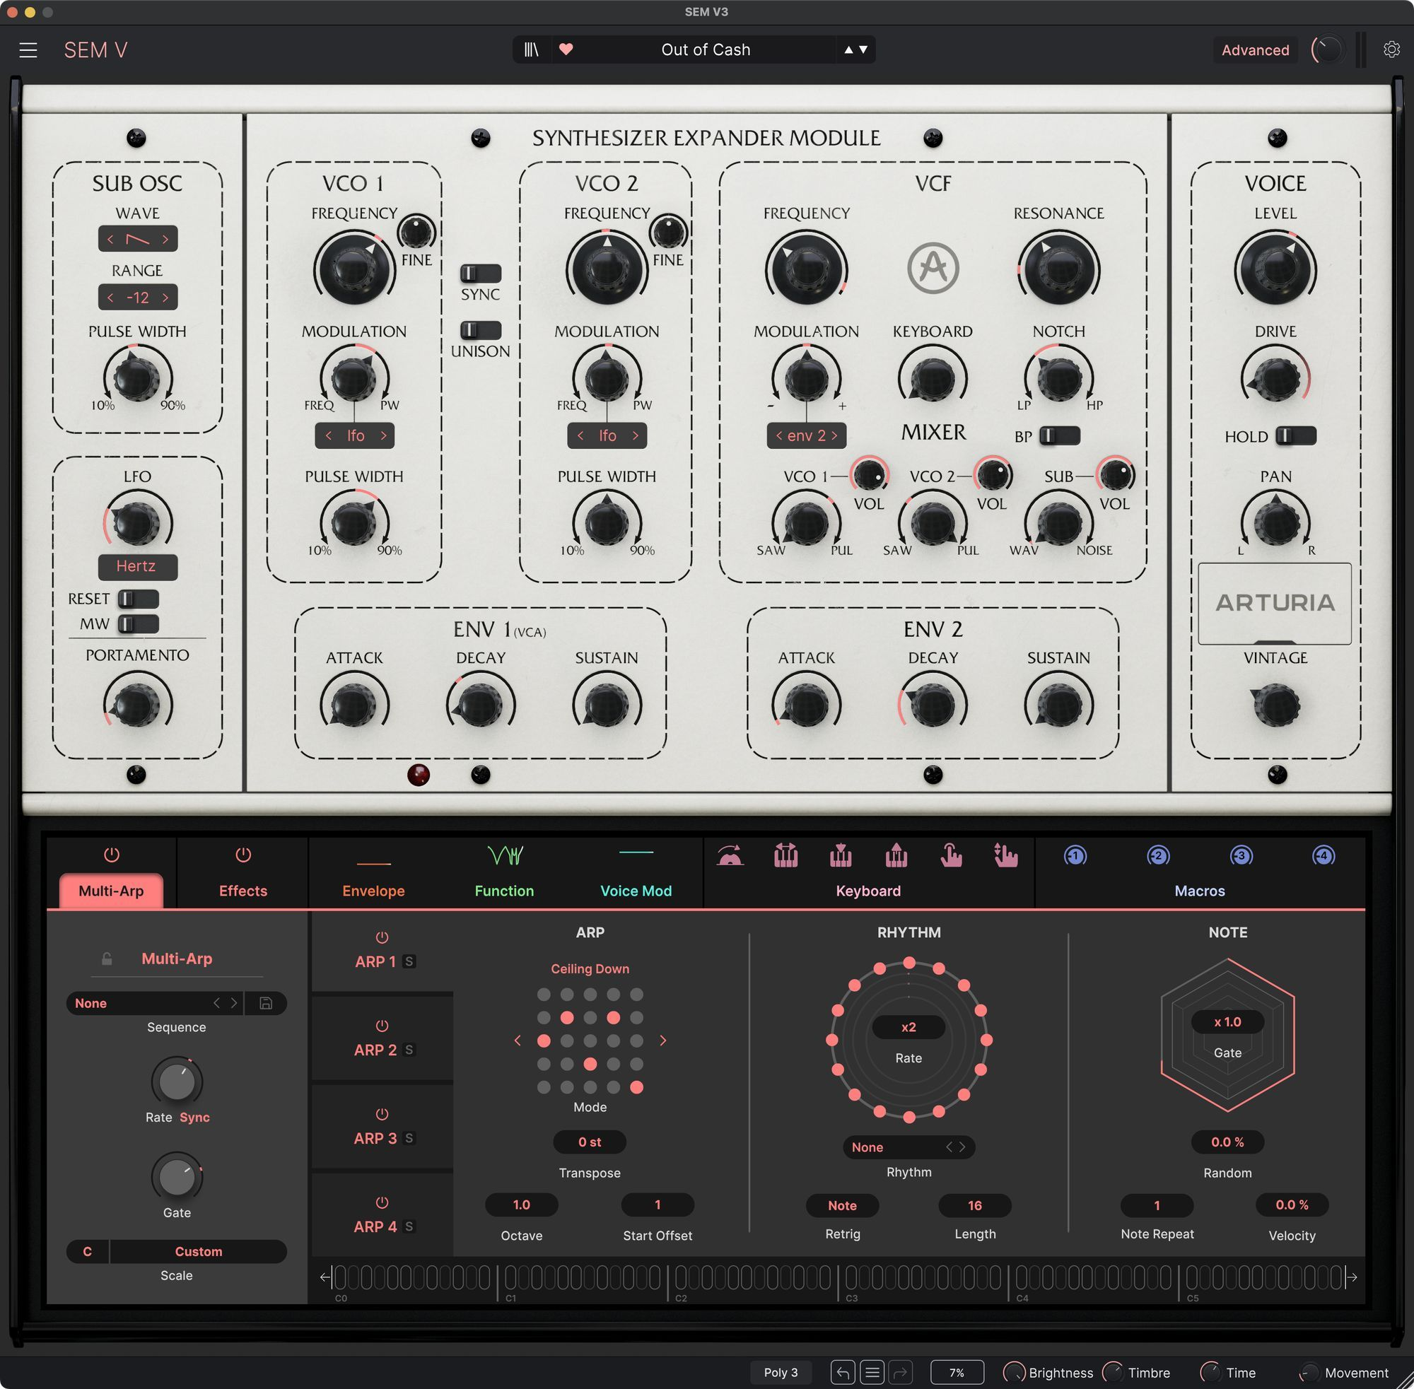
_The "Everywhere" tension:
Identity
JUP8000 V, SEM V3
Notes:
So, this is the result which perfectly captures the core tension of this entire talk. It's not as simple as 'good' or 'bad.'
On the one hand, (point to SEM V), you have the identity problem. This hyper-modern, 4-layer fractal sequencer on a 1970s mono-synth... it can break the vintage metaphor. It can feel less authentic to an original. And, (point to Synthex V).

Slide 26
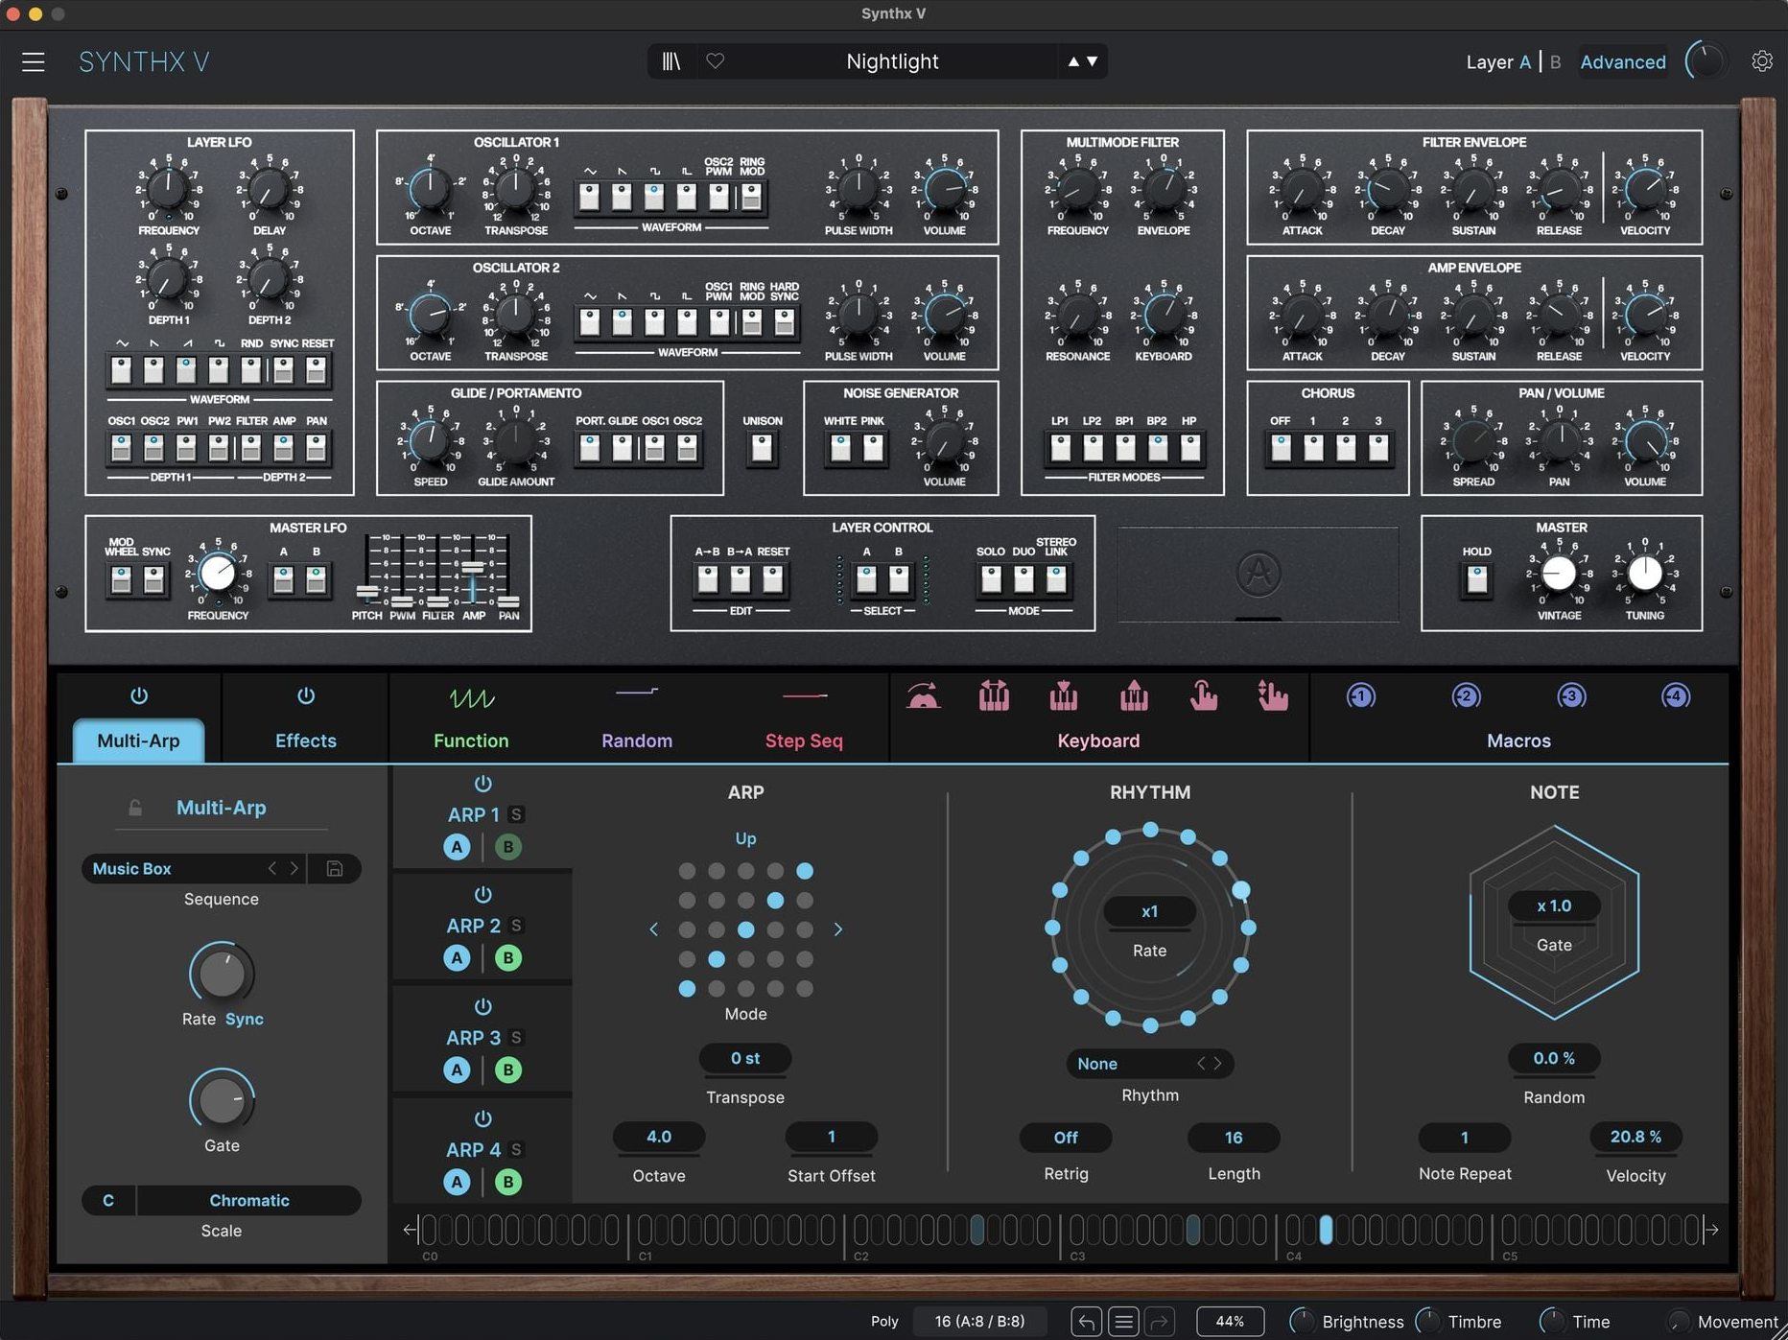
_The "Everywhere" tension:
(Flattening)? Identity
JUP8000 V, SEM V3, SYNTHEX V
Notes:
it's true that it may dilute the unique 'secret sauce' that the Synthex V has to itself.
(Click, text 'Expansion of Creativity' fades in)
But... on the other hand, I don’t agree exactly with the statement, I see it more as

Slide 27
_The "Everywhere" tension:
Flattening Identity Expanding Creativity
Notes:
this is a massive expansion of creativity for the modern user. We've given them a state-of-the-art melodic engine that they can apply to any sound palette. They can now create polyrhythmic sequences with a any of the other audio plugins of the VCollection and external…

Slide 28

_The "Everywhere" tension:
Flattening Identity Expanding Creativity

Slide 29
_The "Everywhere" tension:
Flattening Identity Expanding Creativity
JUP8000 V, SEM V3, SYNTHEX V
Notes:
This is the dilemma, an SDK goal was achieved on consistent quality... when it could’ve created this powerful tension with 'boutique' product identity. This is the trade-off that may arrive to manage

Slide 30
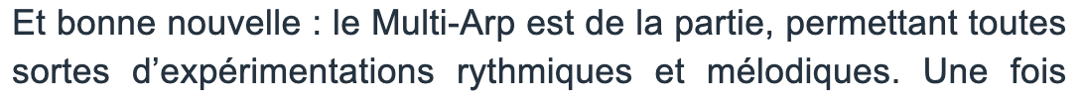
_The "Everywhere" tension:
Flattening Identity Expanding Creativity
“And good news: Multi-Arp is included, allowing for all kinds of rhythmic and melodic experimentation.”
Audiofanzine (FR)
Notes:
the positive aspect of that is that, it enabled for what the users wanted out of the bundle, and this is an example
(SPEAK ABOUT THE SLIDE)

Slide 31
_The "All At Once" challenge:

Slide 32
_The "All At Once" plugin challenge:
Notes:
So, we've discussed the 'Everywhere' tension across a product line.
There's a related challenge, which is the complexity within a single, feature-rich product. I call this next topic the “All At Once” Plugin Challenge - make that trending.

Slide 33
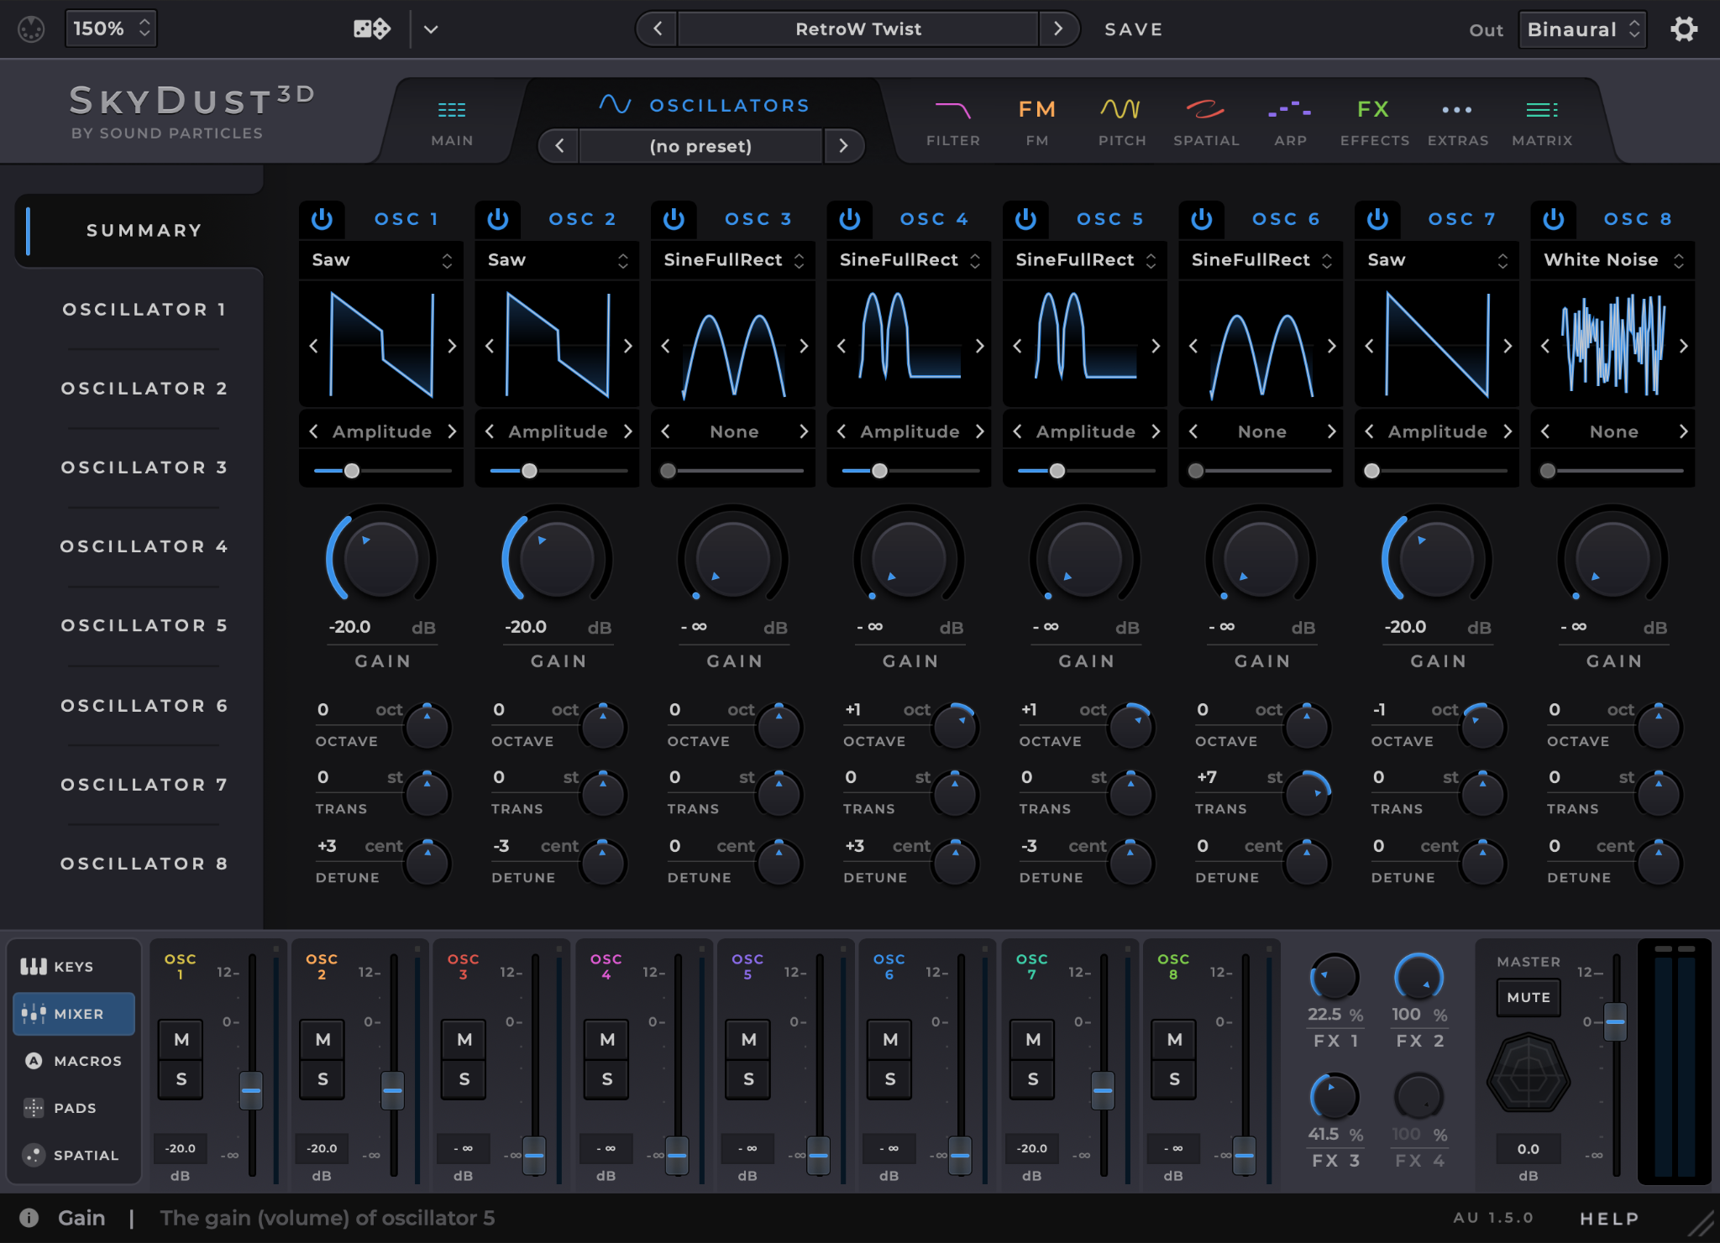
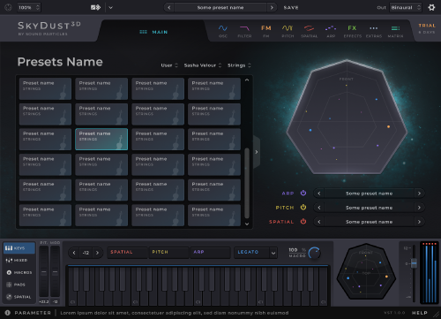
_The "All At Once" challenge:
SKYDUST 3D
Notes:
A plugin I also worked on, SkyDust 3D, is a perfect example of this. It's an incredibly powerful and creative tool—a 3D synthesizer, and a complex spatialization engine all in one.
For a professional sound designer, this density of features is vital. It's a 'maximalist' design that unlocks creative possibilities that a simpler plugin simply cannot. It's designed to be a deep, comprehensive creative suite.
But many of these bespoke plugins comes with its own inherent trade-off: a very steep learning curve. The sheer number of features, while being the source of its power, means the product's identity is its complexity. This can be a high barrier to entry for new users, even while it's an indispensable tool for experts.
So, as developers, we have two clear challenges to balance:
The 'Everywhere' tension, which pits product-line consistency against individual identity.
And the “All at once” challenge, which balances feature-density and creative power against user accessibility and onboarding."

Slide 34
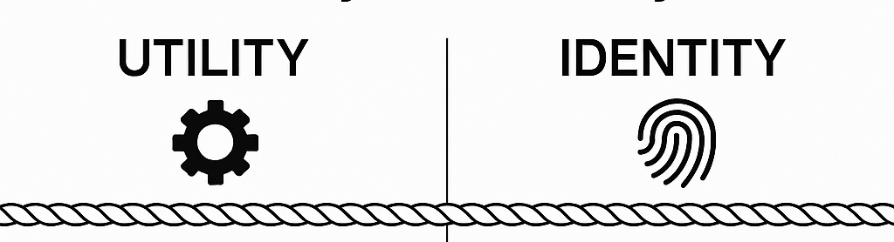
_Utility vs. Identity
Notes:
This tension forces us to create a clear framework for all future decisions. I now analyze every feature by placing it in one of two buckets: Utility or Identity.

Slide 35
_Utility vs. Identity
USER:
_consistent, familiar
_“i expect it to work the same everywhere”
SW Dev:
_standarized sdk
_built once, tested once, maintained centralized
USER:
_the secret sauce
_unique, authentic, bespoke
SW Dev:
_written specifically for this
_complex & deeply integrated
Notes:
(Point to 'UTILITY') "First, you have UTILITY. These are the features that support the experience. From a User's perspective, this is anything they expect to be consistent, like their Preset Browser, It can go as simple as a top and bottom toolbar.
From a Dev perspective, this is our Standardized SDK Module. We follow the 'DRY' principle. It's efficient and stable.
(Point to 'IDENTITY') "But then, you have IDENTITY. These are the features that define the experience. This is the 'Secret Sauce.' From a User's perspective, this is the magic of the product. It's why they bought it. From a Dev perspective, this is Bespoke Product Code, written from scratch for this one product.
From a Dev perspective, its complexity made it a Utility—it was too complex not to standardize. But from a User's perspective, it was pure Identity—one of the 'magics' of the Synthex V.
When we standardized it, our dev (Utility) needs collided with the user's (Identity) expectations. How do we solve this collision? This isn't a philosophy problem; it's an architecture problem."

Slide 36
_The
Architectural
Shift

Slide 37
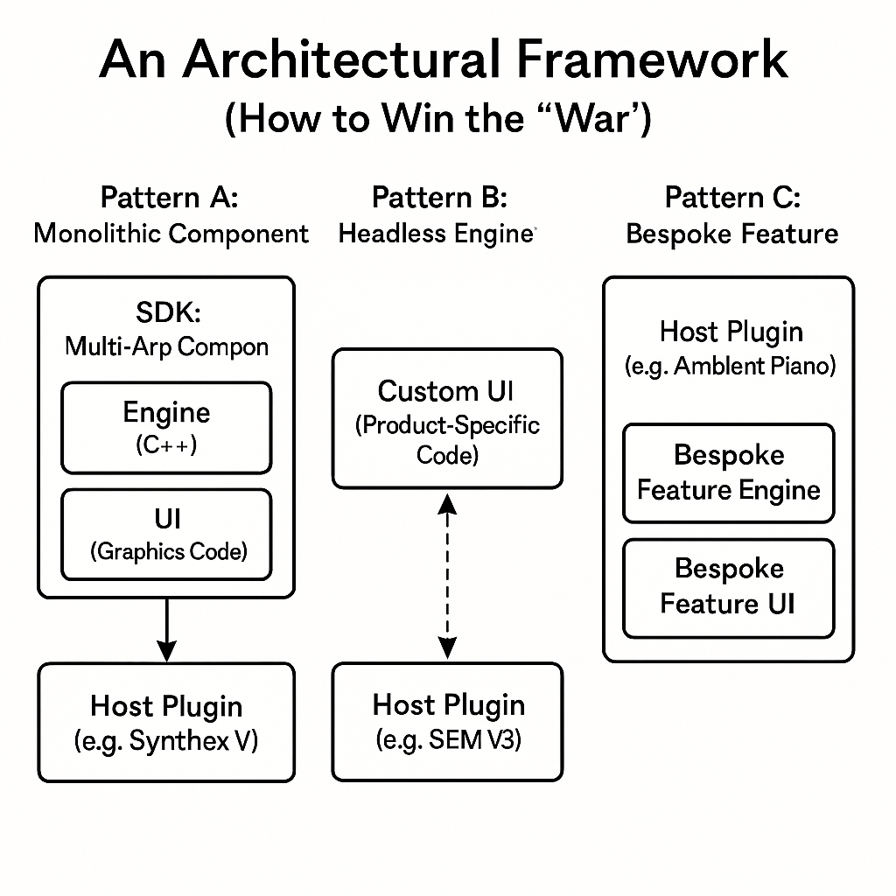
_The
Architectural
Shift
(e.g. a “Pigments”)
Notes:
So, how do we solve this? We build a software architecture. We realized our old SDK was built on Pattern A: The Monolithic Component.

Slide 38
_The
Architectural
Shift
Notes:
What It Is: This is an SDK component where the backend (DSP, logic, state) and the frontend (UI, graphics, knob logic) are tightly coupled into a single, indivisible block of code.
The Analogy: A pre-built, factory-sealed LEGO car. You can drop it into your city, and it's a perfect car. But you cannot take the wheels off to use on your own custom-built LEGO hot-rod.
The "All-or-Nothing" Trap: This is the core problem. When the SEM V team wants a simple arp, they have no choice. They must duplicate the entire, complex, modern UI, or get nothing.

Slide 39
_The
Architectural
Shift
Notes:
The real solution was to refactor our SDK to support Pattern B: The 'Headless' Engine.
Developer Pros:
Resolves the Central Conflict: This is the solution. It is perfectly "DRY" (Don't Repeat Yourself) because the complex engine logic is shared. But it's also perfectly Flexible because the UI is 100% custom
Maintainability: You fix a bug in the MultiArp timing once in the SDK, and all plugins (vintage and modern) inherit the fix on the next build.
Testability: The headless engine is a dream to unit-test.
Developer Cons & Costs:
High Upfront Cost: This is the "3-month refactor" you mentioned. Designing a clean, stable, and future-proof C++ API is extremely difficult.
More "Wiring": The host plugin team has to do more work than in Pattern A. They can't just "drop in" a component; they have to actually build a UI and wire up all the controls to the engine's API.

Slide 40
_The
Architectural
Shift
(e.g. a “Pigments”)
Notes:
(Point to Diagram 3) And then there's Pattern C: The 'Bespoke' Feature. This is when the SDK that’s been done isn't involved at all.
The Analogy: A custom sculpture commissioned for a specific building's lobby. It's perfectly matched to the space, but it was never designed to be moved or replicated

Slide 41
_The Solution:
Modularity ?

Slide 42
_The Solution: Modularity ?
(e.g. a “Pigments”)
Notes:
This shift, especially towards Pattern B, is what gives us a real toolkit for solving the identity problem.
We’re able to deliver now a multi arp as a global asset with the ability of a custom UI per design of product.

Slide 43
_Conclusions
The "Right Thing, in the Right Context"
Notes:
"So, to go back to the original question: 'Should audio plugins have "Everything Everywhere All At Once"?'
The answer is a clear No.
A user doesn't want 'Everything.' They want the right thing, in the right context. Our journey taught us three key lessons.

Slide 44


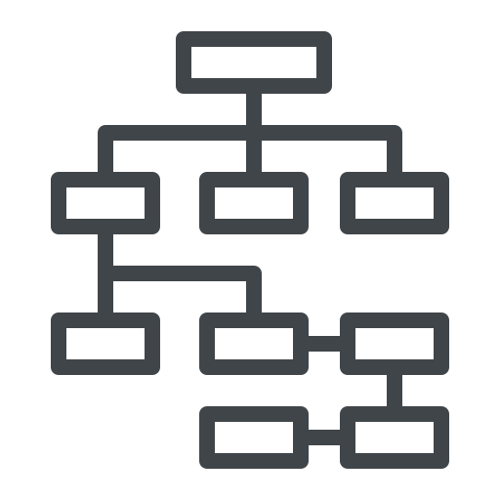
_Conclusions
The "Right Thing, in the Right Context"
Notes:
a few points on this are

Slide 45
_Conclusions
The "Right Thing, in the Right Context"
_protect product
identity
_invest in a decoupled SDK
_use architecture to serve the metaphor
Notes:
First: Protect Product Identity. (Point 1) We learned that when a feature defines a product—when it's your 'secret sauce'—standardizing it for the sake of 'Utility' is dangerous. You risk diluting the very identity that made it special.
Second: Invest in a Decoupled ("Headless") SDK. (Point 2) This is the technical solution for audio developers. A 'Monolithic' component (our Pattern A) forces an all-or-nothing choice. A generic C++ engine (our Pattern B) is the key. It somewhat resolves the Utility vs. Identity conflict.
And finally: Use Architecture to Serve the Metaphor. (Point 3) And for us, this global asset' architecture is what gives us a toolkit. It gives us the choice.
Ultimately, our architecture shouldn't just be efficient; it must be flexible enough to serve the user's experience."

Slide 46
_THANK YOU, ADC!
linkedin.com/in/goncalonbarbernardo/
@calodomaredaterra
goncalonunobernardo@gmail.com
goncalo.bernardo@arturia.com

