Slide 1
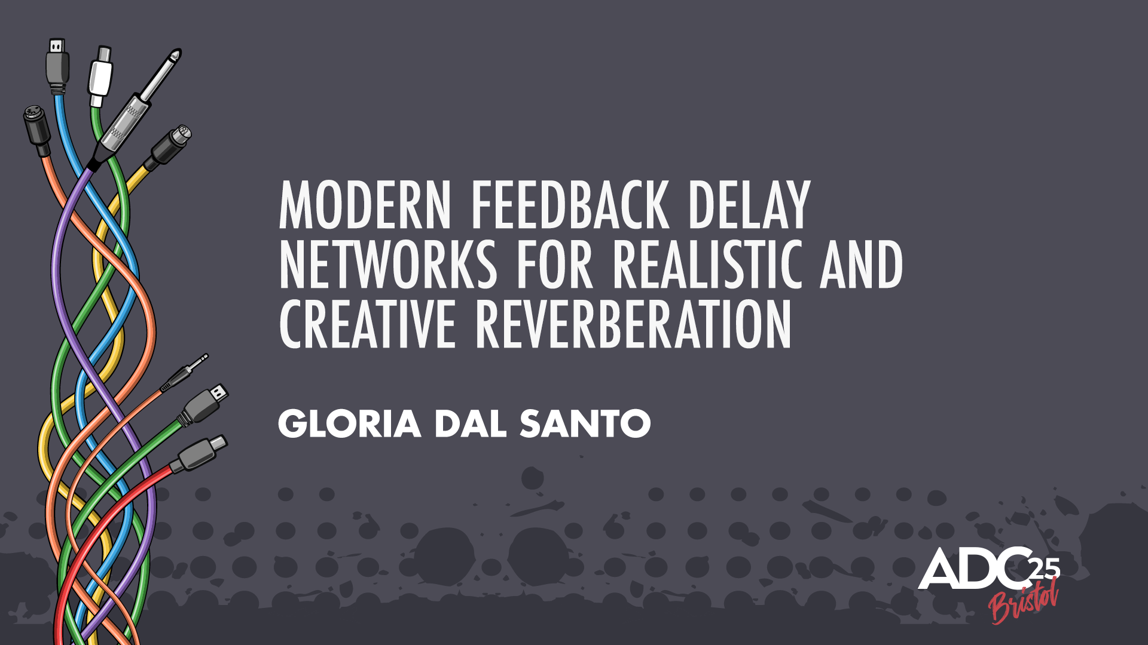


Slide 2
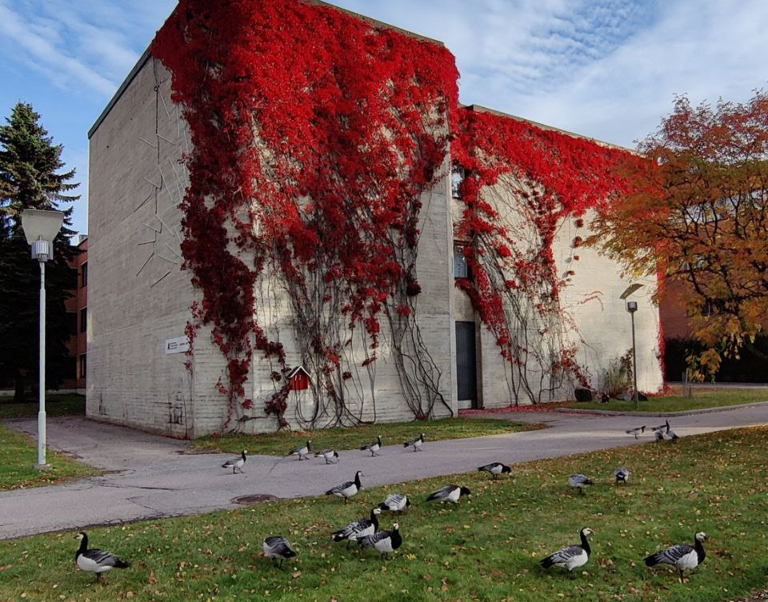
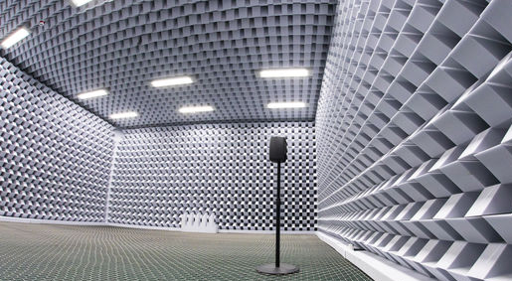
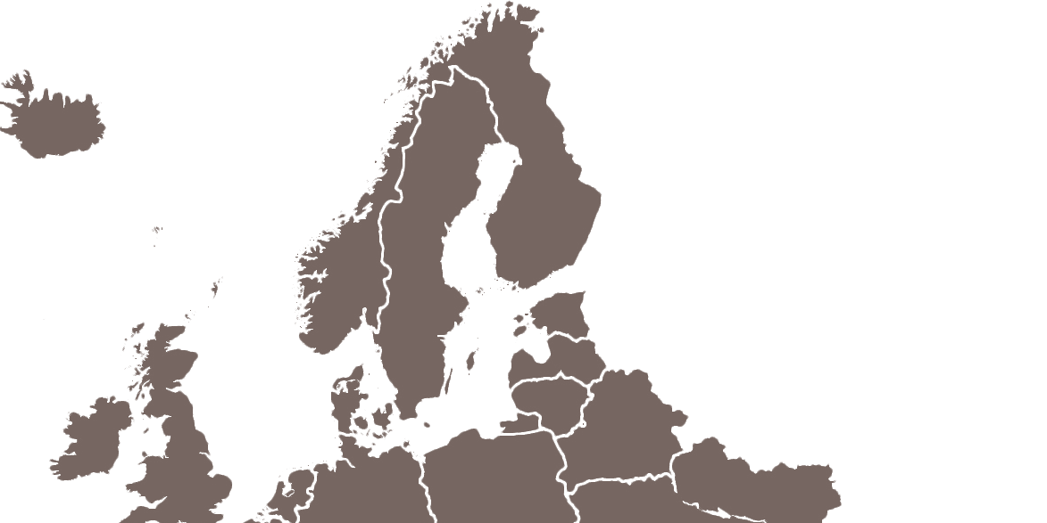
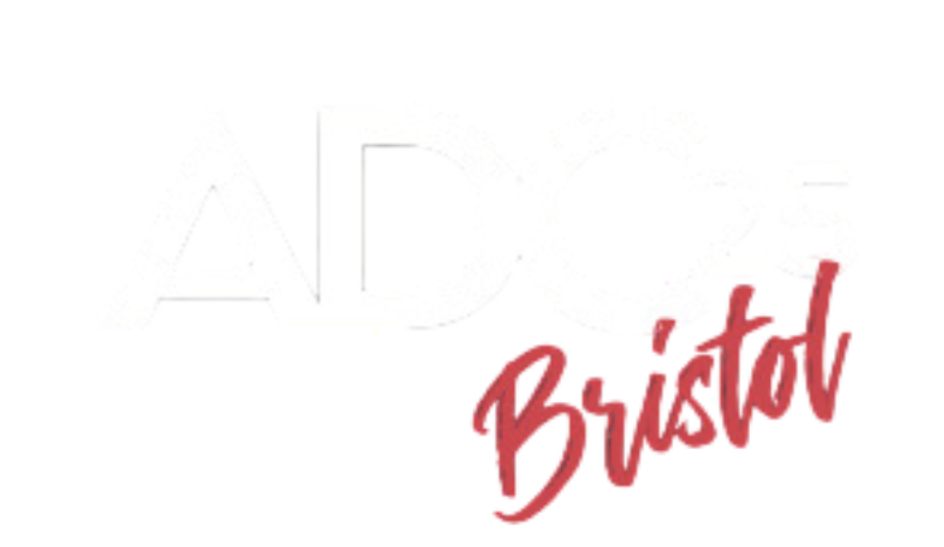
Personal background
Audio Signal Processing, Aalto University (FI)
PhD Team:
Prof. Vesa Välimäki
Prof. Sebastian J. Schlecht (FAU, Germany)
Dr. Karolina Prawda (University of York, UK)
Topic: Machine Learning-based Artificial Reverb
Feedback Delay Network
Differentiable DSP
Audio similarity measures
Also
Acoustic echo cancellation
Flutter echo synthesis
Community-driven realities around electronic music 🔊

Slide 3
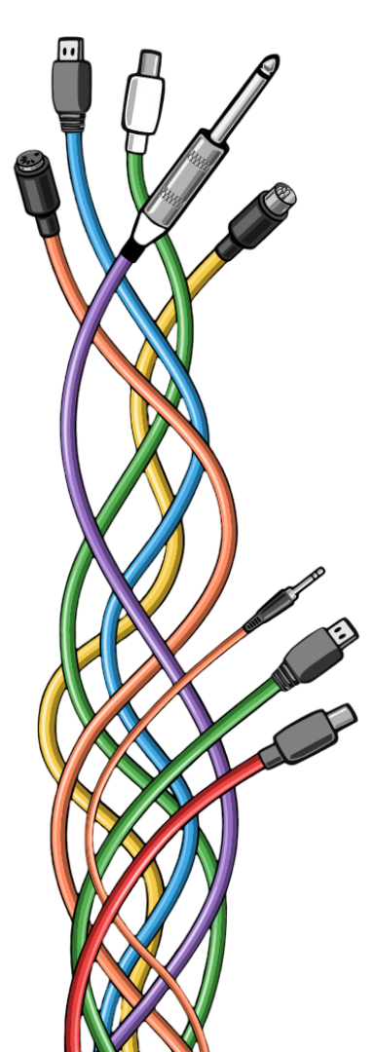
Outline
The Feedback Delay Network
  Background
  General design
  Practical considerations
Synthesizing Realistic RIRs
  FDN optimization
  Blind estimation
  Spatial audio
Creative Reverberation
  Modulating poles
  Reverb enhancement systems
  Introducing non-linearities
motivation:
present what’s available
present what’s currently being researched
understand AudioDev’s needs and wishes

Slide 4
The Feedback Delay Network
. background
. general design
. practical considerations

Slide 5
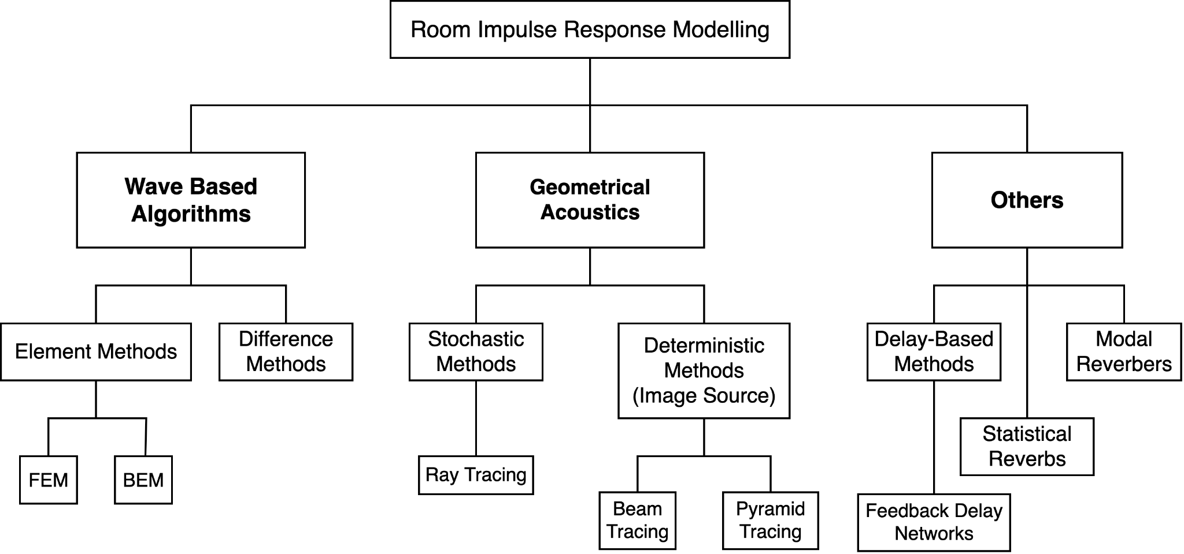
The Feedback Delay Network
accuracy
Background
computational cost
Modal
Reverbs

Slide 6
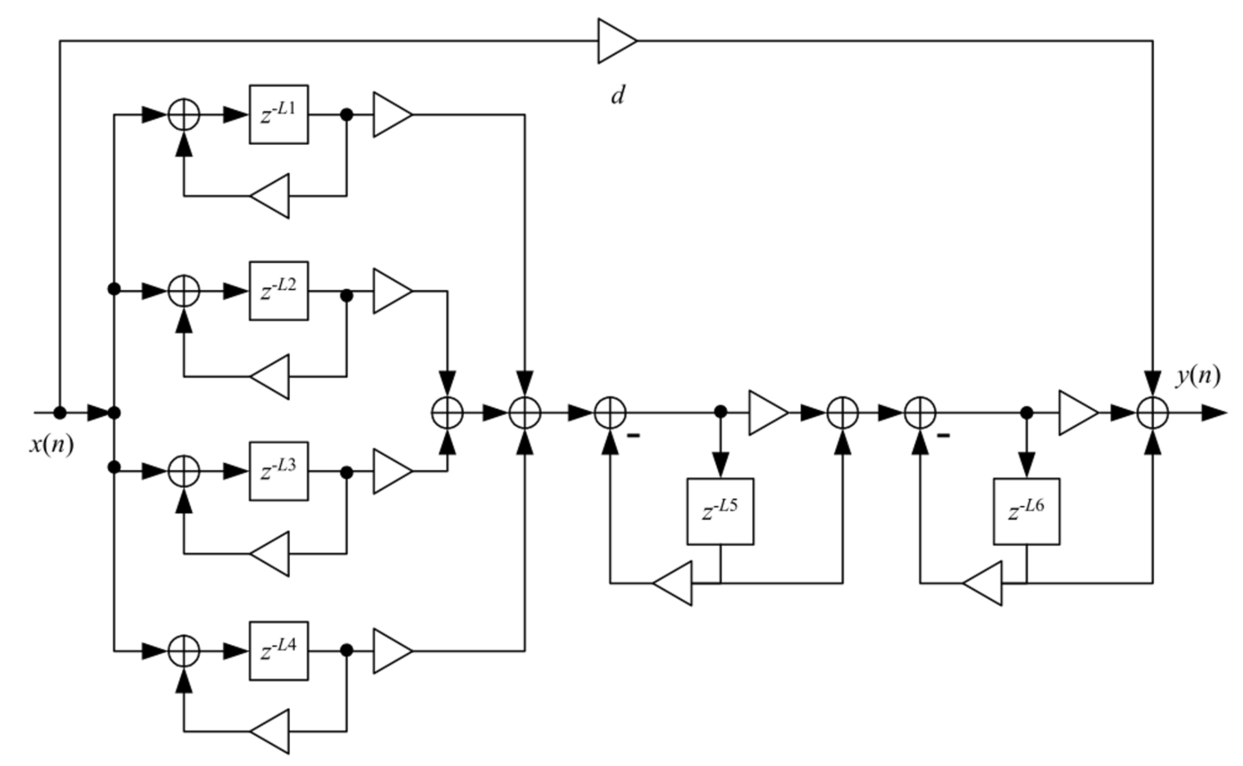

The Feedback Delay Network
Background
  ~1961 Schroeder Reverberator
I
I
Parallel comb filters generate echoes and models the reverberation time of a room
II
II
Series allpass increases the echo density
dry
wet
At the time it was considered indistinguishable from natural reverb ... 🤔
M. R. Schroeder and B. F. Logan, “Colorless artificial reverberation,” J. Audio Eng. Soc., vol. 9, no. 3, pp. 192–197, Jul. 1961.
M. R. Schroeder, ``Natural-sounding artificial reverberation,'' Journal of the Audio Engineering Society, vol. 10, no. 3, pp. 219-223, 1962.

Slide 7
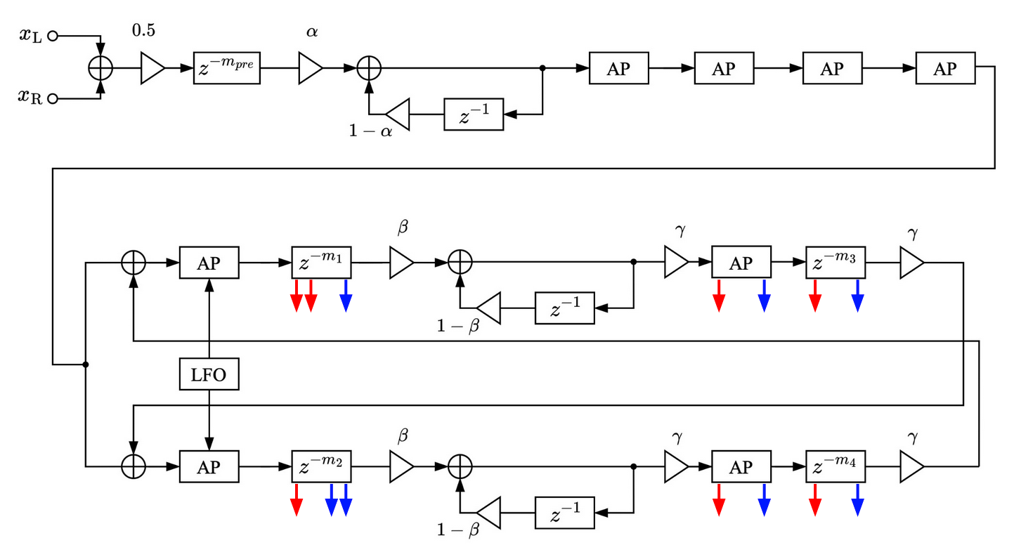
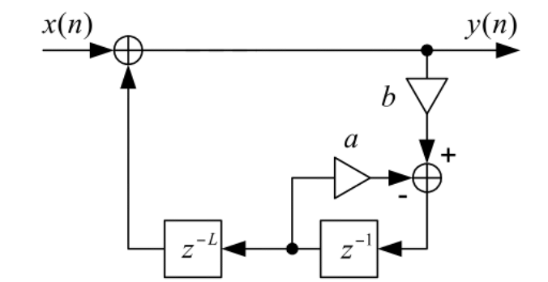
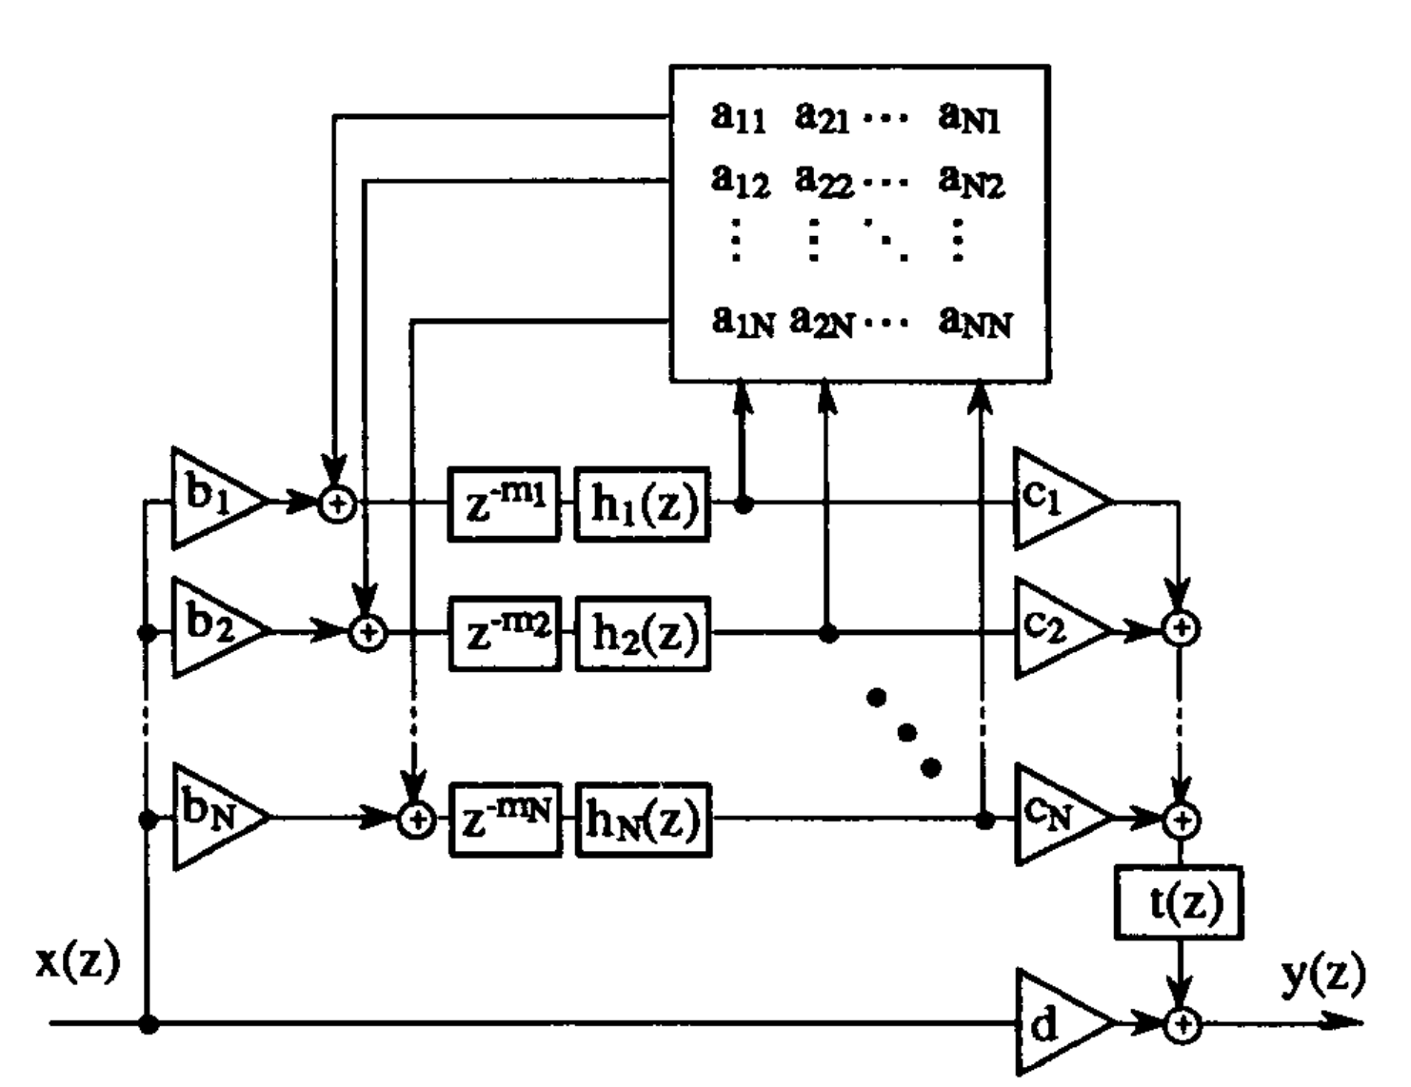
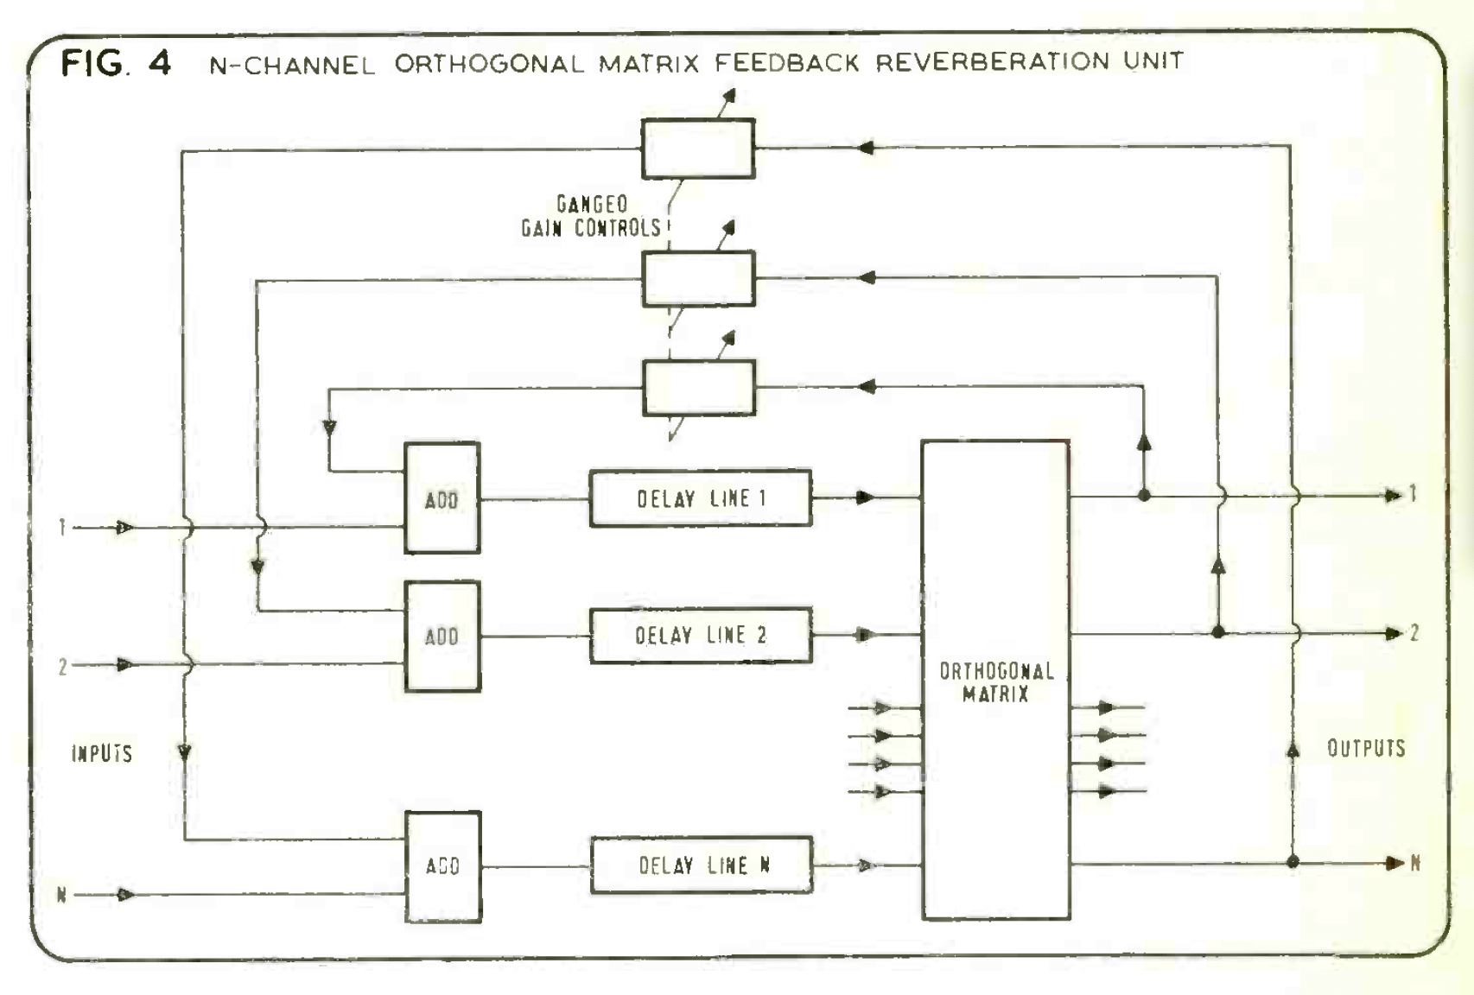
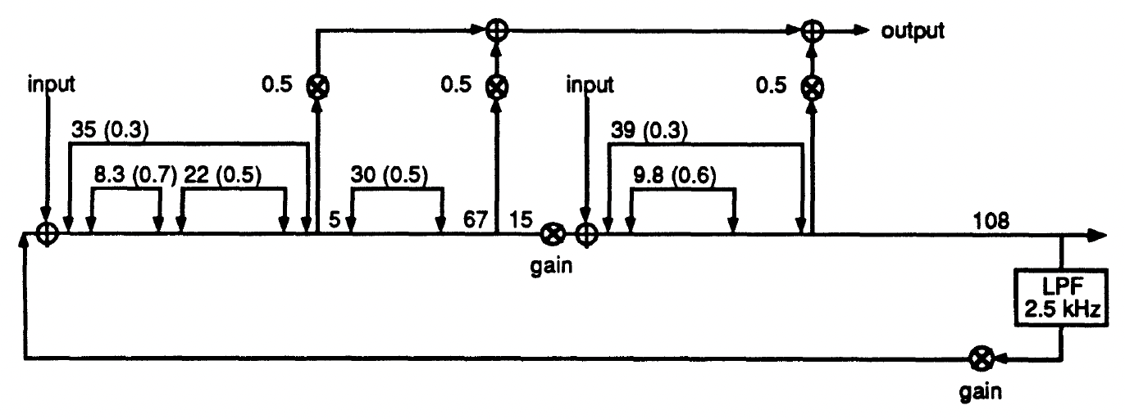
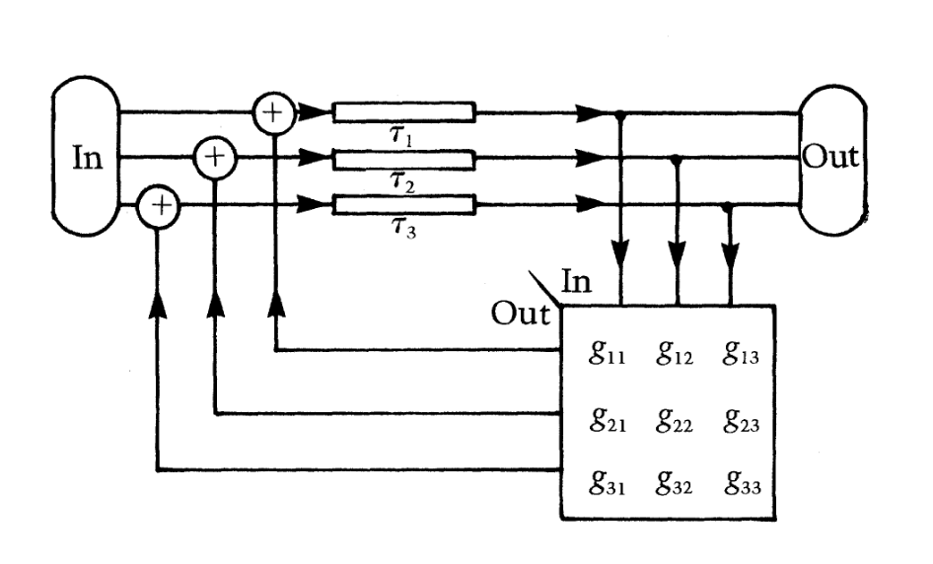
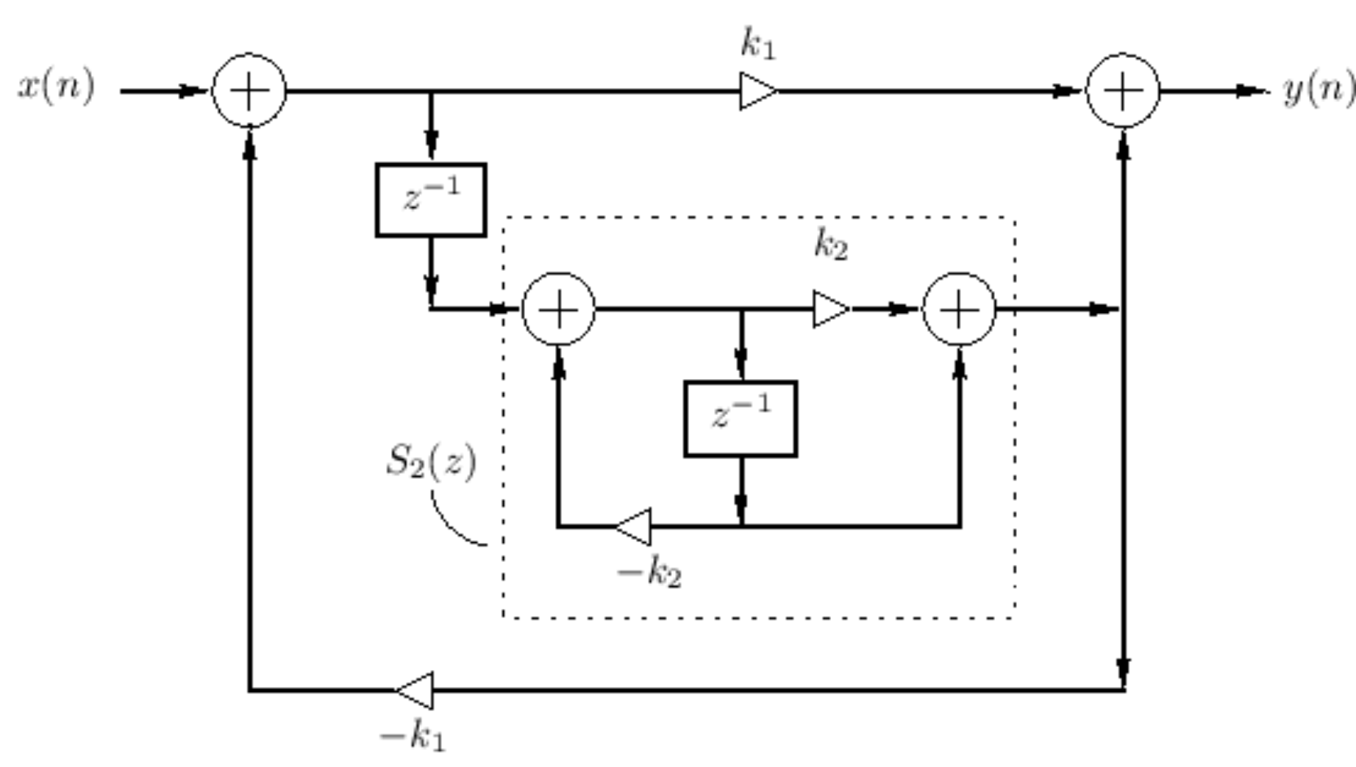
The Feedback Delay Network
Dattorro, 1997
Background
🧑‍🍳
Delay network-based reverb recipe
J. Moorer, 1979
Jot, 1992
Delay network reverb:
  Feedback comb filters
  Damping
  (Allpass filters)
Gerzon, 1971
Gardner, 1992
Gardner, 1992
Stautner, Puckette, 1982
Notes:
[5] J. Moorer, “About this reverberation business,” Comput. Music J., vol. 3, no. 2, pp. 13–28, 1979
[6] M. A. Gerzon, “Synthetic stereo reverberation, parts I and II,” Studio Sound, vol. 13(I), 14(II), pp. 632–635(I), 24–28(II), 1971(I), 1972(II).
[7] W. G. Gardner, ``The virtual acoustic room,'' Master's thesis, MIT, 1992
[8] Dattorro, J. Effect design, part 1: Reverberator and other filters. J. Audio Eng. Soc. 1997, 45, 660–684.
[9] J.-M. Jot and A. Chaigne, “Digital delay networks for designing artificial reverberators,” in Proc. 90th Conv. Audio Eng. Soc., Paris, France, Jan. 1991, preprint no. 3030.
[10] J. Stautner and M. Puckette, “Designing Multi-Channel Reverberators,” Comput. Music J., vol. 6, no. 1, pp. 52–65, 1982.

Slide 8
The Feedback Delay Network
Background
Other relevant ADC talks:
  Odd Challenges of Using Deep Learning in Designing a Feedback Delay Network Reverb by Wojciech Kacper Werkowicz and Benjamin Whateley (ADC 23)
  Let's Write a Reverb by Geraint Luff (ADC 21)
Bonus
  Efficient Reverb Rendering for Auditory Scenes by Jean Marc Jot (DAFx17)
  Feedback Delay Networks for Artificial Reverberation by Sebastian J. Schlecht (CCRMA seminars 22)

Slide 9
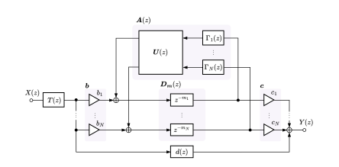
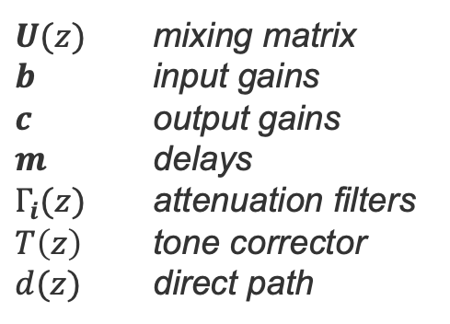
The Feedback Delay Network
General design
Formalized by Jot and Chaigne 1991
Generalization of the parallel comb filter structure
Similar to the multichannel reverberators by Gerzon (1971) and by Stautner and Puckette (1982)
$U(z)$ mixing matrix
$b$ input gains
$c$ output gains
$m$ delays
$Γ_{i}(z)$ attenuation filters
$T\left(z\right)$ tone corrector
$d(z)$ direct path
Ref
FDN
J.-M. Jot and A. Chaigne, “Digital delay networks for designing artificial reverberators,” in Proc. 90th Conv. Audio Eng. Soc., Paris, France, Jan. 1991, preprint no. 3030.
M. A. Gerzon, “Synthetic stereo reverberation, parts I and II,” Studio Sound, vol. 13(I), 14(II), pp. 632–635(I), 24–28(II), 1971(I), 1972(II).
J. Stautner and M. Puckette, “Designing Multi-Channel Reverberators,” Comput. Music J., vol. 6, no. 1, pp. 52–65, 1982.
Notes:
Statistical Reverbs: Generate a Poisson-distributed sequence of sound pulses, filtered to match the frequency-dependent decay and directional randomness of diffuse reflections.

Slide 10
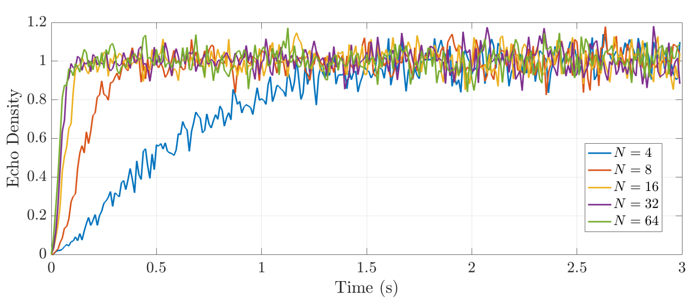
The Feedback Delay Network
General design – size $N$
More delay lines
Denser buildup of echoes
Reduces comb-like artifacts
More suitable for multichannel and directional implementations
More computationally expensive
echo density: number and distribution of reflections over time
N = 4
N = 16
N = 64

Slide 11
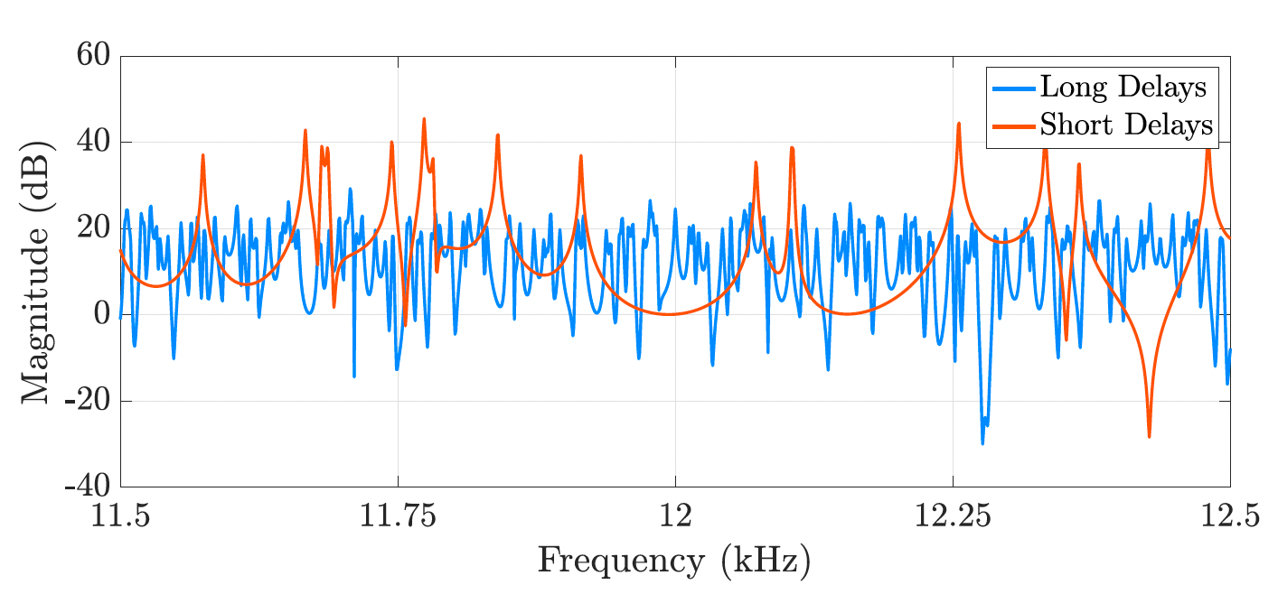
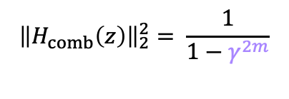
The Feedback Delay Network
General design – delays $m=\left[m_{0}, m_{1}, …, m_{N}\right]$
Designing delays in FDNs is challenging
They determine the echo density profile
They control the modal density
$${\left\|H_{comb}\left(z\right)\right\|}_{2}^{2}= \frac{1}{1−γ^{2m}}$$
Rules of thumb:
Co-prime numbers
Logarithmically distributed (avoid clustering)
Sum to more than 6000 modes
Avoid strongly recirculating short delays
ok delays
[1499, 1889, 2381, 2999]
bad delay choice
[797, 839, 2381, 2999]
Karjalainen, M., Järveläinen, H.: More about this reverberation science: Perceptually good late reverberation. In: Proceedings of the 111th Audio Engineering Society Convention (2001)

Slide 12
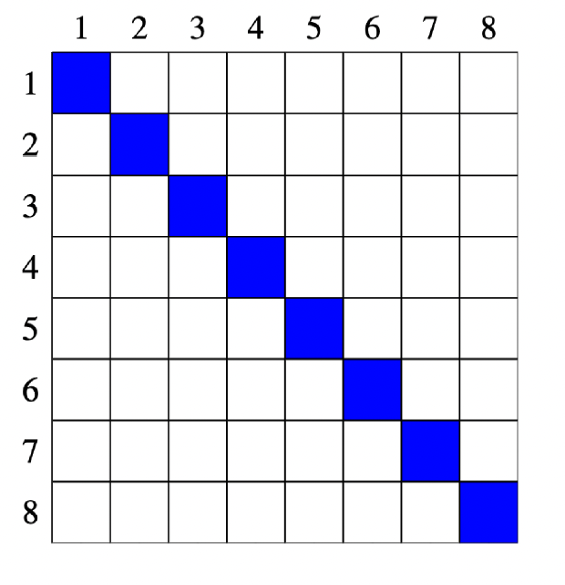
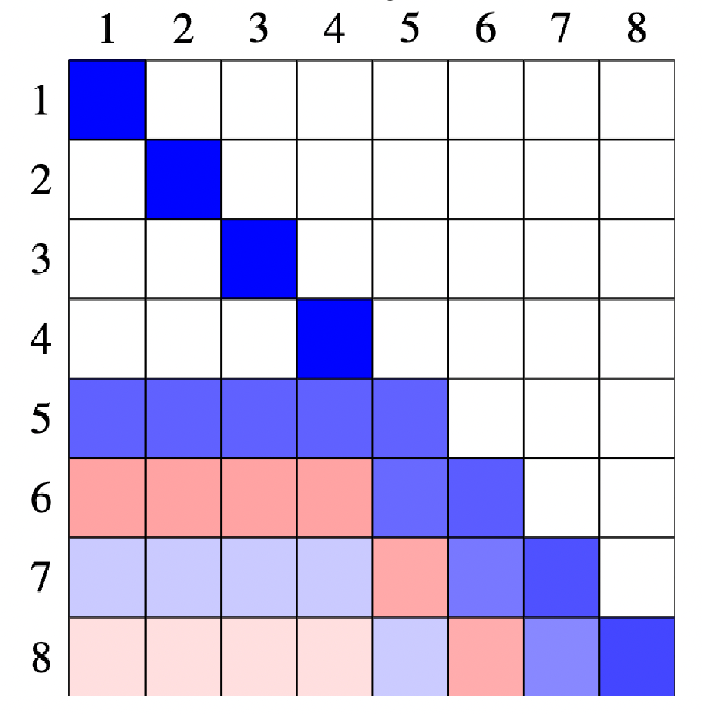
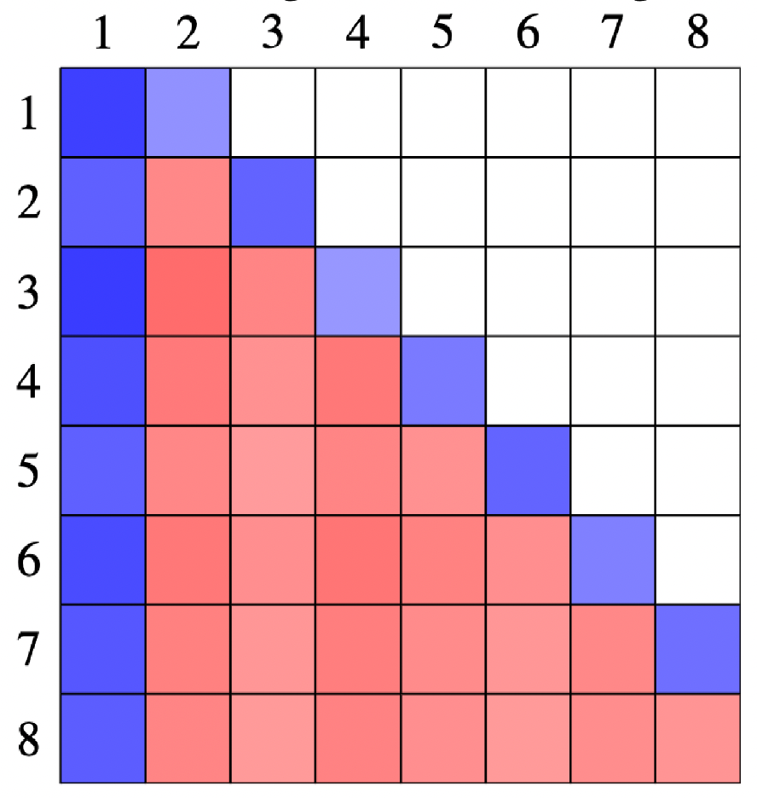
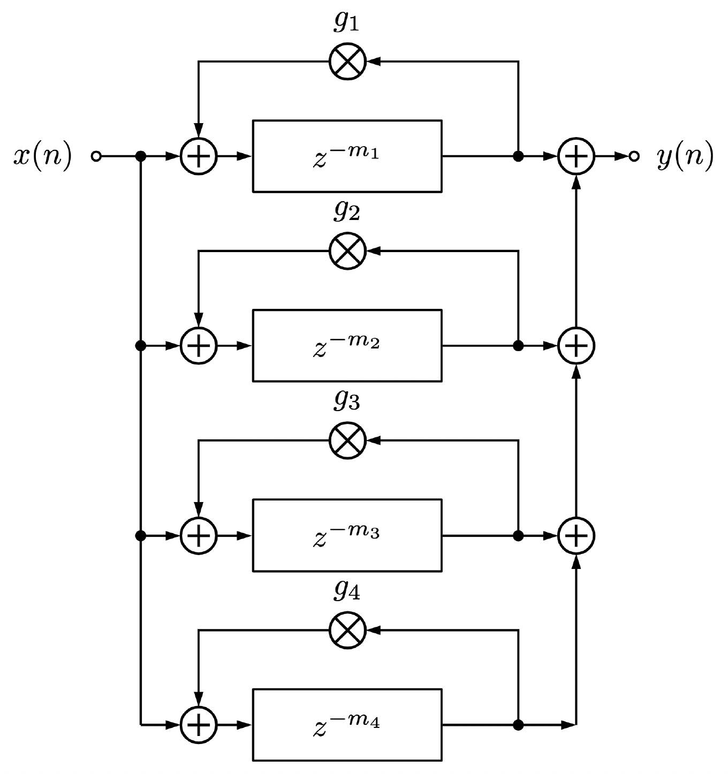
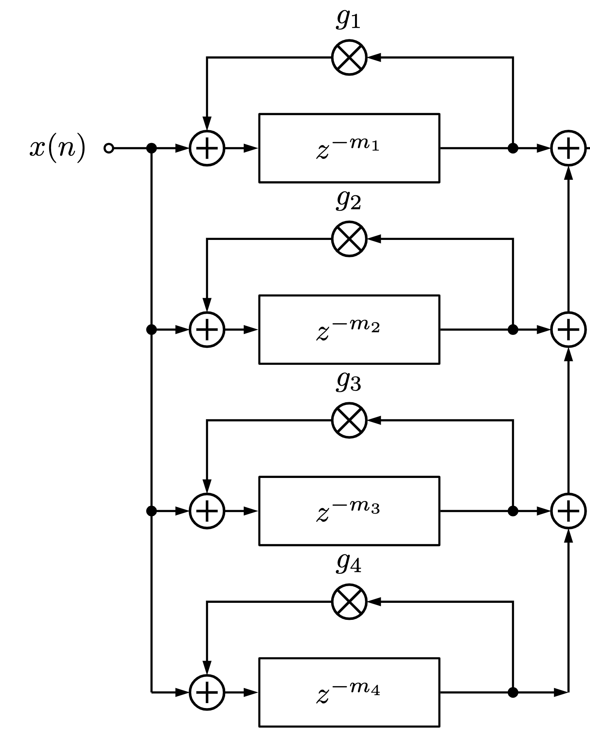
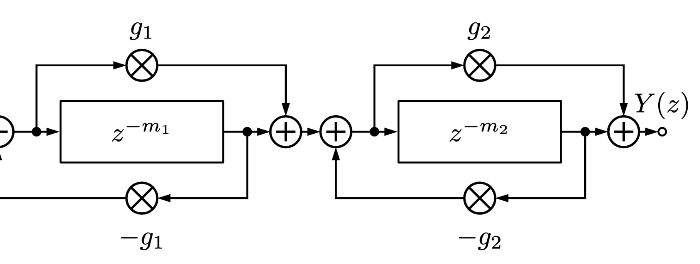
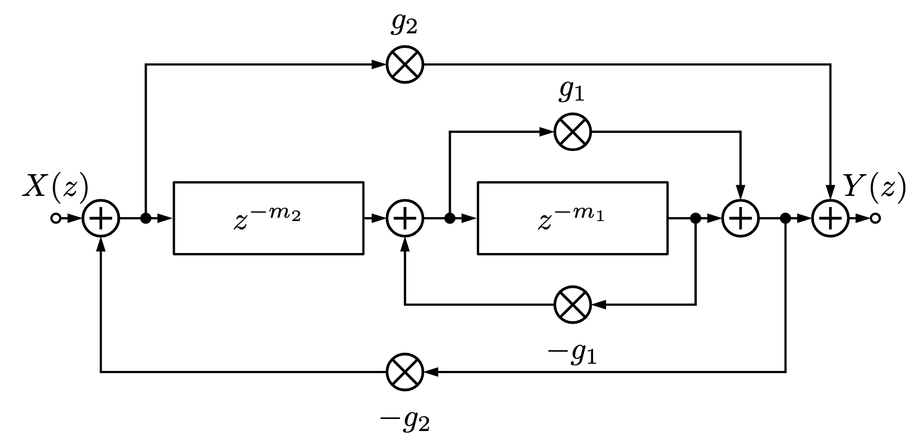
The Feedback Delay Network
General design – mixing matrix $U$
Controls the interaction between the delay lines
usually unitary, e.g., orthogonal
Parallel comb filter
Schroeder Reverb
Nested Allpass
Amplitude
S. J. Schlecht, “FDNTB: The feedback delay network toolbox,” in Proc. Int. Conf. Digital Audio Effects (DAFx), Sept. 2020, pp. 211–218.
Moorer-Schroeder Reverb
Notes:
A matrix U is unilossless if, regardless of the choice of delay m, its eigenvalues are unimodular and its eigenvectors are linearly independe

Slide 13
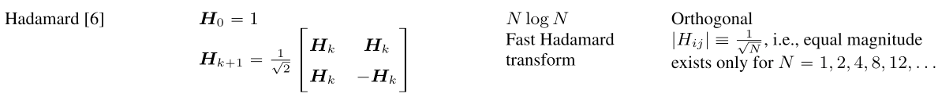
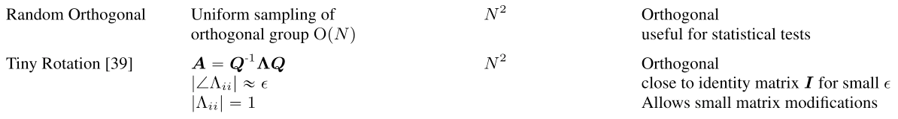
The Feedback Delay Network
General design – feedback matrix $U$
more matrix designs
👇
S. J. Schlecht, “FDNTB: The feedback delay network toolbox,” in Proc. Int. Conf. Digital Audio Effects (DAFx), Sept. 2020, pp. 211–218.
Moorer-Schroeder Reverb

Slide 14
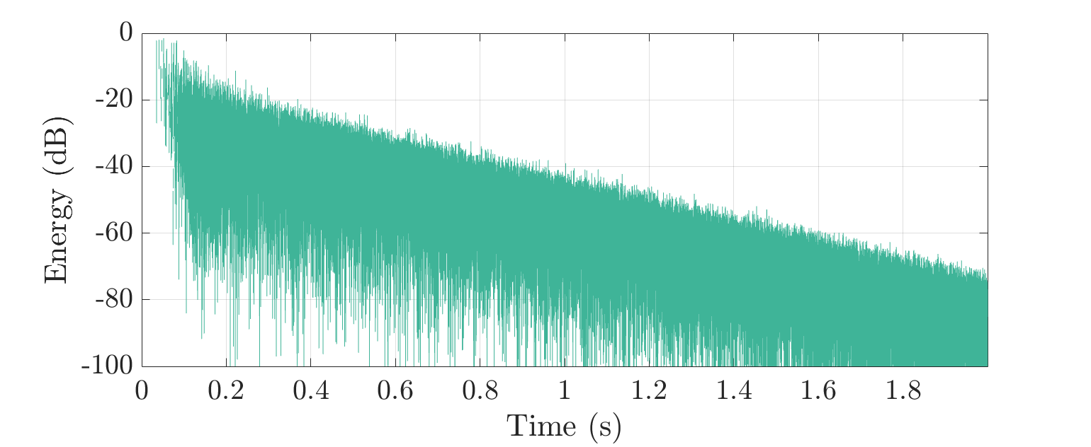
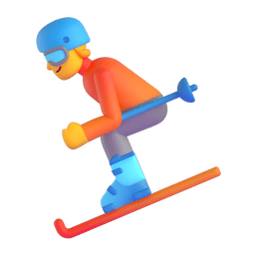
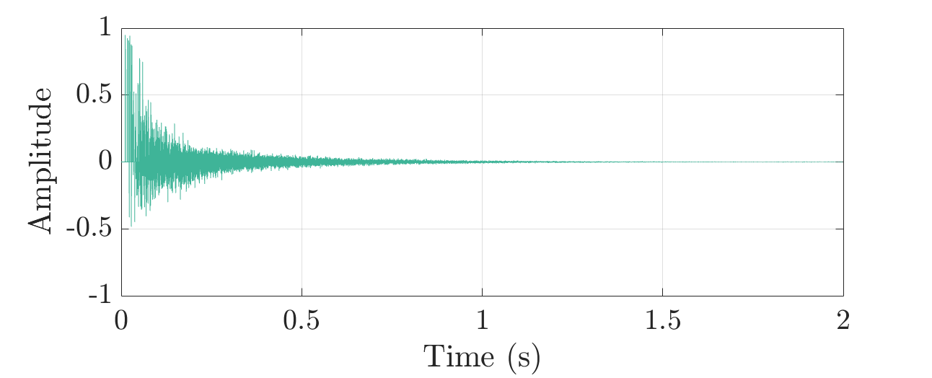
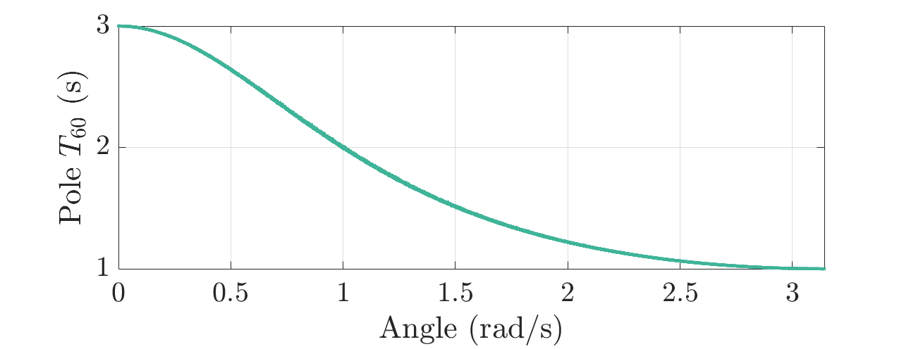

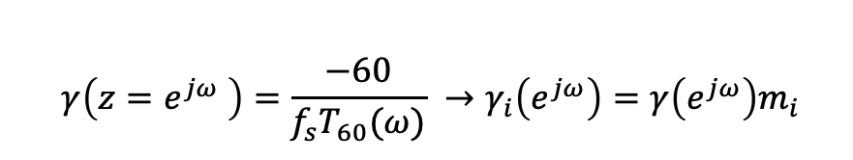
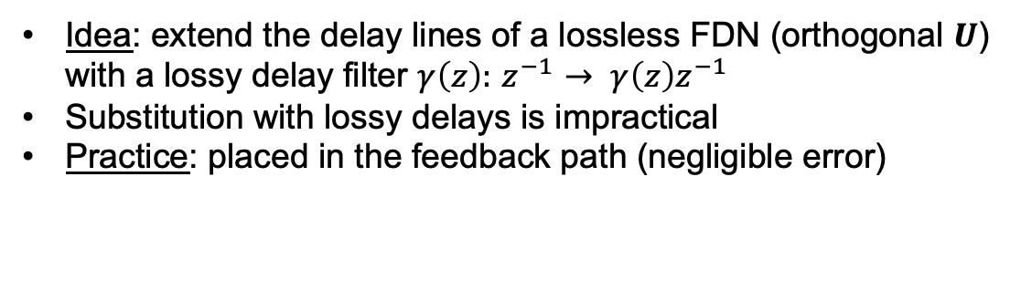
The Feedback Delay Network
General design – damping $Γ(z)$
Idea: extend the delay lines of a lossless FDN (orthogonal $U$) with a lossy delay filter $γ\left(z\right):{ z}^{−1} → γ\left(z\right)z^{−1}$
Substitution with lossy delays is impractical
Practice: placed in the feedback path (negligible error)
models only one decay rate per frequency
$$γ\left(z=e^{jω} \right)=\frac{−60}{f_{s}T_{60}(ω)} →γ_{i}\left(e^{jω}\right)=γ\left(e^{jω}\right)m_{i}$$
homogenous
FD $T_{60}(ω)$

Slide 15
Synthesizing Realistic RIRs
. FDN optimization
. blind estimation
. FDNs for spatial audio

Slide 16

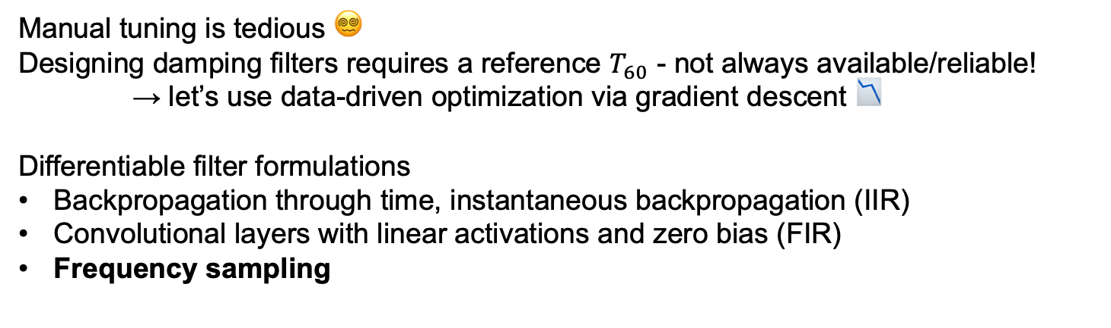
Synthesizing Realistic RIRs
FDN Optimization
Manual tuning is tedious 😵‍💫
Designing damping filters requires a reference $T_{60}$ - not always available/reliable!
→ let’s use data-driven optimization via gradient descent 📉
Differentiable filter formulations
Backpropagation through time, instantaneous backpropagation (IIR)
Convolutional layers with linear activations and zero bias (FIR)
Frequency sampling
$$H\left(z_{M}\right)=T\left(z_{M}\right)(c^{⊺}{\left[D_{m}\left(z_{M}\right)−A\left(z_{M}\right)\right]}^{−1}b+d(z_{M})$$

Slide 17
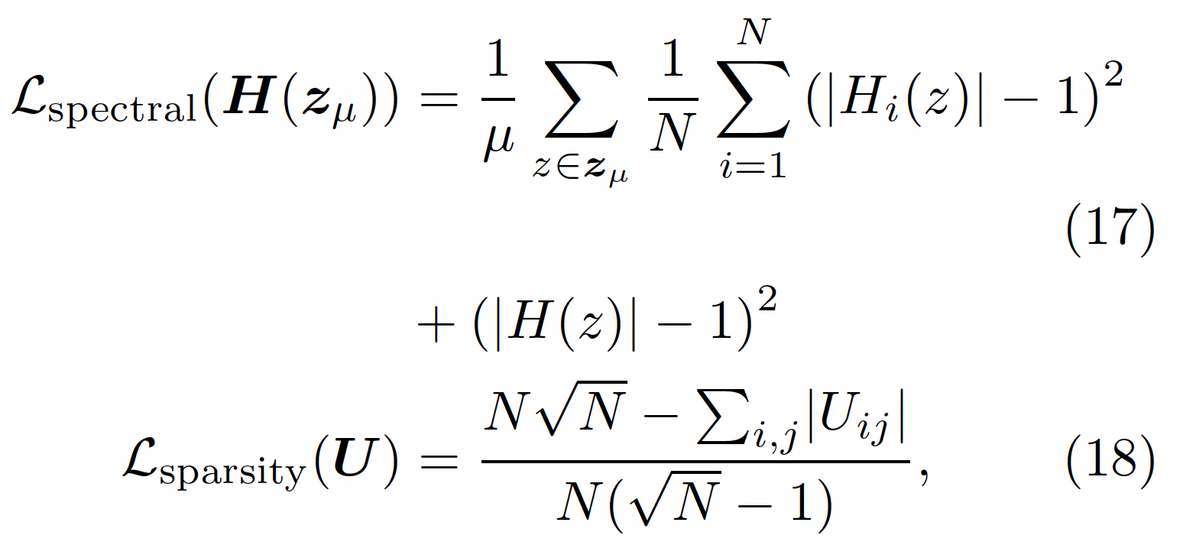
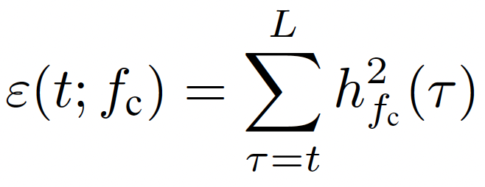
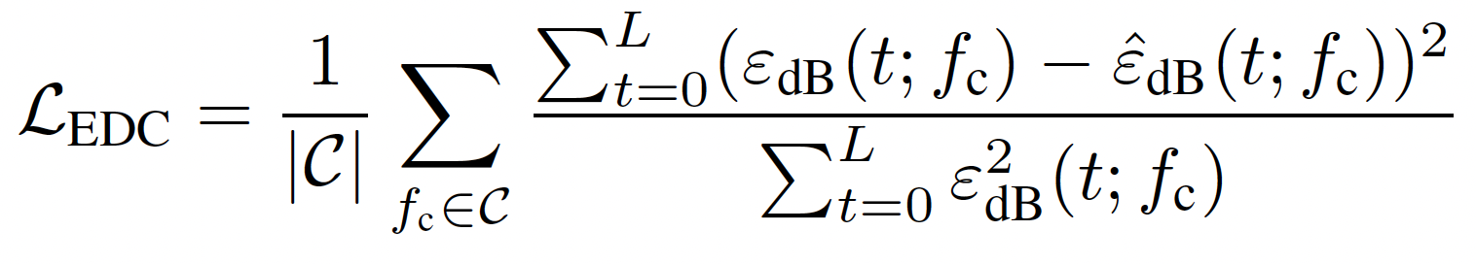

Synthesizing Realistic RIRs
FDN Optimization - challenges
Common audio losses alone are not able to capture common FDN artifacts
Need for model-specific losses
Two examples:
Colorless optimization
Init
Optim
RT optimization

Slide 18
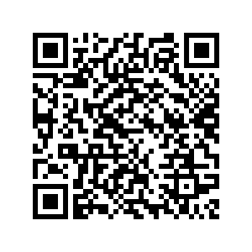

Synthesizing Realistic RIRs
FDN optimization – fitting a RIR
RIR2FDN example
Dal Santo, G., Prawda, K., Schlecht, S. J., & Välimäki, V. (2025). Optimizing tiny colorless feedback delay networks. EURASIP Journal on Audio, Speech, and Music Processing, 2025(1), 13.
Dal Santo, G., De Bortoli, G. M., Prawda, K., Schlecht, S. J., & Välimäki, V. (2025, April). FLAMO: An Open-Source Library for Frequency-Domain Differentiable Audio Processing. In ICASSP 2025-2025 IEEE International Conference on Acoustics, Speech and Signal Processing (ICASSP) (pp. 1-5). IEEE.

Slide 19
Synthesizing Realistic RIRs
FDN optimization – fitting a RIR
flamo library
Dal Santo, G., Prawda, K., Schlecht, S. J., & Välimäki, V. (2025). Optimizing tiny colorless feedback delay networks. EURASIP Journal on Audio, Speech, and Music Processing, 2025(1), 13.
Dal Santo, G., De Bortoli, G. M., Prawda, K., Schlecht, S. J., & Välimäki, V. (2025, April). FLAMO: An Open-Source Library for Frequency-Domain Differentiable Audio Processing. In ICASSP 2025-2025 IEEE International Conference on Acoustics, Speech and Signal Processing (ICASSP) (pp. 1-5). IEEE.

Slide 20
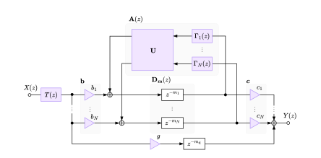
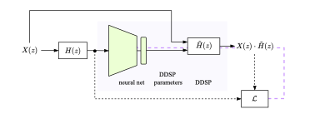
The Feedback Delay Network
FDN optimization – blind estimation of RIRs
Generalize over a dataset of reverberant speech → DDSP framework
Matching Reverberant Speech Through Learned Acoustic Embeddings and Feedback Delay Networks, P. Götz, G. Dal Santo, S. J. Schlecht, V. Välimäki, E. A.P. Habets, https://arxiv.org/abs/2510.23158

Slide 21
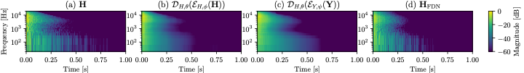
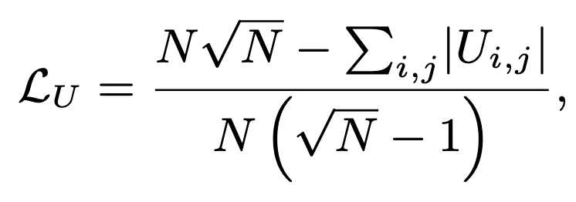
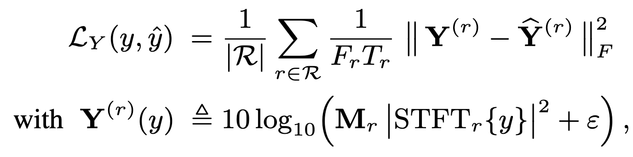

The Feedback Delay Network
FDN optimization – blind estimation of RIRs
Tone control
DRR control
more audio examples
dry
conv
fdn
Matching Reverberant Speech Through Learned Acoustic Embeddings and Feedback Delay Networks, P. Götz, G. Dal Santo, S. J. Schlecht, V. Välimäki, E. A.P. Habets, https://arxiv.org/abs/2510.23158

Slide 22
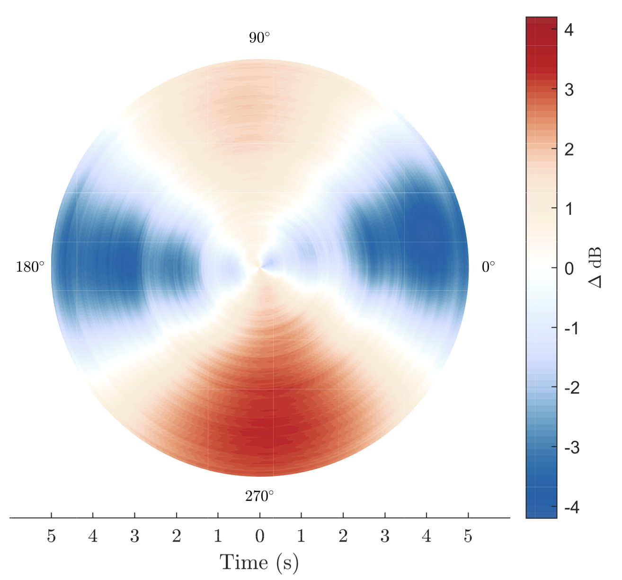
The Feedback Delay Network
FDN for Spatial Audio
Spatial reverberation with delay networks
Low complexity, avoids convolution
No need to generate and store Binaural RIRs / Spatial RIRs
Ideal for 6 DoF rendering
Standard FDN
Create sets of decorrelated signals
All channels decay at the same RT
Real rooms lack good diffusion properties
→ inhomogeneous and anisotropic sound decay
Energy decay deviation on the horizontal plane
👇
more about directional reverberation
Alary, Benoit. "Analysis and Synthesis of Directional Reverberation.” PhD thesis (2021)

Slide 23
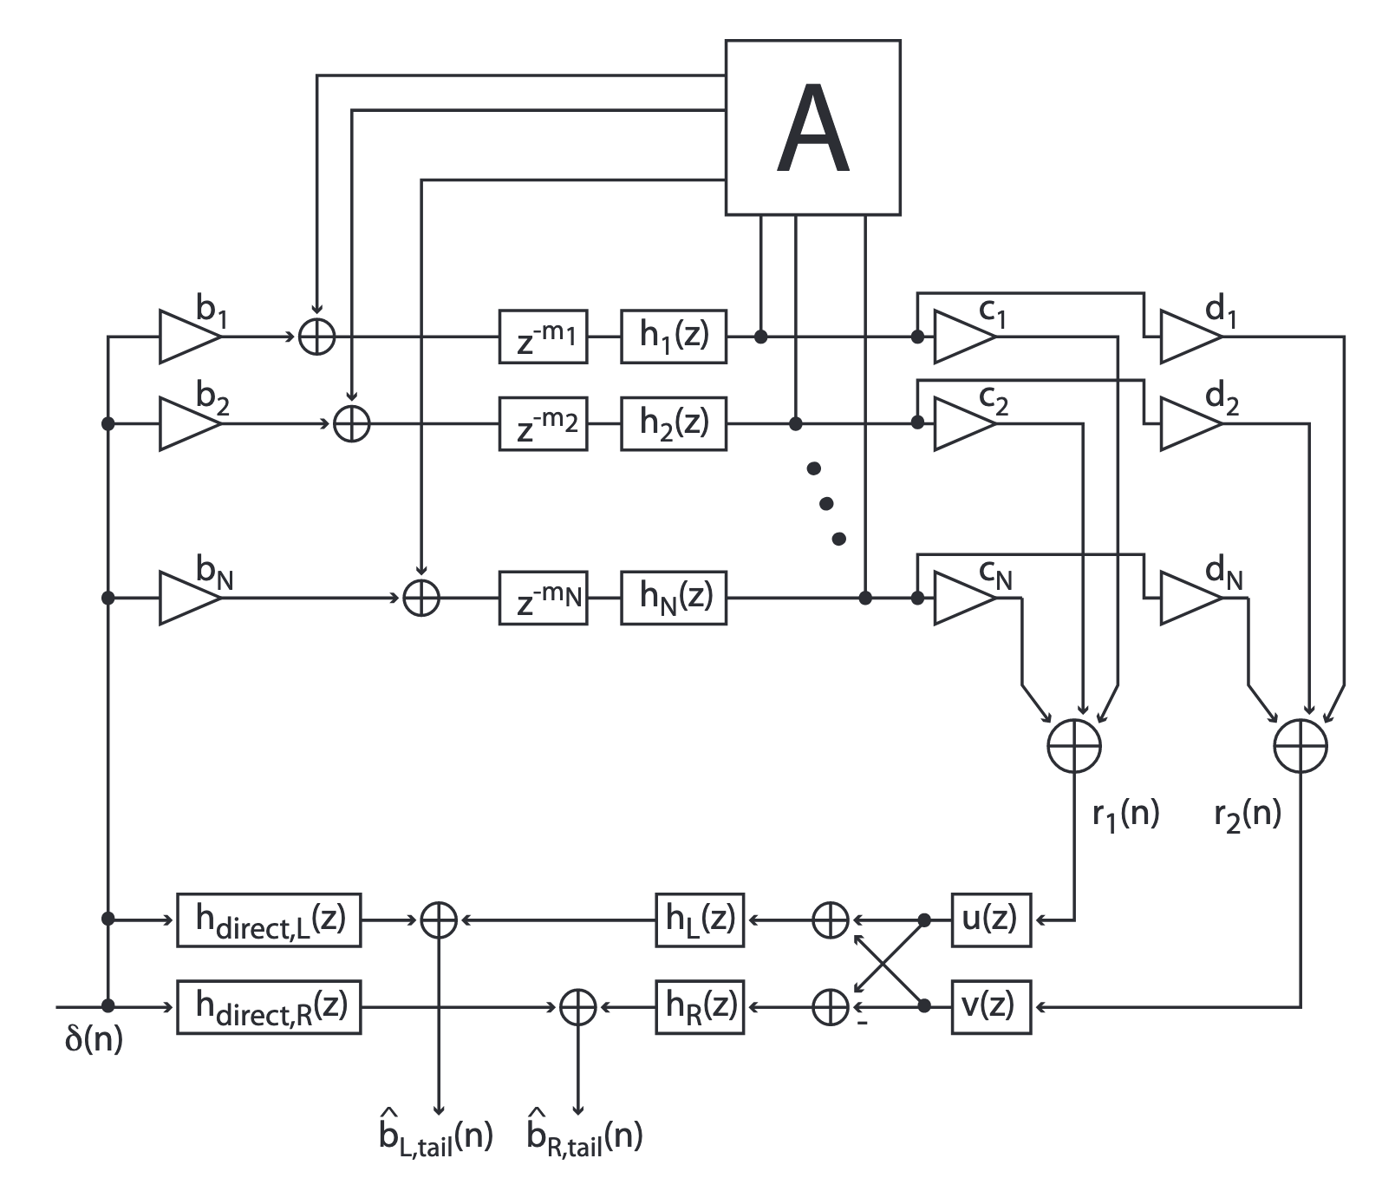

The Feedback Delay Network
Binaural FDN
Jot reverberator with two uncorrelated channels
uncorrelated signals
FIR filters HRTFs direct sound
coherence matching filters
tone correction
F. Menzer, “Binaural reverberation using two parallel feedback delay networks,” in Proc. Audio Eng. Soc. 40th Int. Conf. Spatial Audio, (Tokyo, Japan), Oct. 2010.

Slide 24
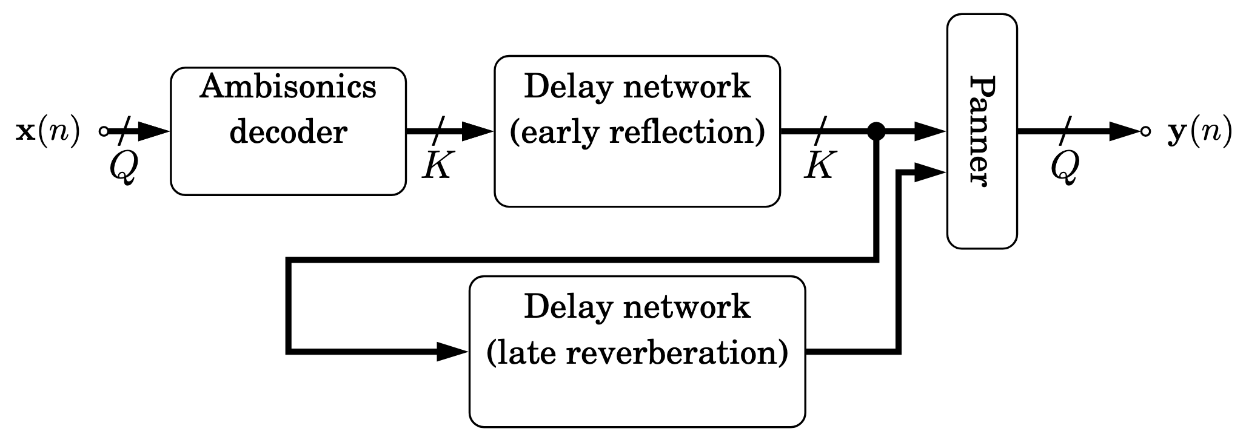
The Feedback Delay Network
Ambisonics FDN
cascaded unitary blocks to increase diffuseness
B-format to A-format (raw)
A-format to B-format with steering rotations
FDN with allpass filters delays
J. Anderson and S. Costello, “Adapting artificial reverberation architectures for B-format signal processing,” in Proc. Ambisonics Symposium, (Graz, Austria), Jun. 2009.

Slide 25
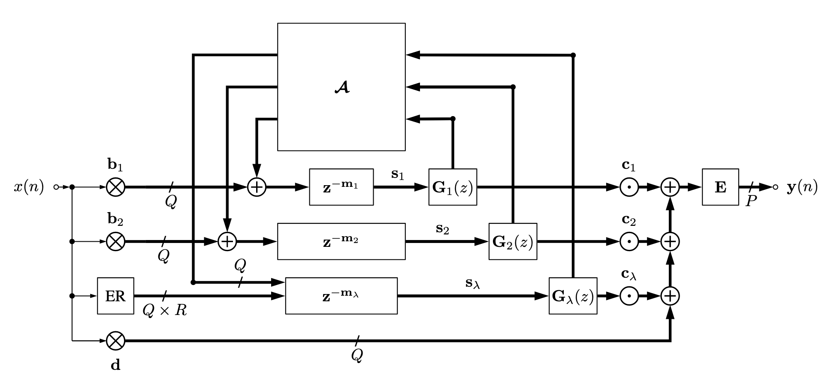
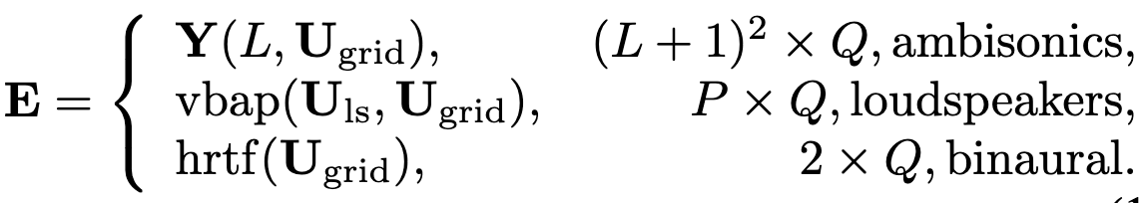

The Feedback Delay Network
Directional FDN
multichannel delay lines:
  $N$ groups of $Q$ delay lines
  each channel within a group corresponds to an incident direction on a spatial grid of $Q$ directions
The channels are defined as plane-waves distributed around a sphere (SH can also be an option)
frequency- and direction-dependent filters $G_{i}\left(z\right)$ from $T_{60}(ω, φ, θ)$
Alary, B. and Välimäki, V., 2021, September. A method for capturing and reproducing directional reverberation in six degrees of freedom. In 2021 Immersive and 3D Audio: from Architecture to Automotive (I3DA) (pp. 1-8). IEEE.
B. Alary and A. Politis, “Frequency-dependent directional feedback delay network,” in Proc. IEEE ICASSP-2020, pp. 176–180, May 2020

Slide 26

The Feedback Delay Network
Directional FDN
Directional energy distribution
image-source method
conventional FDN with single-channel delay lines and a weighted directional output
DFDN is designed to resemble the SIR of the image-source method
Alary, B., Politis, A., Schlecht, S.J. and Välimäki, V., 2019. Directional feedback delay network. AES: Journal of the Audio Engineering Society, 67(10), pp.752-762.

Slide 27



The Feedback Delay Network
Directional and Position-Dependent Grouped FDN
Modeling of multi-stage decay
Multichannel delay lines
  $N$ groups = $N$ decay rates
$U$ controls coupling between rooms
Das, O., Schlecht, S. J., & De Sena, E. (2023). Grouped feedback delay networks with frequency-dependent coupling. IEEE/ACM transactions on audio, speech, and language processing, 31, 2004-2015.
Das, O., & Abel, J. S. (2021). Grouped feedback delay networks for modeling of coupled spaces. J. Audio Eng. Soc, 69(7/8), 486-496.

Slide 28


The Feedback Delay Network
Directional and Position-Dependent Grouped FDN
multichannel delay lines:
  $N$ groups of $Q={\left(N+1\right)}^{2}$ delay lines
listener positions → multi-layer perceptron → spherical harmonic receiver gains
trained to
  minimise spectral deviation,
  promote low sparsity,
  match directional energy decay curves
These were just a few examples.
It’s an active field of research!
e.g., Matteo and Joshua’s poster!
Differentiable Grouped Feedback Delay Networks For Learning
Direction and Position-Dependent Late Reverberation, O. Das et. al. TBA

Slide 29
Creative Reverberation with FDNs
. modulating poles
. reverberation enhancement systems
. introducing non-linearities

Slide 30

The Feedback Delay Network
Time-varying FDNs
Why time-variance:
  air movement from temperature differences and physical interactions
  improve perceptual quality by breaking up temporal patterns
  improve stability in reverberant enhancement systems
Option I: modulate gains in allpass filter equivalent standard FDN
  ⚠️ risk of energy growth and ringing → instability
allpass filter equivalent standard FDN
Schlecht, S. J., & Habets, E. A. (2015). Time-varying feedback matrices in feedback delay networks and their application in artificial reverberation. The Journal of the Acoustical Society of America, 138(3), 1389-1398.

Slide 31


The Feedback Delay Network
Time-varying FDNs
Option II: time-varying feedback matrix → modulation of the zero and pole locations
  update by a fixed unitary matrix to maintain stability
  $U\left(n\right) =U\left(n−1\right)R$
Can be used to break repetition artifacts in small FDNs
Slow
Slow Async
Fast
Sebastian J Schlecht and Emanuël A P Habets, (2015 ) Practical considerations of time-varying feedback delay networks, Proc. Audio Eng. Soc. Conv., pp. 1 – 9.
Schlecht, S. J., & Habets, E. A. (2015). Time-varying feedback matrices in feedback delay networks and their application in artificial reverberation. The Journal of the Acoustical Society of America, 138(3), 1389-1398.

Slide 32


The Feedback Delay Network
Reverb Enhancement Systems (RES)
RES: active systems for controlling room acoustics, consisting of a virtual room that enhances the sound field in the physical room.
De Bortoli, G., Dal Santo, G., Prawda, K., Lokki, T., Välimäki, V., & Schlecht, S. (2024, September). Differentiable Active Acoustics: Optimizing Stability via Gradient Descent. In DAFx24 (pp. 254-261). University of Surrey.
De Bortoli, G. M., Prawda, K., Coleman, P., & Schlecht, S. (2025, September). DataRES and PyRES: A Room Dataset and a Python Library for Reverberation Enhancement System Development, Evaluation, and Simulation. In DAFx25 (pp. 251-258). York.

Slide 33
The Feedback Delay Network
Reverb Enhancement Systems (RES)
Virtual rooms:
truncated unitary random mixing matrix
finite-impulse-response filter mixing matrix
multichannel phase-cancelling modal reverberator
multichannel unitary reverberator
Feedback delay network ← stability optimization
De Bortoli, G., Dal Santo, G., Prawda, K., Lokki, T., Välimäki, V., & Schlecht, S. (2024, September). Differentiable Active Acoustics: Optimizing Stability via Gradient Descent. In DAFx24 (pp. 254-261). University of Surrey.
De Bortoli, G. M., Prawda, K., Coleman, P., & Schlecht, S. (2025, September). DataRES and PyRES: A Room Dataset and a Python Library for Reverberation Enhancement System Development, Evaluation, and Simulation. In DAFx25 (pp. 251-258). York.

Slide 34

The Feedback Delay Network
Shimmer reverb
delayed fade in of the harmonics
long RT
mid-short RT
... can it be more compact? WIP 🔧
“Shimmer Audio Effect: A Harmonic Reverberator,” Jingjie Zhang, Center for Computer Research in Music and Acoustics (CCRMA), MUSIC 421A: project report (2018)

Slide 35


Conclusion
The Feedback Delay Networks are versatile architectures, and using ML, we can achieve more natural reverb and expand their capabilities to a wider range of applications
Aalto Acoustics Lab: https://www.aalto.fi/en/aalto-acoustics-lab
Need some FDN or DDSP code? https://github.com/gdalsanto
gloria.dalsanto@aalto.fi
Thank you!

