Slide 1
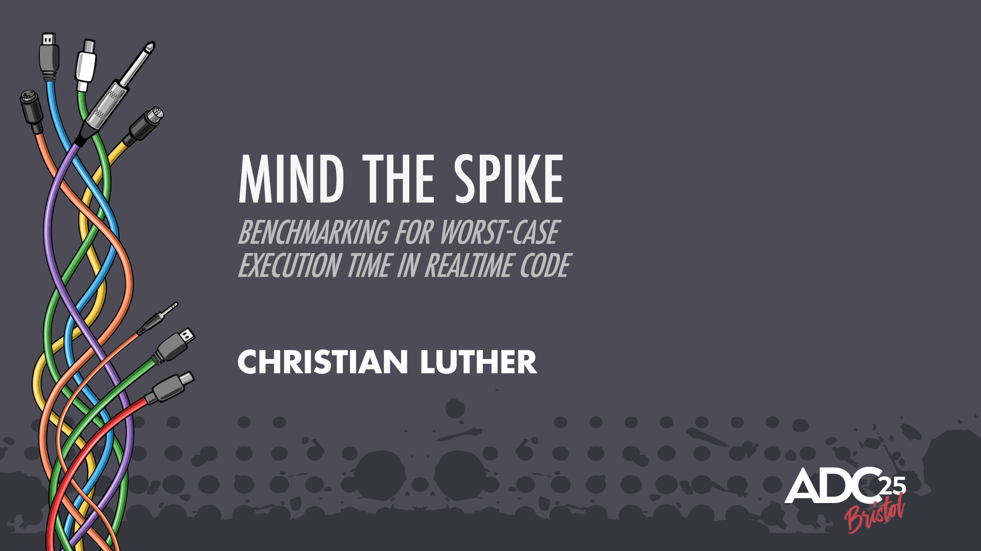

Slide 2
The Realtime Audio Problem
Assume 64 block size @ 48 kHz
We get ~1.33 ms chunks of audio to process
Every ~1.33ms
We need to supply our result before it’s due to be played back
1.33ms = 100% CPU load
- some overhead
- ”safety margin” / “Product Management Margin”

Slide 3
How Do We Know We’re Always Going To Deliver Our Audio On Time?

Slide 4
Measuring CPU Load
Mean: 24.5%

Slide 5
Sources Of Randomness
Branching
  Do A every X samples
  Do B when there are events in some queue
  Do C when the delay buffer wraps
Cache misses
CPU Magic
  Pipelines flushing
  Branch Prediction / speculative execution
  …

Slide 6
Measuring CPU Load
Mean: 24.5%
Std: 0.4%

Slide 7
Measuring CPU Load
Mean: 24.5%
Std: 0.4%
Max: 31.8%

Slide 8
Sanity Check
Mean: 24.5%
Std: 0.4%
Max: 31.8%
(18.9 stds above mean)
(once every 6.43e+68 years)
Age of universe: ~1.38e+10 years

Slide 9
Better Take a look at the data…

Slide 10
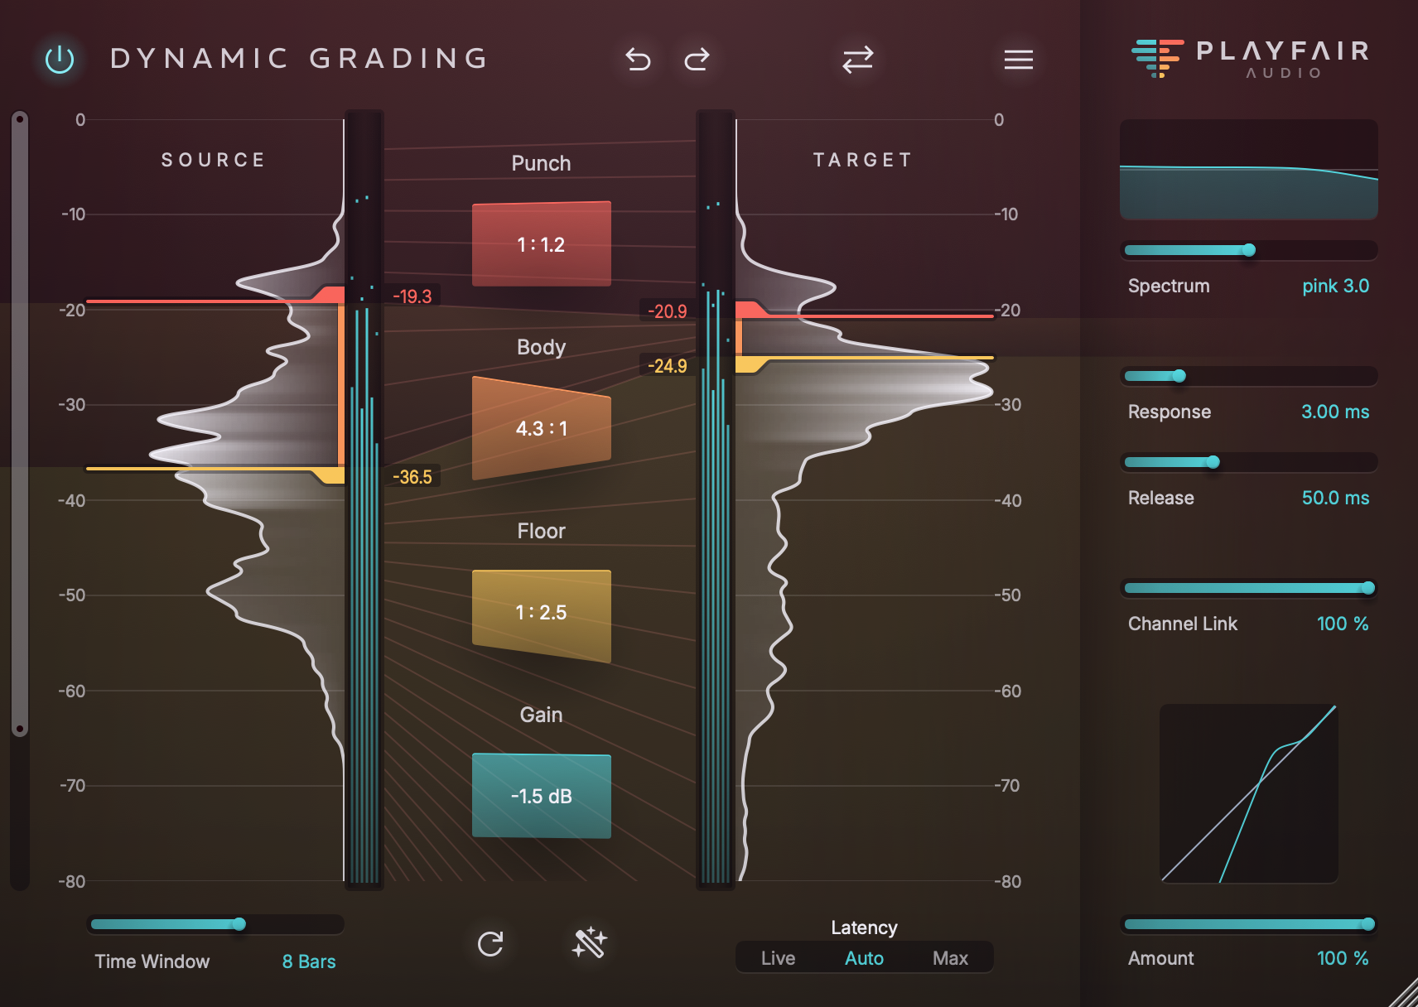


I Love Histograms!
(shameless product plug)

Slide 11
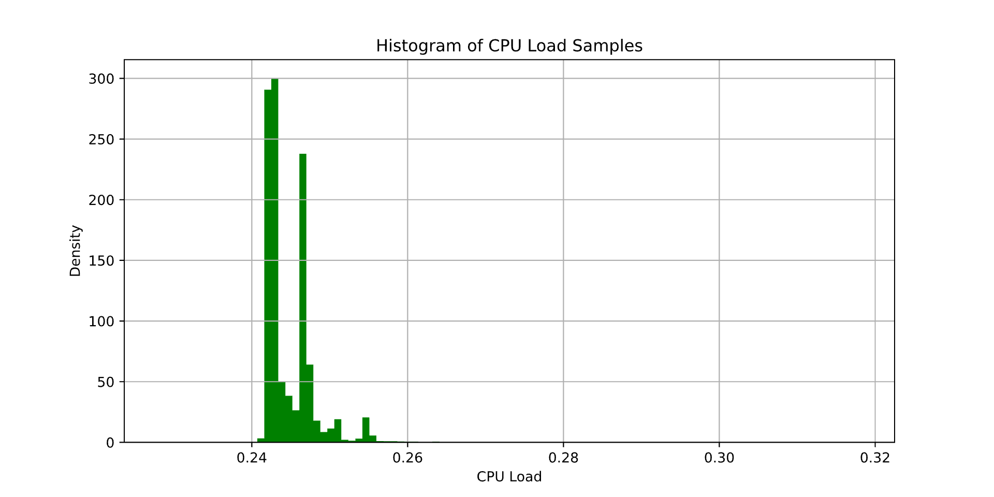
Histogram

Slide 12
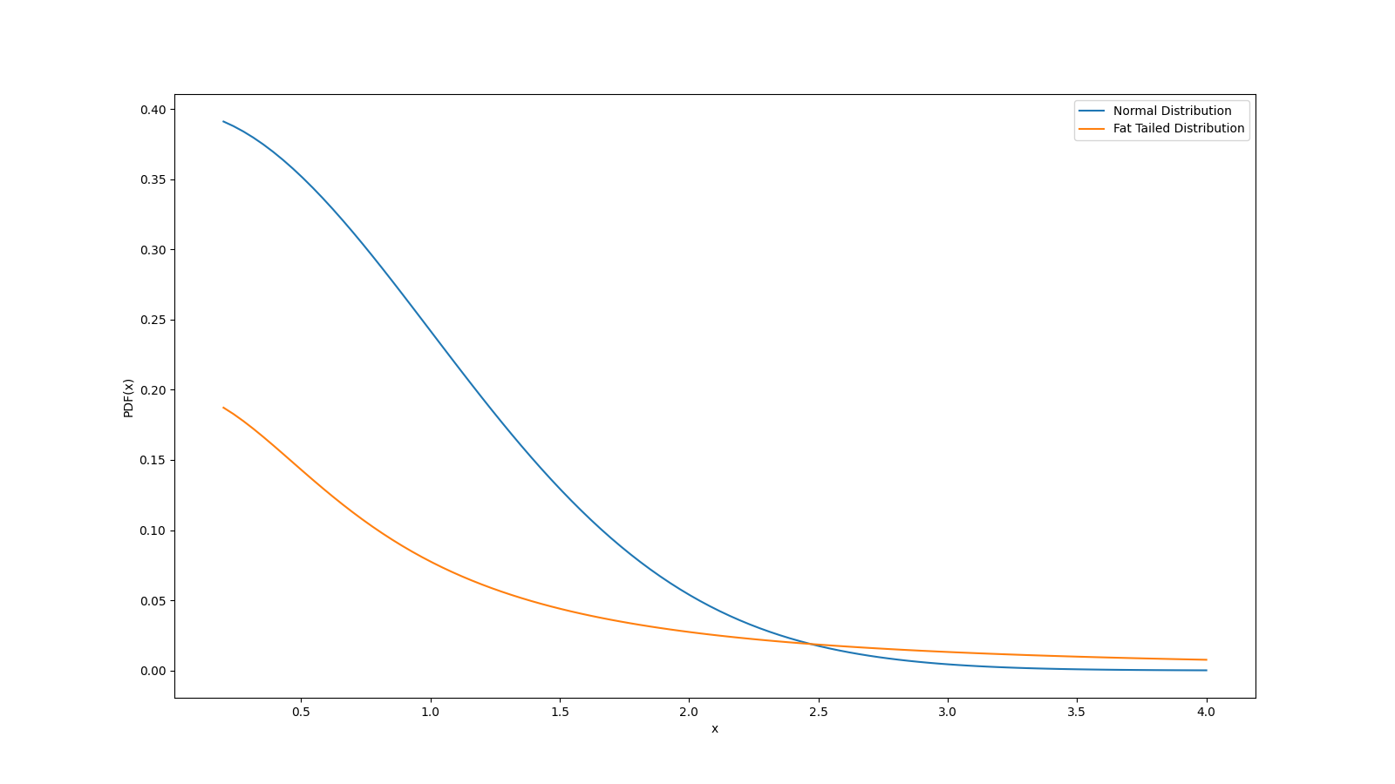
Fat Tailed Randomness
Rare outcomes with high magnitude
Variance appears “low”, until it doesn’t
Found in: floods, stock market crashes, catastrophes

Slide 13
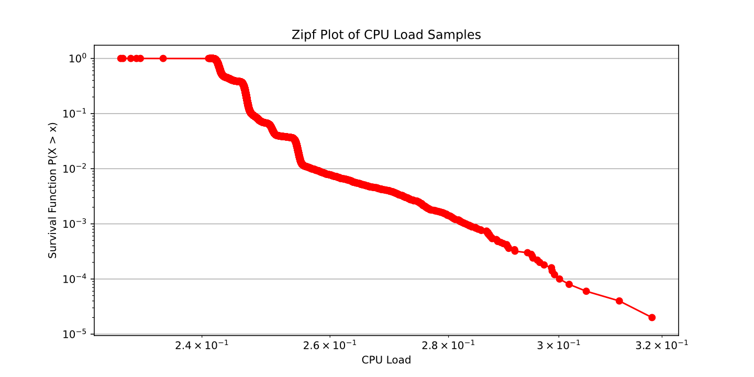
Zipf Plot

Slide 14
Zipf Plot How-To
sorted_samples = np.sort(samples)
sf = np.flip(np.arange(len(samples))+1) / len(samples)
plt.loglog(sorted_samples, sf, marker='o’)

Slide 15
Tail Index Estimation
# Select only highest .1% of samples
idx = slice(-int(0.001 * len(samples), None)
# Linear regression in log-log space
lx = np.log( sorted_samples[idx] )
ly = np.log( prob[idx] )
slope, intercept, _ = linregress(lx, ly)
alpha = -slope
C = np.exp(intercept)
glitch_probability = C * (glitch_level)**(-alpha)

Slide 16
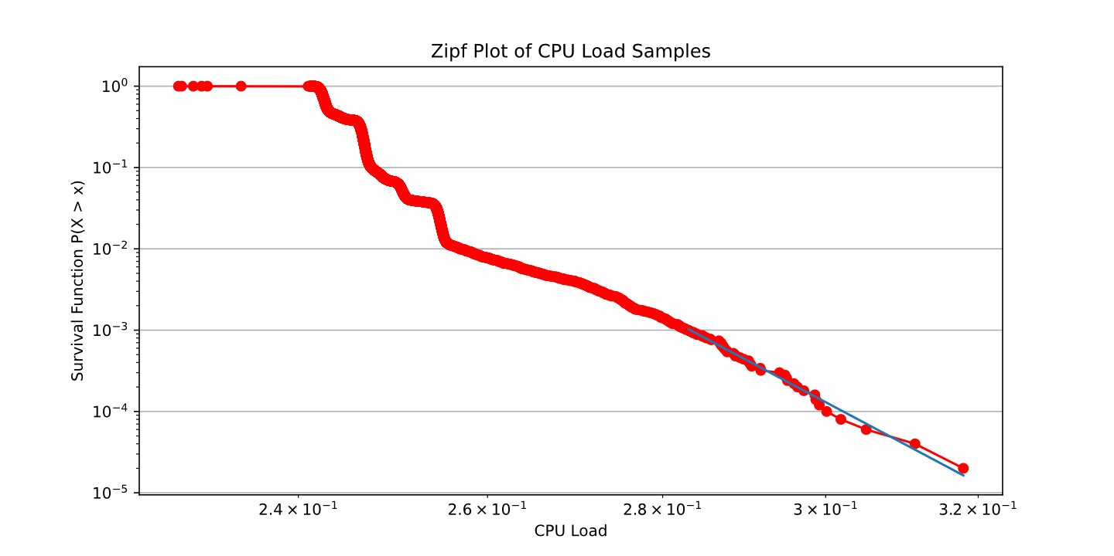
Tail Index Estimation
Mean: 24.5%
Std: 0.4%
Max: 31.8%
Tail index: 35.6
Glitch Frequency:
once every 3.04e+34 years

Slide 17
Unbounded Sources Of Randomness
(the deadly sins of Audio Programming)
Preemption by OS
Memory Allocation
I/O
Mutexes
System Calls
Spin Locks
…

Slide 18
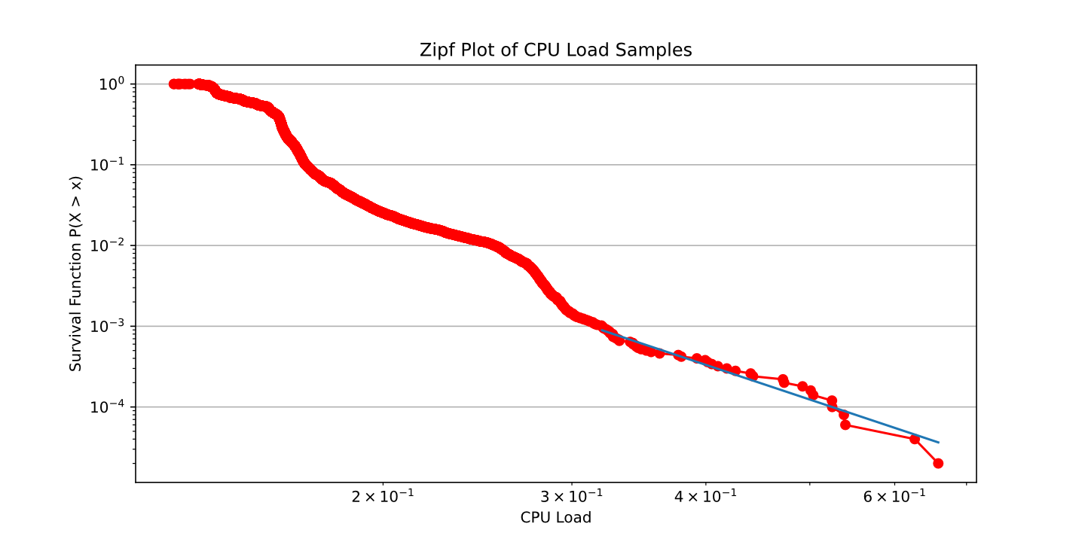
Watch Your Tail!
Mean: 15.6%
Std: 2.0%
Max: 65.9%
Tail index: 4.4
Glitch Frequency:
once every 11.9 minutes

Slide 19
Wrapping Up
Standard Deviation and Maximum almost completely useless
Zipf Plot and Tail Index Estimation
  detect serious issues
  confirm realtime safety
Caveat: Tail index estimation requires some manual supervision
Search Keywords: extreme value theory, fat tails, power laws

Slide 20

Thanks, and Say Hello!
LinkedIn
Here
Playfair Audio

