Slide 1

Notes:
Hi all, so, as the title says, today we’re going to see how to make your filter run fast in PyTorch while still being differentiable.
The techniques I’ll show today are implemented in a package I made called philtorch.

Slide 2




About me
Yu, Chin-Yun （尤靖允）
PhD student in AI & Music at Queen Mary University of London
Research interests
  Music Information Retrieval
  Voice synthesis
  Audio Effects Modelling
  Binaural Audio
https://iamycy.github.io/
Notes:
Something about me: So, my name is 靖允. I’m a phd student at Queen Mary University of London in the AI and music programme. I research things including music information retrieval, voice synthesis, audio effects modelling, and binaural audio.

Slide 3
Sources
Publications
  “Singing voice synthesis using differentiable LPC and glottal-flow-inspired wavetables”, ISMIR 2023
  “Differentiable all-pole filters for time-varying audio systems”, DAFx24
  “DiffVox: A differentiable model for capturing and analysing vocal effects distributions”, DAFx25
Blog posts
  “Introduction to Differentiable Audio Synthesiser Programming”, ISMIR 2023 Tutorial
  “Notes on Differentiable TDF-II Filter”, personal blog
  “Block-based Fast Differentiable IIR in PyTorch”, personal blog
Notes:
I have been looking into the problem of making a differentiable filter run fast for a few years.
This talk is a summary of these publications and some blog posts I wrote.

Slide 4
Agenda
What are differentiable filters
Efficiency problem in PyTorch
Proposed solution: PhilTorch
Benchmarks
Tips for efficient usage
Notes:
Here’s the agenda for today’s talk. We’re gonna see:
What are differentiable filters
The efficiency problem of filters in PyTorch
My proposed solution
some Benchmarks
and tips for efficient usage

Slide 5

What Are Digital Filters?
In the Z domain
$$H\left(z\right)=\frac{b_{0}+b_{1}z^{−1}+…+b_{M}z^{−M}}{1+a_{1}z^{−1}+…+a_{M}z^{−M}}$$
In the time domain
$$y\left(n\right)= b_{0}x\left(n\right)+b_{1}x\left(n−1\right)+…+b_{M}x\left(n−M\right)$$
$$−a_{1}y\left(n−1\right)−…−a_{M}y(n−M)$$
Notes:
So, any linear time-invariant discrete filter is characterised by its transfer function in the z domain like this. It has two polynomials with b and a coefficients, respectively. If we directly convert the function into its difference equation, we get the second equation, where x is the input and y is the output. This is called the direct form, one of the basic forms to build various digital filters. Each output step depends on the past values of the input and output, forming a recursive system.

Slide 6
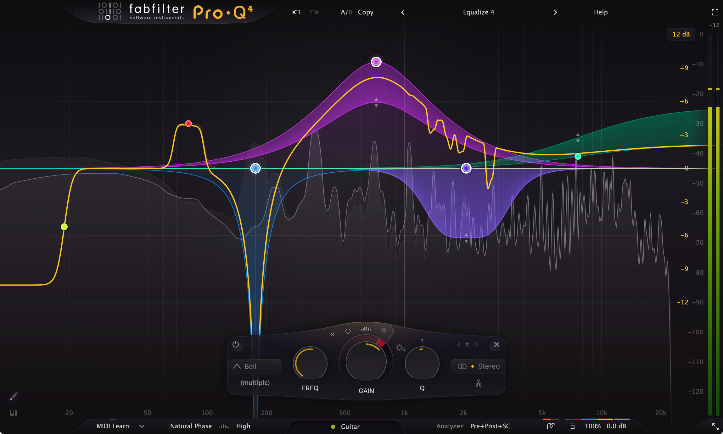
Usage
Low/high/all-pass filters
Shelving filters
Peak filters
Equalisers
Subtractive synthesiser
Phaser
Linear prediction
.etc
Notes:
Filters are widely used in audio applications. pass filter, peak filters, shelving filters, equalisers, subtractive synthesiser, and so on. It’s a very common and essential building block.

Slide 7
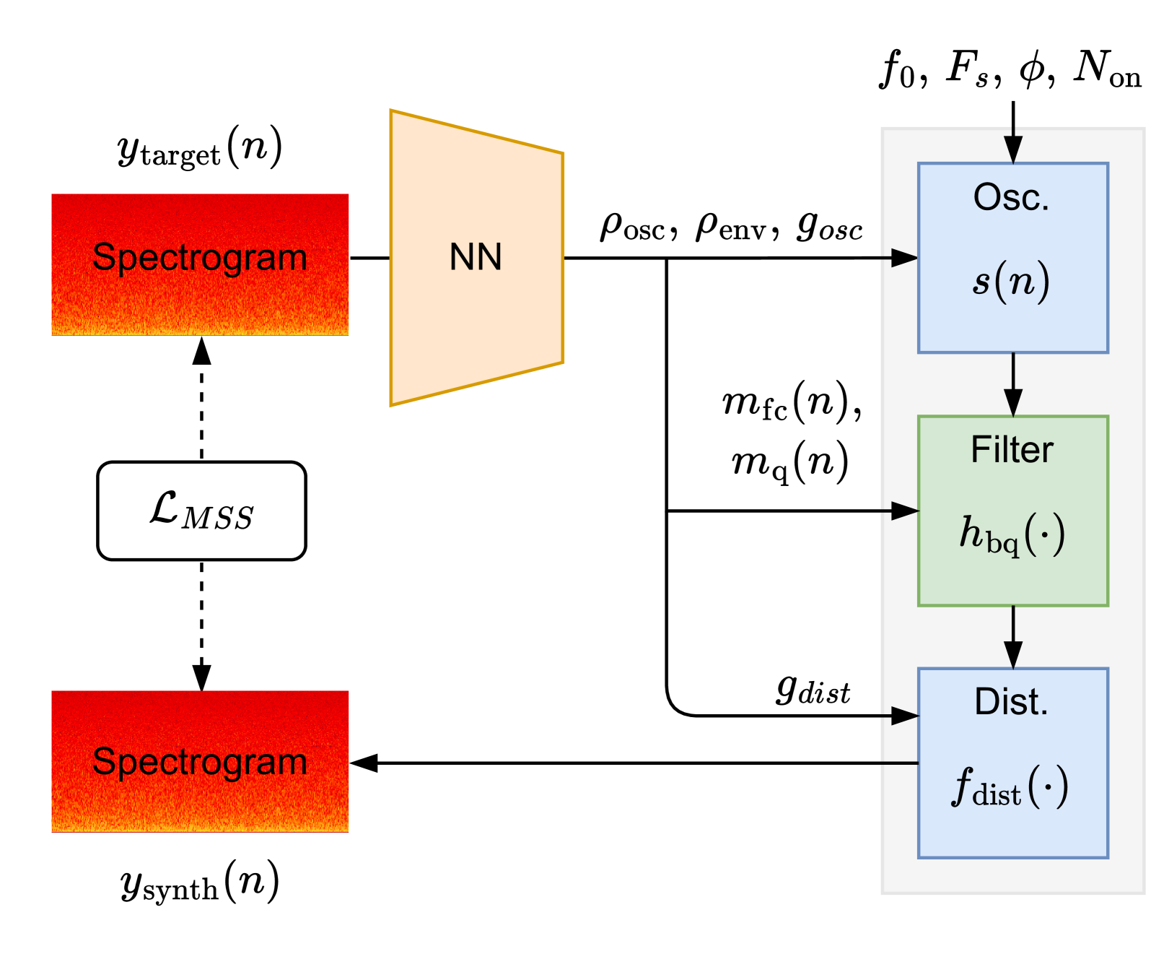
Differentiable Use Cases
Differentiable Digital Signal Processing (DDSP)
  Interpretable structure
  strong inductive bias → highly efficient systems
e.g.
  Grey-box virtual analogue modelling
  Synthesiser parameter retrieval
Fig. 3 from “Differentiable all-pole filters for time-varying audio systems”
Notes:
But why does making it differentiable matter? Differentiable filters have attracted considerable interest from people working on differentiable DSP, often called DDSP. The concept of DDSP is to utilise signal-processing components as differentiable building blocks within a neural network and jointly optimise them for machine learning tasks using gradient-based methods. This approach provides a more interpretable structure for the user to tweak. Also, it introduces strong inductive bias into the model's behaviour, reducing the number of parameters and computational cost.
Show example from my past papers with Chris

Slide 8

Automatic Differentiation (AD) of Filters
Differentiable everywhere? ✓
Fast computation in PyTorch? ✗
Problems
  No native ops for recursions/autoregression
$$y\left(n\right)= b_{0}x\left(n\right)+b_{1}x\left(n−1\right)+…+b_{M}x\left(n−M\right)$$
$$−a_{1}y\left(n−1\right)−…−a_{M}y(n−M)$$
torch.nn.functional.conv1d
torch.* ?
Notes:
Okay, so what’s the problem with using these filters in PyTorch? The problem is that PyTorch's native operators don’t support recursion or autoregression. It only supports a limited set of filters, such as convolution, which corresponds to the b coefficients. For the a coefficients, which introduce a recursion to the filter, there is no equivalent operator to date.

Slide 9
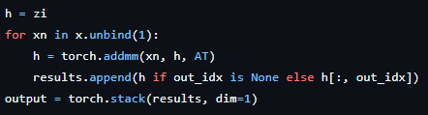
Naïve AD of Recursions
philtorch/lti/ssm.py, L127-131
runtime
torch.addmm
kernel
torch.addmm
kernel
…
torch.stack
kernel
F.conv1d
kernel
Notes:
You might argue that we can build a recursive filter from the ground up using basic PyTorch operators. That’s true, and the computation is differentiable, but it takes a long time to run. This is because the filtering process is split into many small kernels. Before each kernel launch, there are overheads from the Python interpreter, memory allocation, and other PyTorch framework overheads. These overheads interleave between kernel launches. Given hundreds of thousands of audio samples—a very typical number for an audio clip—these overheads consume the majority of the runtime, making the entire process extremely slow. In contrast, the convolution operator is implemented as one kernel in PyTorch. The number of kernel launches doesn’t depend on the sequence length and doesn’t introduce extra idle time.

Slide 10


PhilTorch Φ🔥
A Python package for PyTorch
Fast computation of linear discrete time filtering
Same numerical robustness as SciPy
Reverse- (and forward) mode AD
Linear time-invariant filters
Parameter-varying (time-varying) filters
Code
pip install philtorch
Notes:
To solve this slow computation issue, I made philtorch, a python package for pytorch. it features:
Fast computation of linear discrete-time filtering
Same numerical robustness as SciPy
Reverse- (and forward) mode AD
Linear time-invariant filters
Time-varying filters, which is important for learning modulation and automation.
Due to limited time, I won’t cover forward-mode AD and time-varying filters today, but many of the techniques I’ll show later can be applied to them. You can check the package on PyPI or GitHub.
6 minutes

Slide 11
Things To Be Covered
The state-space formulation
Custom Ops for recursion
Backpropagation
Parallelisation
Notes:
Here is a list of concepts I’ll cover later. We’re going to see
state-space representation
writing custom operators for PyTorch
gradient backpropagation
and lastly, how to parallelise the filter, so we can leverage GPU, which is the default hardware for deep learning.

Slide 12

The State-Space Model (SSM)
… of a direct form (DF) II filter.
$$v\left(n+1\right)=Av\left(n\right)+Bx\left(n\right)$$
$$y\left(n\right)=C^{⊤}v\left(n\right)+Dx\left(n\right)$$
$$A=\left[\begin{matrix}−a \\ \begin{matrix}I & 0\end{matrix}\end{matrix}\right], B=\left[\begin{matrix}1 & ⋯ & 0\end{matrix}\right]$$
$$C=\left[\begin{matrix}b_{1}−b_{0}a_{1} & … & b_{M}−b_{0}a_{M}\end{matrix}\right], D=b_{0}$$
Notes:
Let’s talk about the state-space representation. Philtorch uses SSM internally for two reasons. First, it’s flexible to represent different direct form filters. For example, here’s the parametrisation that equals the direct form filter we showed before. Second, and most importantly, it enables parallel processing on the GPU for massive speedup, which I’ll talk later. The first equation is where the recursion at, which involves the A and B matrices.

Slide 13
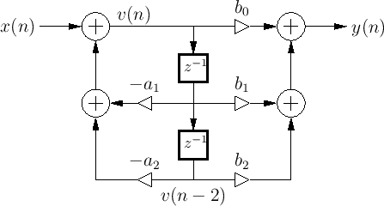
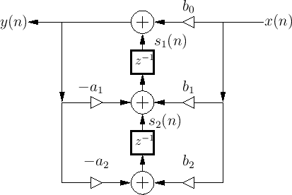

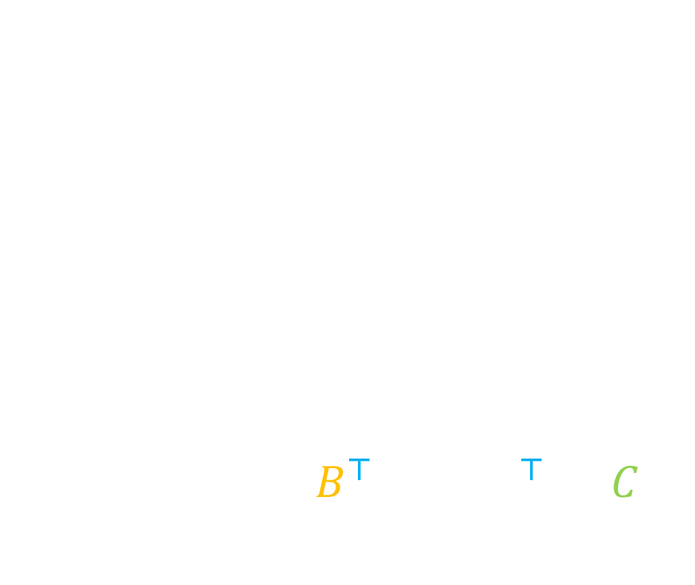
Different Direct Forms
DF-II
  Used in TorchAudio
$$H\left(z\right)=D+C^{⊤}{\left(zI−A\right)}^{−1}B$$
Transposed DF-II (TDF-II)
  Used in SciPy
$$H\left(z\right)=D+B^{⊤}{\left(zI−A^{⊤}\right)}^{−1}C$$
Image source: Julius Smith , “Introduction to Digital Filters with Audio Applications”.
Notes:
In the past, there existed a mismatch between the lfilter function in TorchAudio and the one implemented in scipy, which is widely used by the research communities. Scipy uses transposed direct form 2, which is more numerically robust than direct form. These two forms actually have the same flow diagram, but the signal flow directions are reversed. That’s why it’s called a transposed form. In SSM, we can switch between these two forms easily, just replacing the A matrix with its transpose and swapping the B and C matrices. Their responses are the same.

Slide 14


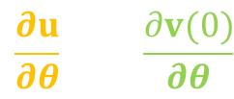


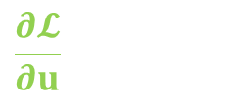
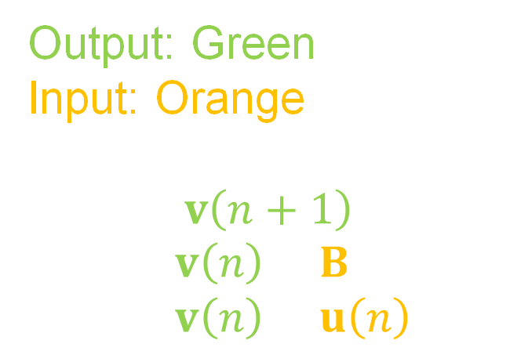
Writing Custom Operators in PyTorch
class Recurrence(torch.autograd.Function)
Output: Green
Input: Orange
$$v\left(n+1\right)$$
$$=Av\left(n\right)+Bx\left(n\right)=Av\left(n\right)+u\left(n\right)$$
*.cpp/cu
$$u,A,v(0)$$
forward
$$y$$
$$\frac{∂𝓛}{∂u},\frac{∂𝓛}{∂A},\frac{∂𝓛}{∂v(0)}$$
backward
$$\frac{∂𝓛}{∂v}$$
$$\frac{∂u}{∂θ},\frac{∂A}{∂θ},\frac{∂v(0)}{∂θ}$$
jvp
$$\frac{∂v}{∂θ}$$
Recurrence.apply
kernel
Notes:
Next, as I showed before, the fundamental solution to reduce framework overhead is to implement the filter at the kernel level, so the function call overhead will remain mostly the same. In Philtorch, instead of implementing the entire SSM, we handle only the recurrent part —the first equation, and implement it in C++ and CUDA. In the later slides, I’ll use different colours to mark the input and recursive output variables in every recursion. To make the kernel differentiable, in addition to registering the forward pass of the filter, we also need to define how to compute the gradients during backpropagation. If you want to support forward-mode AD, the jvp function must be implemented as well.

Slide 15
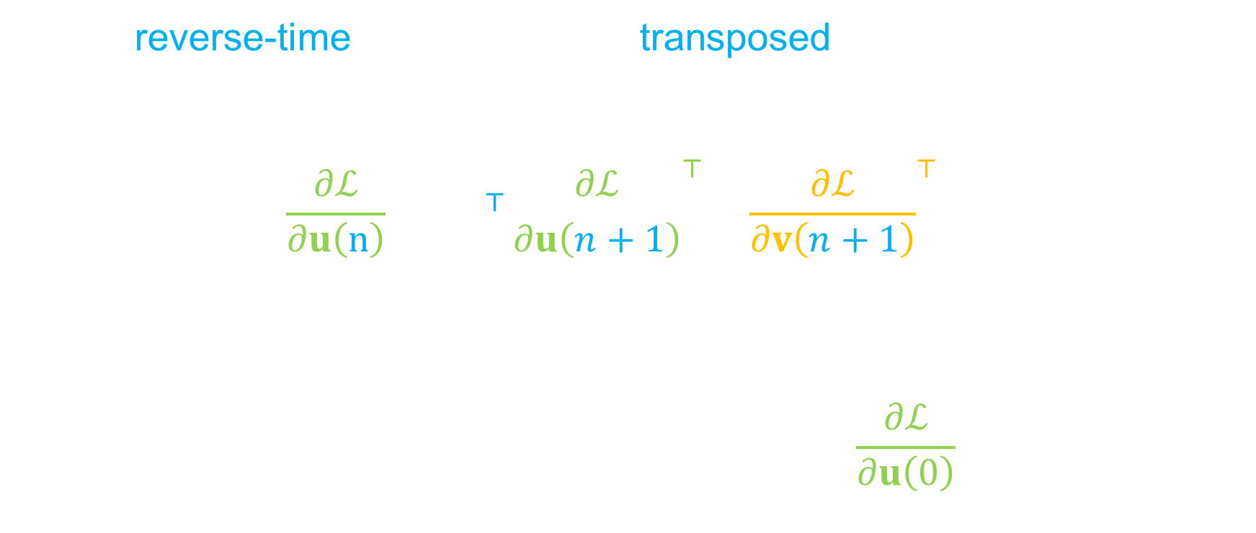
Backpropagation
…is a reverse-time recurrence with transposed A.
Gradients for the input
$$\frac{∂ℒ}{∂u\left(n\right)}={\left(A^{⊤}{\frac{∂ℒ}{∂u\left(n+1\right)}}^{⊤}+{\frac{∂ℒ}{∂v\left(n+1\right)}}^{⊤}\right)}^{⊤}$$
Gradients for coefficients & initial condition
$$\frac{∂ℒ}{∂A}=\sum_{n}{v\left(n\right)\frac{∂ℒ}{∂u\left(n\right)}, \frac{∂ℒ}{∂v(0)}=}\frac{∂ℒ}{∂u\left(0\right)}A$$
Notes:
So, how to backpropagate the gradients for the filter? After doing the math, it turns out that backpropagation of this recursion is also a recursion, but with a transposed A matrix and reverse time filtering. Once this recursive filter is evaluated, the gradients for the input, the a coefficients, and the initial condition to the filter are trivial to compute, as I show at the bottom. This property helps to reduce the number of operators needed when building philtorch.

Slide 16
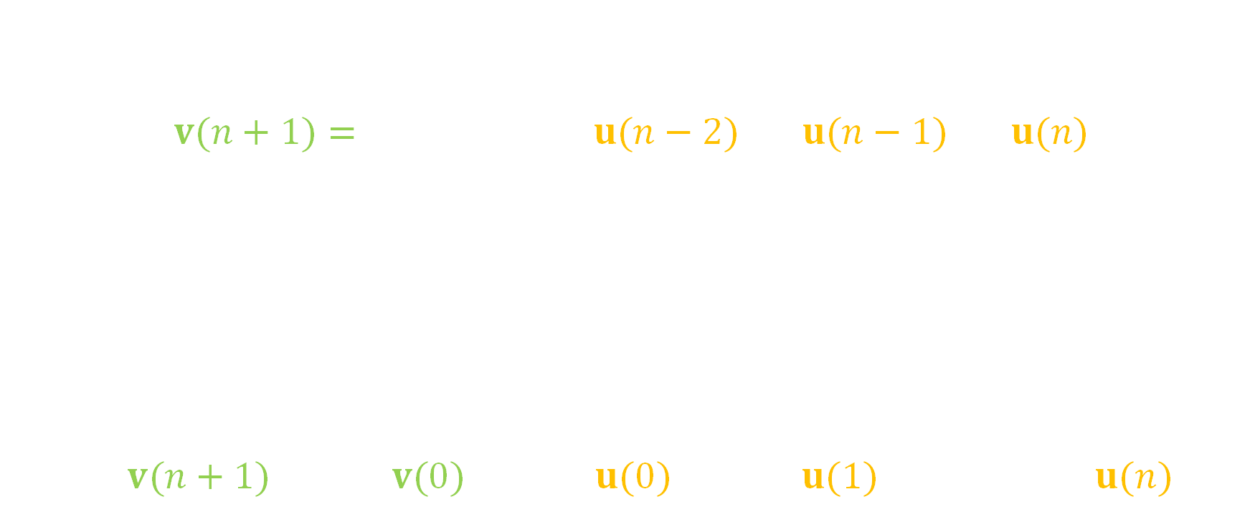
Parallel implementation
Non-parallelisable and sequential ☹
$$v(n+1)=A\left(A\left(A\left(…\right)+u(n−2)\right)+u(n−1)\right)+u(n)$$
Parallelisable ☺
Parallel associative scan
$$\left(U,x\right)⊕\left(V,z\right)↦\left(VU,Vx+z\right)$$
$$\left(0,v(n+1)\right)=\left(0,v(0)\right)⊕\left(A,u(0)\right)⊕\left(A,u(1)\right)⊕⋯⊕\left(A,u(n)\right)$$
Notes:
Ok, good! Now we remove the overheads from the PyTorch framework. Is there anything we can do to the kernel? Yes! Let’s look at the recursion again. You might think it’s a recursive definition, so it can only be computed sequentially.
However, if we can re-express the computation into an accumulation over a sequence using an associative operator, then the order of computing the sequence element doesn’t matter.
We can compute partial results in parallel and combine them later. There’s an algorithm called parallel associative scan that does precisely that. In Philtorch, we use the scan implementation in the CUDA toolkit, which is highly optimised.

Slide 17
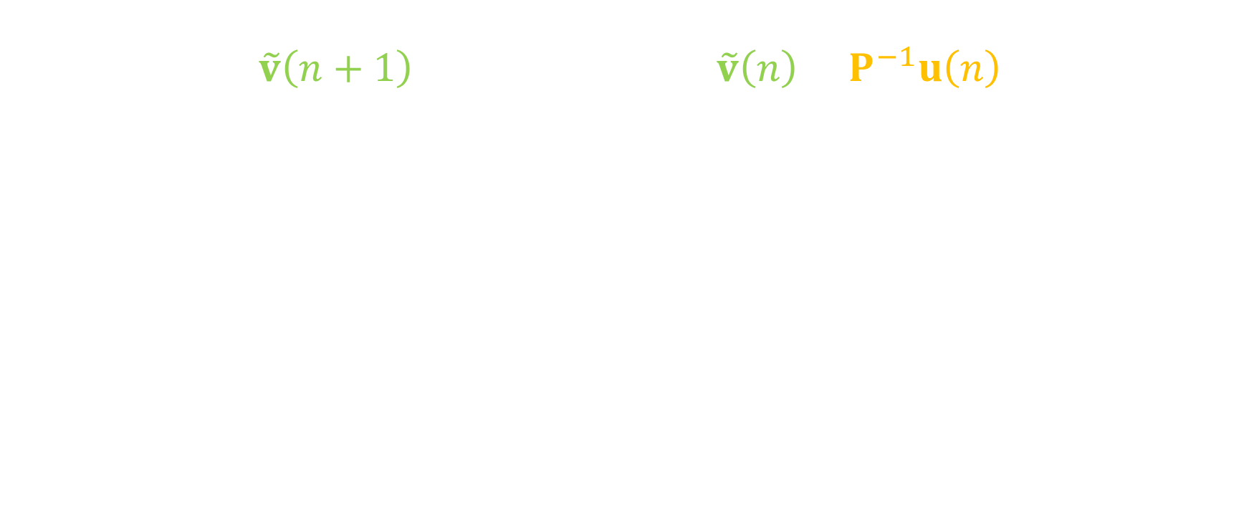
Diagonalised SSM
$$\tilde{v}\left(n+1\right)=\left[\begin{matrix}λ_{1} & ⋯ & 0 \\ ⋮ & ⋱ & ⋮ \\ 0 & ⋯ & λ_{M}\end{matrix}\right]\tilde{v}\left(n\right)+P^{−1}u\left(n\right)$$
$$v\left(n\right)=P\tilde{v}\left(n\right), A=P\left[\begin{matrix}λ_{1} & ⋯ & 0 \\ ⋮ & ⋱ & ⋮ \\ 0 & ⋯ & λ_{M}\end{matrix}\right]P^{−1}$$
Matrix multiplication → elementwise multiplications
Equals to M first-order filters run in parallel
Notes:
Moreover, there’s one more thing we can leverage. If the A matrix can be decomposed into a diagonal matrix and an invertible matrix, which means this filter has distinct poles, we can reformulate the recursion into this new recursion, where the A matrix is replaced with the diagonal matrix. Thus, matrix multiplications are replaced by simple element-wise multiplications, which can save significant computation when the filter order is high. This new form also corresponds to filtering the input signal with multiple first-order filters in parallel, then summing their outputs.

Slide 18
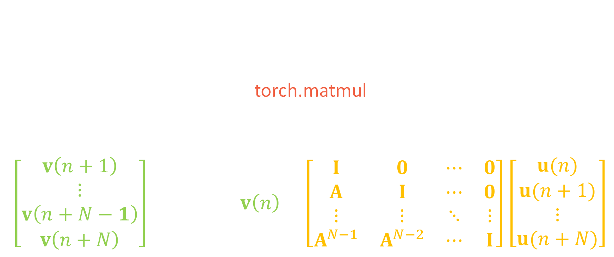
Alternative Solution w/o Custom Ops
Sample unrolling
  Andres Viso, “Implementing real-time Parallel DSP on GPUs”, ADC 2022.
Pros: very efficient using torch.matmul
Cons: still sequential
$$\left[\begin{matrix}v\left(n+1\right) \\ ⋮ \\ v\left(n+N−1\right) \\ v\left(n+N\right)\end{matrix}\right]=\left[\begin{matrix}A \\ ⋮ \\ A^{N−1} \\ A^{N}\end{matrix}\right]v\left(n\right)+\left[\begin{matrix}I & 0 & ⋯ & 0 \\ A & I & ⋯ & 0 \\ ⋮ & ⋮ & ⋱ & ⋮ \\ A^{N−1} & A^{N−2} & ⋯ & I\end{matrix}\right]\left[\begin{matrix}u(n) \\ u(n+1) \\ ⋮ \\ u(n+N)\end{matrix}\right]$$
Notes:
Lastly, I want to present an alternative method that doesn’t involve custom kernels and instead uses PyTorch's Python API. It’s based on a talk by Andres from GPU Audio in ADC 2022. It’s called sample unrolling. The idea is that we can augment the matrix in the recursion to predict multiple steps at once; thus, we reduce the number of recursions and can leverage PyTorch's efficient matrix multiplication. The problem is that the algorithm is still sequential. It’s an online algorithm, but we’re interested in offline acceleration.
If we remove the requirement that each sample has to be processed sequentially, can we make it faster?

Slide 19
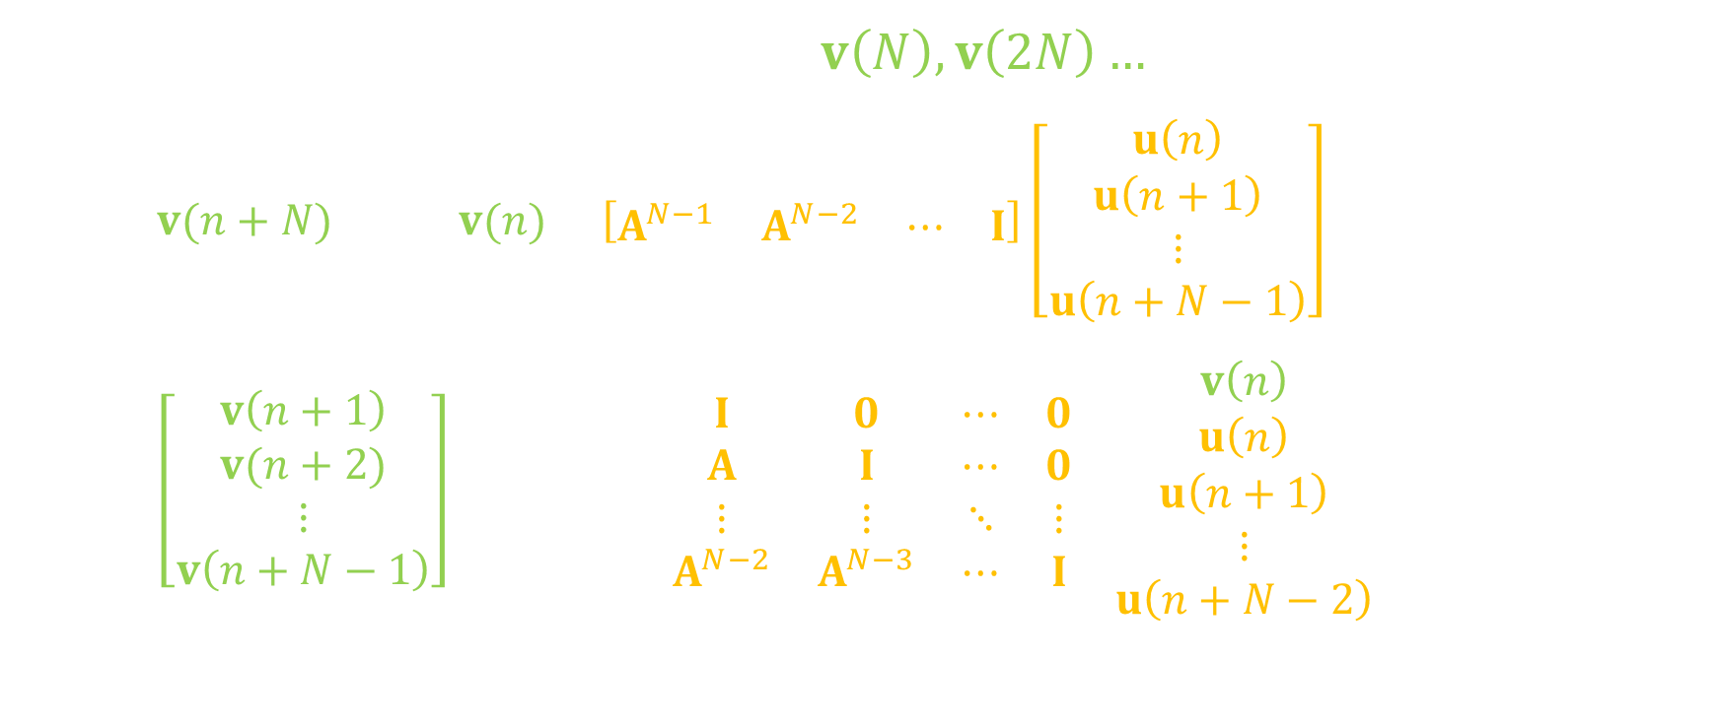
Extend to Offline Filtering
Compute by hopping through $v\left(N\right),v\left(2N\right)…$
  $v(n+N) =A^{N}v(n)+\left[\begin{matrix}A^{N−1} & A^{N−2} & ⋯ & I\end{matrix}\right]\left[\begin{matrix}u\left(n\right) \\ u\left(n+1\right) \\ ⋮ \\ u\left(n+N−1\right)\end{matrix}\right]$
Compute the rest in parallel:
  $\left[\begin{matrix}v\left(n+1\right) \\ v(n+2) \\ ⋮ \\ v\left(n+N−1\right)\end{matrix}\right]=\left[\begin{matrix}A & I & 0 & ⋯ & 0 \\ A^{2} & A & I & ⋯ & 0 \\ ⋮ & ⋮ & ⋮ & ⋱ & ⋮ \\ A^{N−1} & A^{N−2} & A^{N−3} & ⋯ & I\end{matrix}\right]\left[\begin{matrix}v\left(n\right) \\ u\left(n\right) \\ u\left(n+1\right) \\ ⋮ \\ u\left(n+N−2\right)\end{matrix}\right]$
Note: We can apply step 1 repeatedly (it’s a recursive definition).
Notes:
The offline version of sample unrolling is simply dividing the previous equation into two steps. In the first step, instead of computing all the outputs in one chunk, we just compute the last output of the chunk, which is enough to calculate the next chunk. In this way, the matrix sizes in the recursion are smaller and faster to compute. How about the rest of the outputs? Once step one is complete, we can compute the remaining steps in parallel using the subsampled output we obtained. BTW, you should notice something. What is step one? It’s a recursive filter. Can we solve it using the same process? Sure, we can! This algorithm can be recursively applied for optimal speedup.

Slide 20
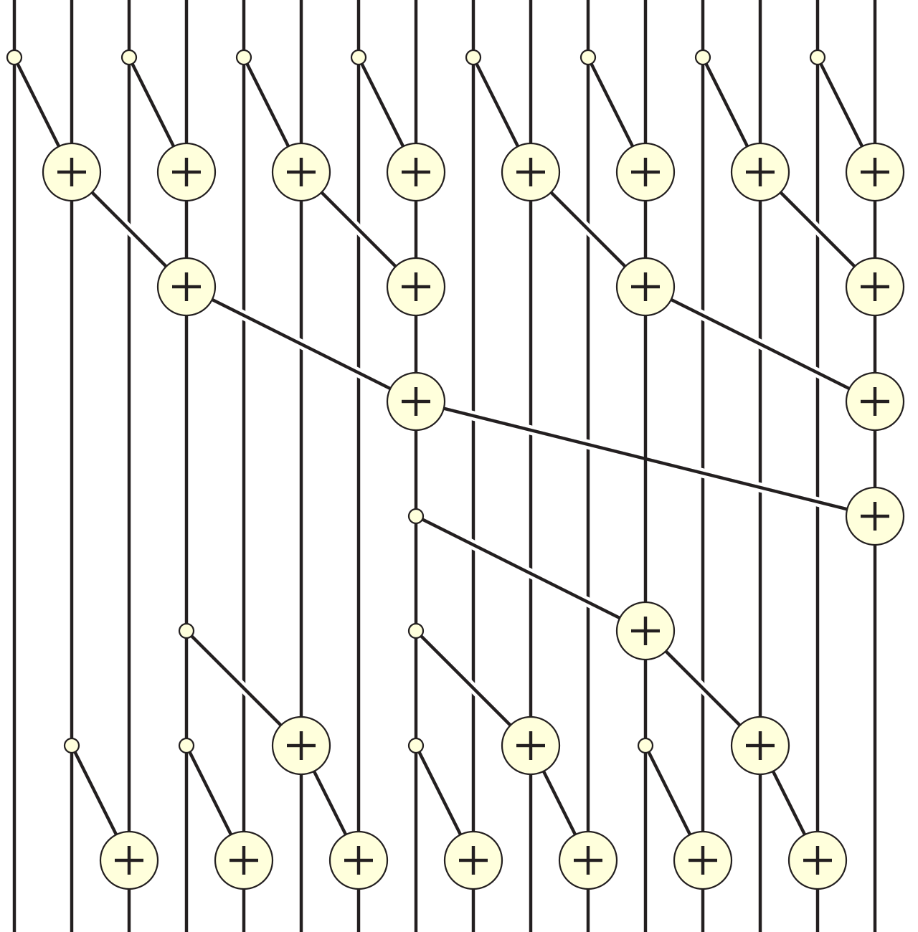

Assemble Parallel Associative Scan
u(0), u(1),…,u(15)
Step 1 (4 times, N=2)
$$O\left(n\right)⟶O\left(\log\left(n\right)\right)$$
Step 2 (4 times)
Image source: https://en.wikipedia.org/wiki/Prefix_sum
Notes:
The recursive algorithm I just presented actually is the parallel associative scan algorithm. Here’s an example diagram I copied from Wikipedia just to give you an idea of how it actually works.
We can interpret this diagram as a sequence with 16 elements, and we hop every two samples in step one.
You see that, assuming we have enough parallel processors, the number of computational steps becomes proportional to the sequence length logarithmically instead of linearly. So, the longer the sequence is, the more speedup you can get. That’s the power of parallel associative scan.

Slide 21
Take away
> 1000 small kernels → write custom extension
Associative? → parallelisable!
You can do both
Notes:
These are all the tricks I used.

Slide 22
Benchmarks (M=2, forward)
Intel i7 7700K, 1 thread
RTX 5060 Ti
Notes:
To compare the speed of Philtorch, I did a very simple benchmark. The methods I compared are the naive for-loop method, the optimised SSM kernel, diagonalised SSM, and sample unrolling. I used a second-order filter, the fundamental building block of any higher-order filter. I benchmarked their runtime on an Intel i7 and an RTX 5060 Ti. You can see that using a custom kernel, the SSM is already more than 100 times faster than the naive one. On the GPU, this difference is bigger, since we can leverage super-optimised parallel scan. Sample unrolling is around 10 times slower on the GPU, but it’s also super fast.

Slide 23
Benchmarks (M=2, backpropagation)
Intel i7 7700K, 1 thread
RTX 5060 Ti
Notes:
Now, let’s look at the speed of gradient computation. The naive method is even slower and went off the chart, while all other methods perform comparably fast. On the GPU, the fastest method is SSM, but I expect that when the filter order is higher, the diagonal method will outperform it.

Slide 24
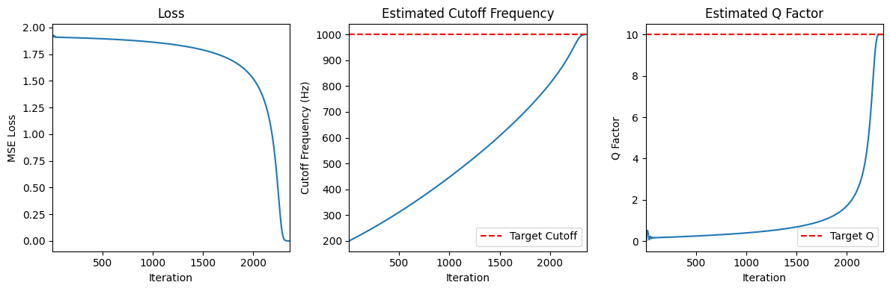

Tips For Using PhilTorch
PhilTorch has fast kernel for M = 1 or 2.
  Sample unrolling for M > 2.
Decompose your filter into second-order sections (SOS)
  Cascaded SOS 👍
  Parallel SOS 👍 👍
Check out the example!
Estimate lowpass filter
Notes:
We have reached the end of this talk. Finally, some tips for using Philtorch. Currently, it has optimised kernels for first and second-order filters. Fast kernels for higher filters are on the way. I suggest decomposing your filters into multiple second-order filters, either cascaded or in parallel, and accelerating each small filter using philtorch.

Slide 25
References
https://ccrma.stanford.edu/~jos/filters/
https://en.wikipedia.org/wiki/Prefix_sum
https://youtu.be/UmYnoFo0Bb8
Engel, Jesse, et al. "DDSP: Differentiable Digital Signal Processing." ICLR 2020.
Notes:
And here are the references. That’s all. Thank you for listening!

Slide 26
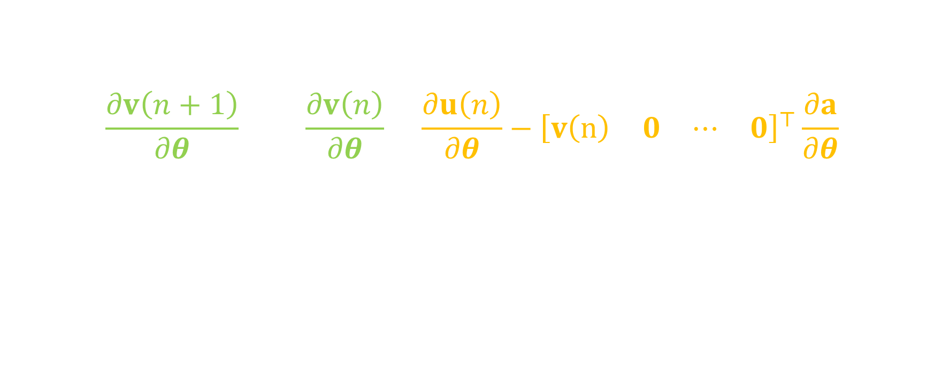
Forward-mode AD
… uses the same recurrence.
$$\frac{∂v\left(n+1\right)}{∂θ}=A\frac{∂v\left(n\right)}{∂θ}+\frac{∂u\left(n\right)}{∂θ}−{\left[\begin{matrix}v\left(n\right) & 0 & ⋯ & 0\end{matrix}\right]}^{⊤}\frac{∂a}{∂θ}$$
Beneficial for higher order gradients.

Slide 27
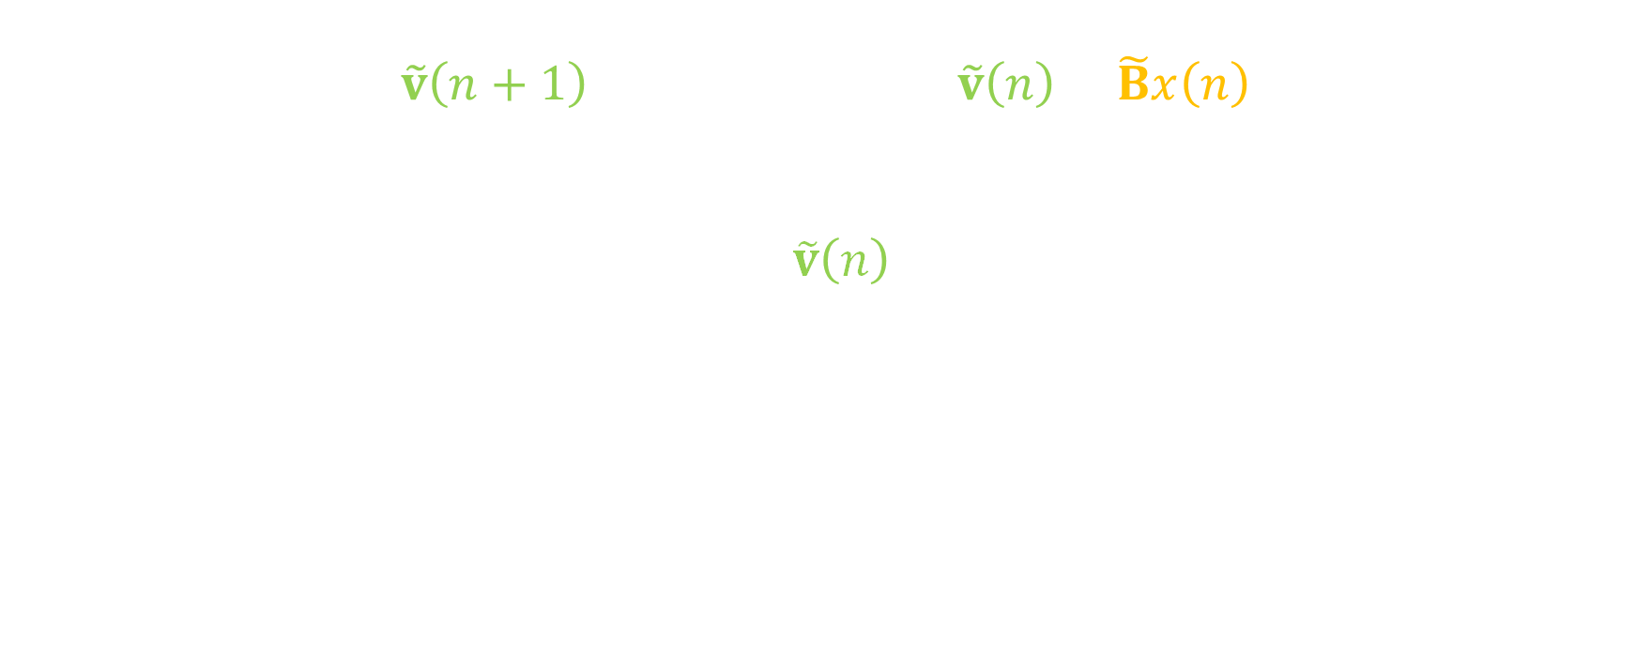
Partial Fraction Expansion (PFE)
$$\tilde{v}\left(n+1\right)=\left[\begin{matrix}λ_{1} & ⋯ & 0 \\ ⋮ & ⋱ & ⋮ \\ 0 & ⋯ & λ_{M}\end{matrix}\right]\tilde{v}\left(n\right)+\tilde{B}x\left(n\right)$$
$$y\left(n\right)={\tilde{C}}^{⊤}\tilde{v}\left(n\right)+Dx\left(n\right)$$
Diagonalised state-space = M first-order filters run in parallel
$$H\left(z\right)={D+z}^{−1}\sum_{i=1}^{M}{\frac{{\tilde{c}}_{i}{\tilde{b}}_{i}}{1−λ_{i}z^{−1}}}$$

