Slide 1


Slide 2
Housekeeping
Audience
Beginners, Intermediates… Everyone?
Intent
How to take the DFT from theory to practice… from the perspective of someone who doesn’t have it all figured out (Me)
“Don’t deny yourself the pleasure of trying to synthesize the ideas as we go along…
there is nothing so pleasurable as thinking about something you already know”
- Brad Osgood

Slide 3
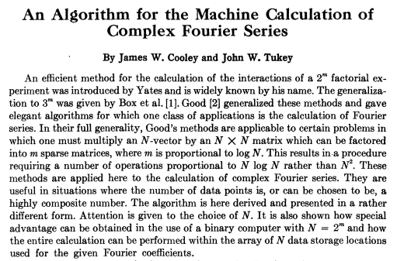
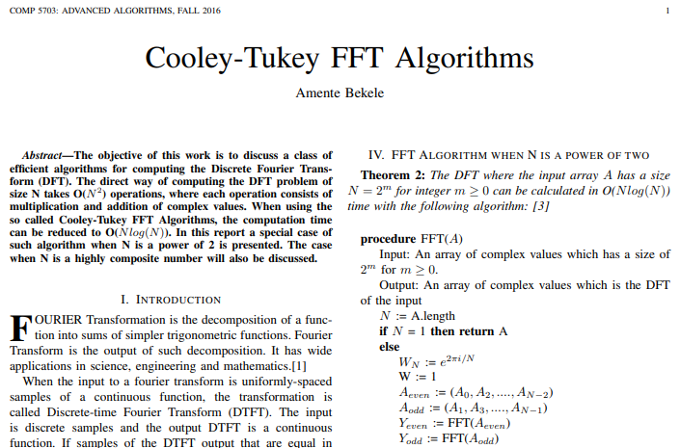
Call of Adventure
Can you write us an FFT from scratch?
NO
https://web.stanford.edu/class/cme324/classics/cooley-tukey.pdf
https://people.scs.carleton.ca/~maheshwa/courses/5703COMP/16Fall/FFT_Report.pdf

Slide 4
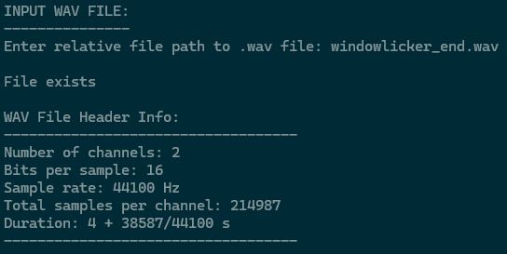
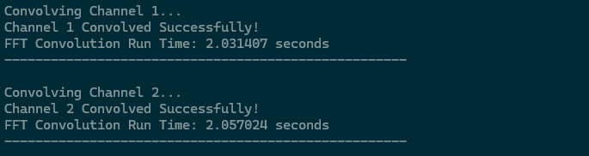
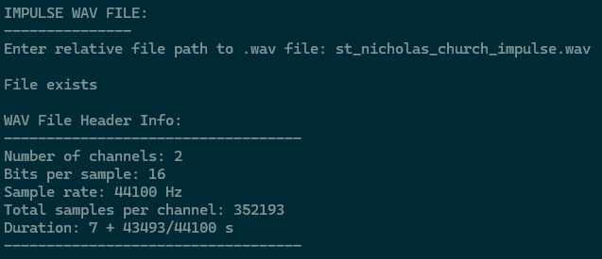
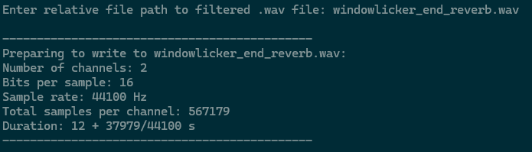
Call of Adventure
Convolutional Reverberation

Slide 5
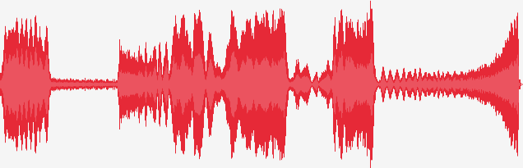
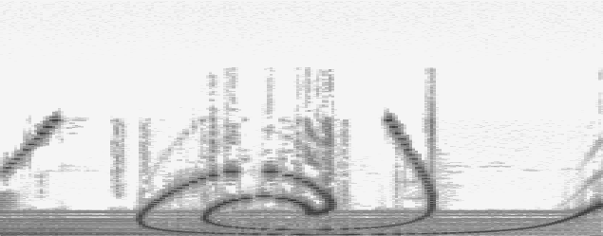
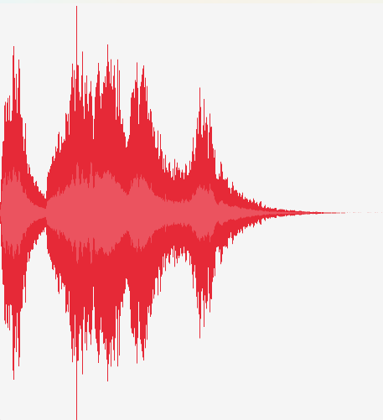

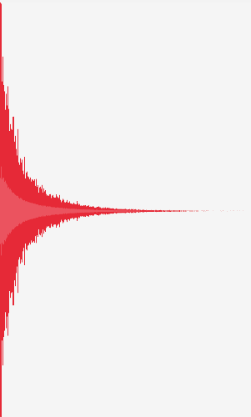

The Gap
How does the Fourier Transform work?
How do you use Fourier Transforms on real time signals?
How do you add effects in the frequency domain?
FFT
IFFT
FFT

Slide 6
How does the Fourier Transform work?

Slide 7
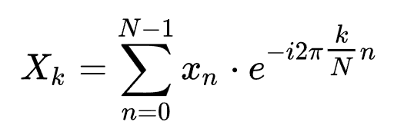
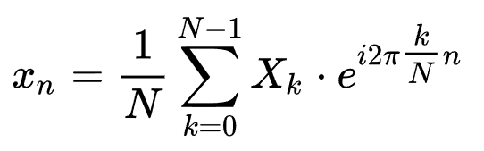
Discrete Fourier Transform
Take 1
DFT
Inverse DFT

Slide 8
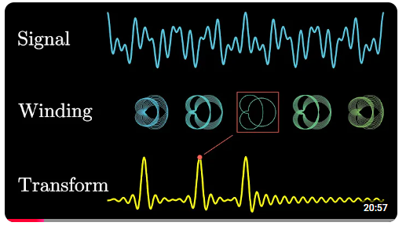
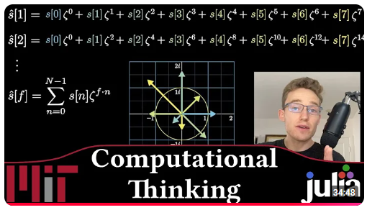
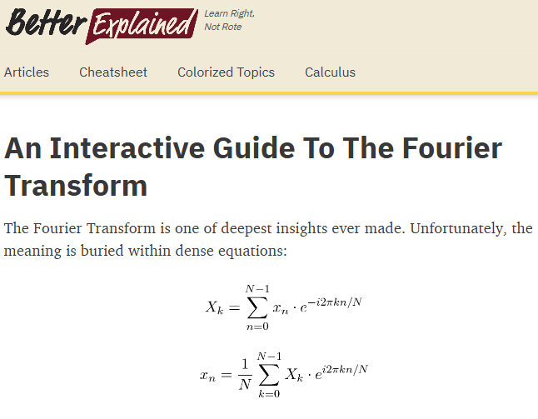
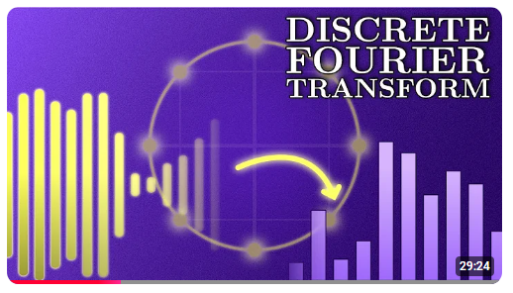
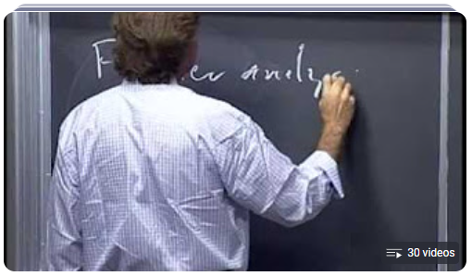
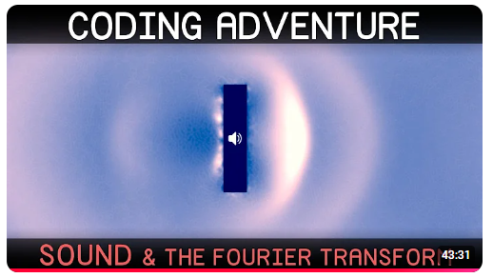
Discrete Fourier Transform
Take 2
...
https://betterexplained.com/articles/an-interactive-guide-to-the-fourier-transform/

Slide 9
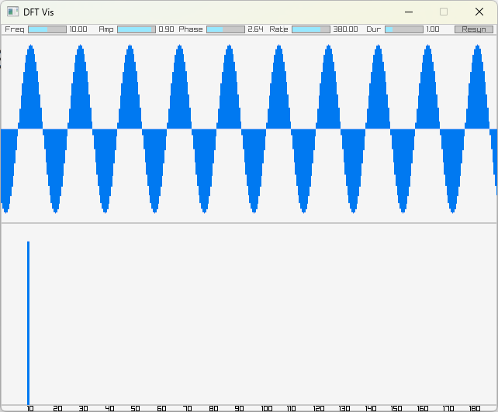
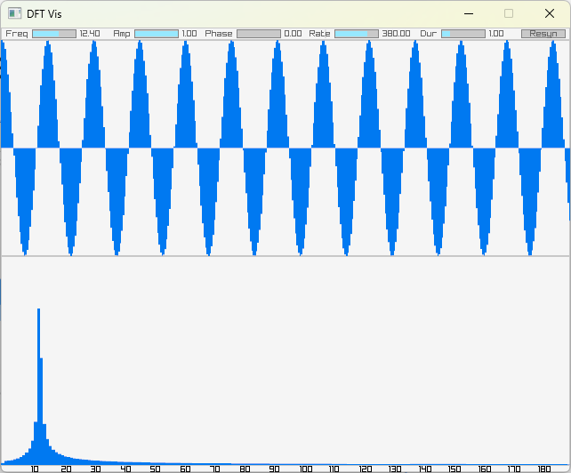
Discrete Fourier Transform
Take 3

Slide 10
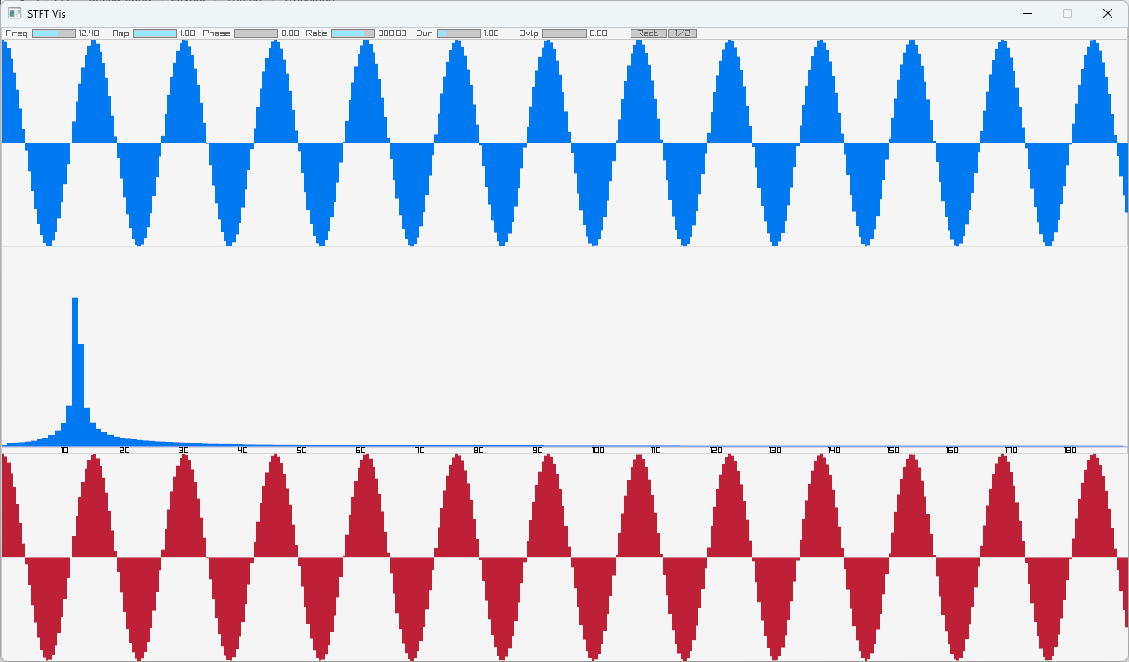
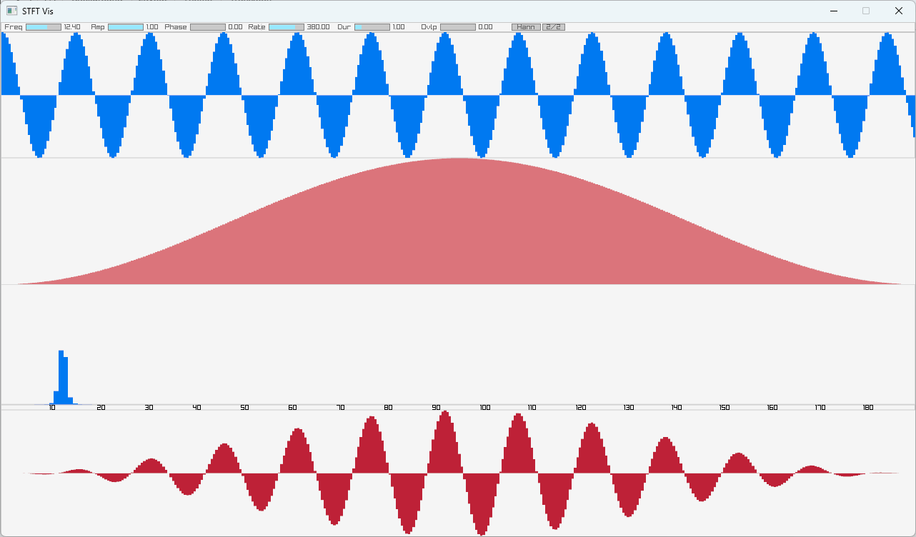
Discrete Fourier Transform
Take 3.5

Slide 11
How do you use Fourier Transforms on real-time signals?

Slide 12
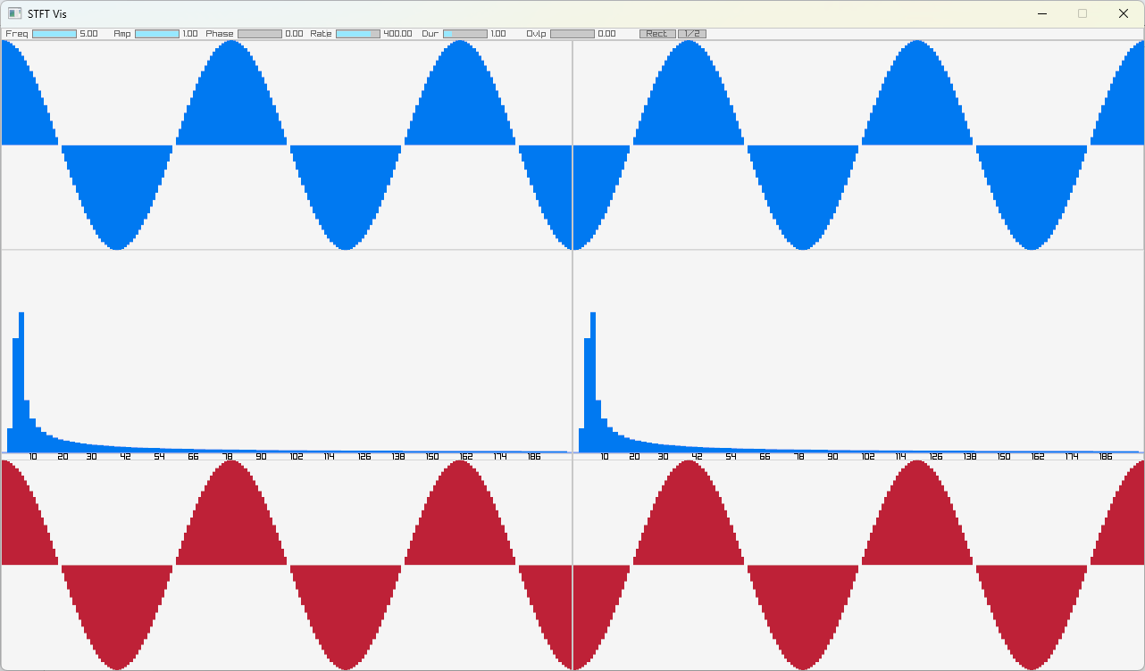
Short Time Fourier Transform
Introduction

Slide 13
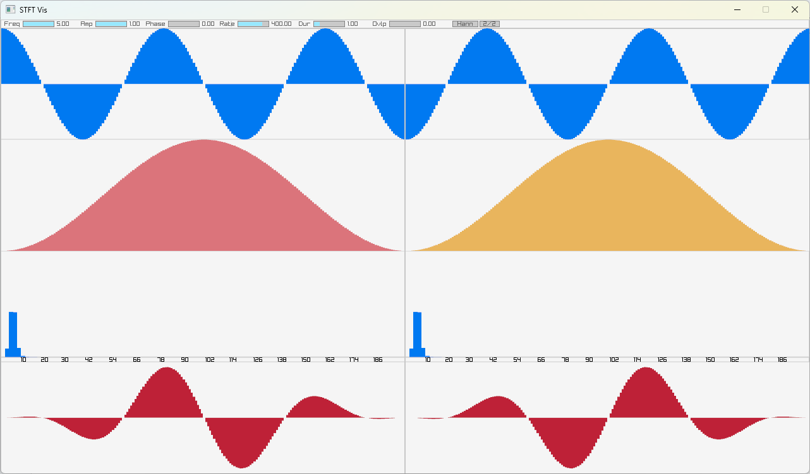
Short Time Fourier Transform
Windowing

Slide 14
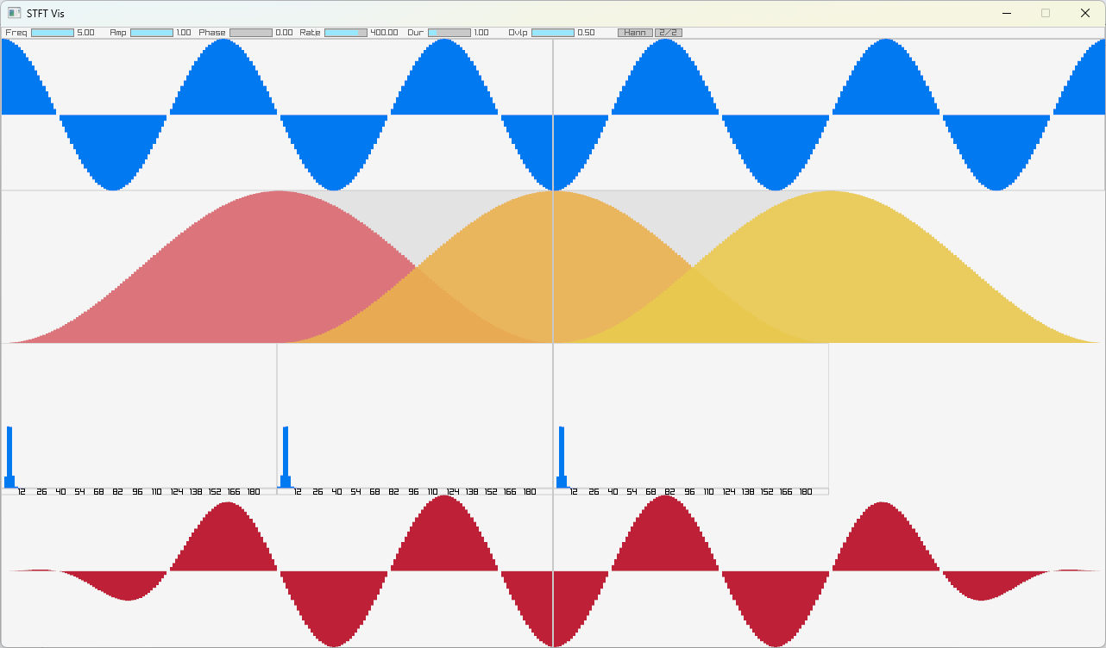
Short Time Fourier Transform
Overlap
Window Length: 100
Hop Length: 50

Slide 15
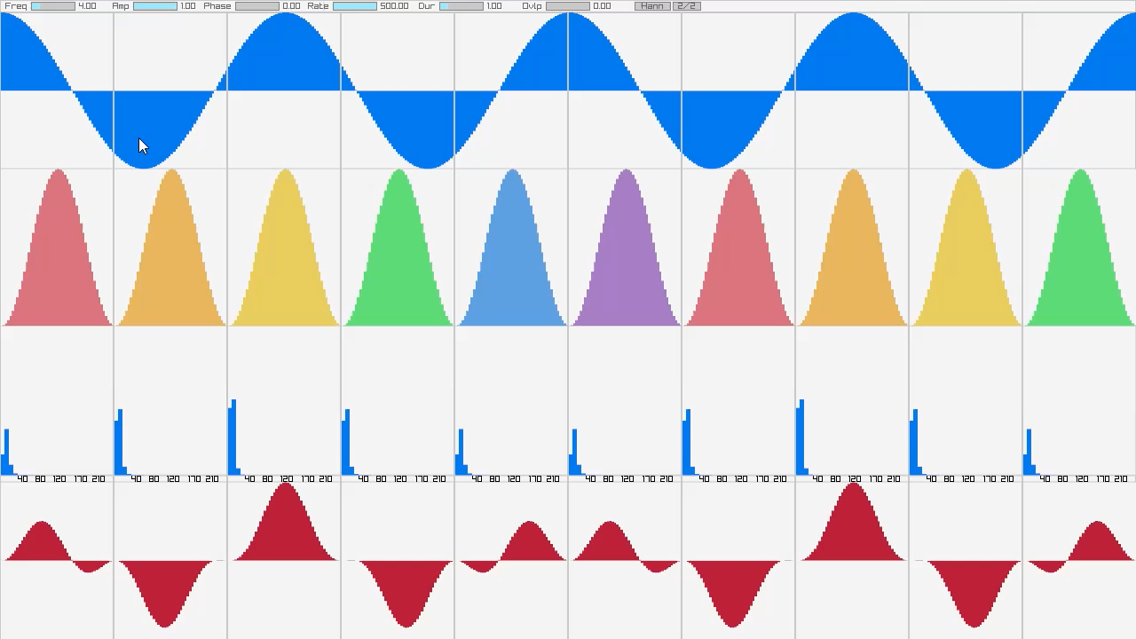
Short Time Fourier Transform
Demonstration

Slide 16
How do you add effects in the frequency-domain?

Slide 17
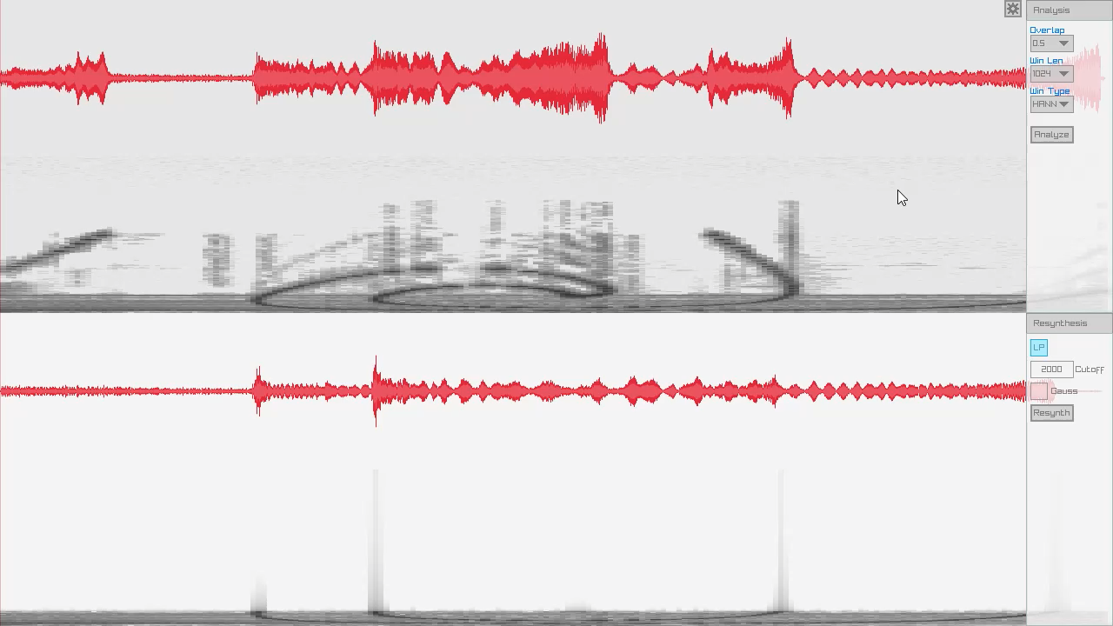
Short Time Fourier Transform
Naive Low-pass

Slide 18
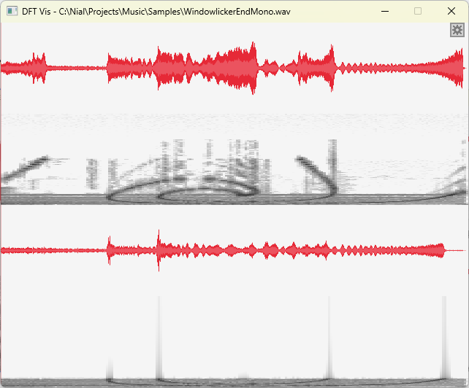
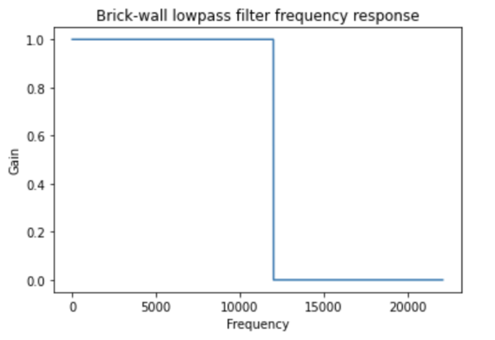
Short Time Fourier Transform
Naive Low-pass
https://cycling74.com/tutorials/demystifying-digital-filters-part-2

Slide 19
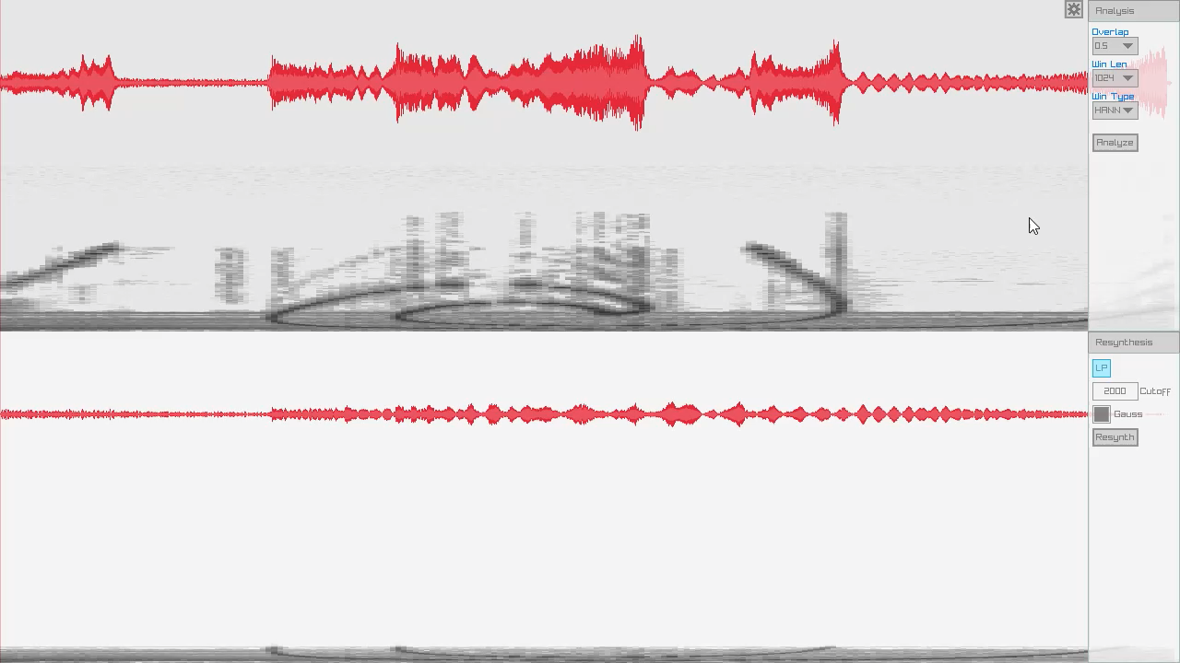
Short Time Fourier Transform
Gaussian Low-pass

Slide 20
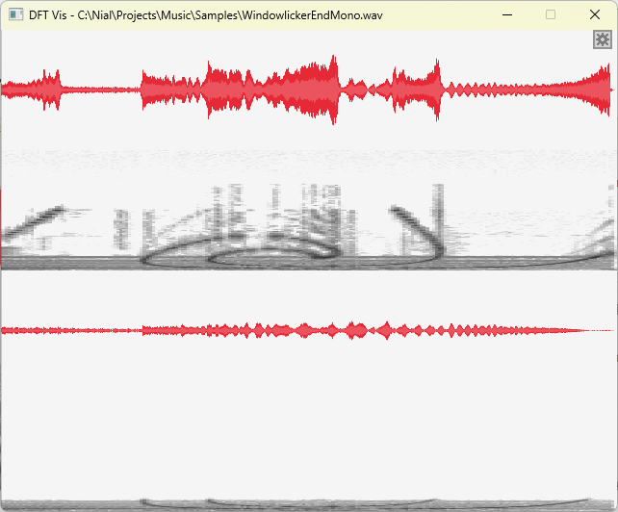
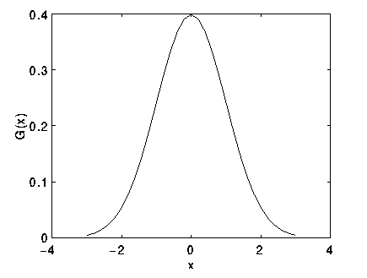
Short Time Fourier Transform
Gaussian Low-pass
https://homepages.inf.ed.ac.uk/rbf/HIPR2/gsmooth.htm

Slide 21
Conclusion
“Discrete Fourier Transforms are hard.”
Me
“Above all else show the data.”
Edward Tufte
“Stop optimizing things…
and you might actually learn something”
David Zicarelli

