Slide 1

aq

Slide 2
Goals of this talk
Explore some of the JavaScript engines which are available
Allow you to make a more informed choice of which to use
Skip some of the leg work for options that aren’t relevant to your use case

Slide 3
About Me
10+ years of JUCE and C++
A bit of everything in the audio space
From build systems to distribution and everything in between

Slide 4
Why I looked at these engines
Building a UI framework allowing off the shelf
JS frameworks to be used with a JUCE based UI

Slide 5
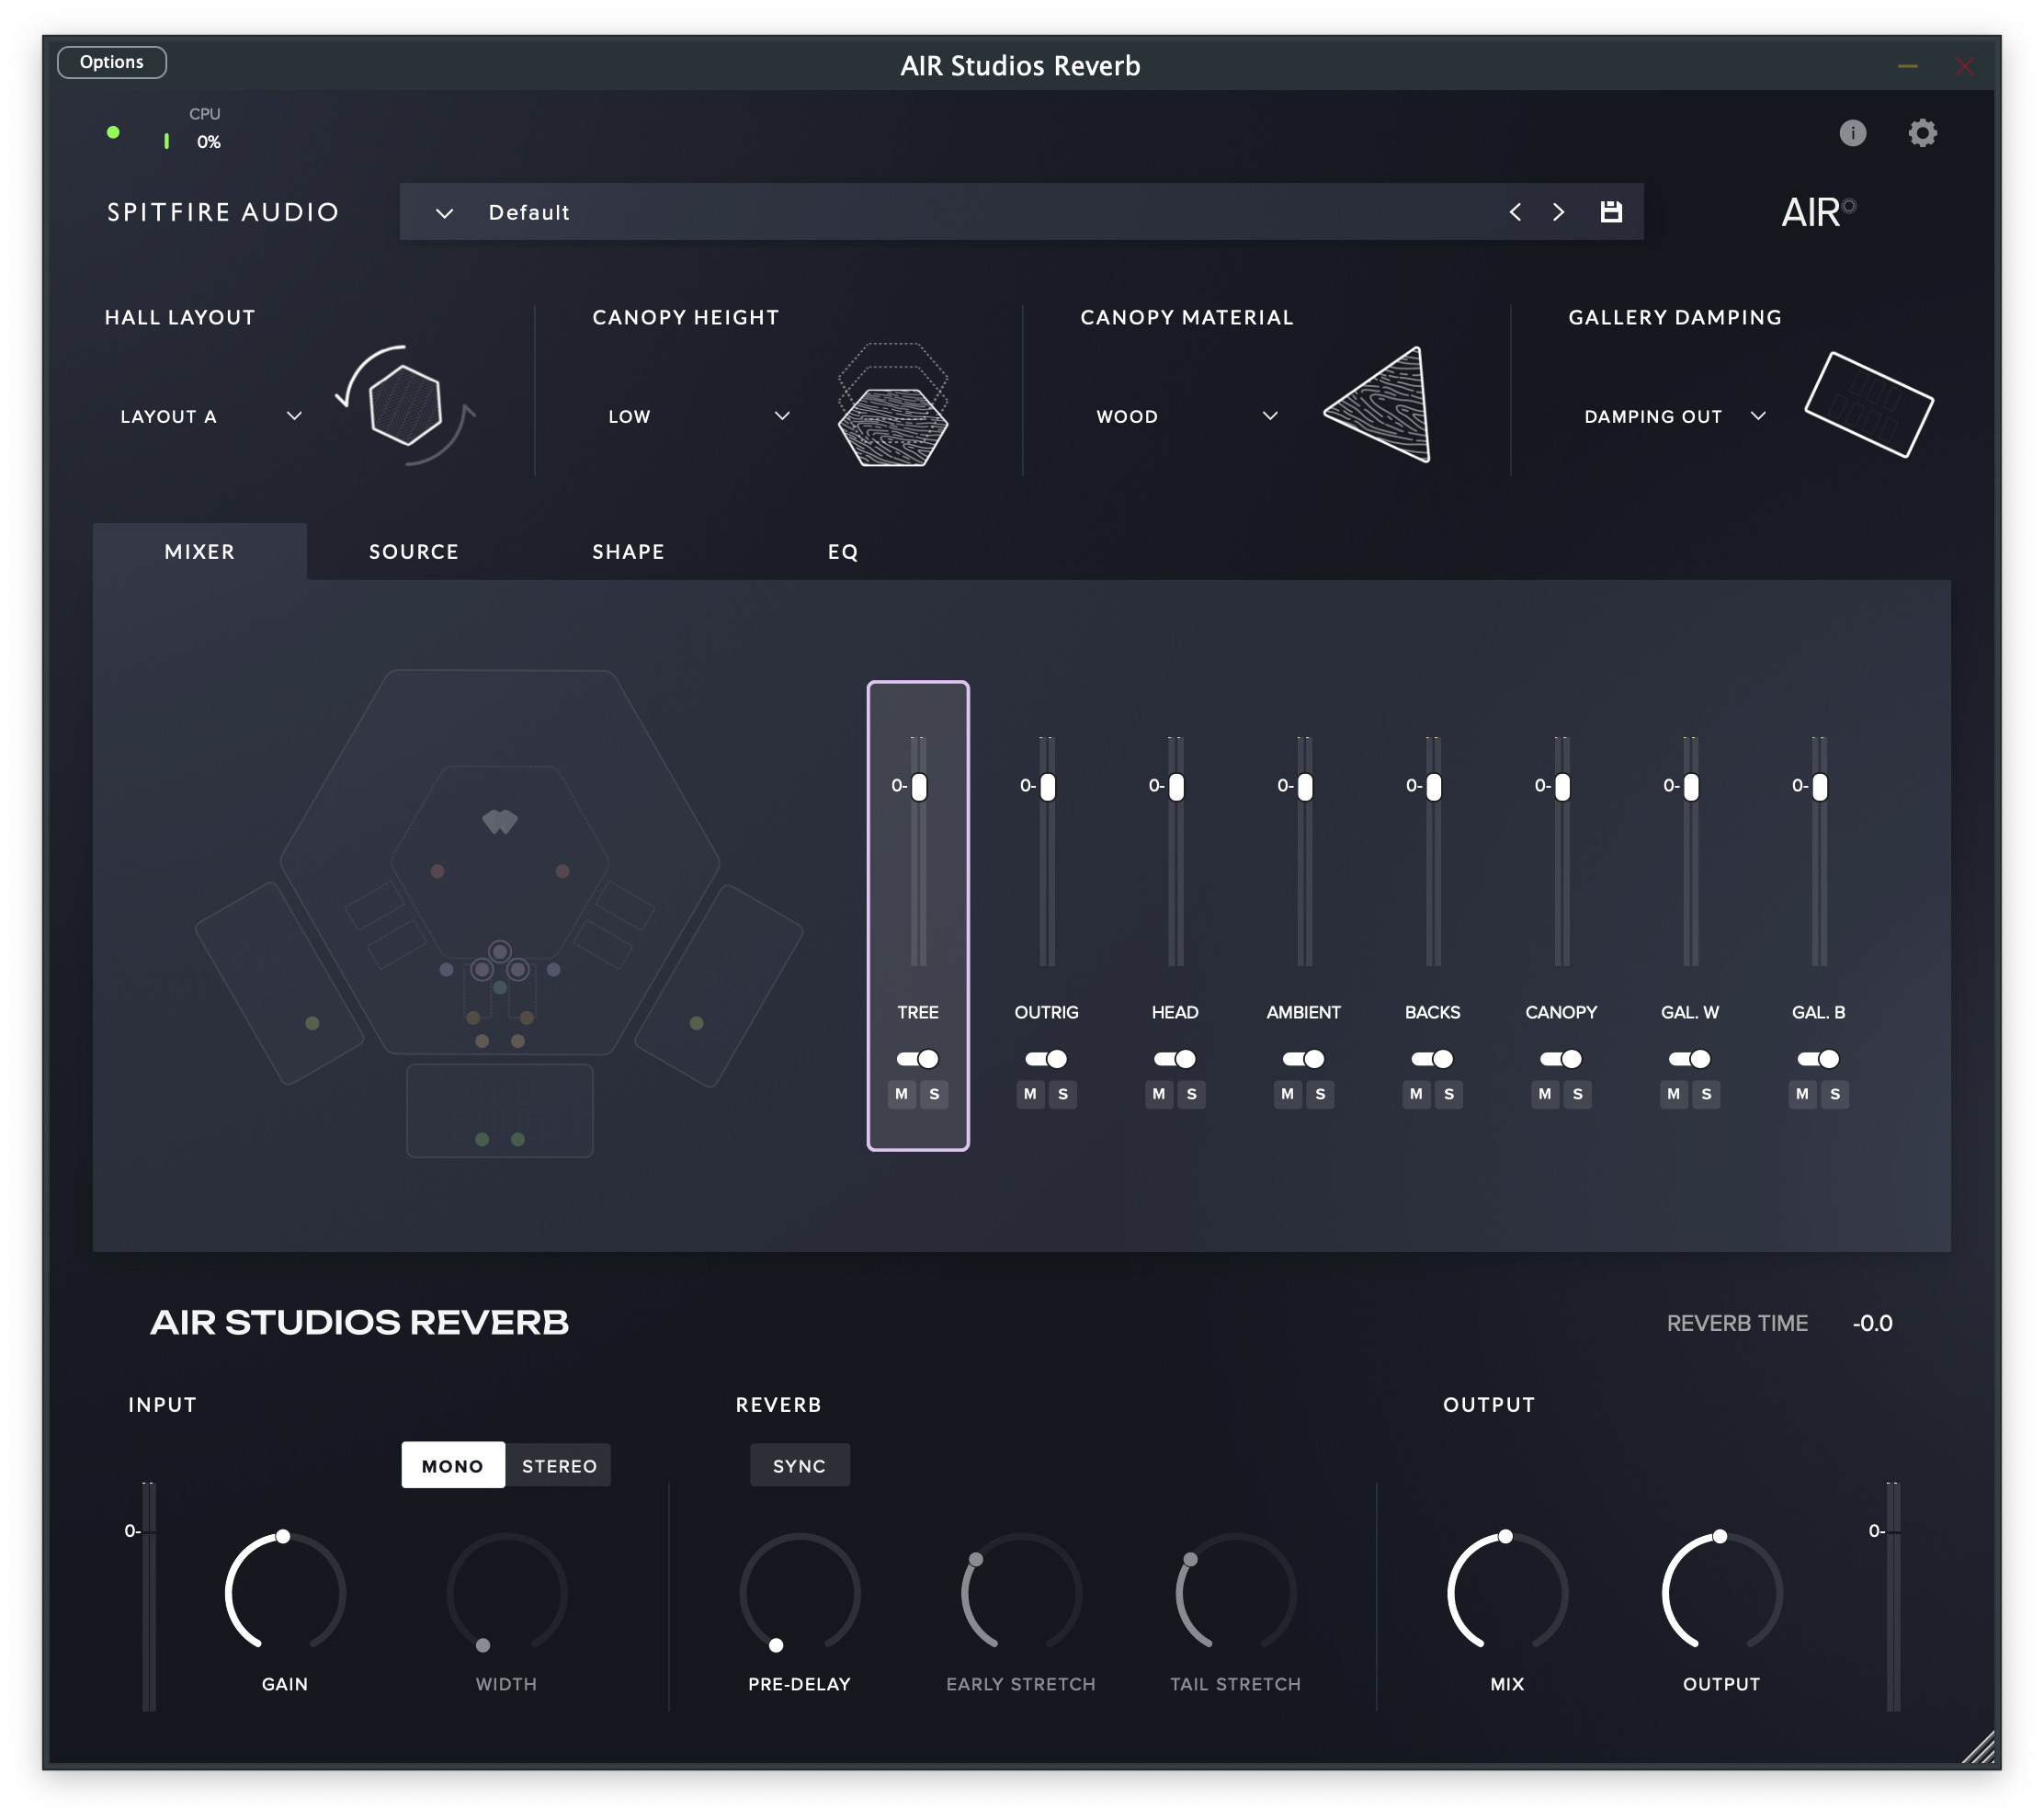
SCREENSHOT OF AIR REVERB

Slide 6
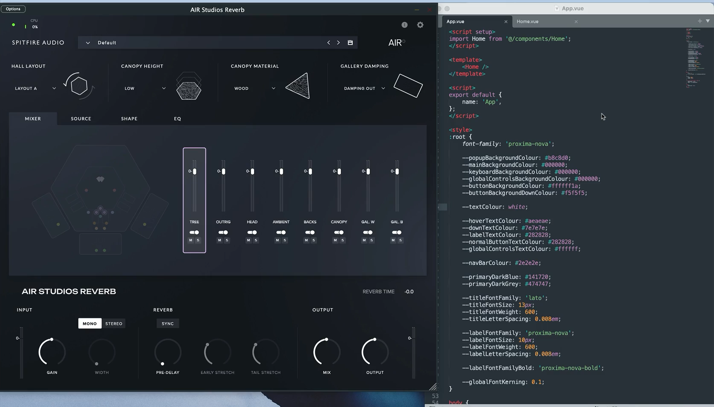

Slide 7
What we won’t be doing today…
UI - HTML/CSS
Web Views
Saying you must use Engine X

Slide 8
Why you might be looking at these engines
End user scripting
Tools for creating content for your products
Experimenting without requiring a rebuild

Slide 9
Why JavaScript specifically
Popular

Slide 10
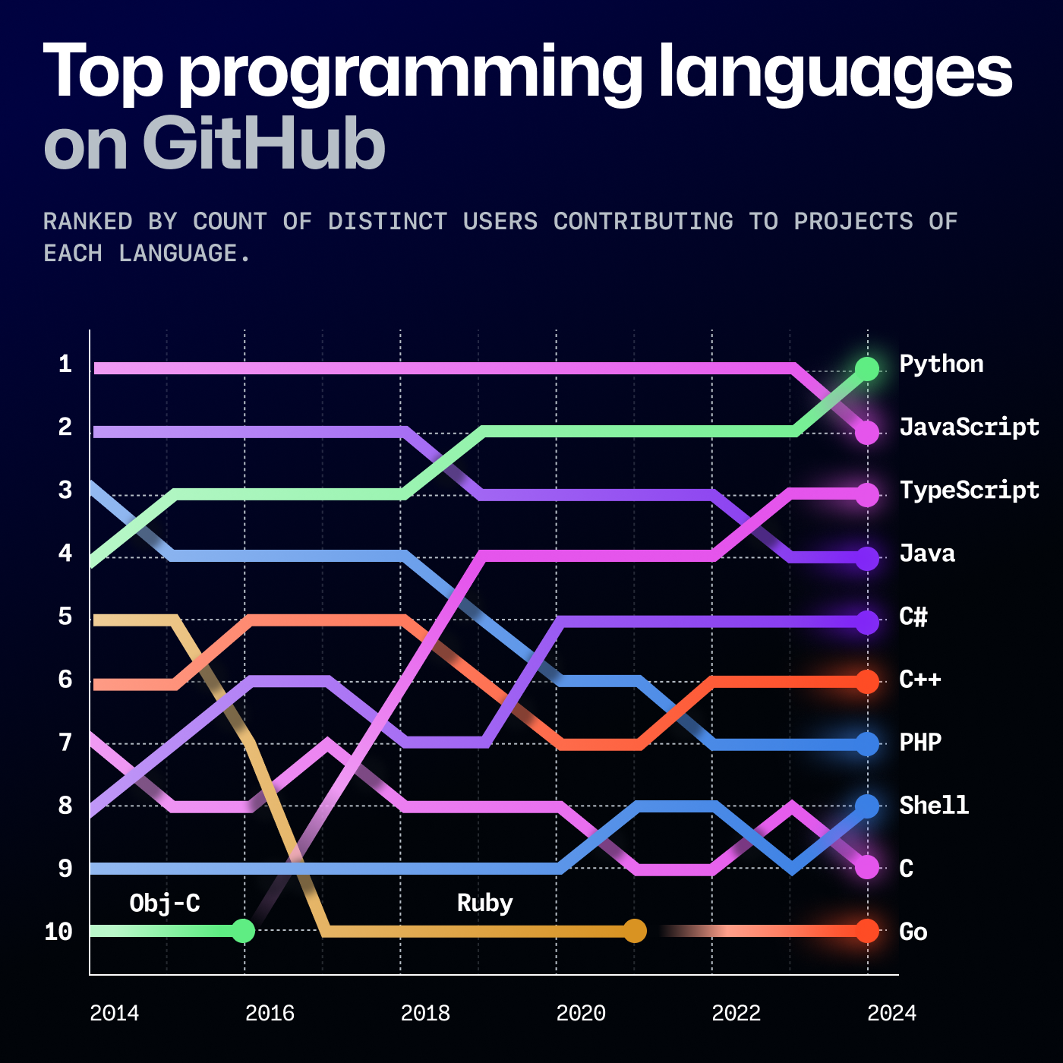
Why JavaScript specifically

Slide 11
Why JavaScript specifically
Lots of resources online
Potentially the most familiar to customers
NPM Packages

Slide 12
Why JavaScript specifically
Lots of resources online
Potentially the most familiar to customers
NPM Packages
Very familiar syntax
Lots of engine options of differing sizes

Slide 13
What we’ll be focusing on…
Characteristics of each engine
C++ Interop
Building with CMake
Desktop Cross Platform concerns and gotchas

Slide 14
Supporting Repo
https://github.com/andyjtb/js-engine-emporium

Slide 15
Factors to Consider
Binary Size
Startup time
Test262 Conformance
Ease of integration (both build and code)

Slide 16
ECMA Conformance
https://compat-table.github.io/compat-table/es6/
And
https://test262.fyi/

Slide 17
The Big Hitters

Slide 18
V8
JavaScriptCore
Made for Chrome
Very Fast - JIT-ed
Fairly large
Builds with GN - But CMake projects exist
Fairly Debuggable
Made for WebKit (Safari)
Very Fast - JIT-ed
Fairly large
Builds with CMake - Clang on Windows for JIT
Debuggable in Safari on Mac, hard on Windows

Slide 19
Small and embeddable

Slide 20
Duktape
JerryScript
Very small
All C - DukGlue exists
Somewhat old – All ECMA 5.1 (2011), some 6 and 7
Somewhat slow
Potentially some crossover with Escargot
All in C
Code doesn’t look all that similar
ECMAScript 5.1

Slide 21
QuickJS
Very small
All C – Lots of C++ wrappers
Quick for interpreted - Not JIT but Bytecode
Debuggable with modifications
Available in JUCE 8 onwards

Slide 22
The Experimental

Slide 23
Hermes
Made by Facebook for React Native
Recently added JIT
Small Footprint – 4mb
Static Hermes

Slide 24
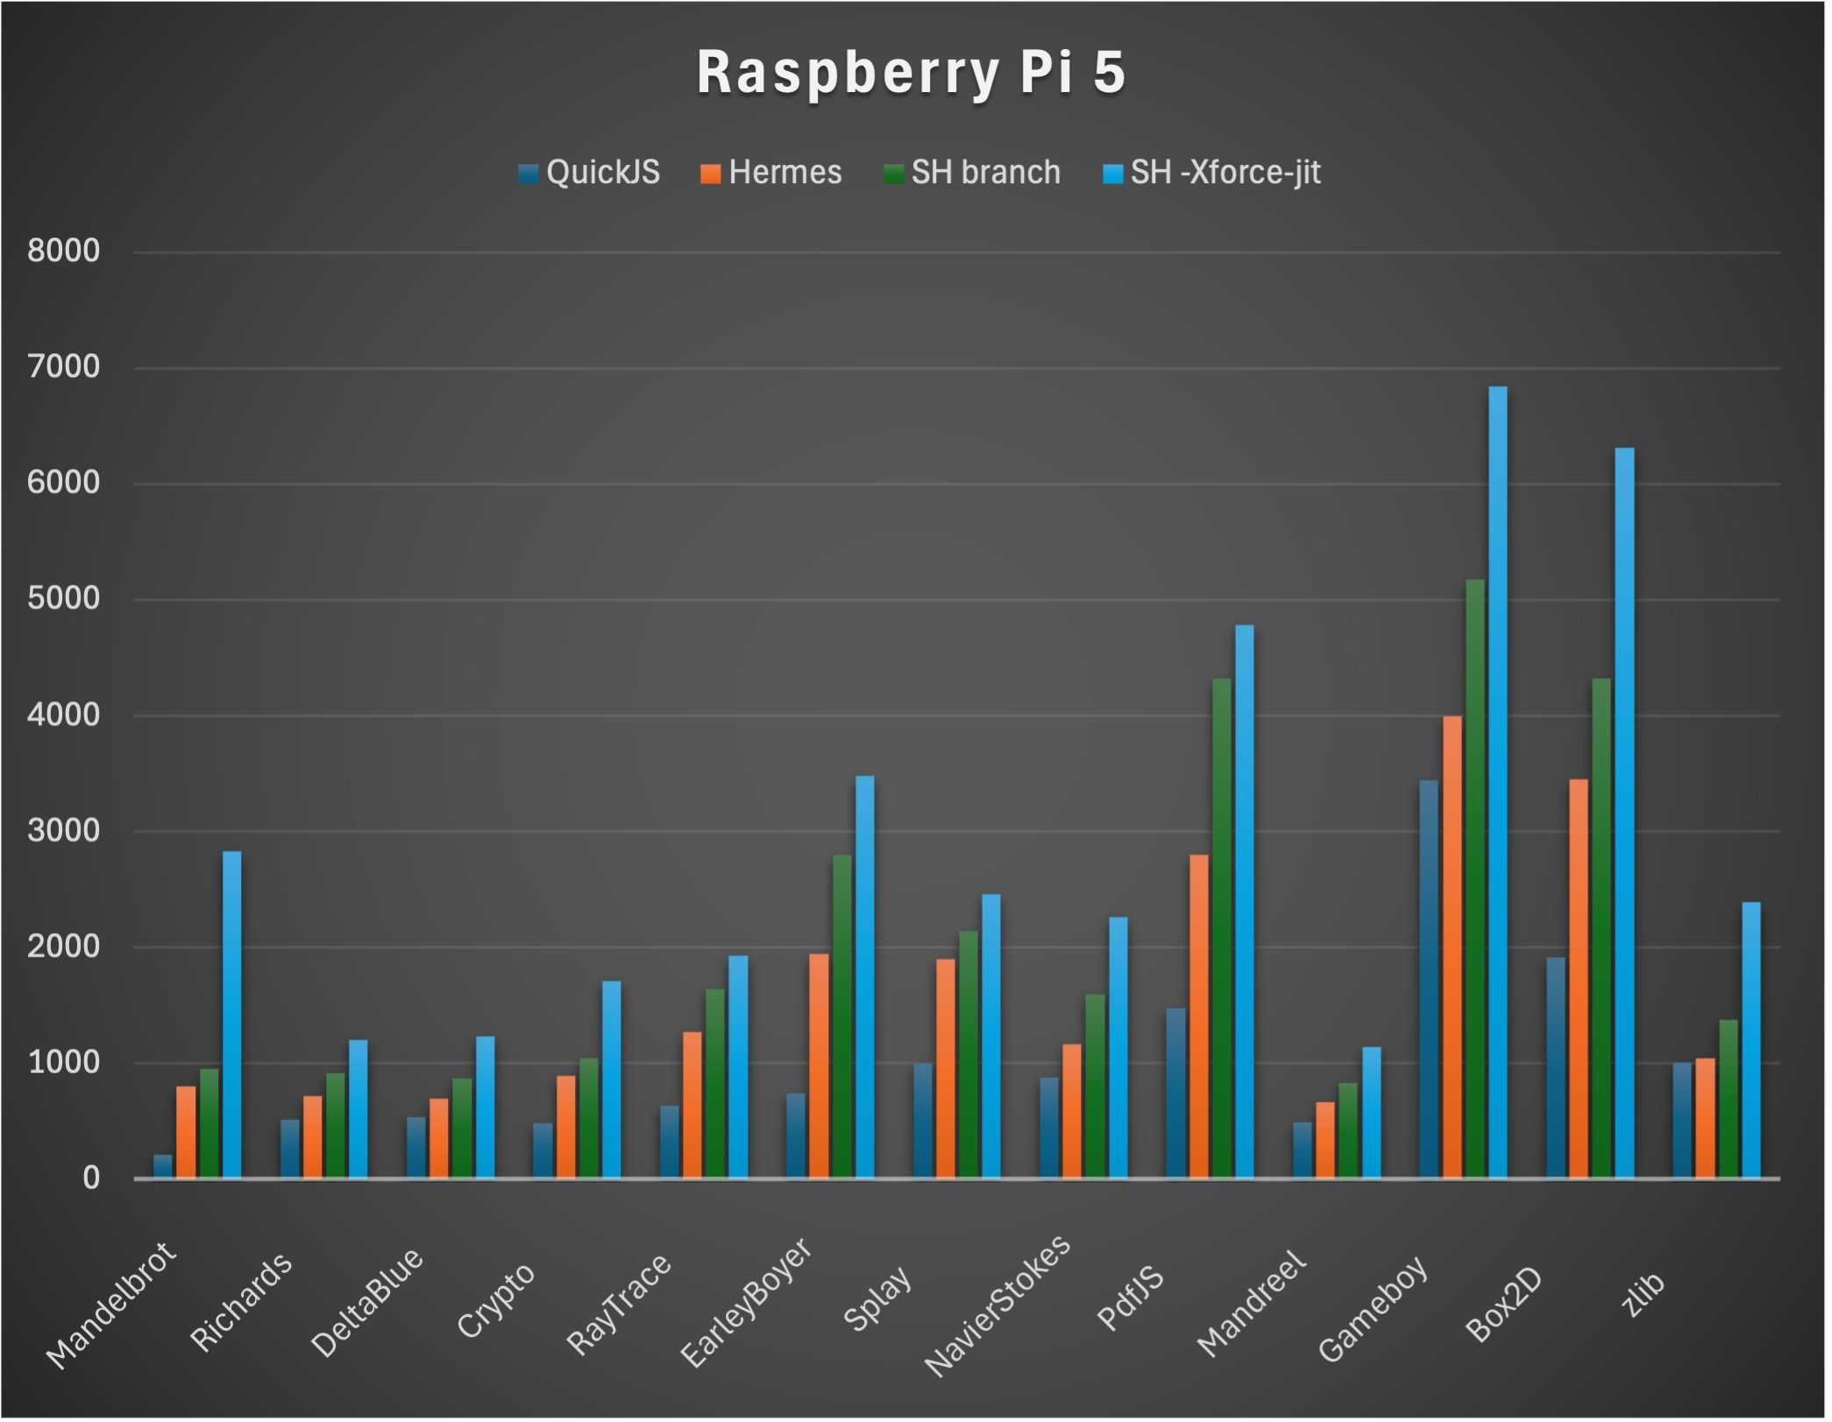

Slide 25
Hermes
Made by Facebook for React Native
Recently added JIT
Small Footprint – 4mb
Static Hermes

Slide 26
Porffor
Made in JS
AOT compiler for WASM and C

Slide 27
I think I’ve made some decisions
Any other information you want to throw at me?

Slide 28
Suggestions
Use a wrapper for C++

Slide 29
Wrappers
ScriptX – JavascriptCore, V8, QuickJS, Hermes (kind of)
JSI - JSI V8, JavascriptCore
Choc JS Engines – QuickJS, V8, Duktape

Slide 30
Suggestions
Use a wrapper for C++
Precompile if code known before

Slide 31
Suggestions
Use a wrapper for C++
Precompile is code known before
Check build options

Slide 32
Thanks
https://github.com/andyjtb/js-engine-emporium

