Slide 1
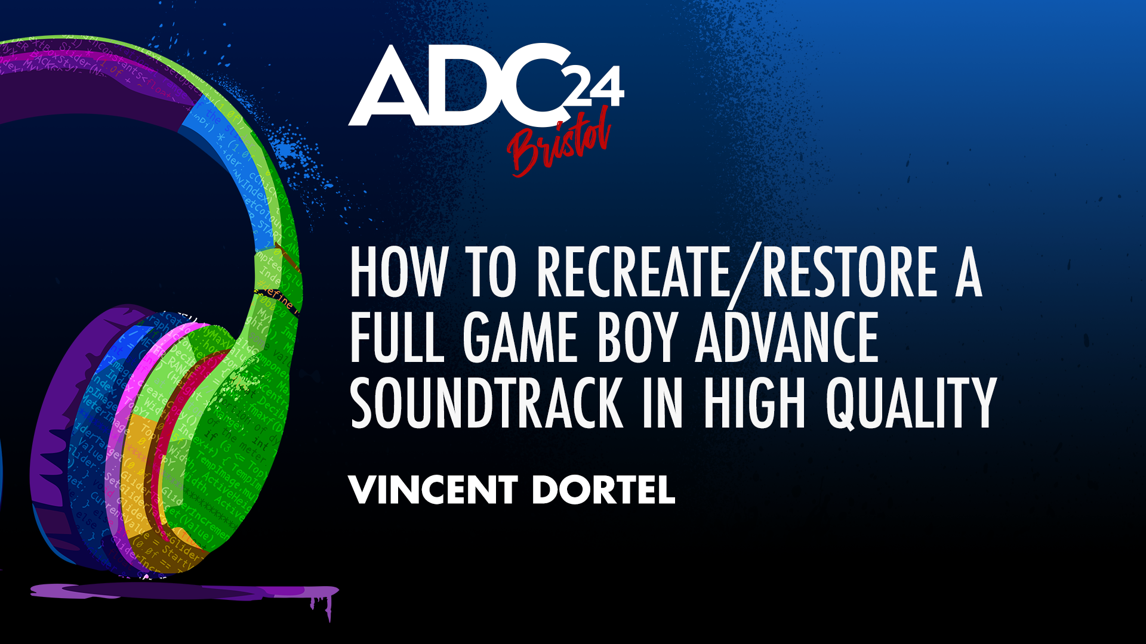

Slide 2

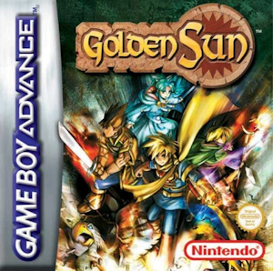
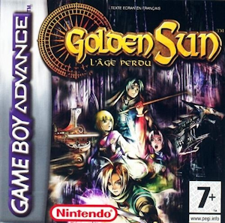
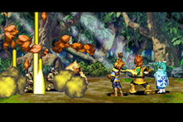
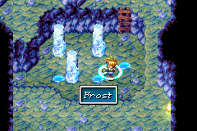
Golden Sun 1 & 2
Golden Sun 1
Released in August 2001 (JP), February 2002 (EU)
Golden Sun 2 The Lost Age
Released in June 2002 (JP), April 2003 (EU)
Developed by Camelot Software Planning
Music composed by Motoi Sakuraba

Slide 3
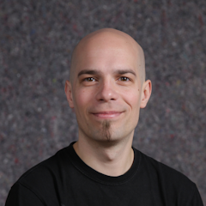
About me
Audio programmer in the game industry for 12+ years
Worked for Quantic Dream, Rocksteady, Ubisoft, Compulsion Games… and now freelance.
Passionate about:
  old game soundtracks
  synthesizers

Slide 4
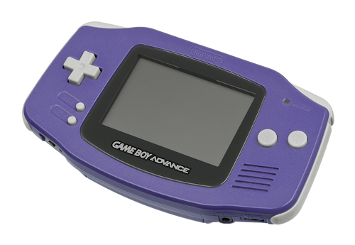
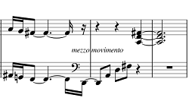
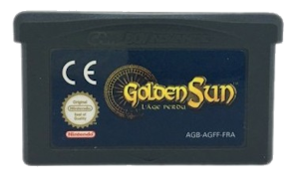
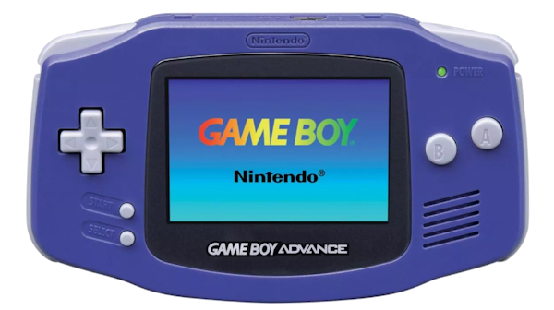
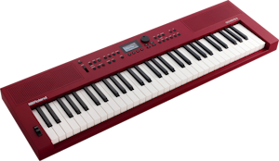
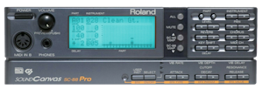

What are we trying to do?
Game Boy Advance (2001)
Two audio sub-systems:
Sound generator inherited from the original Game Boy
(4 programmable channels: Square 1, Square 2, Wave, Noise)
Stereo sample playback with Digital-to-analog converter
(8-bit PCM, with sample rates varying between 5kHz and 42 kHz)
Mono
speaker
Data
converted and
compressed
3.5mm stereo headphone jack
In-game mix
Game cartridge:
4 to 32 MB of data
Final output
(resampled to 32.768kHz, 9-bit)
Music composed on hardware synths and modules

Slide 5
What is game music restoration?
Analyze, research and reverse-engineer the console hardware and game data
Search for the original samples in high quality before they got compressed
Extract the original music sequences as MIDI files (when possible)
Recreate the tracks from scratch with the updated samples and sequences
Use modern mixing techniques

Slide 6
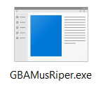
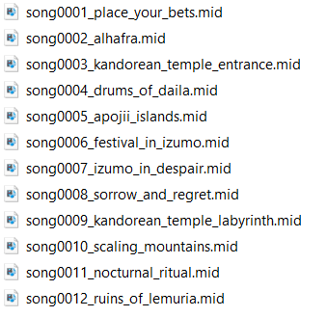
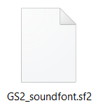
Extracting the data
GBA Mus Ripper:
Tool created in the 2000s by Bregalad (not maintained anymore)
The GBA sound driver (MP2k/m4a/sappy) was reverse-engineered and documented
Locates the sequence structures and sample data
  Creates midi files and a soundfont containing the samples

Slide 7
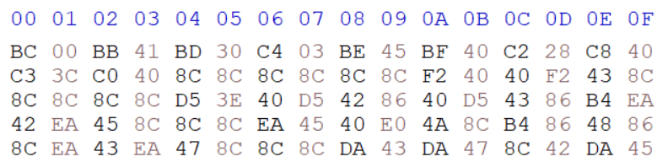
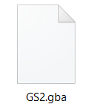
0xBC | Key shift - 0
0xC2 | LFO Speed
0cBB | Tempo - 0x41 x 2 = 130 BPM
0xC8 | Master tune 0x40 (64 : no change)
0xBD | Set Instrument - 0x30 (48)
0xC3 | LFO Delay: 0x3c
0xC4 | LFO Depth
0xC0 | Pitch Bend value: 0x40
0xBE | Set Volume to 0x45 (69)
0xBF | Set Panning to 0x40 (64: center)
0x8C | Delta time of 0x8C - 0x80 = 0x0C
0xF2 | NoteOn with auto NoteOff - Key: 0x40 (E4), Velocity: 0x40, 0xF2: duration
0xF2 | NoteOn with auto NoteOff - Key: 0x43 (G4), Velocity: 0x8C, 0xF2: duration

Slide 8
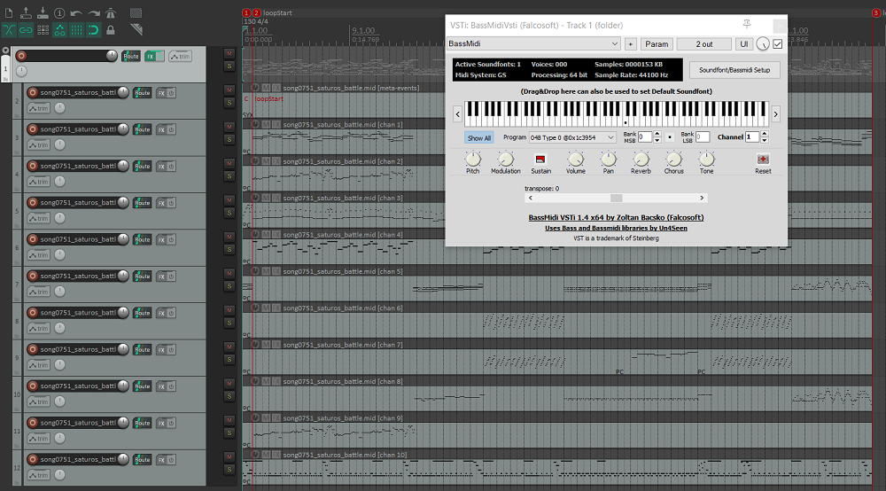
Extracting the data
You can play the MIDI files using a soundfont VST in your favourite DAW.

Slide 9
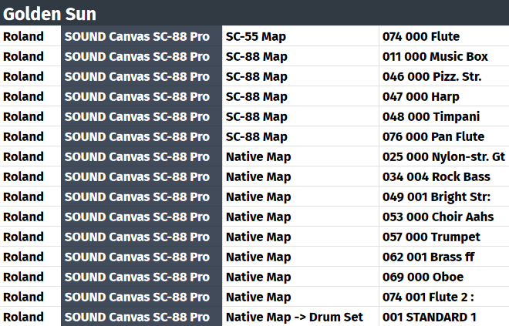
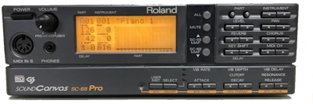
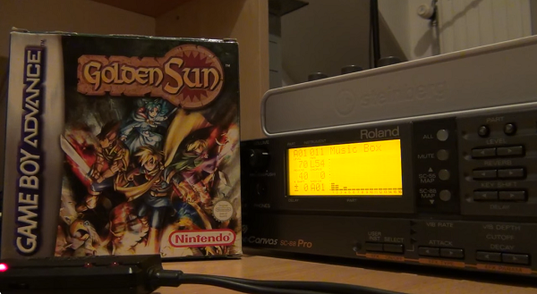
Where to find the original samples?
Video Game Music Sources community (collaborative database / Discord)
Roland SC-88 Pro
Cyanne on
Youtube

Slide 10
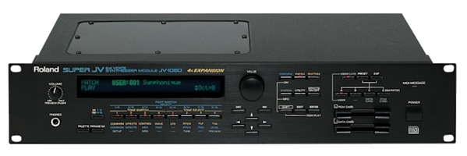
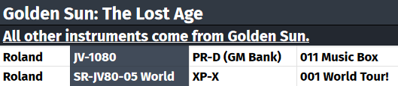
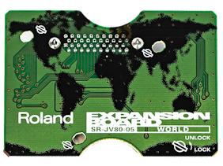
Where to find the original samples?
Video Game Music Sources community (collaborative database / Discord)
Roland SC-88 Pro
Roland JV-1080
Expansion card
SR-JV80-05 World

Slide 11
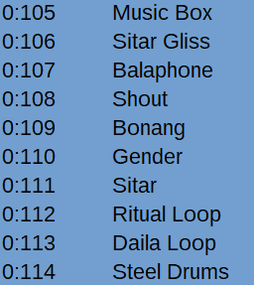
Where to find the original samples?
Video Game Music Sources community (collaborative database / Discord)
Personal research

Slide 12

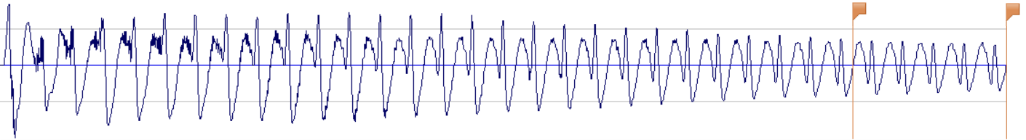
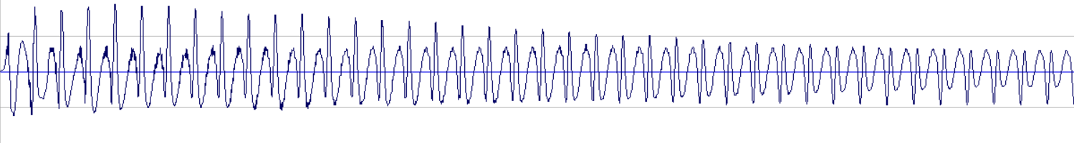
Restoring the samples
Example: Bass instrument
Extracted from the GBA cartridge (8-bit, 31 536 Hz)
« Picked Bass » recorded from the Roland SC-88 (24-bit, 44100 Hz)

Slide 13
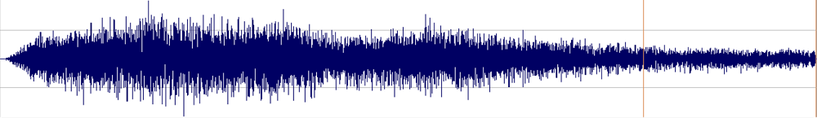
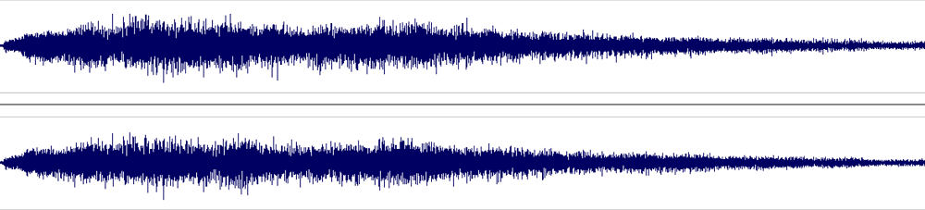
Restoring the samples
Example: Sitar Gliss
Extracted from the GBA cartridge (8-bit, 31 536 Hz)
« Sitar Gliss » recorded from the JV-1080 + World expansion card (24-bit, 44100 Hz)

Slide 14
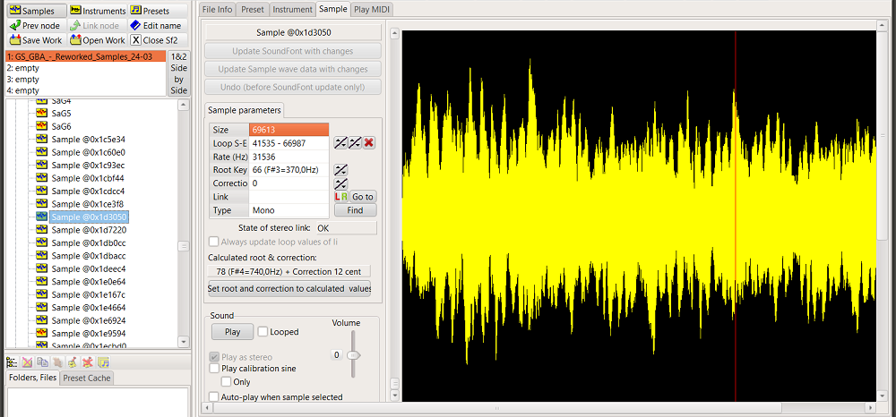
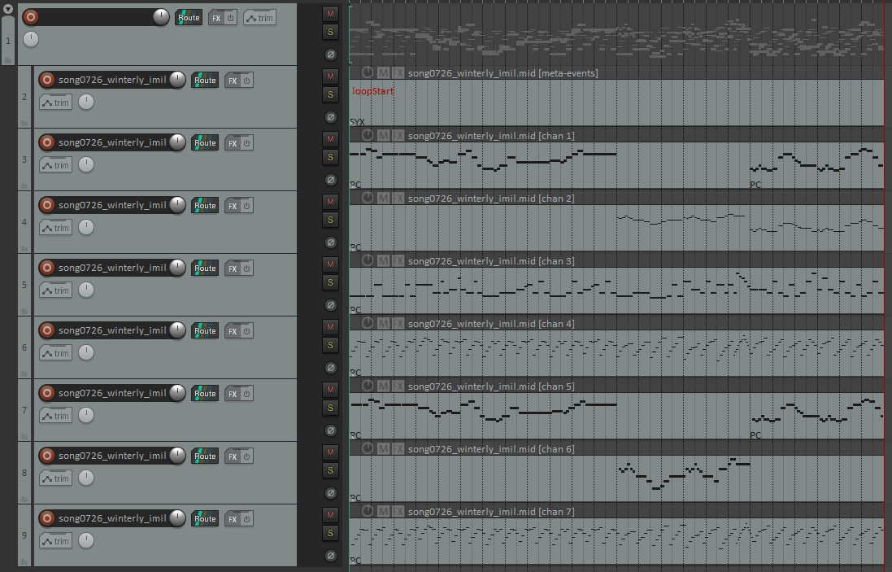
Restoring the samples
Edit the soundfont, replace the original samples with the restored ones
(adjust ADSR and panning if necessary)
Viena SoundFont Editor
Reaper

Slide 15
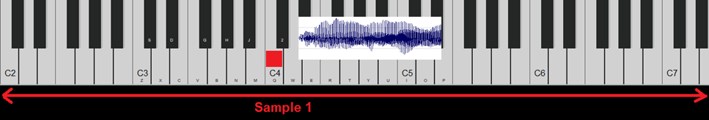
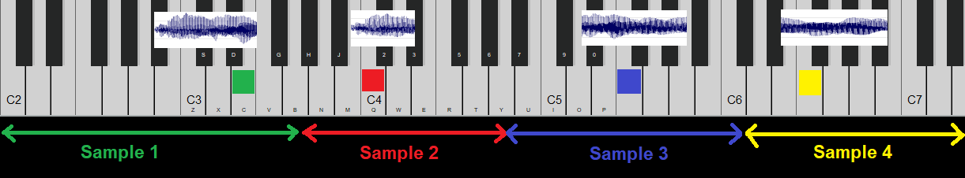
Single sample vs Full patch

Slide 16
Single sample vs Full patch
Example that doesn’t work: “Brass ff” in Venus Lighthouse:
Recording 1: played on the SC-88 (full patch)
Recording 2: extracted and played with SF2 VST (single sample)
Example that works: “BrightStr” in The First Book
Recording: played on the SC-88 (full patch)
Conclusion:
Some sounds will work great in their « full patch » version
Some sounds will work better if we stick to single patch

Slide 17
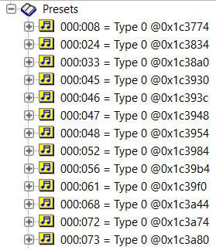
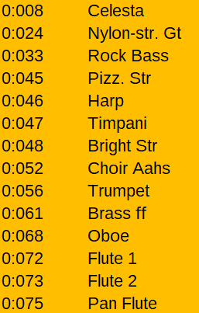
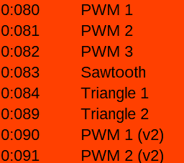
Python scripts to improve the workflow
Identify the samples (and give them friendly names)

Slide 18
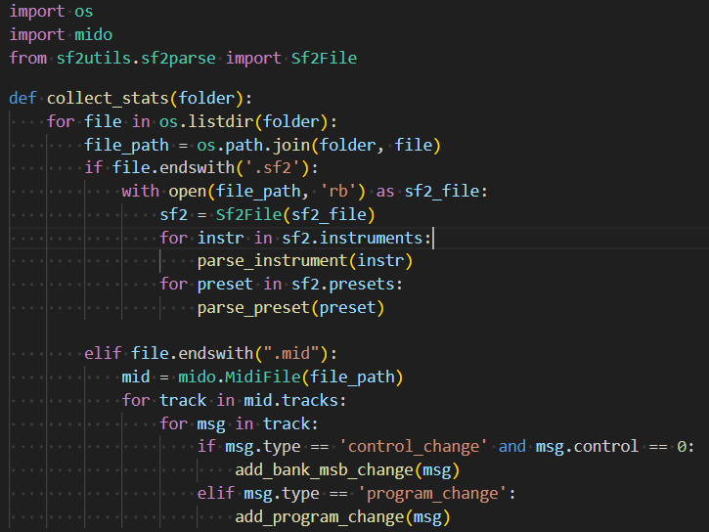
Python scripts to improve the workflow
Identify the samples (and rename them)
Write scripts to get statistics so you can plan ahead

Slide 19
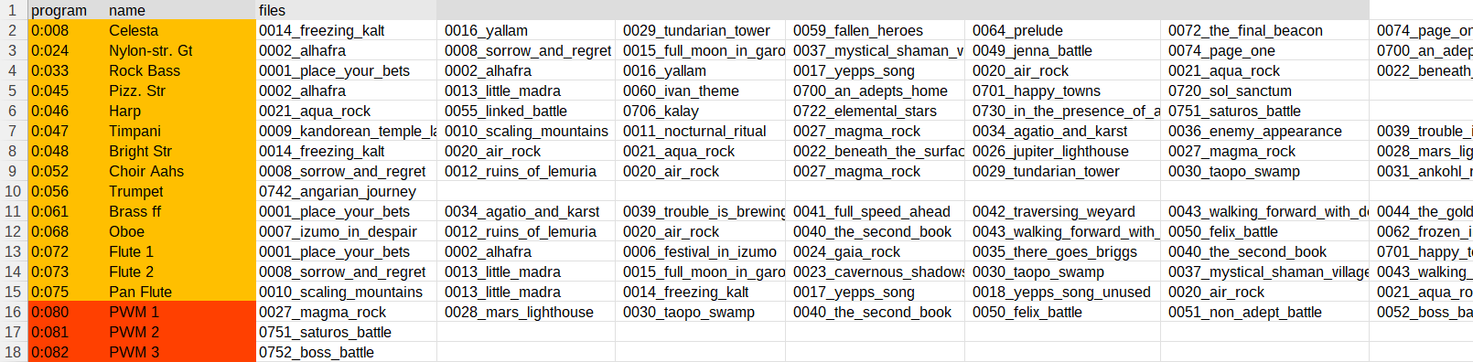
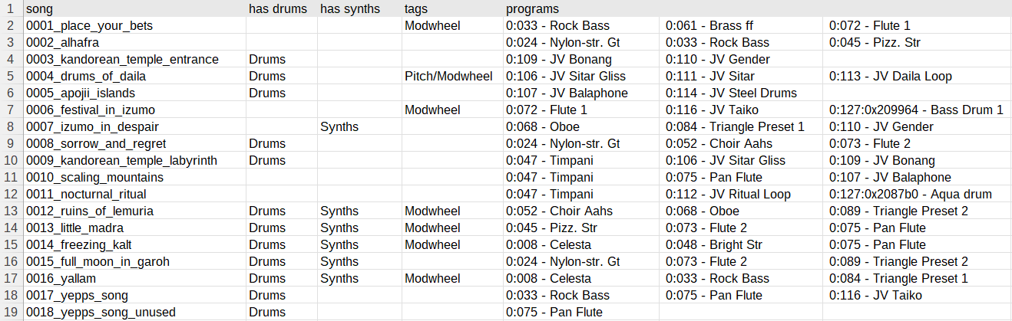
Python scripts to improve the workflow

Slide 20
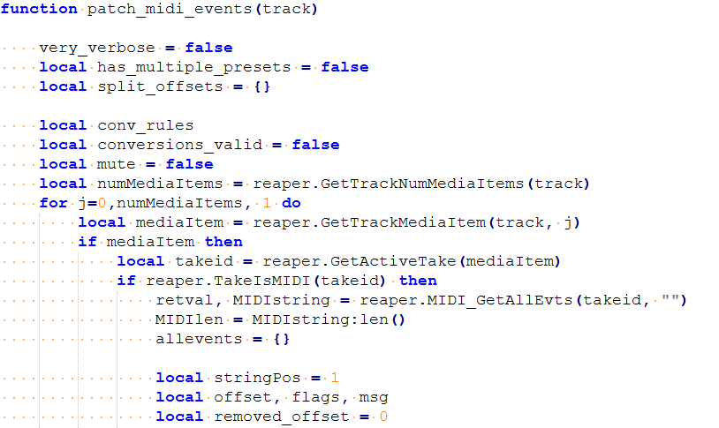
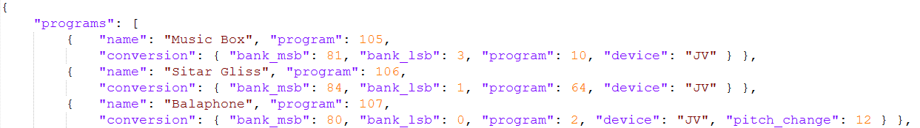
Reaper script in Lua to improve the workflow
ReaScript to modify and route the midi files
Conversion rules in a json file

Slide 21
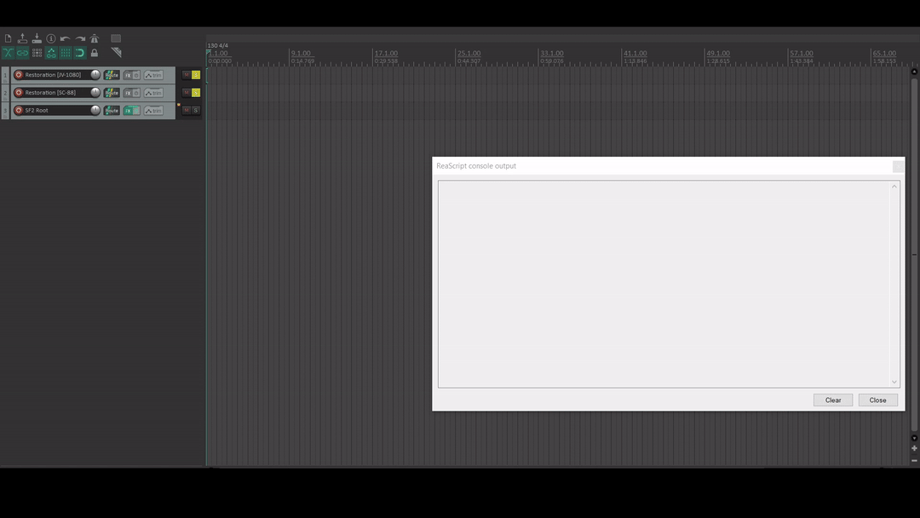
Reaper script in Lua to improve the workflow

Slide 22
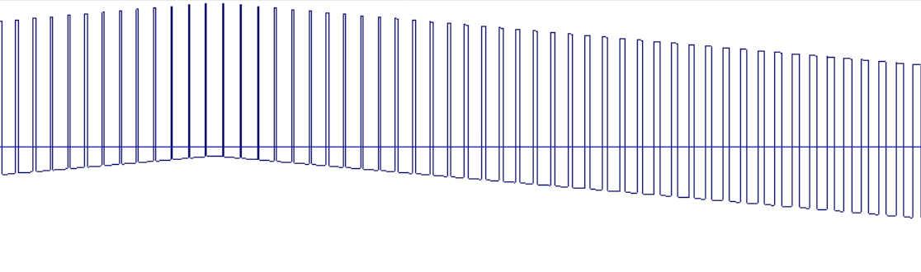
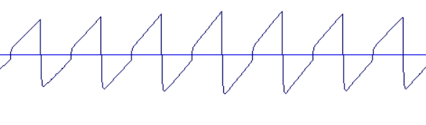
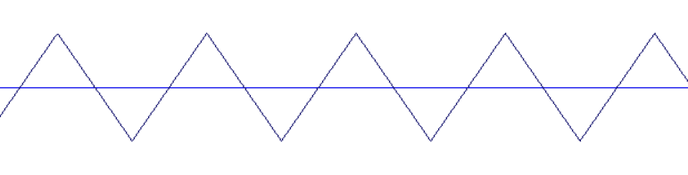
Golden Sun’s custom synths
Custom synths hacked into the game by the Camelot devs
Three types
Multiple presets (different ADSRs)
Custom parameters
PWM
Sawtooth
Triangle

Slide 23
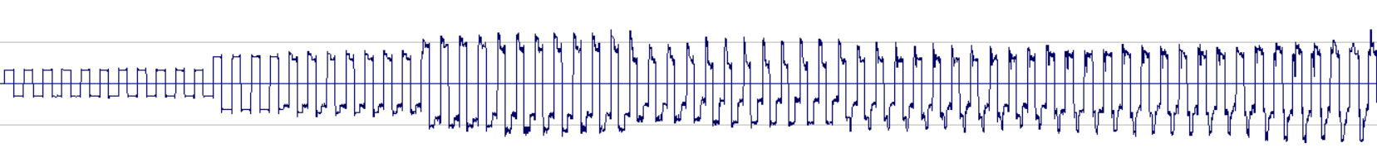
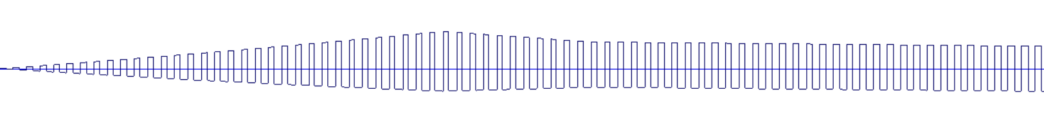
Golden Sun’s custom synths
Approach 1: isolate and record synths from the rom
Approach 2: reverse engineer the synths
Thanks to Michael Panzlaff (ipatix) for reverse-engineering the synths!

Slide 24
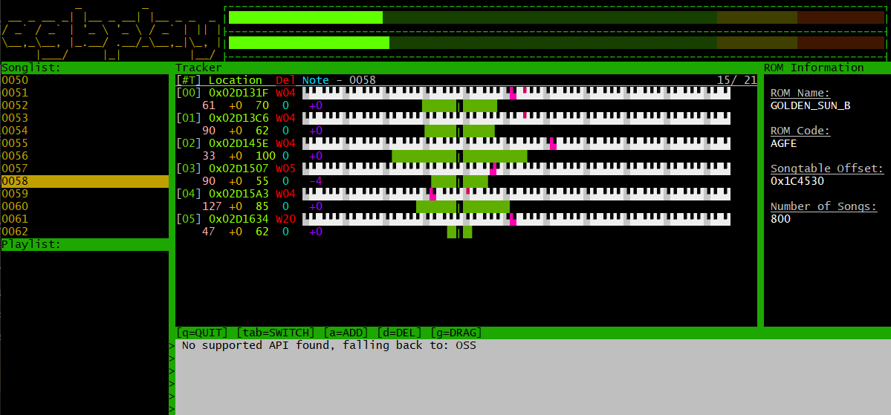
Agbplay by ipatix
agbplay
Direct output
or export to wav
GBA rom

Slide 25
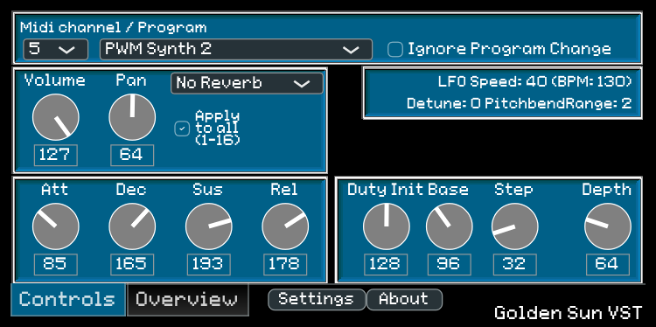
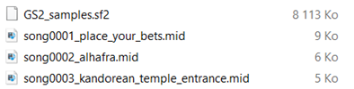
Turning agbplay into a VST
VST plugin
Midi files
+ soundfont
+ wav samples
Direct output
External dependencies:
Juce framework
TinySoundFont by schellingb

Slide 26



Additional challenges
The search for drum sounds
Alesis DM5
GS1 Drumkit
GS2 Drumkit
Mario Tennis
Drumkit

Slide 27


The search for drum sounds
Example: Ride Cymbal 1 (#51)
Extracted from Golden Sun 2, GBA (8-bit, 31 536 Hz)
Extracted from Mario Golf Toadstool Tour, GameCube (16-bit, 32 kHz)

Slide 28

Other challenges
The search for drum sounds
Custom LFO (modulation): tempo-based pitch bending (BPM affects update rate)
Some samples were altered in post-production (ex: Steel Drums)

Slide 29

Final mix

Slide 30


Examples of restored tracks
Drums of Daila (Golden Sun 2, track 8)
Original version (GBA)
Restored version

Slide 31


Examples of restored tracks
Boss Battle (Golden Sun 2, track 11)
Original version (GBA)
Restored version

Slide 32
Thank you!
All my source code is available on:
https://github.com/justedni
Youtube channel with the full restored soundtrack:
https://www.youtube.com/@JusteDni
(or just google “Vincent Dortel”)
Recommended Youtube channels
(about game music restoration)
Mathew Valente (tssf)
Jammin’ Sam Miller
Special thanks
Coaltergeist, Cyanne
FreeJusticeHere, ipatix, TheAdorableOsha

