Slide 1
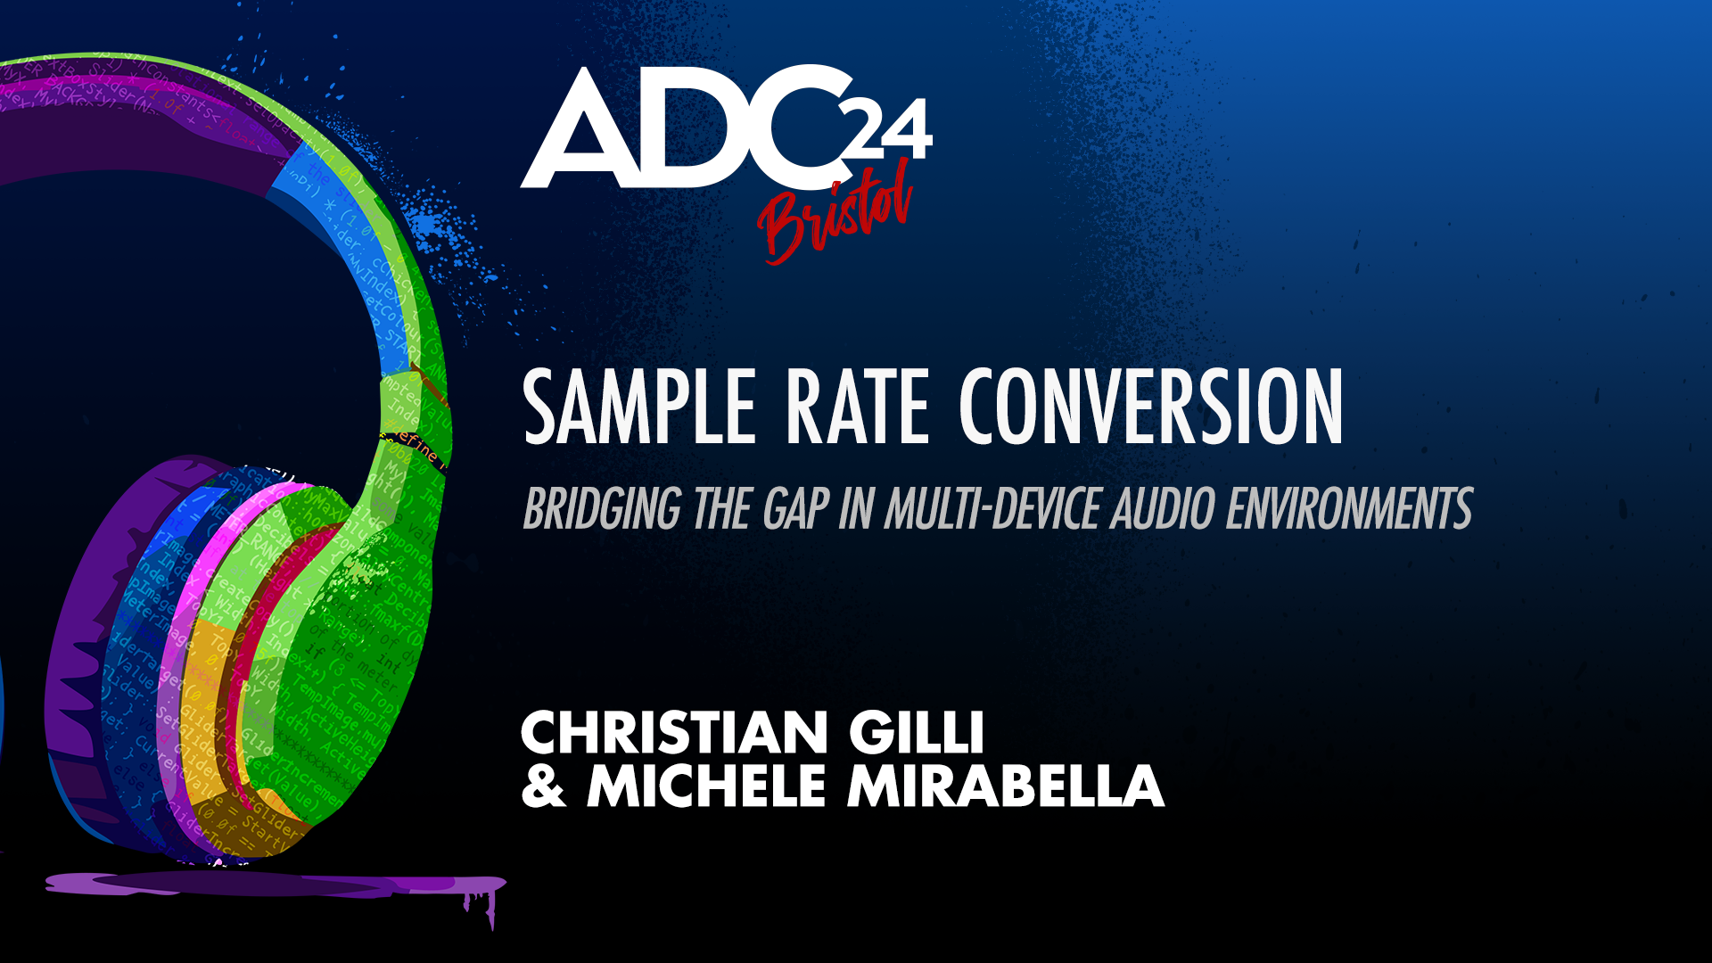

Slide 2
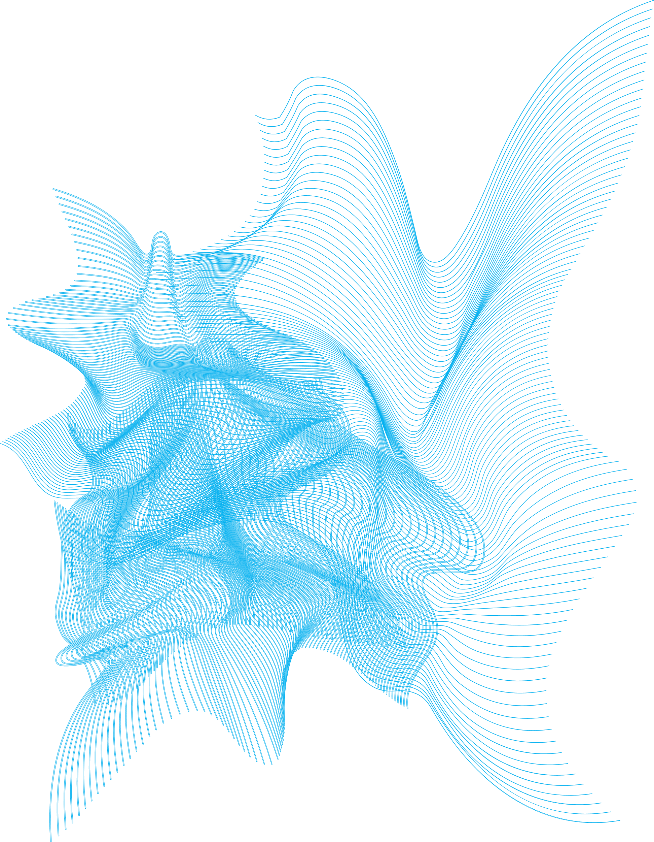
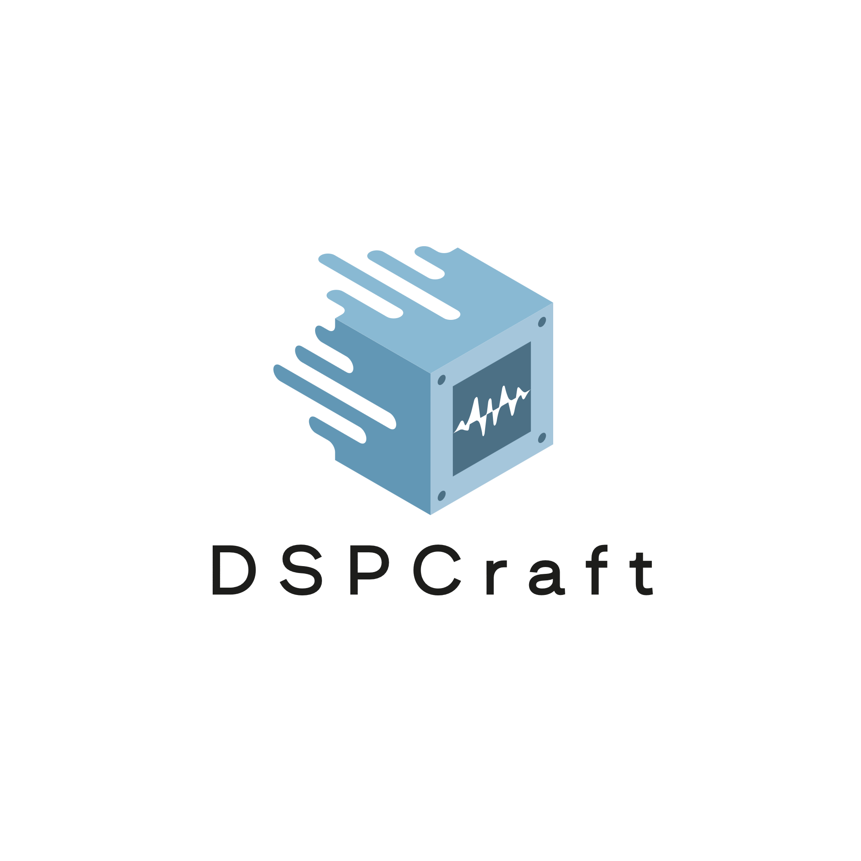
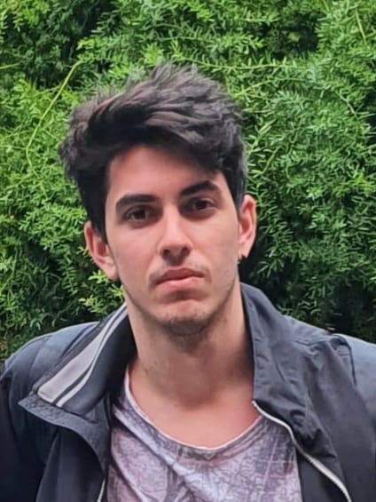

Who We Are
Foto
Foto
Christian Gilli
Software Engineer
MSc
7+ years in the pro audio industry
Performance optimisation of numerical software
Michele Mirabella
Electronic Engineer
PhD Student in ICT
High mobility comm. towards 6G
Joint communication and sensing (JCAS) systems

Slide 3
Outline
What is sample rate conversion and why it is important
Mathematical foundations of sample rate conversion
What makes a good sample rate converter
Comparison of different implementations

Slide 4
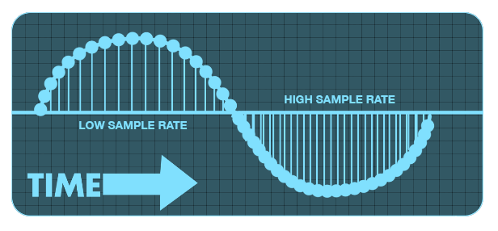
Intro: Sample Rate Conversion
Sample Rate Conversion (SRC) is the process of converting discrete samples from one sample rate to a different sample rate.
Sampling: measuring the signal amplitude at even intervals
Sample: a single measurement of a waveform/signal
Sample Rate: the frequency at which samples are taken per second (Hz)

Slide 5
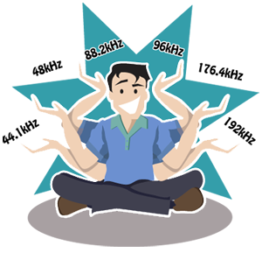

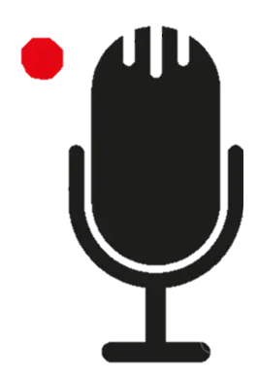
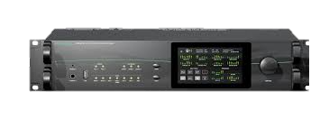
Why Sample Sate Conversion?
Typically, digital audio is recorded, stored and played back at more than one sample rate
In both the audio recording and playback, it is often necessary or convenient to synchronize streams at different frequencies.
Distribution media limited support (e.g., CDs only support 44.1 kHz sample rates)
No standard sample rate for audio recording
Mixed audio-video systems operating at different frequencies ^{[1]}
[1]: https://www.directout.eu/
Notes:
Decidiamo se mettere questi dettagli in un’altra slide. Sample rate Usage44.1 kHz:Audio cd quality and the most commonly used sample rate in music recordings.48 kHz:Professional digital video equipment and also the sampling rate of a lot of professional audio gear such as mixers and recorders.88.2 kHz:Not often used – doubling of the cd-quality, can sometimes be found.96 kHz:DVD audio quality from stereo-mixes up 5.1-surround-mixes.192 kHz:DVD audio quality for stereo-mixes.

Slide 6
SRC Theory
Notes:
Aliases out of audible range may still be a problem, not for our ears but for audio devices (e.g., your tweeters might not like them) and processors.

Slide 7

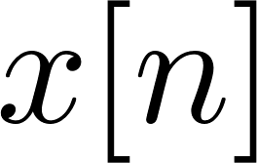
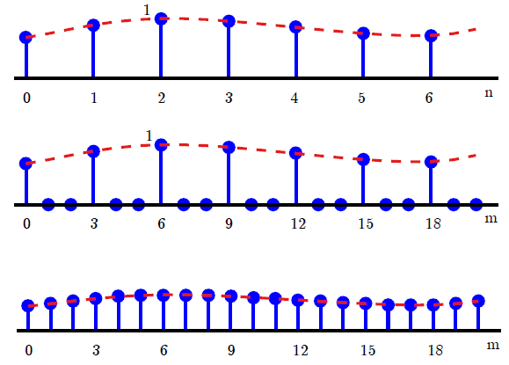
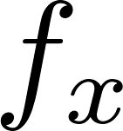
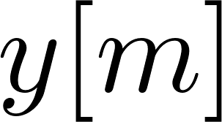
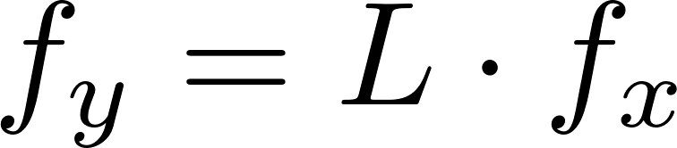
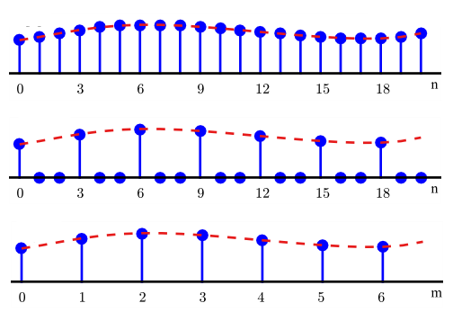
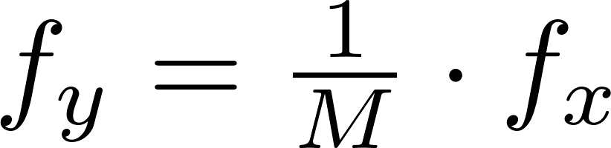
SRC Theory
Core operations:
Upsample:
L↑
Downsample:
M↓
Notes:
Aliases out of audible range may still be a problem, not for our ears but for audio devices (e.g., your tweeters might not like them) and processors.

Slide 8

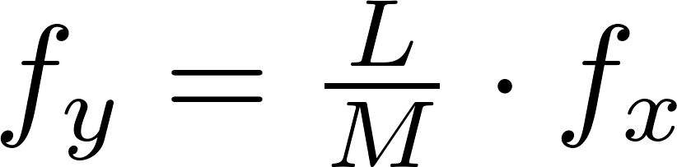
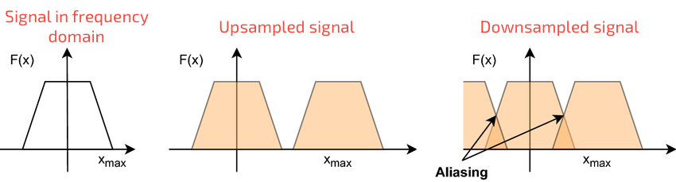
SRC Theory
Core operations:
Upsample:
In principle:
L↑
M↓
L↑
However:
Upsampling → introduce spectral copies at integer multiples of the original frequencies
Downsampling → risk of going below Shannon Nyquist ^{[2]} limit, thus introducing aliasing
Downsample:
M↓
[2]: https://en.wikipedia.org/wiki/Nyquist–Shannon_sampling_theorem
Notes:
Aliases out of audible range may still be a problem, not for our ears but for audio devices (e.g., your tweeters might not like them) and processors.

Slide 9
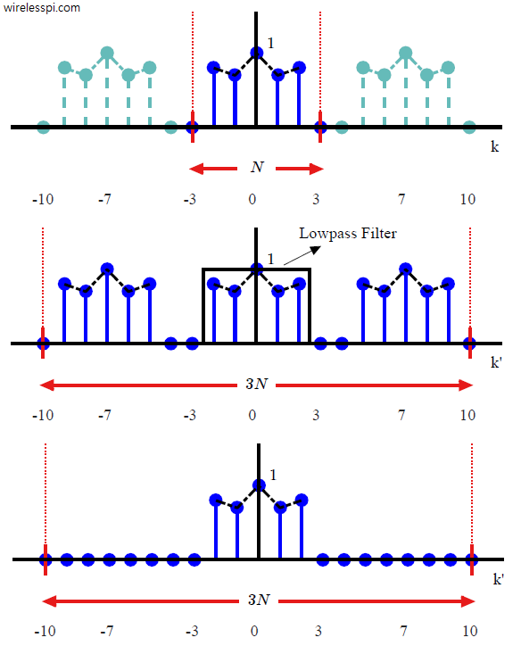
SRC Theory
Basic Implementation:
Replace
L↑
M↓
+ aliasing
With
L↑
Low-pass filter
M↓
no aliasing

Slide 10
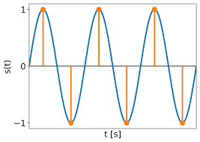
SRC Quality Metrics
Aliasing:
Presence of artifacts caused by the conversion

Slide 11
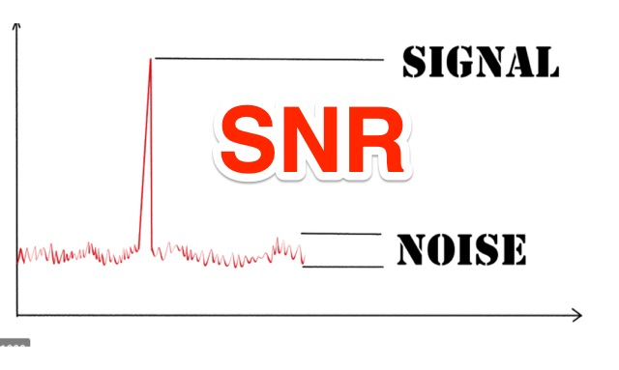
SRC Quality Metrics
Aliasing:
Signal-to-noise ratio (SNR):
Presence of artifacts caused by the conversion
Measure of how much noise the SRC adds to the signal.

Slide 12
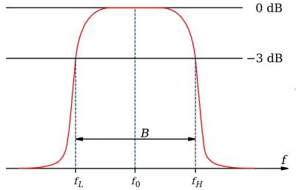
SRC Quality Metrics
Aliasing:
Signal-to-noise ratio (SNR):
Presence of artifacts caused by the conversion
Measure of how much noise the SRC adds to the signal.
Bandwidth:
% of the full bandwidth at which SRC operates

Slide 13
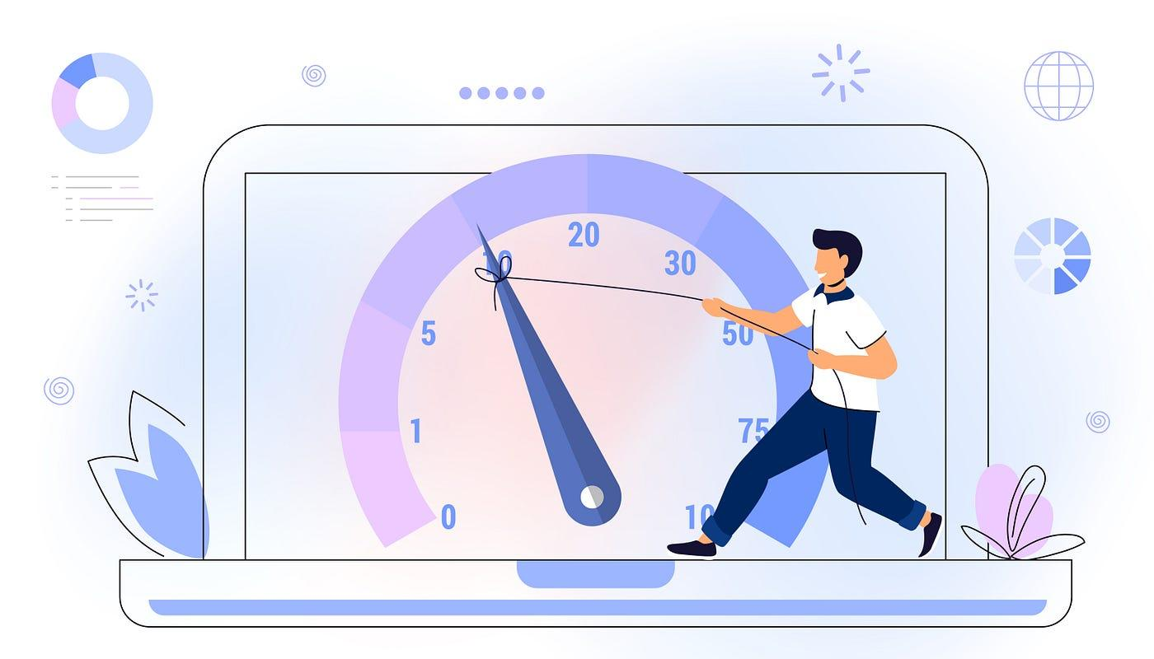
SRC Quality Metrics
Aliasing:
Signal-to-noise ratio (SNR):
Presence of artifacts caused by the conversion
Measure of how much noise the SRC adds to the signal
Bandwidth:
Conversion speed:
% of the full bandwidth at which SRC operates
Inverse of conversion time

Slide 14
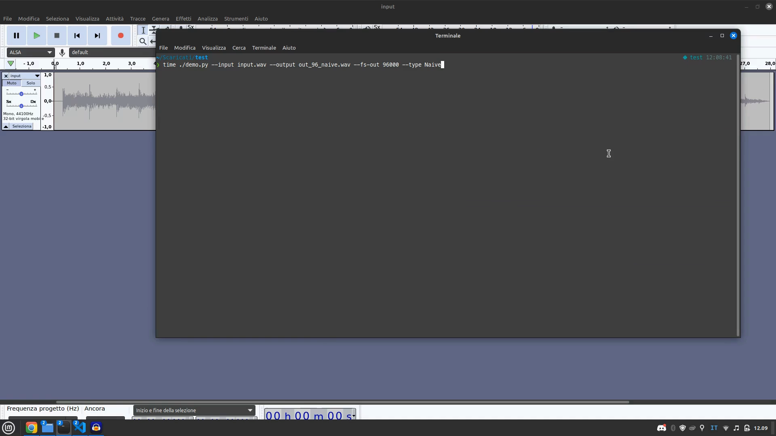
Simple SRC Showcase

Slide 15
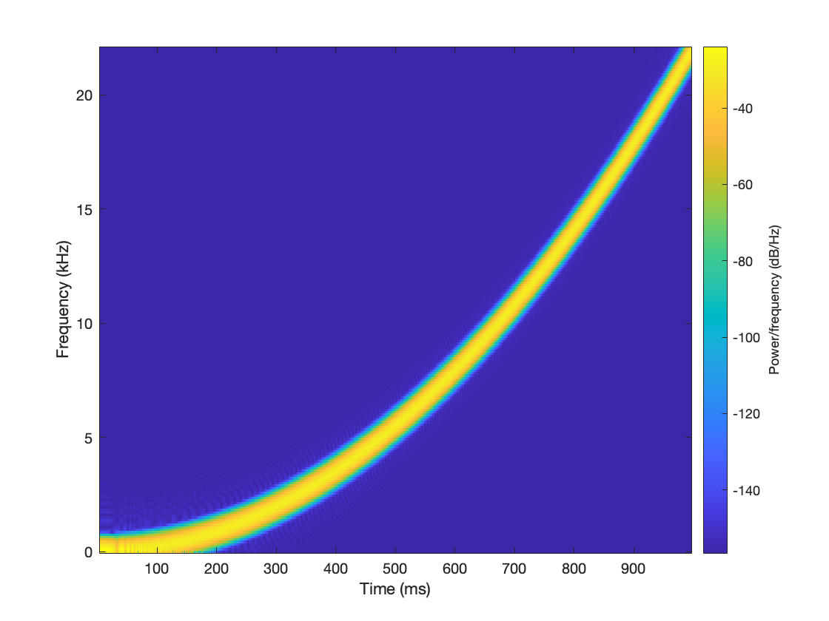
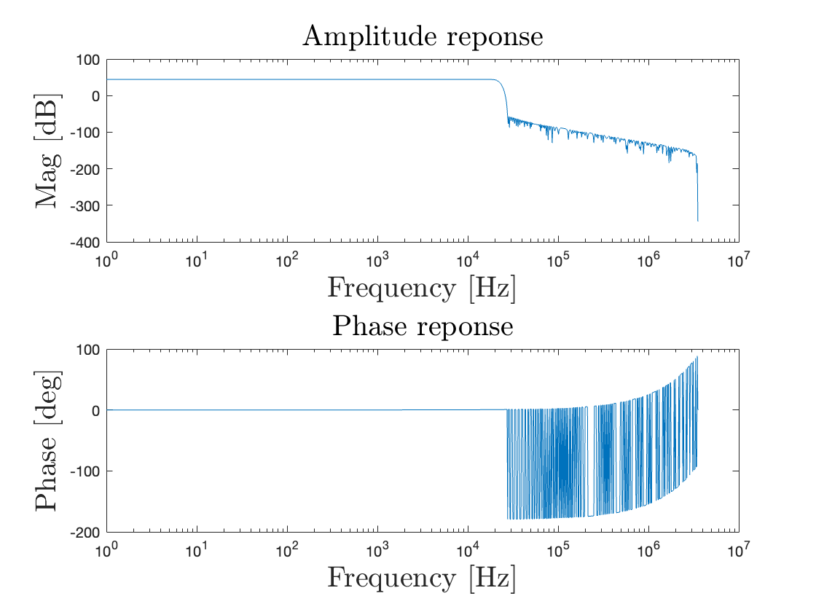
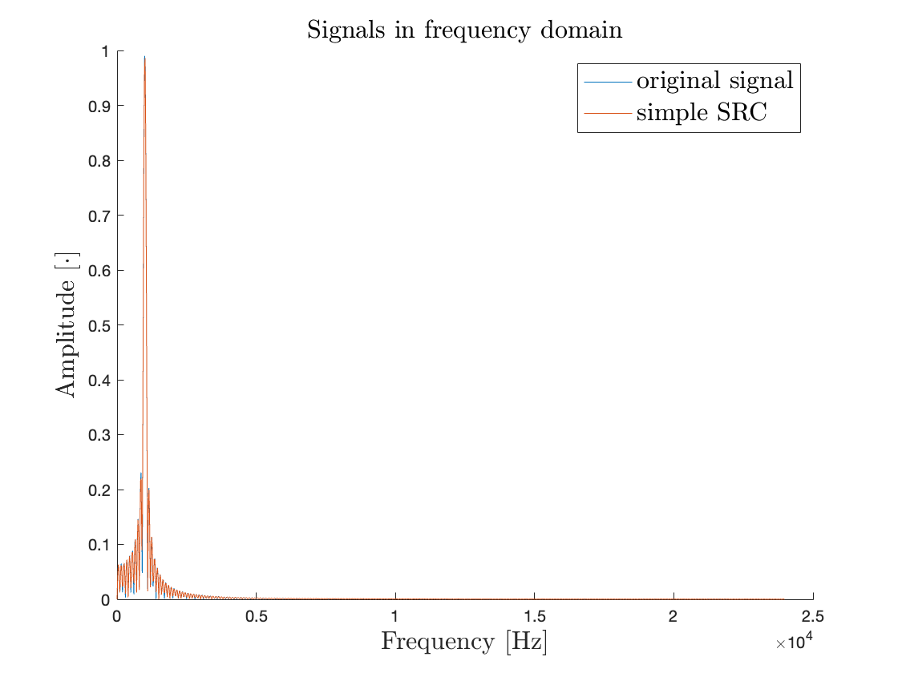
Simple SRC Performance
SNR | Bandwidth % | Speed
130 dB | 95,23% | SLOW

Slide 16
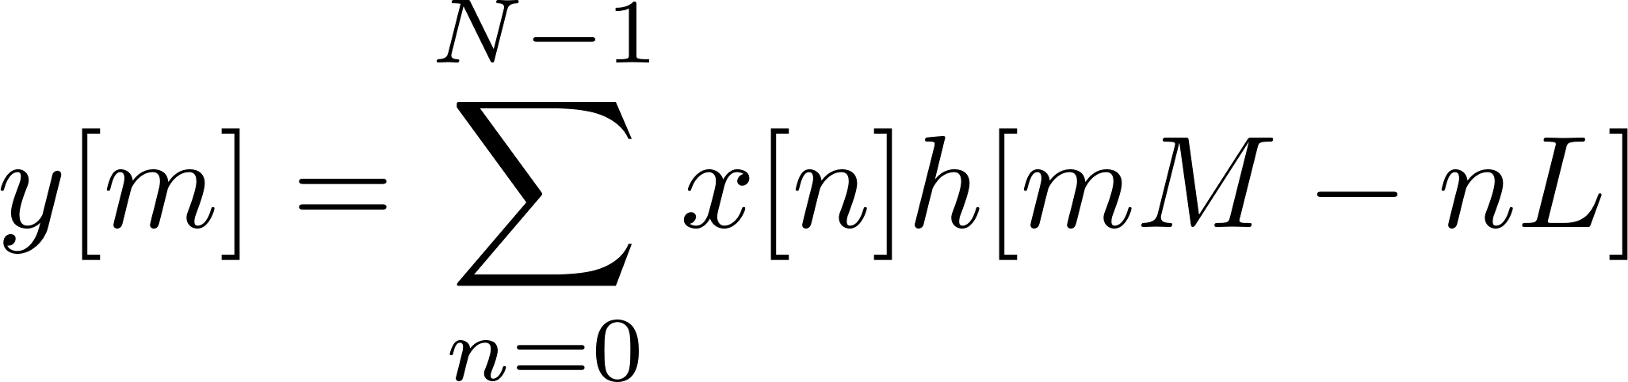

Multirate SRC
Strategies for increasing SRC speed while maintaining good conversion quality
The system operates at the maximum sampling frequency
→ High computational cost
L↑
Low-pass filter
M↓
Idea^{[3]}: filter at the lowest possible rate
M↓
L↑
M↓
L↑
.
.
.
.
.
.
.
.
.
.
.
.
M↓
L↑
Decomposition
Polyphase filtering
Reconstruction
[3]: https://authors.library.caltech.edu/records/rmhds-22q28

Slide 17
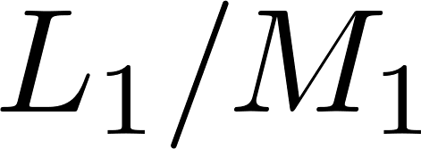
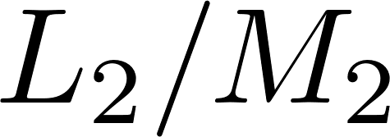
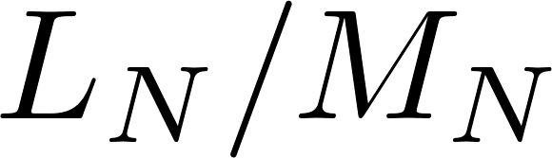
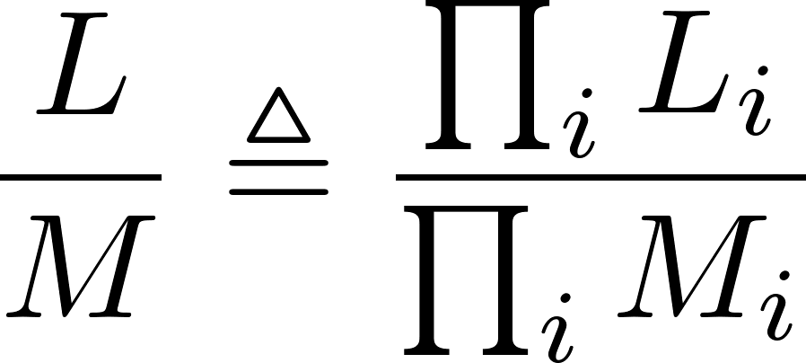
Multistage SRC
SRC can be done in multiple conversion stages:
Operate on smaller signal portions (thus reducing complexity)
Use multiple filters (one per stage)
Each stage can be whatever SRC system
…
Overall sample rate conversion factor

Slide 18

Multi SRC Showcase

Slide 19
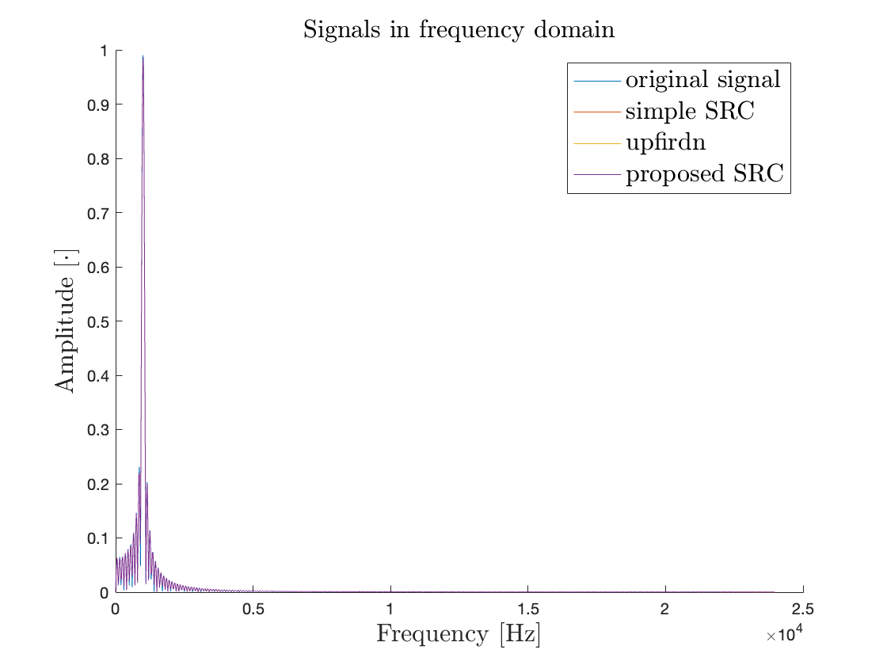
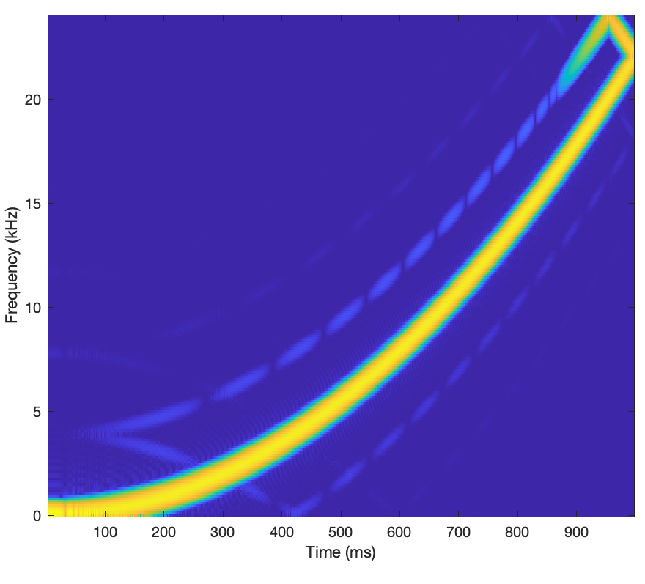
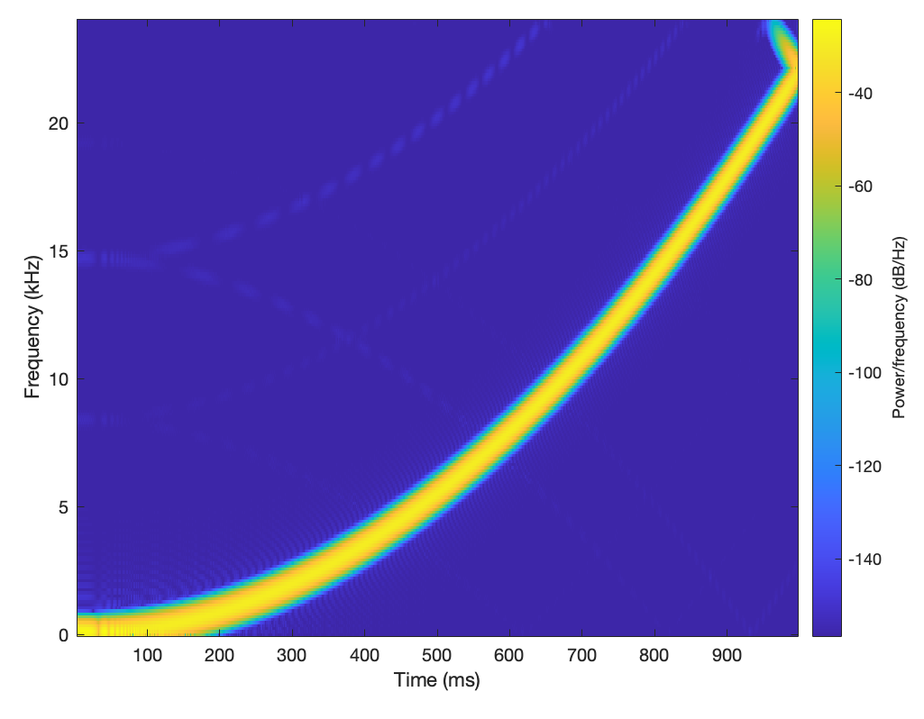
Comparison
SRC from 44.1 kHz to 48 kHz, comparison of different methods
Simple SRC
SciPy upfirdn ^{[4]}
Proposed Multirate Multistage
Method | SNR | BW % | Speed
Simple SRC | 130 dB | 95,23% | SLOW
upfirdn | 129 dB | 95,18% | FAST
Proposed Multirate Multistage | 125 dB | 95,23% | FAST
[4]: https://docs.scipy.org/doc/scipy/reference/generated/scipy.signal.upfirdn.html

Slide 20

Thank You!
Check out our SRC demo online:
dspcraft.com/src
If you have any questions or comments reach out!
christian.gilli@dspcraft.com
michele.mirabella@dspcraft.com

