Slide 1


Slide 2
or:
Confessions of a ValueTree Skeptic
Brett g Porter * bgporter.net

Slide 3
ValueTree Crash Course
"The ValueTree class is JUCE's secret weapon."
– juce.com
a super-flexible data structure that can hold a list of (key, value) pairs
…where the value data can be any* arbitrary data type, stored as a juce::var
has no fixed schema for data; properties may be added/removed at runtime

Slide 4
ValueTree Crash Course
has a type (a juce::Identifier)
can also contain 0..n child ValueTree objects
application code can listen for changes to the tree
  properties
  add/remove/re-order child trees
can manage undo/redo operations

Slide 5
ValueTree Crash Course
underlying internal data structure is shared and reference counted
ValueTree1
ValueTree2
SharedObject

Slide 6
Basic Usage
// please give things better names than this!
static juce::Identifier parentType { "root" };
static juce::Identifier childType { "leaf" };
static juce::Identifier prop1 { "property1" };
static juce::Identifier prop2 { "property2" };
// create a tree
juce::ValueTree rootNode { parentType };
// set some property values
rootNode.setProperty (prop1, 42, nullptr);
rootNode.setProperty (prop2, "the answer!", nullptr);

Slide 7
Basic Usage
// retrieve values - note different (equivalent) syntaxes
int prop1Val = rootNode.getProperty (prop1);
juce::String prop2Val = rootNode[prop2];
// append a child to the tree
juce::ValueTree child { childType };
rootNode.appendChild (child);

Slide 8
Basic Usage
<!-- which looks like this in XML -->
<root property1="42" property2="the answer!">
<child />
</root>
// or in C++:
struct Child { /* whatever... */ };
struct Root
{
int prop1;
juce::String prop2;
Child child;
};

Slide 9
Theses
the best way to understand something is to use it in earnest
the best way to critique something is to make something that you like better
all problems in Computer Science (except one) are solved by adding another layer of abstraction

Slide 10
Broad Goals
// I want this code using the ValueTree API...
juce::ValueTree rootNode { parentType };
// set some property values
rootNode.setProperty (prop1, 42, nullptr);
rootNode.setProperty (prop2, "the answer!", nullptr);
// retrieve values - note different (equivalent) syntaxes
int prop1Val = rootNode.getProperty (prop1);
juce::String prop2Val = rootNode[prop2];

Slide 11
Broad Goals
// ...to look like this instead:
Root rootNode;
rootNode.prop1 = 42;
rootNode.prop2 = "a different answer!";
int prop1Val = rootNode.prop1;
juce::String prop2Val = rootNode.prop2;

Slide 12
Model: Object/Relational Mappers
ActiveRecord (Ruby)
SQLAlchemy (Python)
Hibernate (Java)
CoreData (macOS/iOS)

Slide 13
Model: Python Requests
“HTTP for Humans”
wraps urllib3 module to hide API calls behind a Pythonic interface
imposes some structure and common usage patterns on the underlying libraries used

Slide 14
Specific Goals
hide property access behind dot/arrow syntax
add type safety and data validation
guarantee initialization of properties
remove/reduce boilerplate
  no need to derive ValueTree::Listener classes
  define data validation & class invariants in the object, not at point of call
  handle type coercion via VariantConverters internally
enable functional reactive programming

Slide 15
Specific Goals
decouple all the things!
add safe sync between threads and processes
programmers should not need to know that they are using ValueTrees under the hood
…but should have easy access to the underlying ValueTree for any functionality we don’t expose

Slide 16
Acknowledgements
Chris Roberts (aka `cpr2323`) wrote the ValueTreeWrapper class used at Artiphon
That class has received additional enhancements and tweaks from
  Vincent Berthiaume
  Megan Jurek
  Sean Maloney
  Walter Kopacz
  Joël Langlois
David Rowland’s ADC17 talk
Matt Gonzalez tried to convince me to use VTs a decade ago.

Slide 17
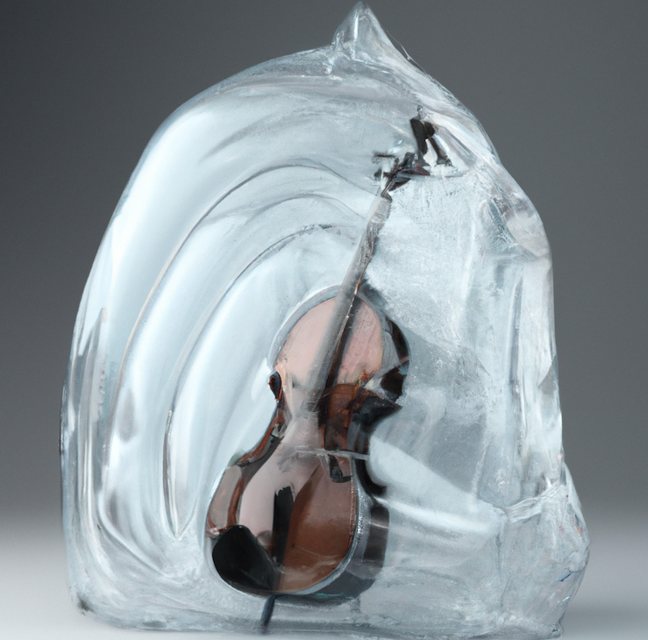
cello
ValueTrees for Humans

Slide 18
Classes ->
cello::Object
cello::Value
cello::Query
cello::Sync
cello::IpcClient

Slide 19
cello::Value
an object that acts as a proxy to a property in a ValueTree
templated on a concrete type
arbitrary data types supported; VariantConverters are invoked automatically
optional onSet/onGet lambdas to validate data
optional onPropertyChange lambda
arithmetic operators defined when template type is numeric

Slide 20
cello::Value
contains a reference to the cello::Object of which it is a member
has a juce::Identifier specifying its property name
Types used must
have an operator != defined
be supported by juce::var or have a VariantConverter defined

Slide 21
Uniform Access Principle
"All services offered by a module should be available through a uniform notation, which does not betray whether they are implemented through storage or through computation."
– Bertrand Meyer, inventor of the Eiffel language
Goal:
obj.x = 42;
int myValue = obj.x;

Slide 22
Set a Property Value
template <typename T> class Value
{
Value& operator= (T val)
{
if (onSet)
val = onSet (val);
juce::var asVar {juce::VariantConverter<T>::toVar(val)};
tree.setProperty (propId, asVar, obj.getUndoManager ());
return *this;
}
}

Slide 23
Get a Property Value
template <typename T> class Value
{
operator T ()
{
juce::var asVar = tree.getProperty (propId);
T val = juce::VariantConverter<T>::fromVar (asVar);
if (onGet)
val = onGet (val);
return val;
}
}

Slide 24
cello::Object
has-a juce::ValueTree
is-a juce::ValueTree::Listener
may have a juce::UndoManager
derived classes contain 1..n cello::Value members
derived classes contain 0..n cello::Object children
manages undo/redo & persistence
exposes NoSQL-ish database operations
manages callbacks when tree state changes

Slide 25
Define cello::Value Members
class MyObject : public cello::Object
{
// Basic syntax:
// specify type, reference to ‘this’, Identifier, init val
cello::Value<int> val1 { *this, “val1”, {} };
// convenience macro:
MAKE_VALUE_MEMBER (int, val2, {});
};

Slide 26
Create or Wrap
basic Object ctor is:
Object (const juce::String& typeName, const Object* state);
if state pointer is null, will create a new internal ValueTree of the specified type, set to default values
if state points to an Object
  if the type of the Object is typeName, we’ll wrap that tree.
  if the Object contains a child of type typeName, we’ll wrap that child.
  else, we’ll create a new ValueTree of type typeName and append it as a child of the state Object.

Slide 27
Paths
simple behavior when wrapping an Object:
  Object has type we’re looking for? Wrap it.
  Object contains a child of our type? Wrap that child.
we can also provide a directory-like Path to define where we look for an Object to wrap.
if necessary, we’ll create empty intermediate trees to create the correct hierarchy, like “/foo/bar/baz” will create “foo” and “bar” trees if they don’t exist

Slide 28
Callbacks
called from cello::Object’s ValueTree::Listener implementation
onPropertyChange
onChildAdded
onChildRemoved
onChildMoved
onParentChanged
onTreeRedirected

Slide 29
Functional Reactive Programming
getting and setting properties that are visible from anywhere in an app is extremely useful, obviously.
the magic happens when change notifications on an atomic per-property level are used to invoke callables focused on a single property.
because everything is decoupled, building systems that can be extended and modified without breaking things or introducing new bugs becomes much more straightforward.

Slide 30
cello::Query
define NoSQL-style queries of a cello::Object
contain 0..n cello::Query::Predicate functions
contain 0..n cello::Query::Comparison functions
pass a Query to cello::Object::find() or findOne()
cello::Object::upsert() and upsertAll()
  perform a query; get 1..n copies of child objects
  modify some/all of those copies or add new items
  pass the list of items to upsert() to update the originals or add the new items

Slide 31
cello::Sync
ValueTrees are not thread-safe
cello::Sync connects a pair of cello::Objects, each to be used in a different thread context
uses the juce::ValueTreeSynchronizer class to generate a binary delta when the “producer” Object changes
we add the delta blob to a thread-safe queue and notify the thread on the “consumer” side
when it can do so, that thread applies the delta to bring the two trees into sync

Slide 32
cello::IpcClient
why stop at thread boundaries?
connect two cello::Objects in separate processes
connect using TCP sockets or named pipes
uses the juce::InterprocessConnection classes for low-level implementation

Slide 33
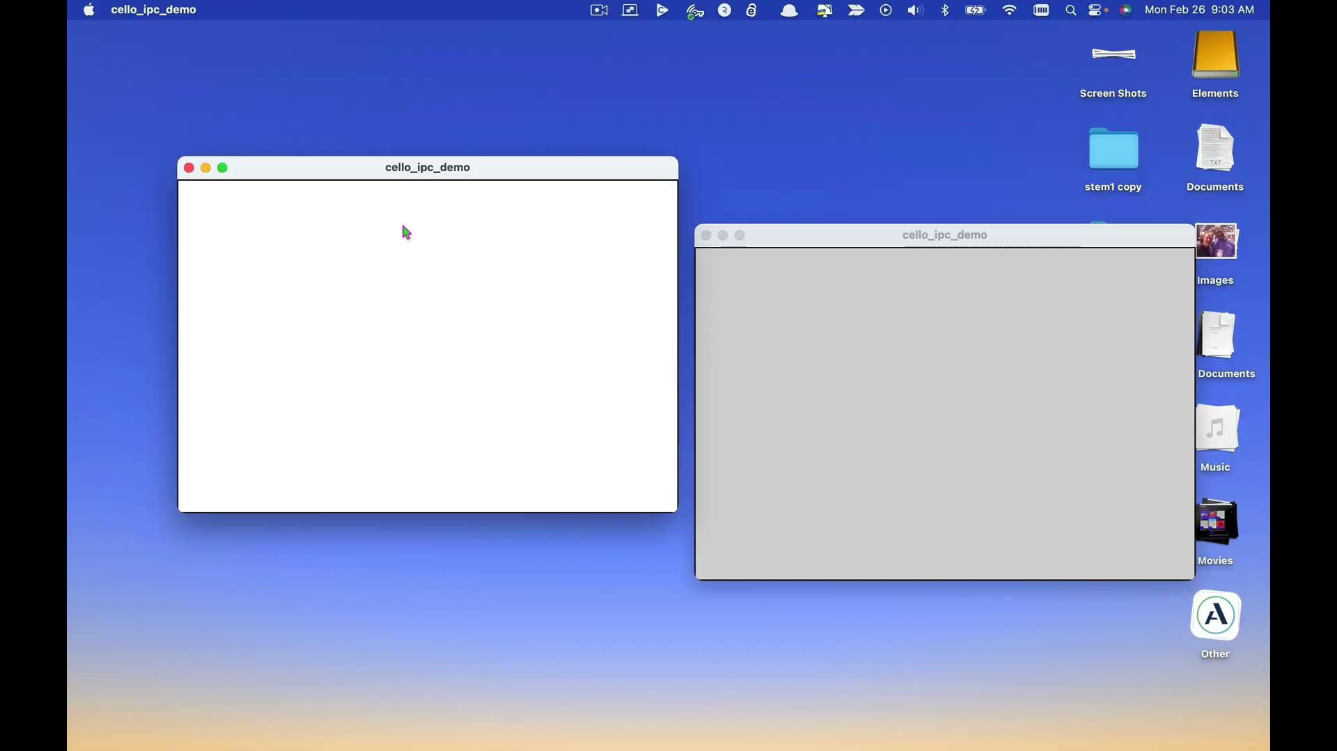
IpcClient Demo

Slide 34
Working with Objects/Values
the main Component or Application classes instantiate each of the top-level cello::Object classes in the hierarchy, usually created by some kind of a Model or Controller object
user interface components or classes needing state data are passed a pointer or reference to the root cello::Object that owns the app state, and they wrap whatever chunks of the state they’re interested in, or append their own state for other modules to work with

Slide 35
Case Study: Analytics
new Product Manager decided it was time to add analytic tracking to the app
…which would touch a huge number of modules across the entire app if we did this intrusively
because we have access to the entire app state, a new Analytics module just adds onPropertyChange callbacks to every interesting Value.

Slide 36
Case Study: MIDI Comms
control/monitor instrument via MIDI SysEx
three threads involved:
  Message thread
  Send thread (queue outbound messages, retry, etc)
  MIDI Rx thread
uses a pair of cello::Sync objects
Message Thread
Send Thread
MIDI Rx Thread

Slide 37
Case Study: Content Library
~350 pieces of factory content (+ 1000s of .wav files)
need to track location of each piece of content
scans of local directory and connected instruments running on separate threads, Sync-ed back into Message thread
filters, searches, and sorts performed with cello::Query

Slide 38
Other Useful Stuff
“Pythonesque” access simplifies dynamic schemas while retaining type safety & convenience
persistence to/from files
forced and excluded property updates
soon: class factory support
someday: a generic approach to complex async call chains

Slide 39
Lessons and Thoughts
should you use this? Maybe.
the real point: making your tools fit your hand is your responsibility and privilege
share what you make!
risk: having your car up on blocks all the time
risk: the JUCE team might add code that makes yours unneeded.
use what you made to build better applications

Slide 40

Get It:
https://github.com/bgporter/cello
JUCE module: drop in and go
MIT license

