Slide 1


Slide 2
Performance implications of frequency domain crossfading for time-varying FIR filtering
Iustin Sandu
d&b audiotechnik GmbH & Co. KG
Audio Developer Conference 2024

Slide 3
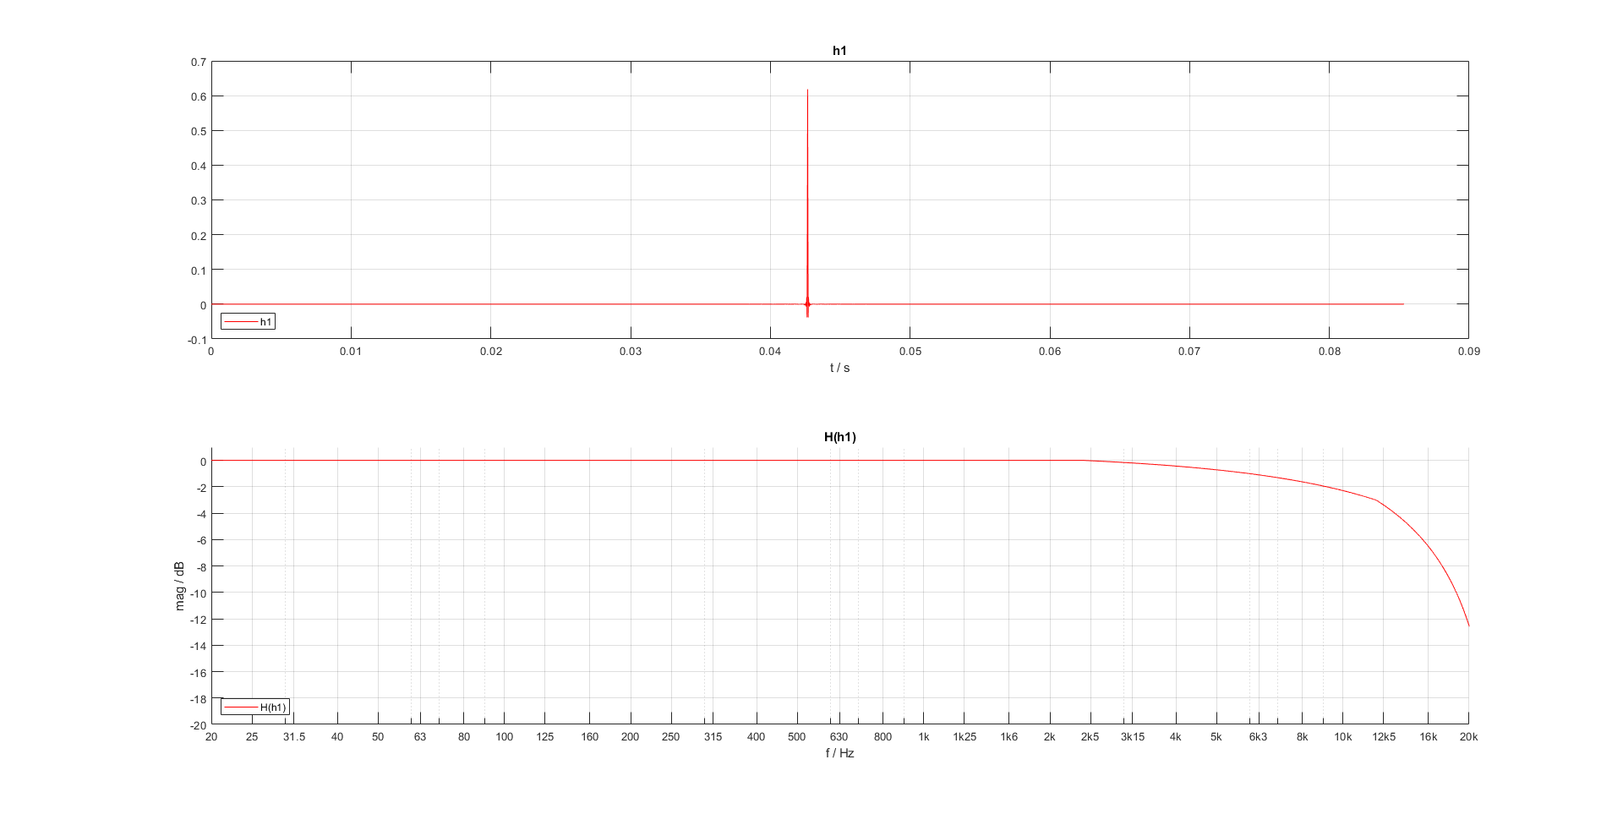
FIR filtering
Linear systems modelled with impulse responses

Slide 4
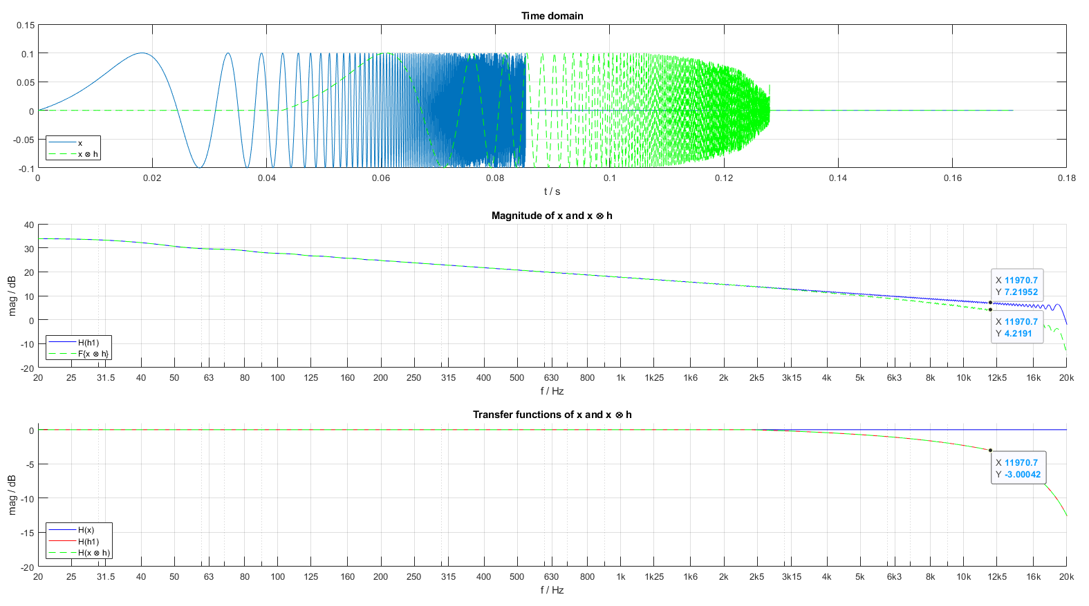
FIR filtering
Impulse response applied to signals by convolution

Slide 5
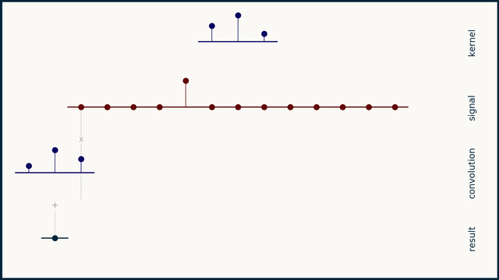
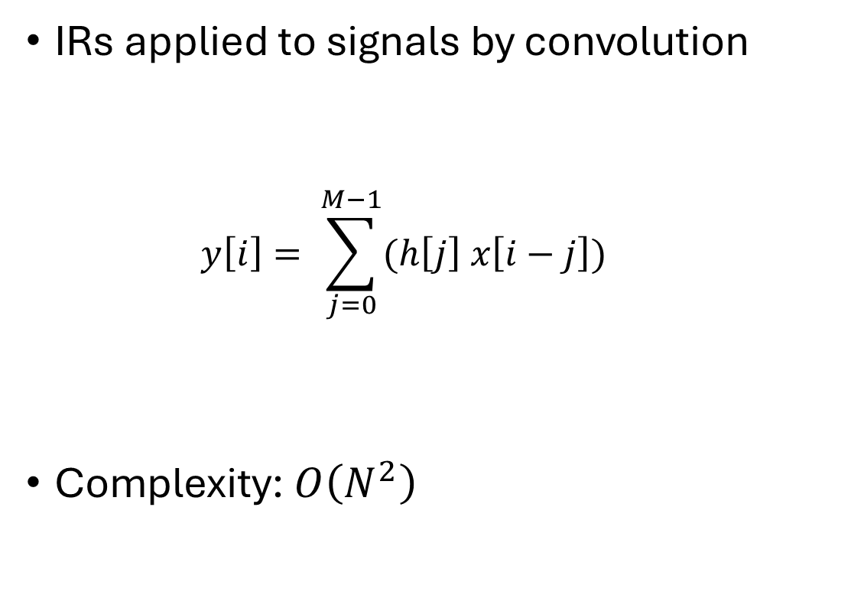
Convolution
IRs applied to signals by convolution
  $$y\left[i\right]= \sum_{j=0}^{M−1}{(h\left[j\right] x\left[i−j\right])}$$
Complexity: $O\left(N^{2}\right)$
Credit: https://e2eml.school/convolution_one_d.html

Slide 6
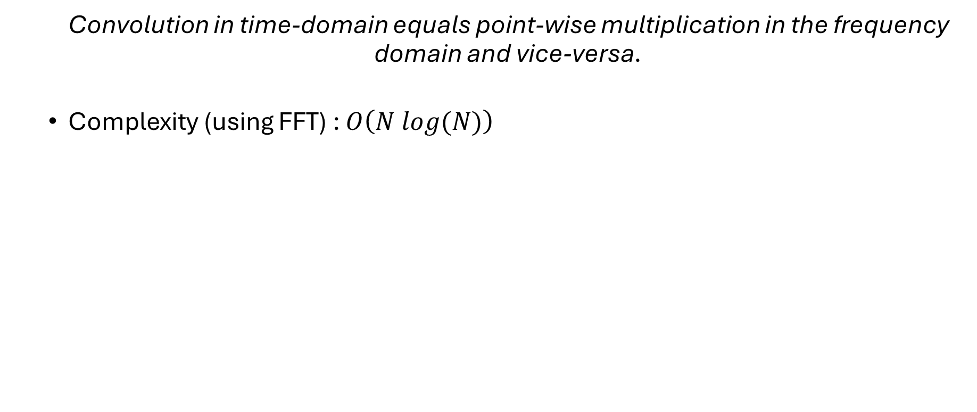
Convolution theorem
  Convolution in time-domain equals point-wise multiplication in the frequency domain and vice-versa.
  Complexity (using FFT) : $O\left(N log(N)\right)$

Slide 7
Measurement procedure
2018 Laptop
Intel Core i7-7700HQ, 2.8GHz
16 GB RAM
32KB Split L1 Cache
256KB Unified L2 Cache
6144KB Unified L3 Cache (shared)
Measurements using google benchmark in manual time configuration

Slide 8
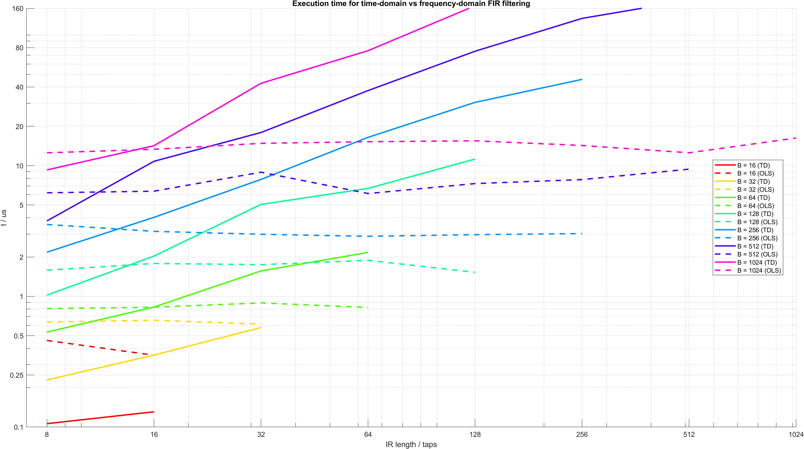
Time / Frequency domain filtering – execution time
Notes:
Unless the filters are really small (probably something to do with the cache)
To be expected, N^2 algo
Time-domain execution time skyrockets with longer filters.
Why the OLS constant -> FFT size dependent on the max(B, NFIR), in this case the block size.

Slide 9
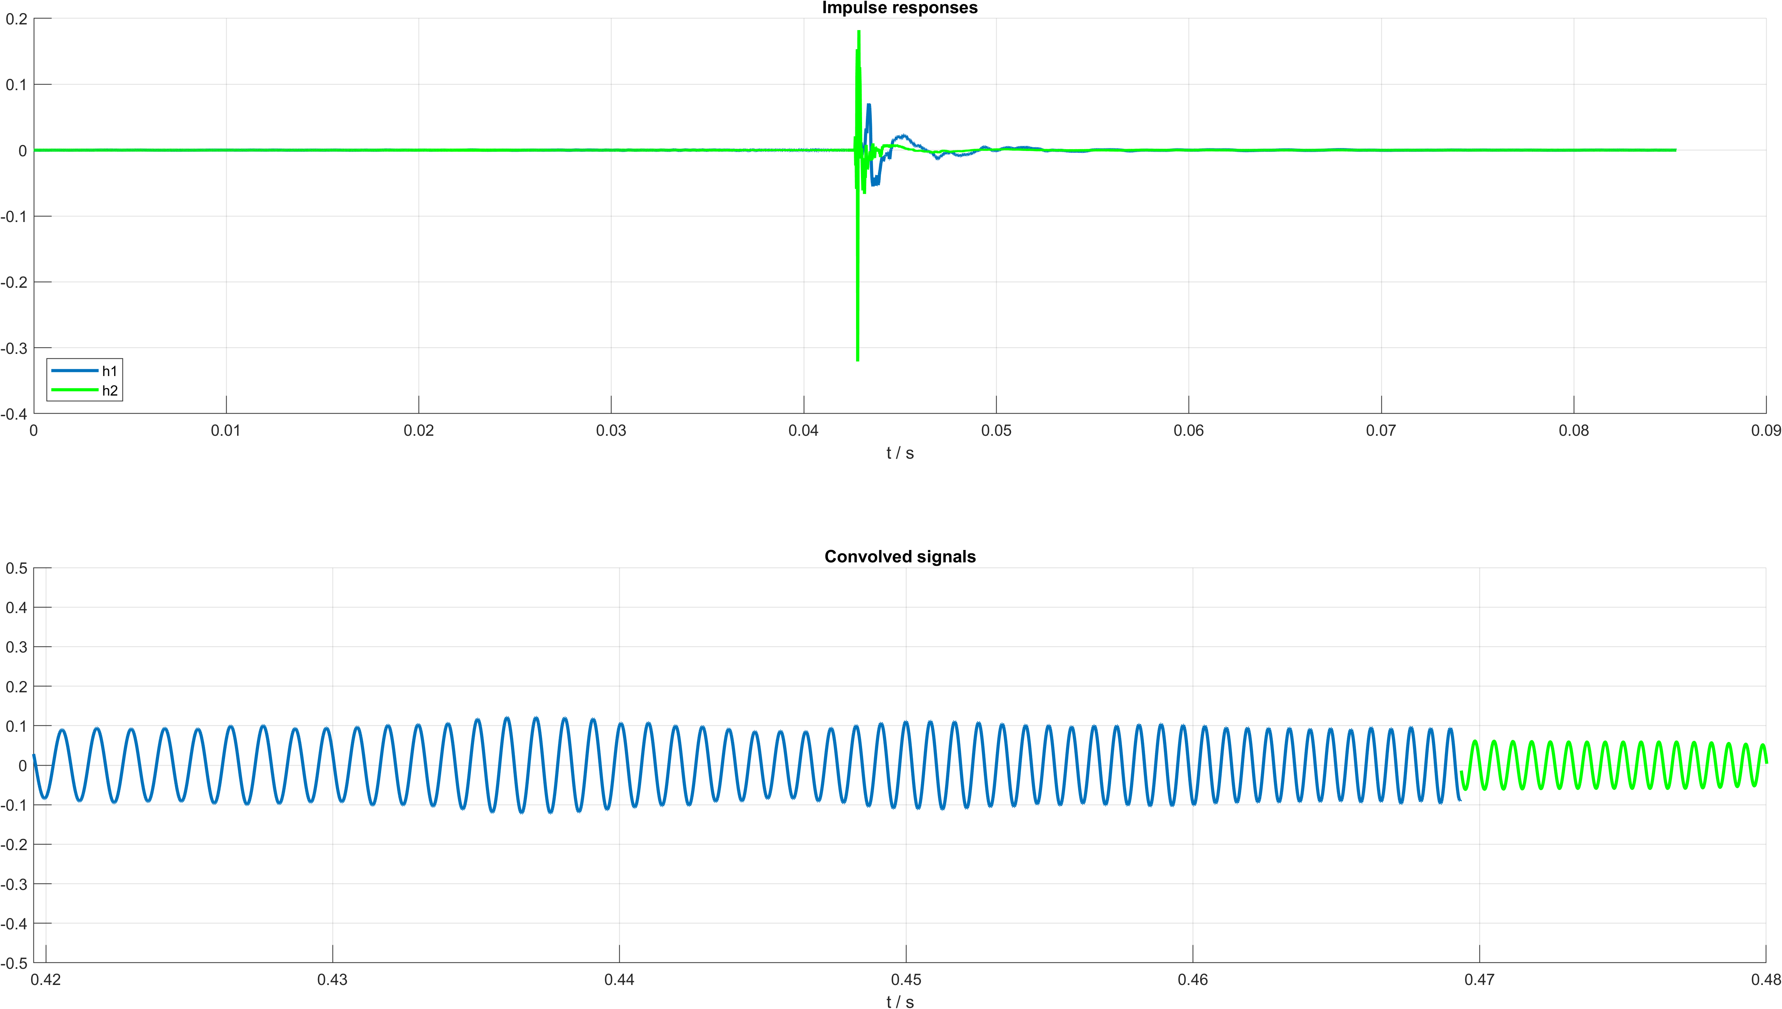
Filter exchange

Slide 10
Filter exchange
GOAL: Avoid audible artefacts when transitioning

Slide 11
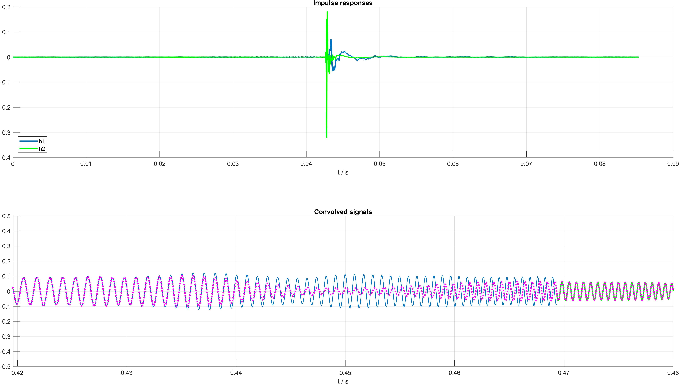
Filter exchange – crossfading

Slide 12
Filter exchange – crossfading
$\left(x ⨂h1\right) .∗f_{out}+\left(x ⨂h2\right) .∗f_{in}$

Slide 13
Filter exchange – crossfading
$$\left(x ⨂h1\right) .∗f_{out}+\left(x ⨂h2\right) .∗f_{in}$$
$$F\left\{ F\left\{x\right\} .∗F\left\{h1\right\} \right\} .∗f_{out}+F\left\{ F\left\{x′\right\} .∗F\left\{h2\right\} \right\} .∗f_{in}$$
$$F\left\{ X .∗H1\right\} .∗f_{out}+F\left\{ X′ .∗H2\right\} .∗f_{in}$$

Slide 14
Filter exchange – crossfading
// Time-invariant case
y = ifft ( fft(x) .* H1 );
// Time-variant case
y = ifft ( fft(x) .* H1 ) .* fOut + ifft ( fft(x´) .* H2 ) .* fIn;
>2x the amount of operations

Slide 15
Filter exchange – crossfading
// Time-invariant case
y = ifft ( fft(x) .* H1 );
// Time-variant case
y = ifft ( fft(x) .* H1 ) .* fOut + ifft ( fft(x) .* H2 ) .* fIn;
>2x the amount of operations

Slide 16
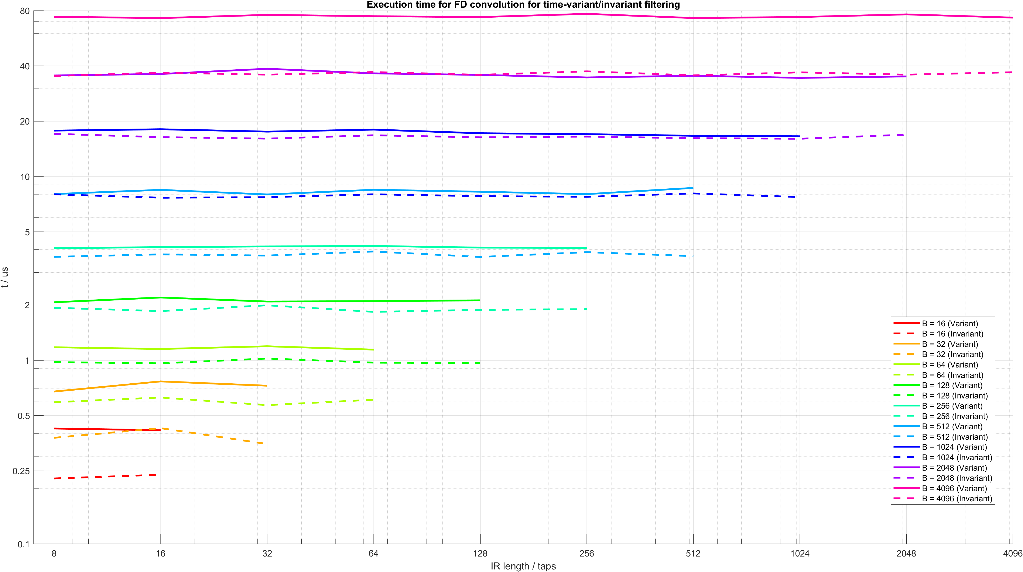
Filter exchange – static vs variable filter
Notes:
Why do they stay the same? FFT size is determined by max(B,N), so no matter what the filter length is, it will be cast to the blocksize.
Of relevance is the diference between the two: 30%

Slide 17
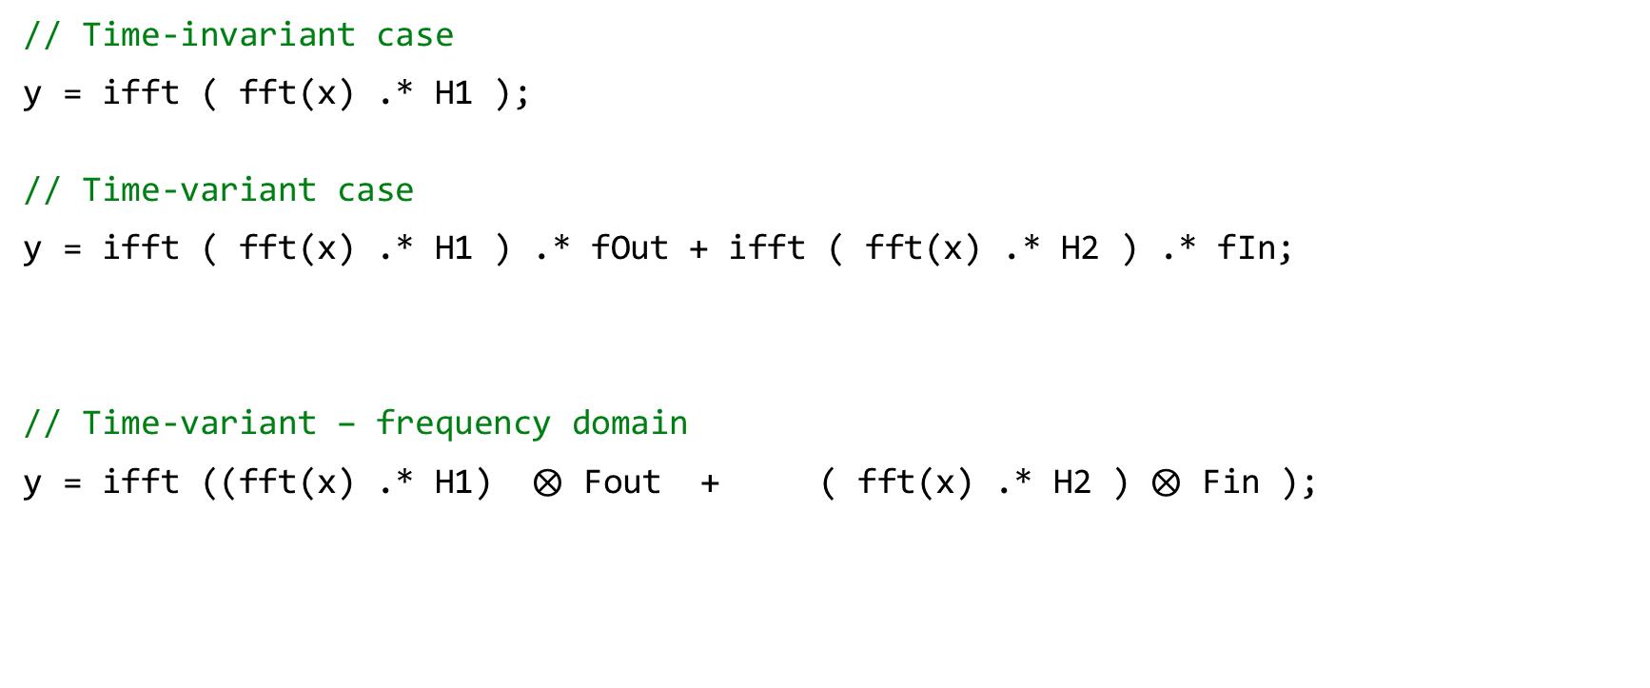
Filter exchange – crossfading
// Time-invariant case
y = ifft ( fft(x) .* H1 );
// Time-variant case
y = ifft ( fft(x) .* H1 ) .* fOut + ifft ( fft(x) .* H2 ) .* fIn;
// Time-variant – frequency domain
y = ifft ((fft(x) .* H1) $⨂$ Fout + ( fft(x) .* H2 ) $⨂$ Fin );

Slide 18
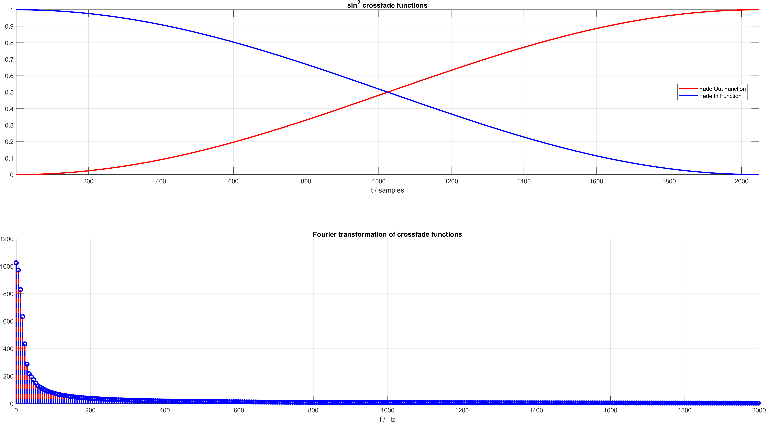
Crossfade function
Notes:
Fade function is non-periodic, spectrum will contain many factors
Efficient time-varying FIR filtering using crossfading implemented in the DFT domain, Frank Wefers and Michael Vorländer
Since FFT is a decomposition into sinusoids so, we can get a sparse spectrum when the signal (fade envelope) is composed of a sinusoid covering an integer multiple period
-> Convolution, length of the output signal is M+N-1 -> performance reasons in audio at least 2*N;

Slide 19
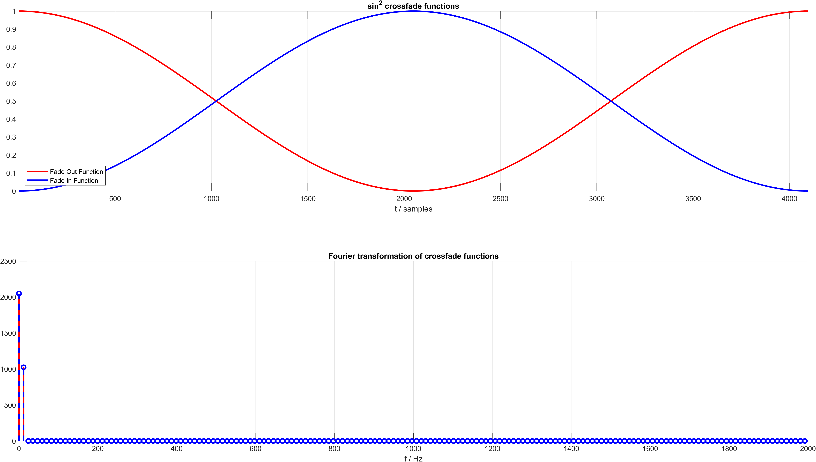
Crossfade function
Notes:
Sparse spectrum (only 3!! non-zero coefficients – one of them is at Nyquist)-> most of the factors are 0 ---> we have drastically removed the number of multiplications.
-> Equal POWER crossfade

Slide 20
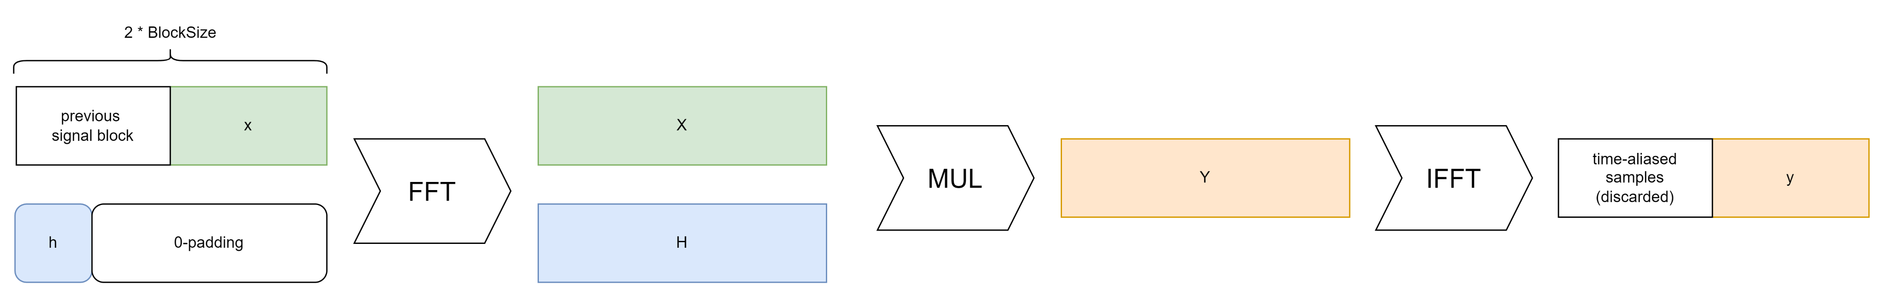
FFT Convolution – overlap-save
Due to circular convolution -> unwanted „fading“ shifted into the time-aliased sample region
Notes:
OLS
FFTs in powers of 2. Blocksize pow 2. Half a block is discarded.

Slide 21
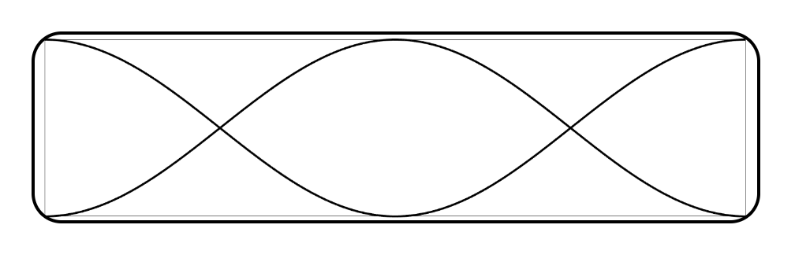
FFT Convolution – overlap-save
*
* not mathematically accurate – for mental model purposes only.
Notes:
-> OLS

Slide 22
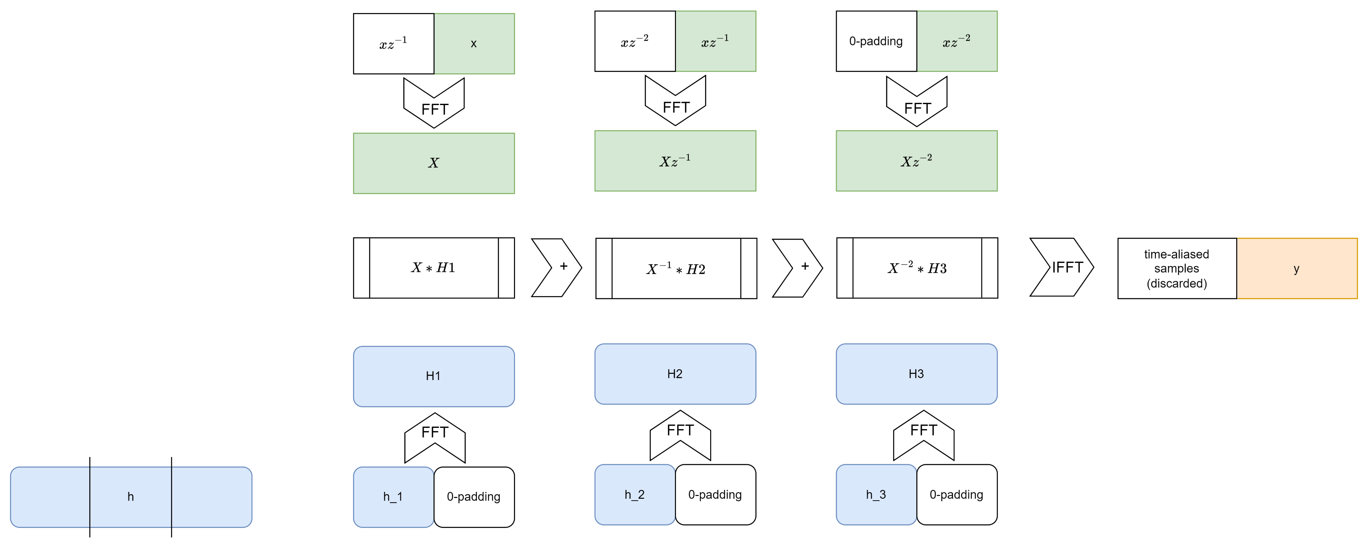
Partitioned convolution – overlap-save review

Slide 23
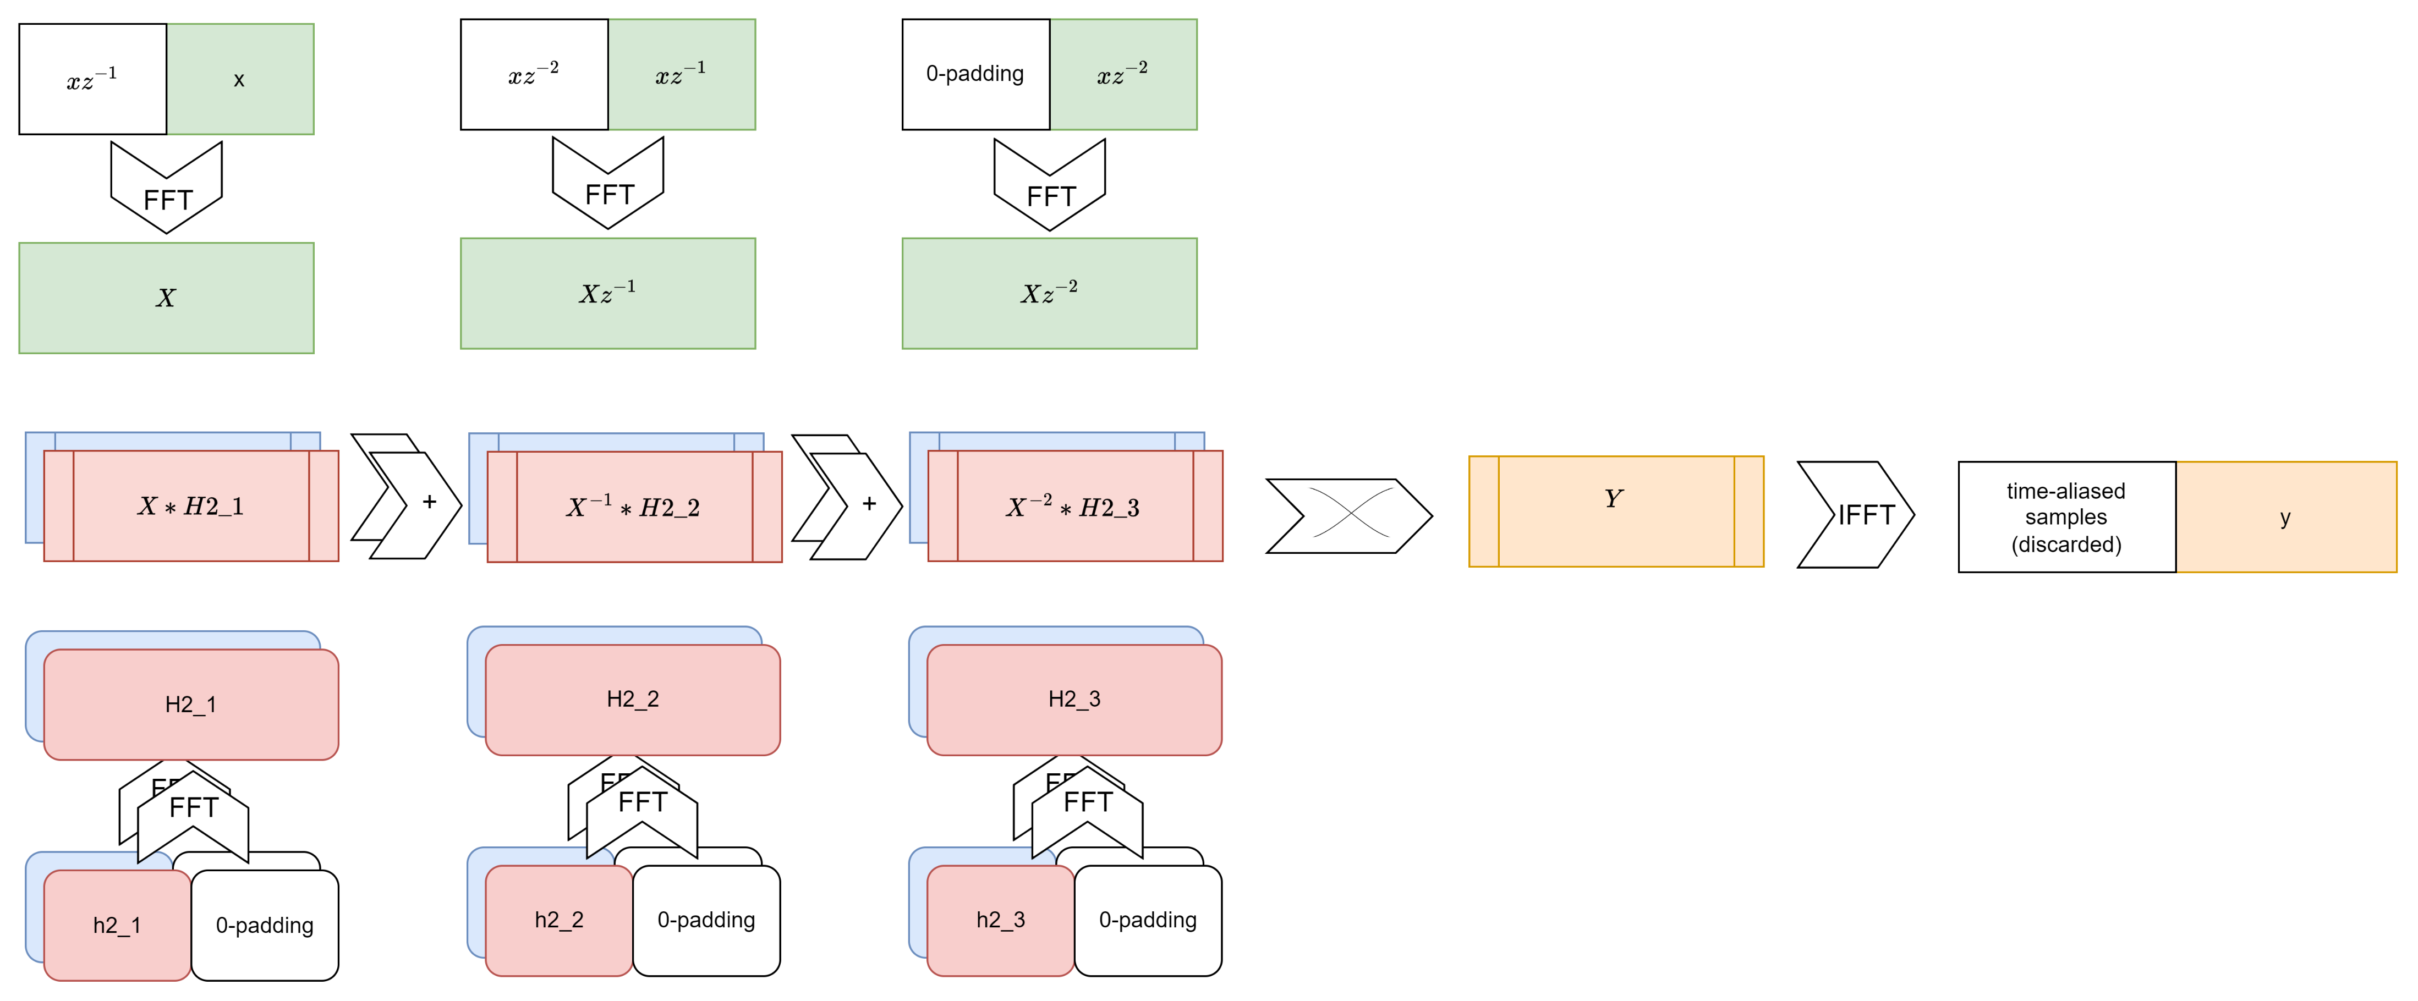
Partitioned convolution – spectrum crossfade
Notes:
Temptation to „reuse“ modules

Slide 24
Partitioned convolution – spectrum crossfade – naive approach
//
slidingWindow = assignNewBlock( x );
X_1 = fft(slidingWindow);
// h1
Y1 = (X_1 .* H1_1) + (X_2 .* H1_2) + ... + (X_N .* H1_N);
// h2
Y2 = (X_1 .* H2_1) + (X_2 .* H2_1) + ... + (X_N .* H2_N);
// xfade
y = ifft( frequencyDomainXFade(Y1, Y2) );
Notes:
Worse – operations that we do not need
→ 2nd part of the equation is filtered signal that would not be there in the time domain (it would assume we started the filtering even earlier)

Slide 25
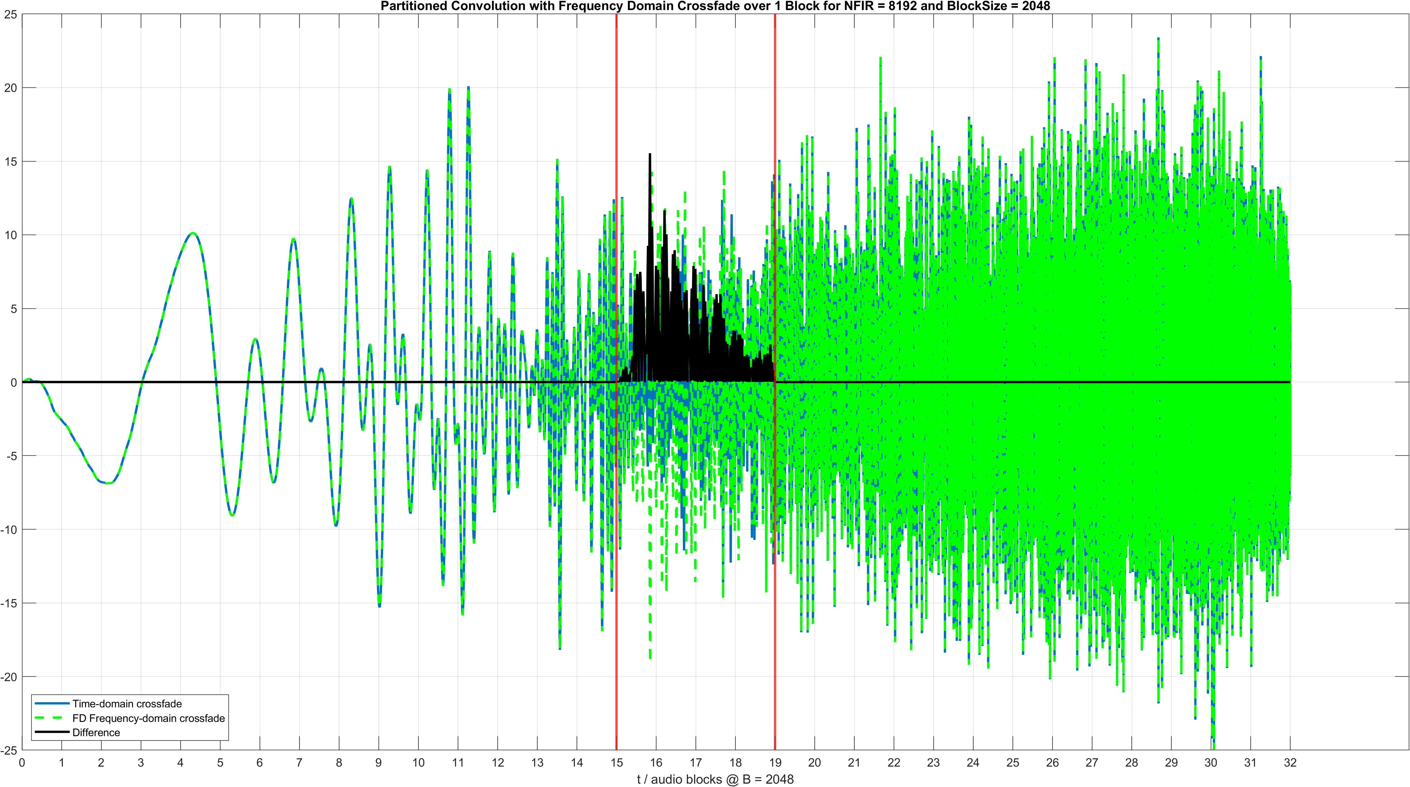
Partitioned convolution – spectrum crossfade

Slide 26

Partitioned convolution – spectrum crossfade – naive approach
Notes:
Essentially adding previous parts of the signal to our H2 filter result. The time-domain version, the filter starts with the
Practically, behaves as if the filter started 3 Blocks ago, but only now it is being crossfaded

Slide 27
Partitioned convolution – spectrum crossfade – naive approach
//
slidingWindow = assignNewBlock( x );
X_1 = fft(slidingWindow);
// h1
Y1 = (X_1 .* H1_1) + (X_2 .* H1_2) + ... + (X_N .* H1_N);
// h2
Y2 = (X_1 .* H2_1) + (X_2 .* H2_1) + ... + (X_N .* H2_N);
// xfade
y = ifft( frequencyDomainXFade(Y1, Y2) );
Notes:
Worse – operations that we do not need
→ 2nd part of the equation is filtered signal that would not be there in the time domain (it would assume we started the filtering even earlier)

Slide 28
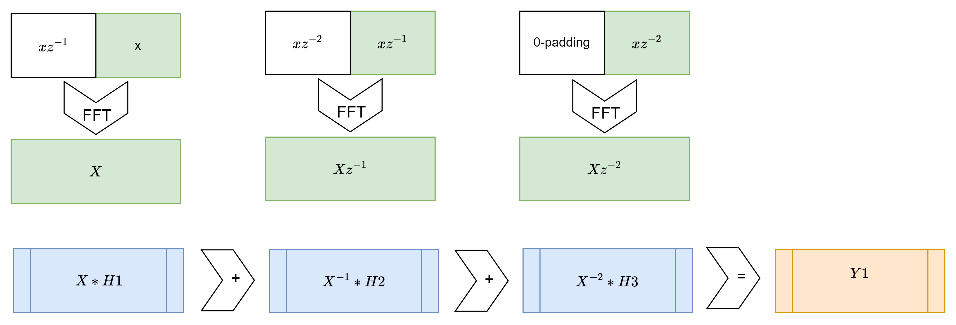
Partitioned convolution – spectrum crossfade
Notes:
Process first signal normally

Slide 29
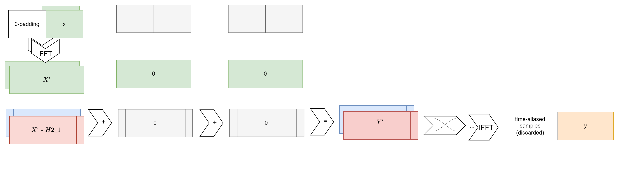
Partitioned convolution – spectrum crossfade
Notes:
Process first signal normally

Slide 30
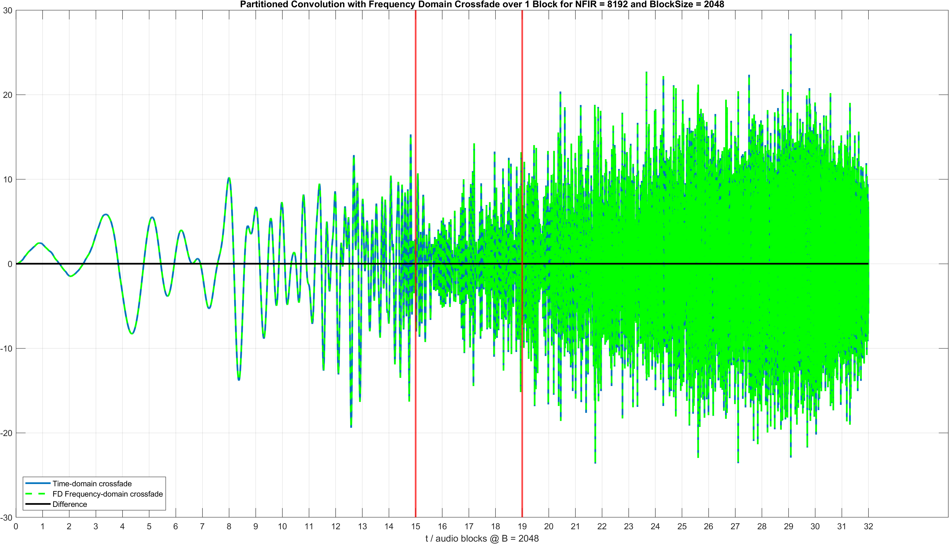
Partitioned convolution – spectrum crossfade

Slide 31
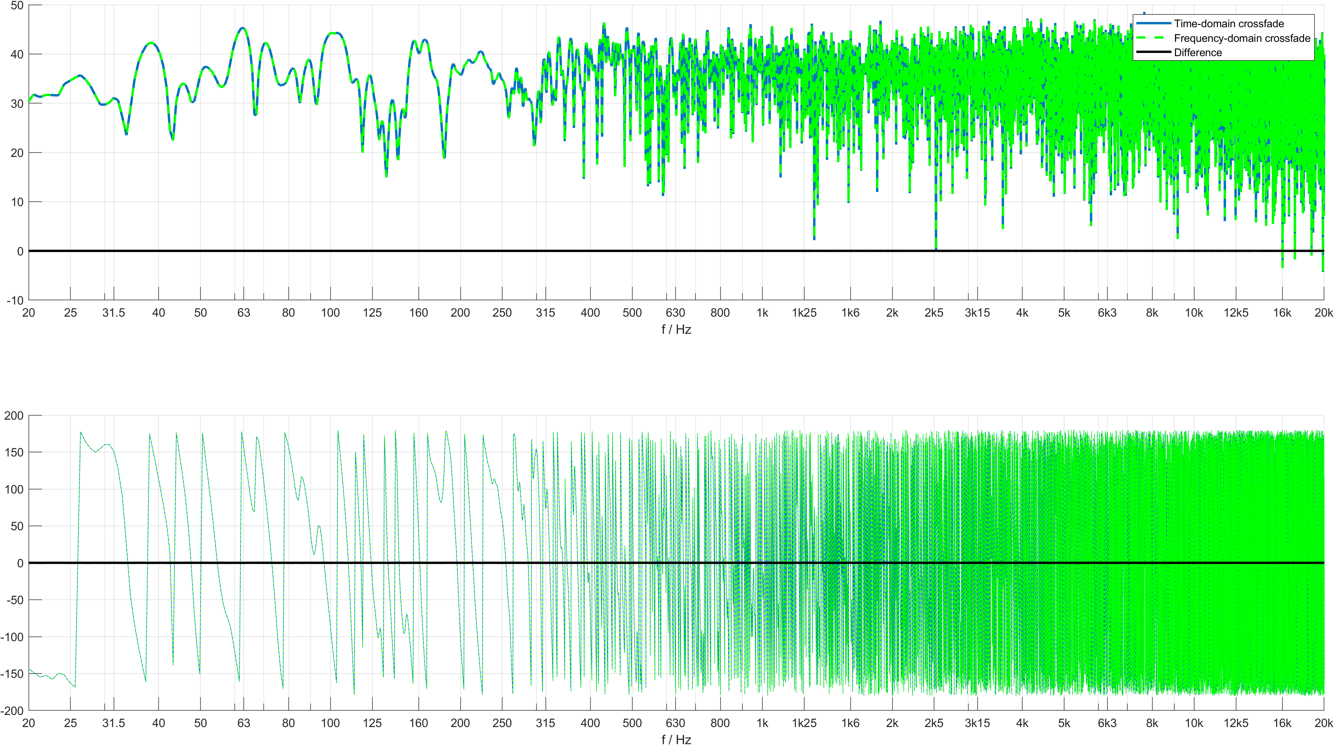
Partitioned convolution – spectrum crossfade
Notes:
- This issue is present also in the non-partitioned OLS.

Slide 32
Partitioned convolution – spectrum crossfade
GOAL: Avoid audible artefacts when transitioning
& minimal unwanted (audible) coloration
Notes:
Additional FFT ---

Slide 33
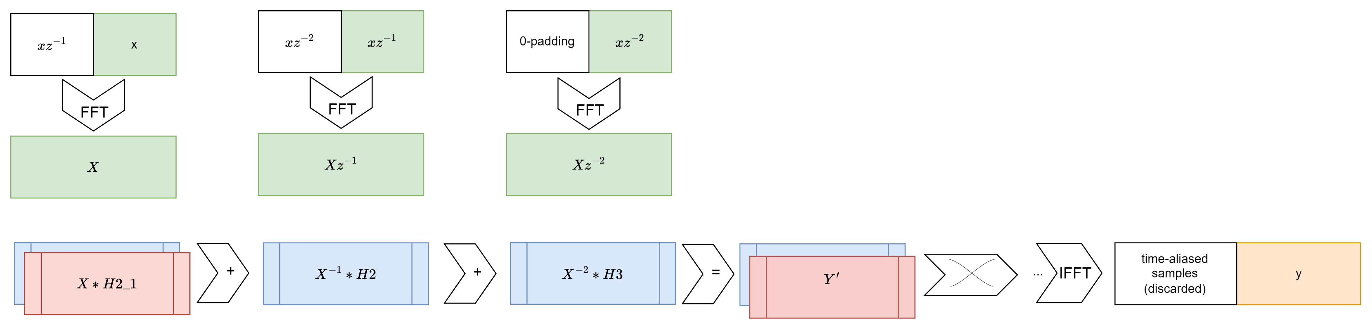
Partitioned convolution – spectrum crossfade
If the the few blocks of „wrong“ results are ok - „no audible coloration“ - you can get away with a single FFT

Slide 34
Partitioned spectrum crossfade– naive approach
If the the few blocks of „wrong“ results are ok - „no audible coloration“ - you can get away with a single FFT

Slide 35
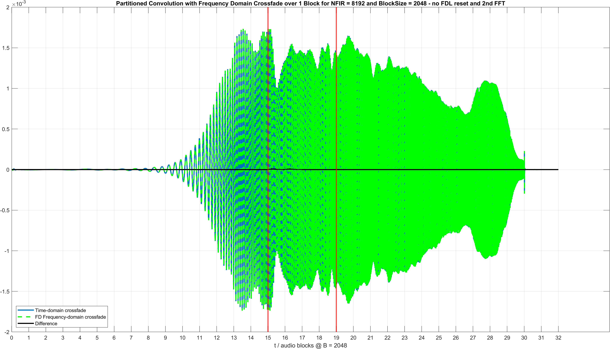
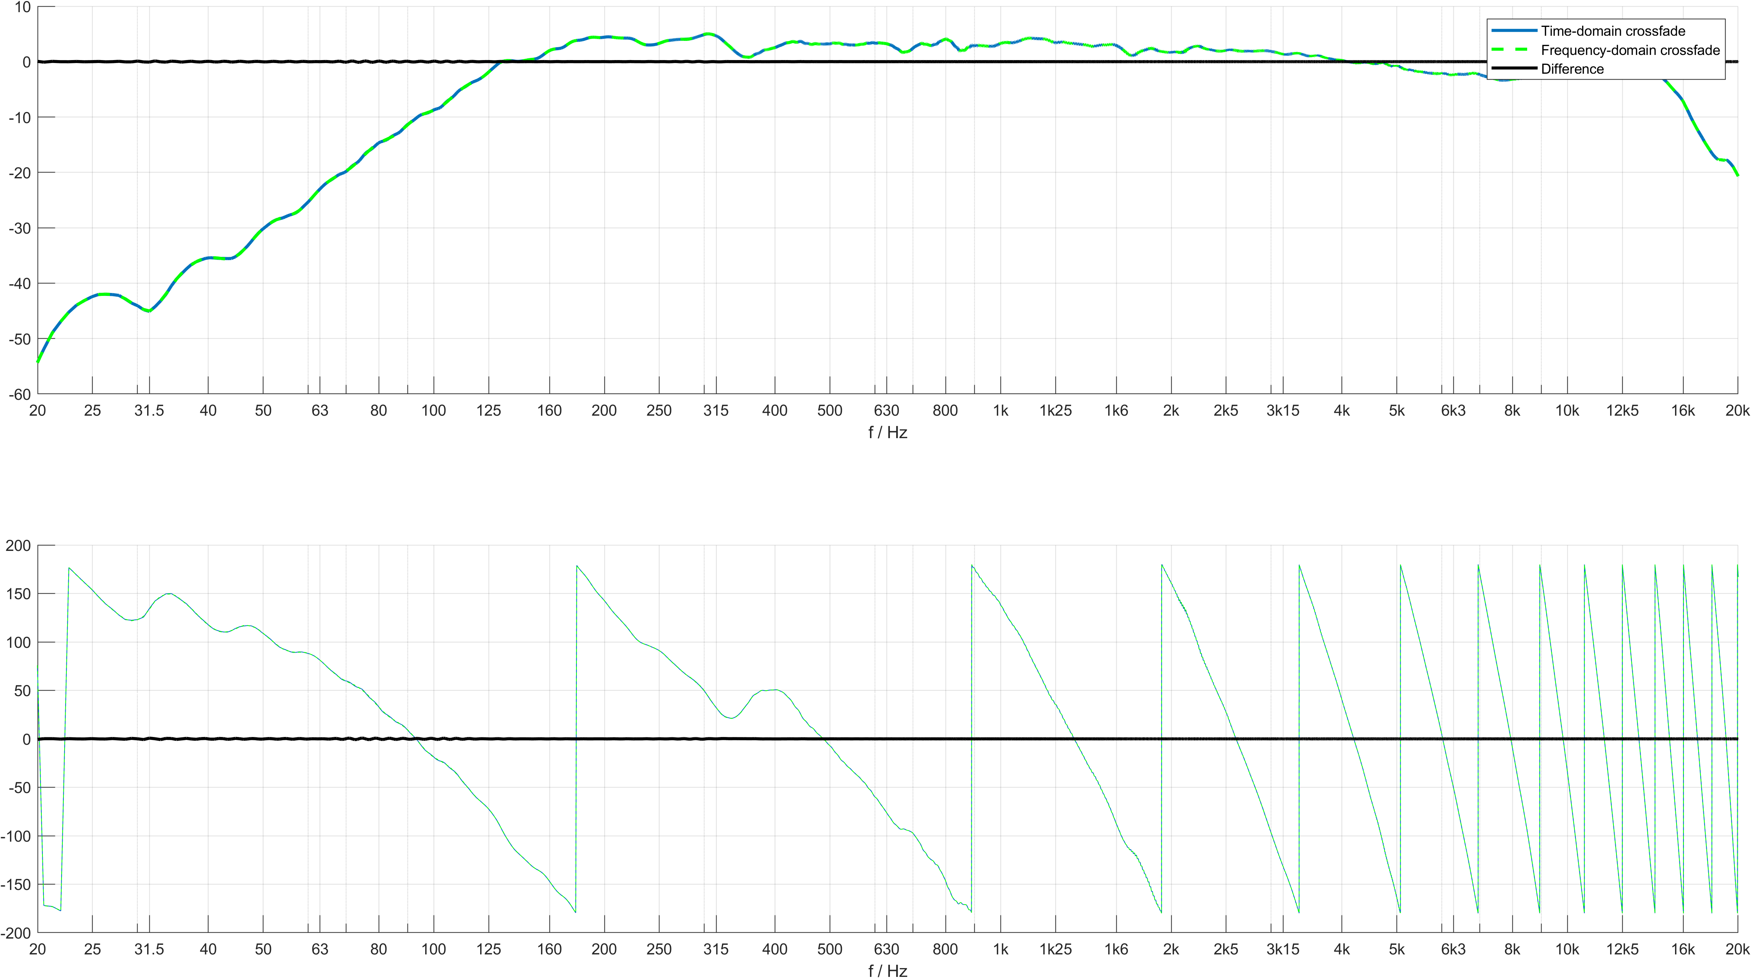
Partitioned convolution – spectrum crossfade
The IRs in the previous slide were random generated sequences
Real systems *may* be more forgiving ( for once )
Notes:
Real loudspeaker impulse responsese, without resetting the input buffer and delay line
No artefacts etc.

Slide 36
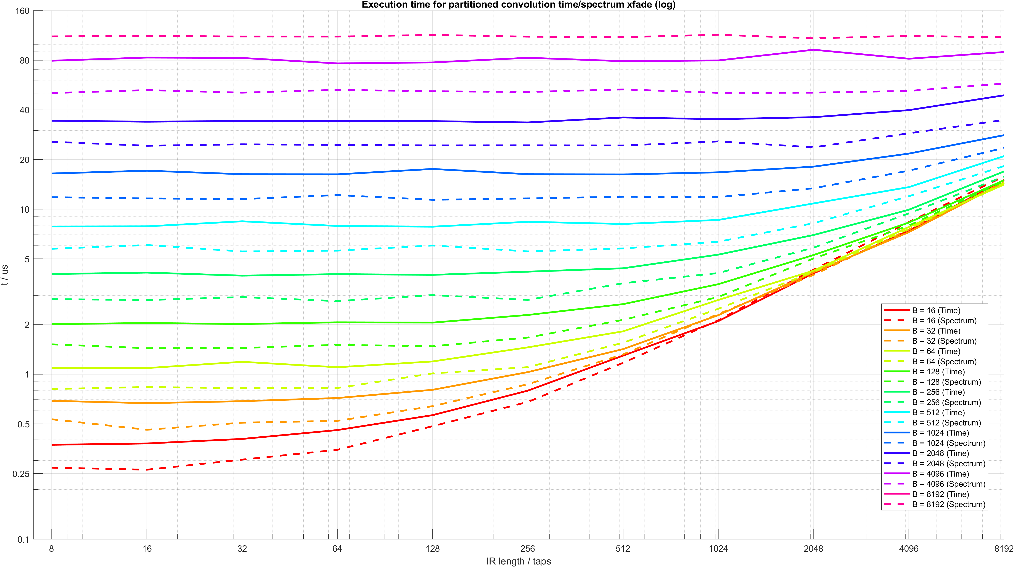
Partitioned – time vs spectrum
Notes:
Small block size and large filters, so many partition multiplications that the one xfade does not make much difference.

Slide 37
Caveats
Restricted to the envelopes covering an integer multiple of double the block length
Only works with the Overlap-Save
  Overlap-Add does not discard any samples
Only tested with fades ranging one block
  May not be suited for cases where you need a fade over multiple blocks (i.e. steady-state signals, B <= 128 and filters with differing delays)
Notes:
-> Implications: Very significant different filters (i.e. different delay, etc), if the block-size is too small – may still hear a click. This is the case with the time-domain fading as well, only that with the TD fade you can increase the fade size without increasing the block-size, whereas in FD there is a direct connection (or at least I didn‘t get it to work over multiple blocks).

Slide 38
Conclusions
Use case is important and subjective evaluation will be the deciding factor.
NFIR >> B
  unpartitioned convolution: FD will provide somewhat ~30% speed improvements
  partitioned convolution: frequency-delay line multiplications dominate so xfade performance is neglectable
NFIR <= B and fade length limitation is ok for the use-case – frequency-domain xfade can also provide ~30% performance increase
Notes:
-> Implications: Very significant different filters (i.e. different delay, etc), if the block-size is too small – may still hear a click. This is the case with the time-domain fading as well, only that with the TD fade you can increase the fade size without increasing the block-size, whereas in FD there is a direct connection (or at least I didn‘t get it to work over multiple blocks).

