Slide 1

Frontend Dev Strategies for Plugin UI

Slide 2
Introduction and Background
JUCE 8 has headline support for Web UI. What are some useful development tools?
  Marked the talk beginner + intermediate
  JUCE-leaning but not JUCE Specific
  Not affiliated with any of the mentioned tools
Other talks at ADC
  High Performance WebView User Interfaces
  Javascript, WebViews and C++ / “If You Can’t Beat Them, Join Them”
  ADC23: Build a High Performance Audio App With a Web GUI & C++ Audio Engine
https://github.com/tskare/adc24-demos for demos, notes, and these slides

Slide 3
Massive Amount of Available Resources
E-Books and Tree-Based Books
  Check your local library
YouTube videos
Interactive Tutorials
Web Forums
Consultants / Design Agencies / Prospective Hires

Slide 4
Growing Amount of JUCE-Specific Resources
Feature page for general tips, pros/cons, engines per platform
  https://juce.com/blog/juce-8-feature-overview-webview-uis/
Tutorial Series on YouTube:
  https://www.youtube.com/playlist?list=PLrJPU5Myec8Z-8gEj3kJdMfuuuWFbpy7D
Audience favorites?

Slide 5
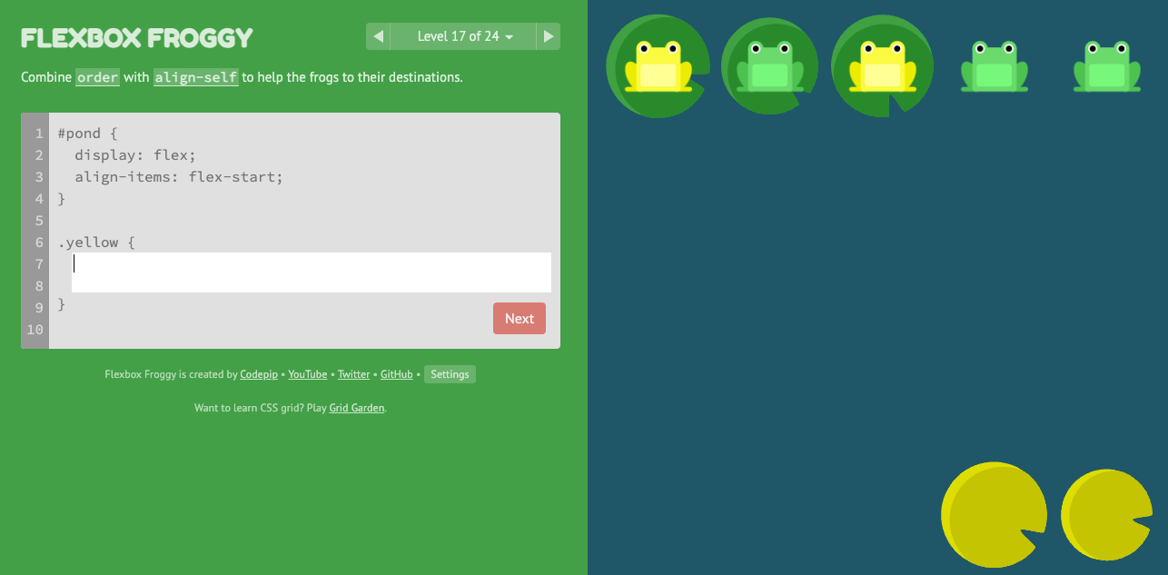
Interactive Resource Example: Learn Flexbox

Slide 6
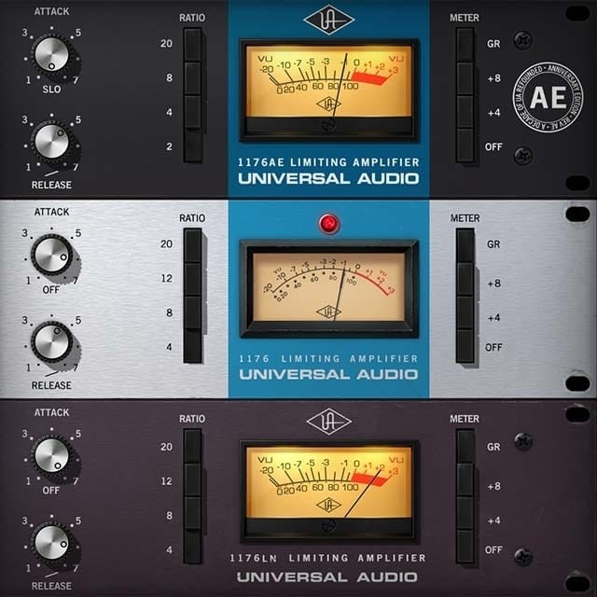
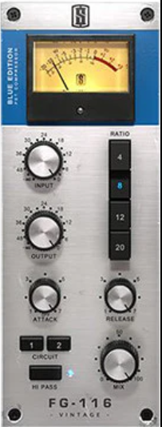

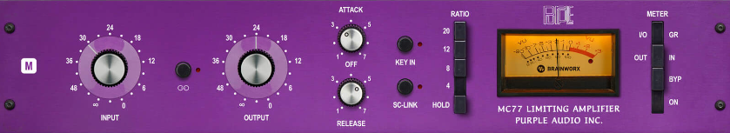





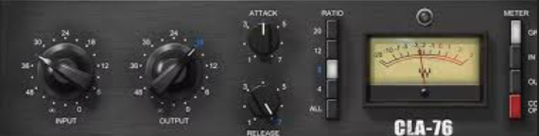

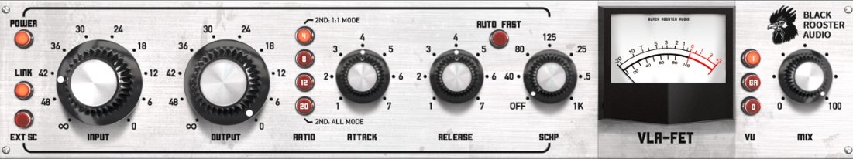
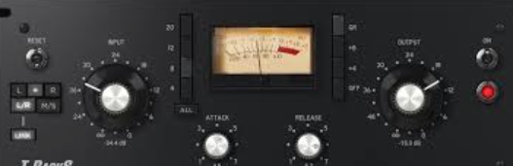
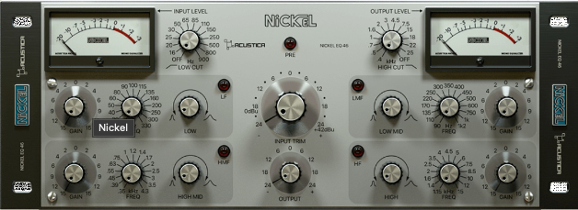
Many Frameworks, Libraries, Tools

Slide 7
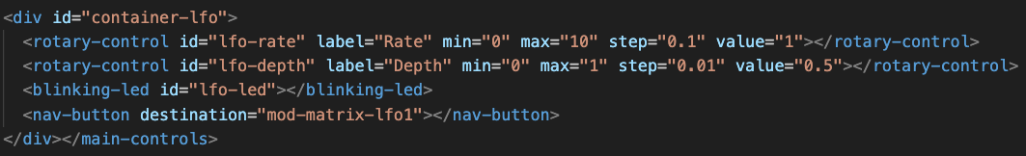
Web Components
Custom reusable elements for readable code, modular/encapsulated behavior.
Can be used with frameworks, or not. Some
Ongoing discussion on their utility, overhead, etc. (largely website-focused)
May both reduce and add complexity. Several proposals in flight.

Slide 8
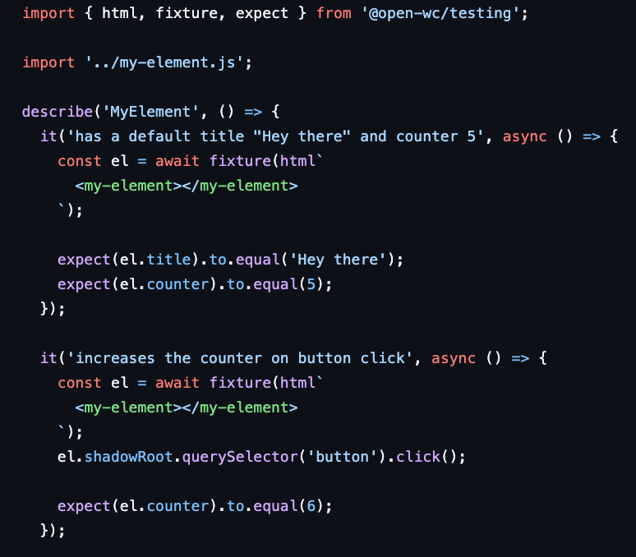
Testability
A variety of test frameworks
(Alpine, Karma, Jest, etc...)
Web Test Runner:
https://modern-web.dev/docs/test-runner/overview/
Example of WebTestRunner + Lit shown here.

Slide 9
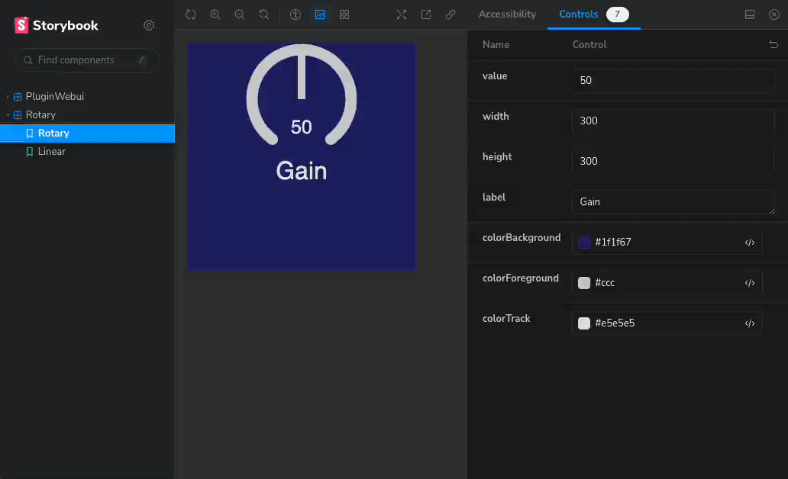
Storybook (and similar) for Widget Development

Slide 10

DevTools
Powerful set of tools to develop, debug, profile WebUI.
JUCE / MacOS: Available in Debug mode or un-#if JUCE_DEBUG:
[preferences setValue: @(true) forKey: @"developerExtrasEnabled"];
You might want to choose the pop-out view.
Windows: Similar, see JUCE WebUI tutorial. Linux: TBD at time of writing
Many resources online
~180 Quick tips: https://devtoolstips.org/
Chrome Documentation: https://developer.chrome.com/docs/devtools/

Slide 11
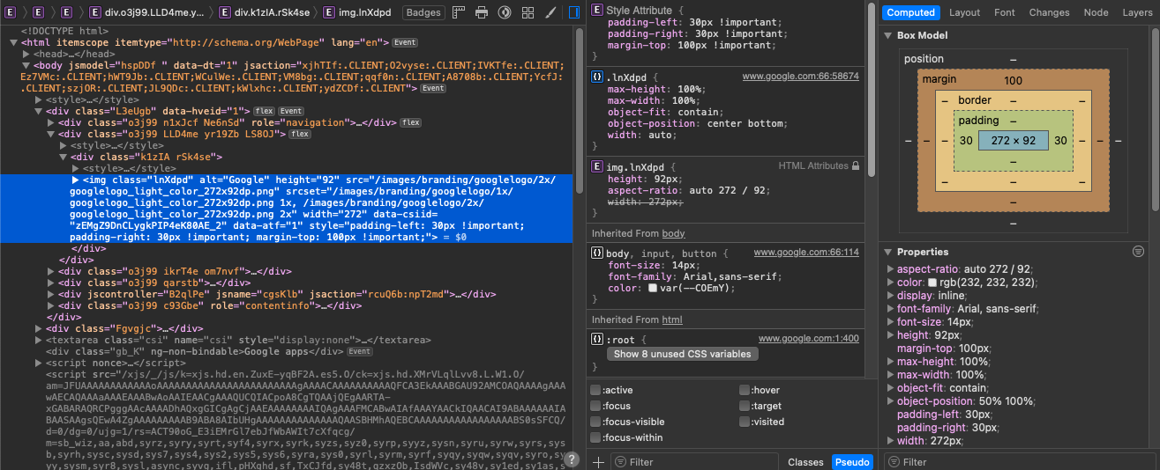
DevTools: Layout
Most values seen here are editable or inspectable

Slide 12
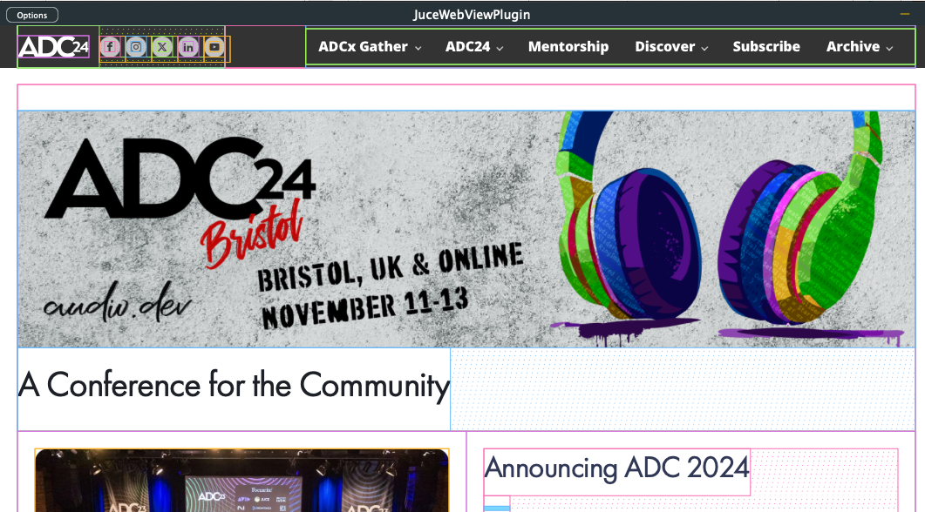
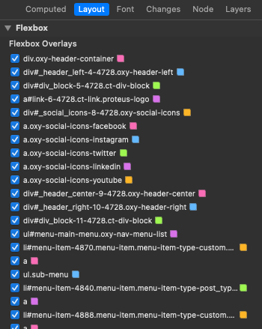
DevTools: Layout: Flexbox Debugging

Slide 13
Remote Debugging
Placeholder Slide – investigating at time of writing

Slide 14
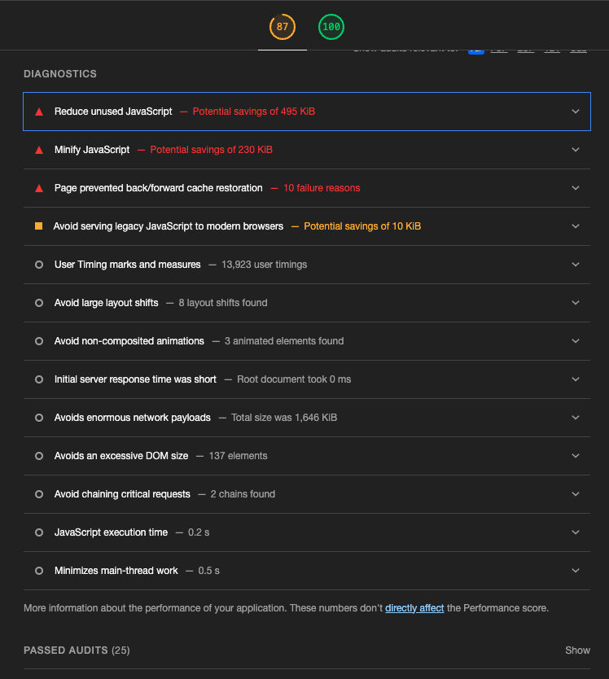
DevTools (Chrome): Lighthouse Audits
Accessibility and Performance audits
Often web and navigation-focused, but can identify antipatterns, excess Javascript, etc.

Slide 15
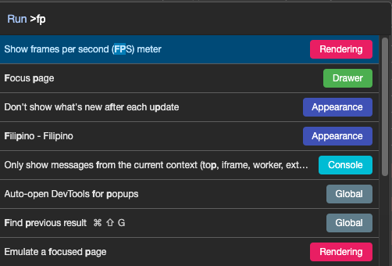
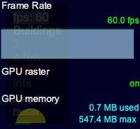
DevTools (Chromiums): Command Palette
Ctrl/Cmd + Shift + P
Example: Enable FPS overlay
Example: Take full/region/node screenshot

Slide 16
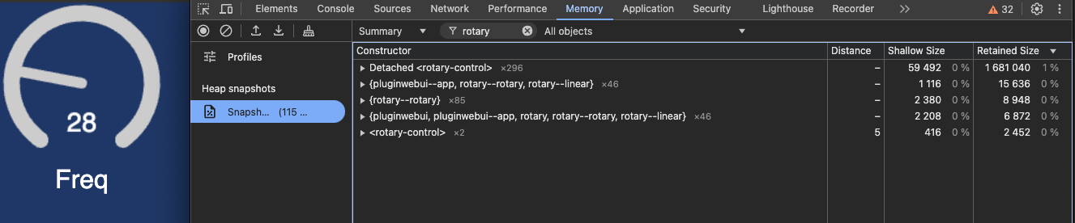
Memory: Plot Memory Usage, Diff Heap Snapshots

Slide 17
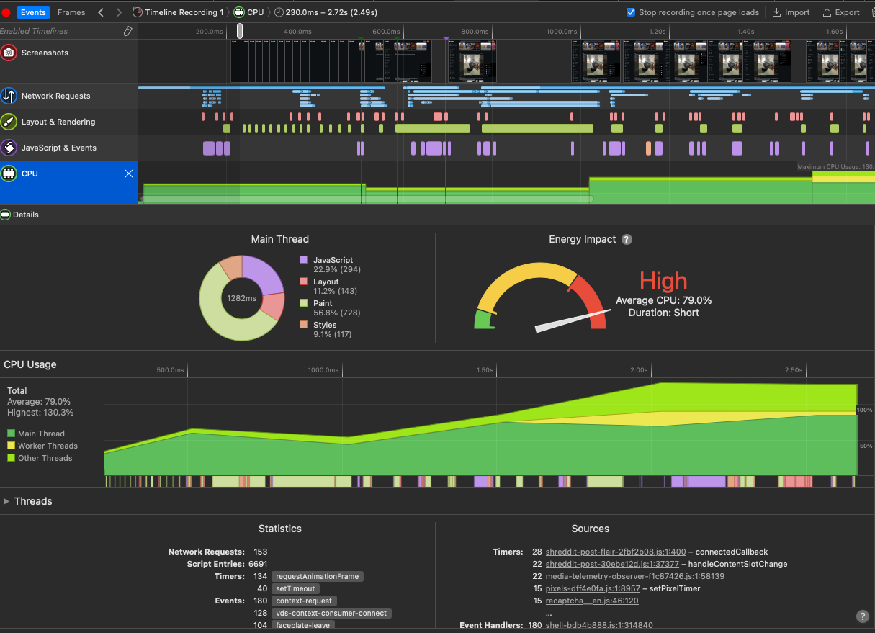
Timeline: Resource Usage

Slide 18
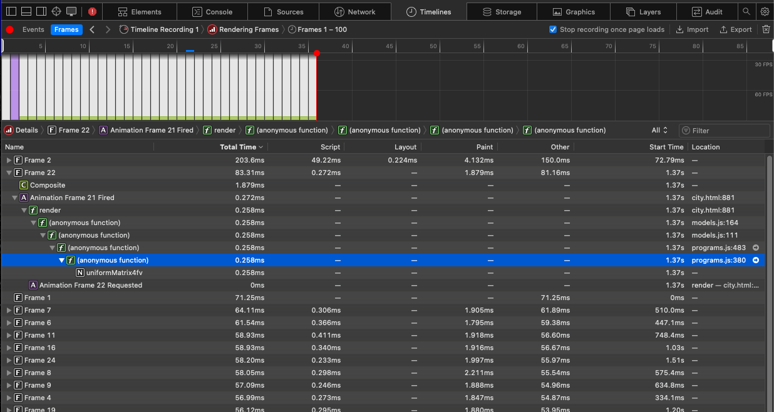
Timeline: Frame Timing
Note: I'm more familiar with the Chromium view, see https://www.youtube.com/watch?v=3_5DKEx72qk

Slide 19
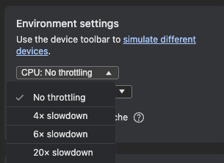
Simulating slow machine / overhead (Chromiums)

Slide 20
console beyond console.log()
https://developer.mozilla.org/en-US/docs/Web/API/Console_API
https://developer.apple.com/library/archive/documentation/AppleApplications/Conceptual/Safari_Developer_Guide/Console/Console.html
group() - indent messages
.count("thing happened")
.time(label)
.timeStamp("something else happened")
.profile() and .profileEnd()

Slide 21
DevTools: 4 characters or fewer
$0 contains the last selected element. $1, $2, ... are the last N selected nodes.
$_ contains previous console output
$(selector) aliases document.querySelector()
$$(selector) aliases querySelectorAll()
  Uses: $('#myElement'), $$("div.panel > indicator-led[blinking='1']")
dir(object) lists an object's properties
copy(foo) -- places value of foo on clipboard.
  tip: send last output to clipboard with copy($_)

Slide 22
Thank You!
Notes, Slides, Example Elements
  https://github.com/tskare/adc24
Questions, comments
  travisskare@gmail.com / travissk@ccrma.stanford.edu

