Slide 1
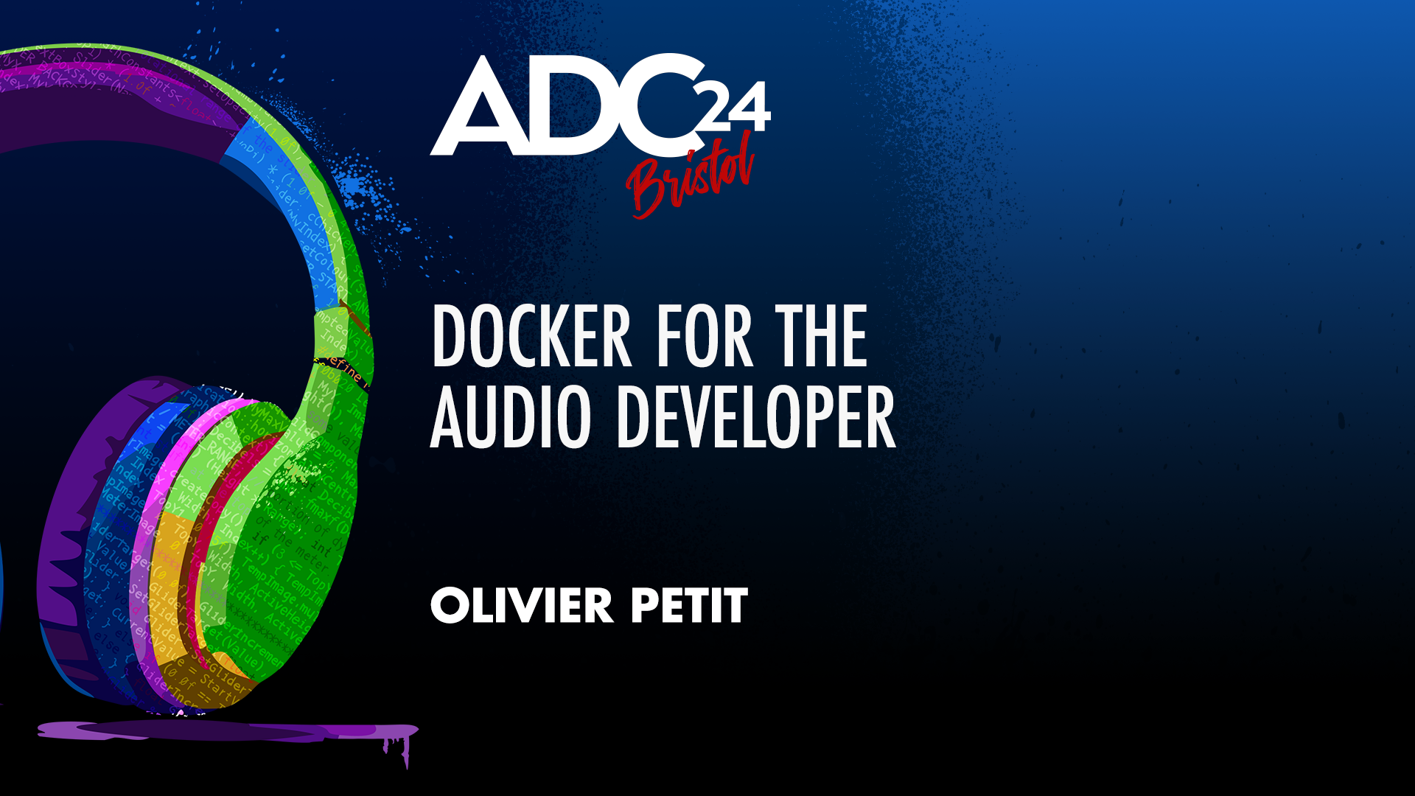

Slide 2

About me & L-Acoustics
Olivier Petit - https://www.linkedin.com/in/olivier-petit-9104b210a/

Slide 3
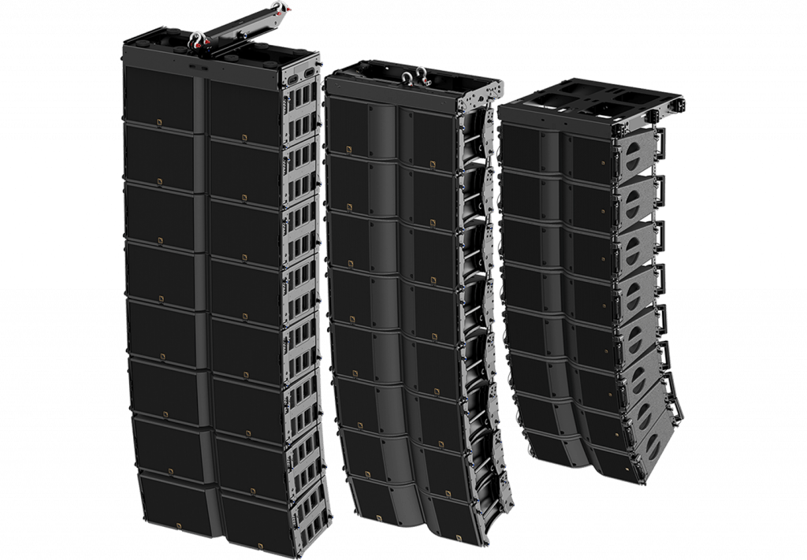
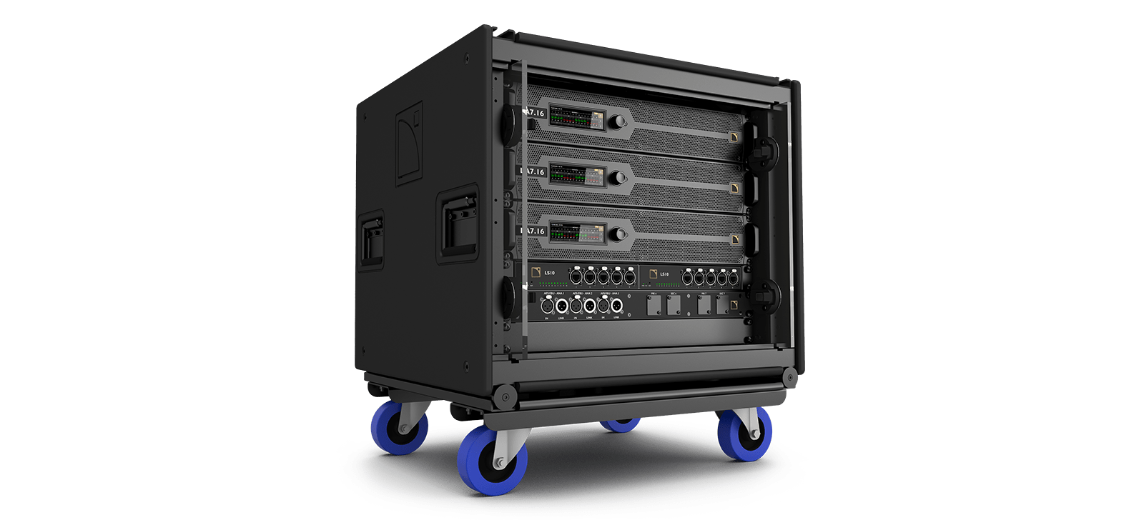
About me & L-Acoustics

Slide 4
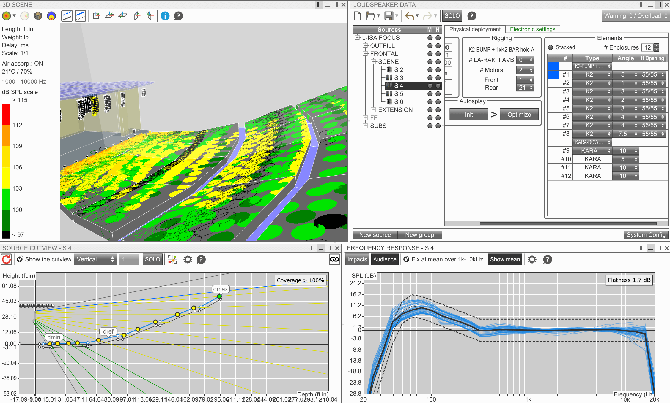
About me & L-Acoustics

Slide 5
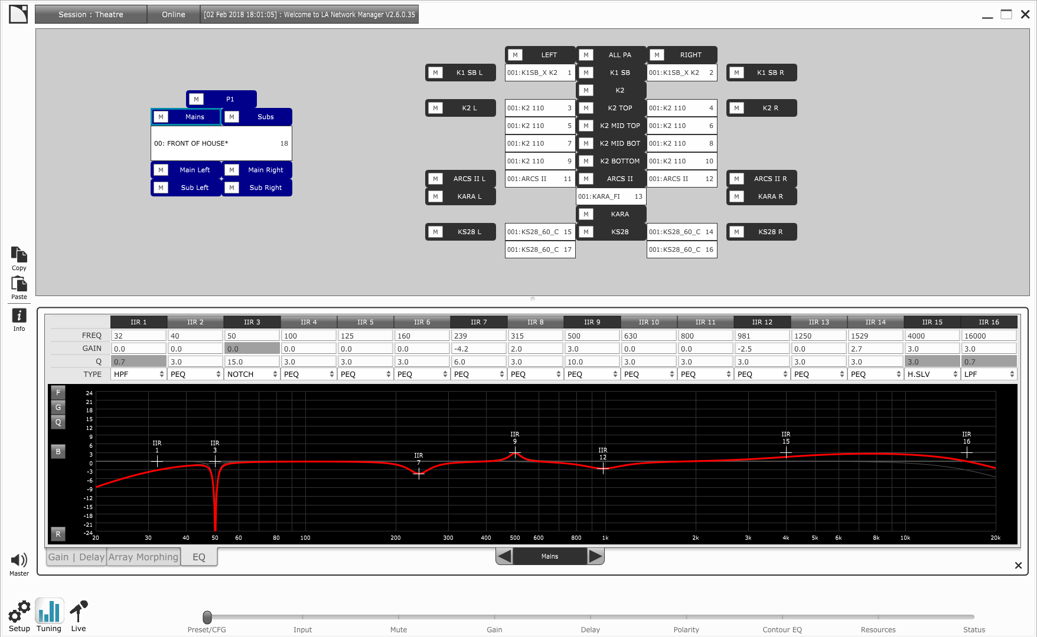
About me & L-Acoustics

Slide 6

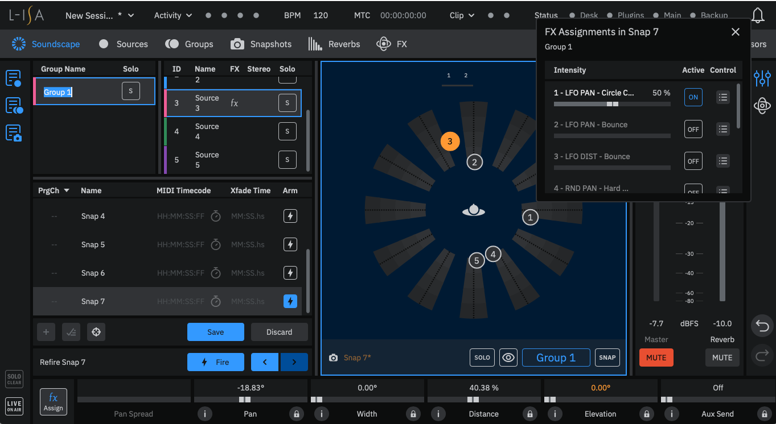
About me & L-Acoustics

Slide 7
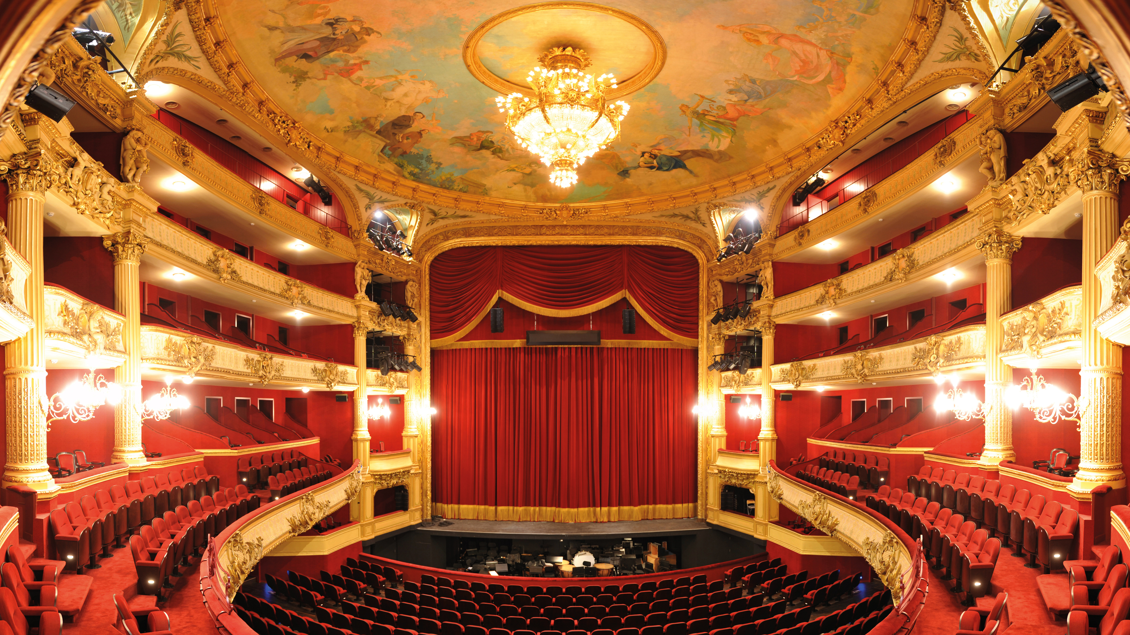
About me & L-Acoustics

Slide 8
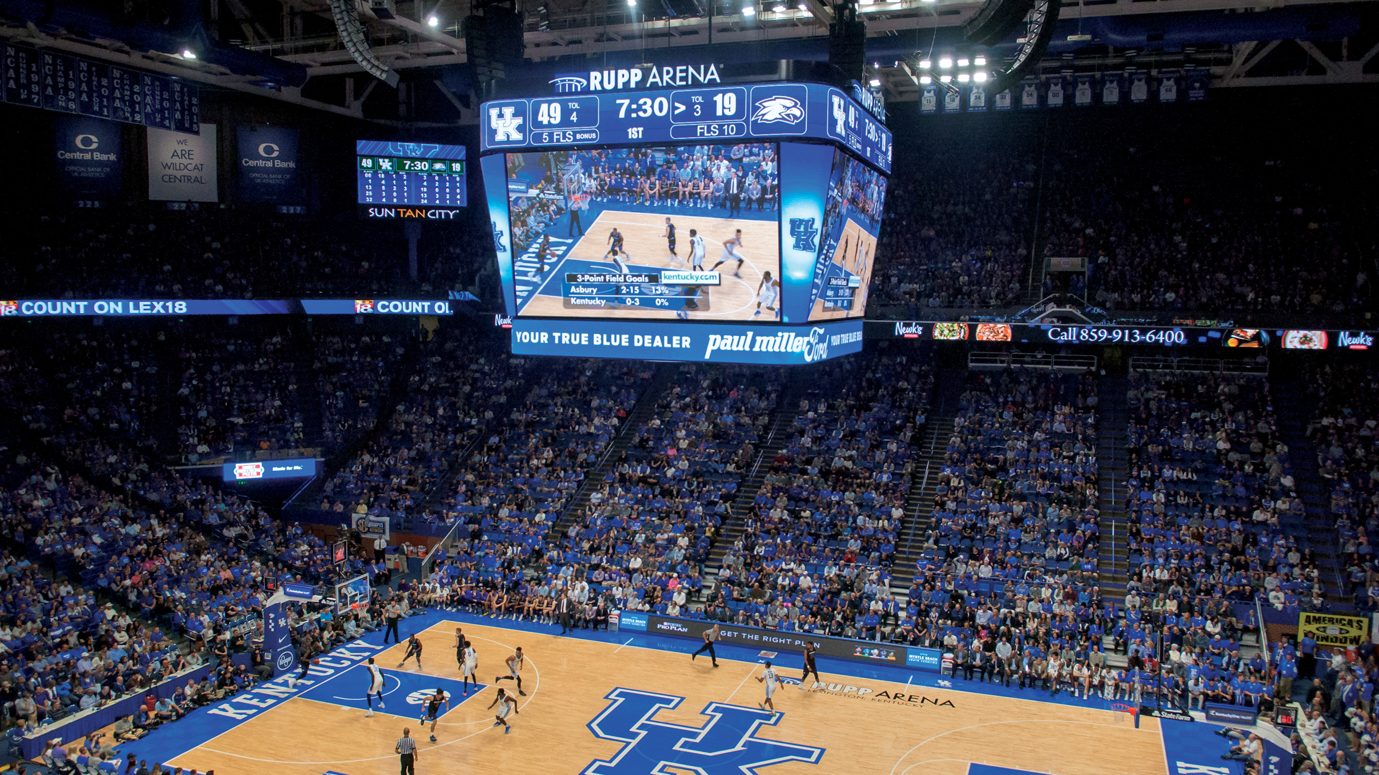
About me & L-Acoustics

Slide 9
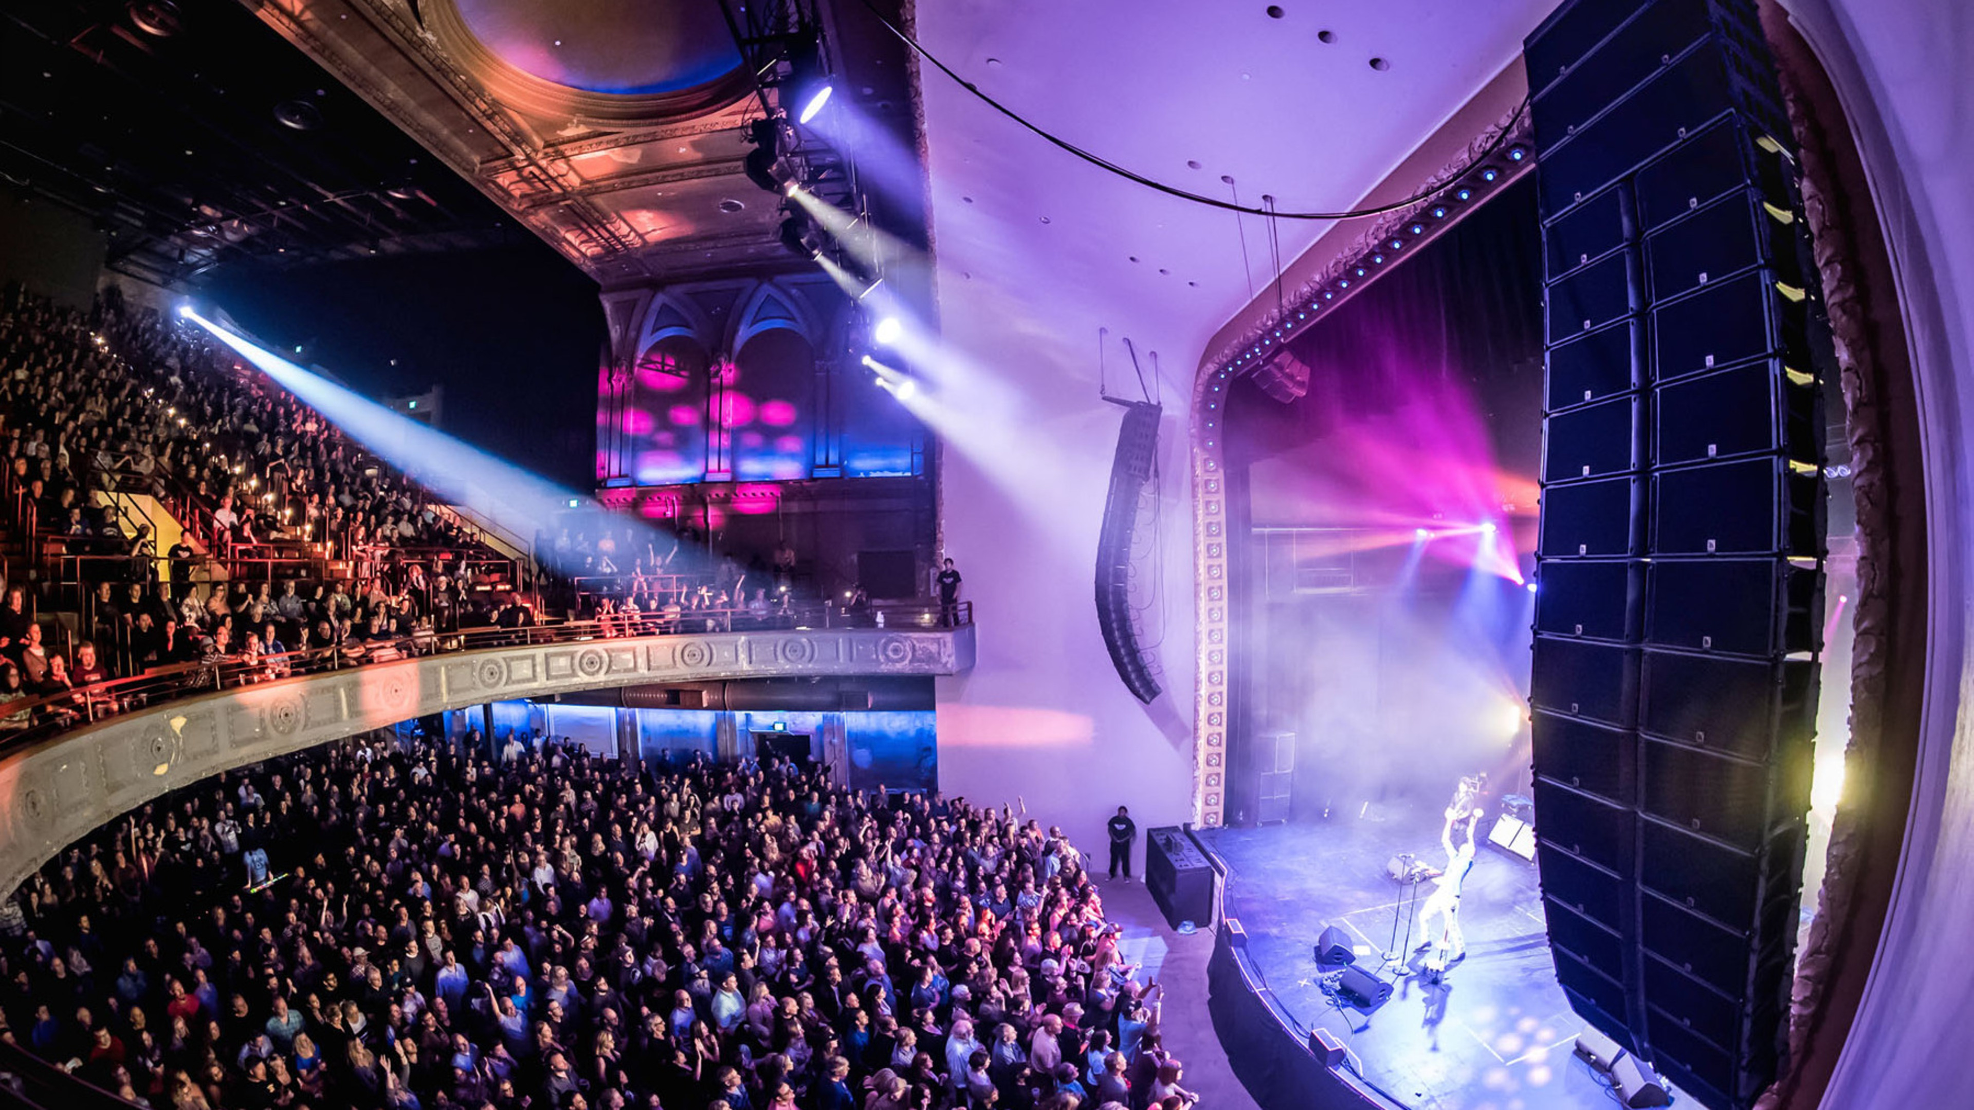
About me & L-Acoustics

Slide 10
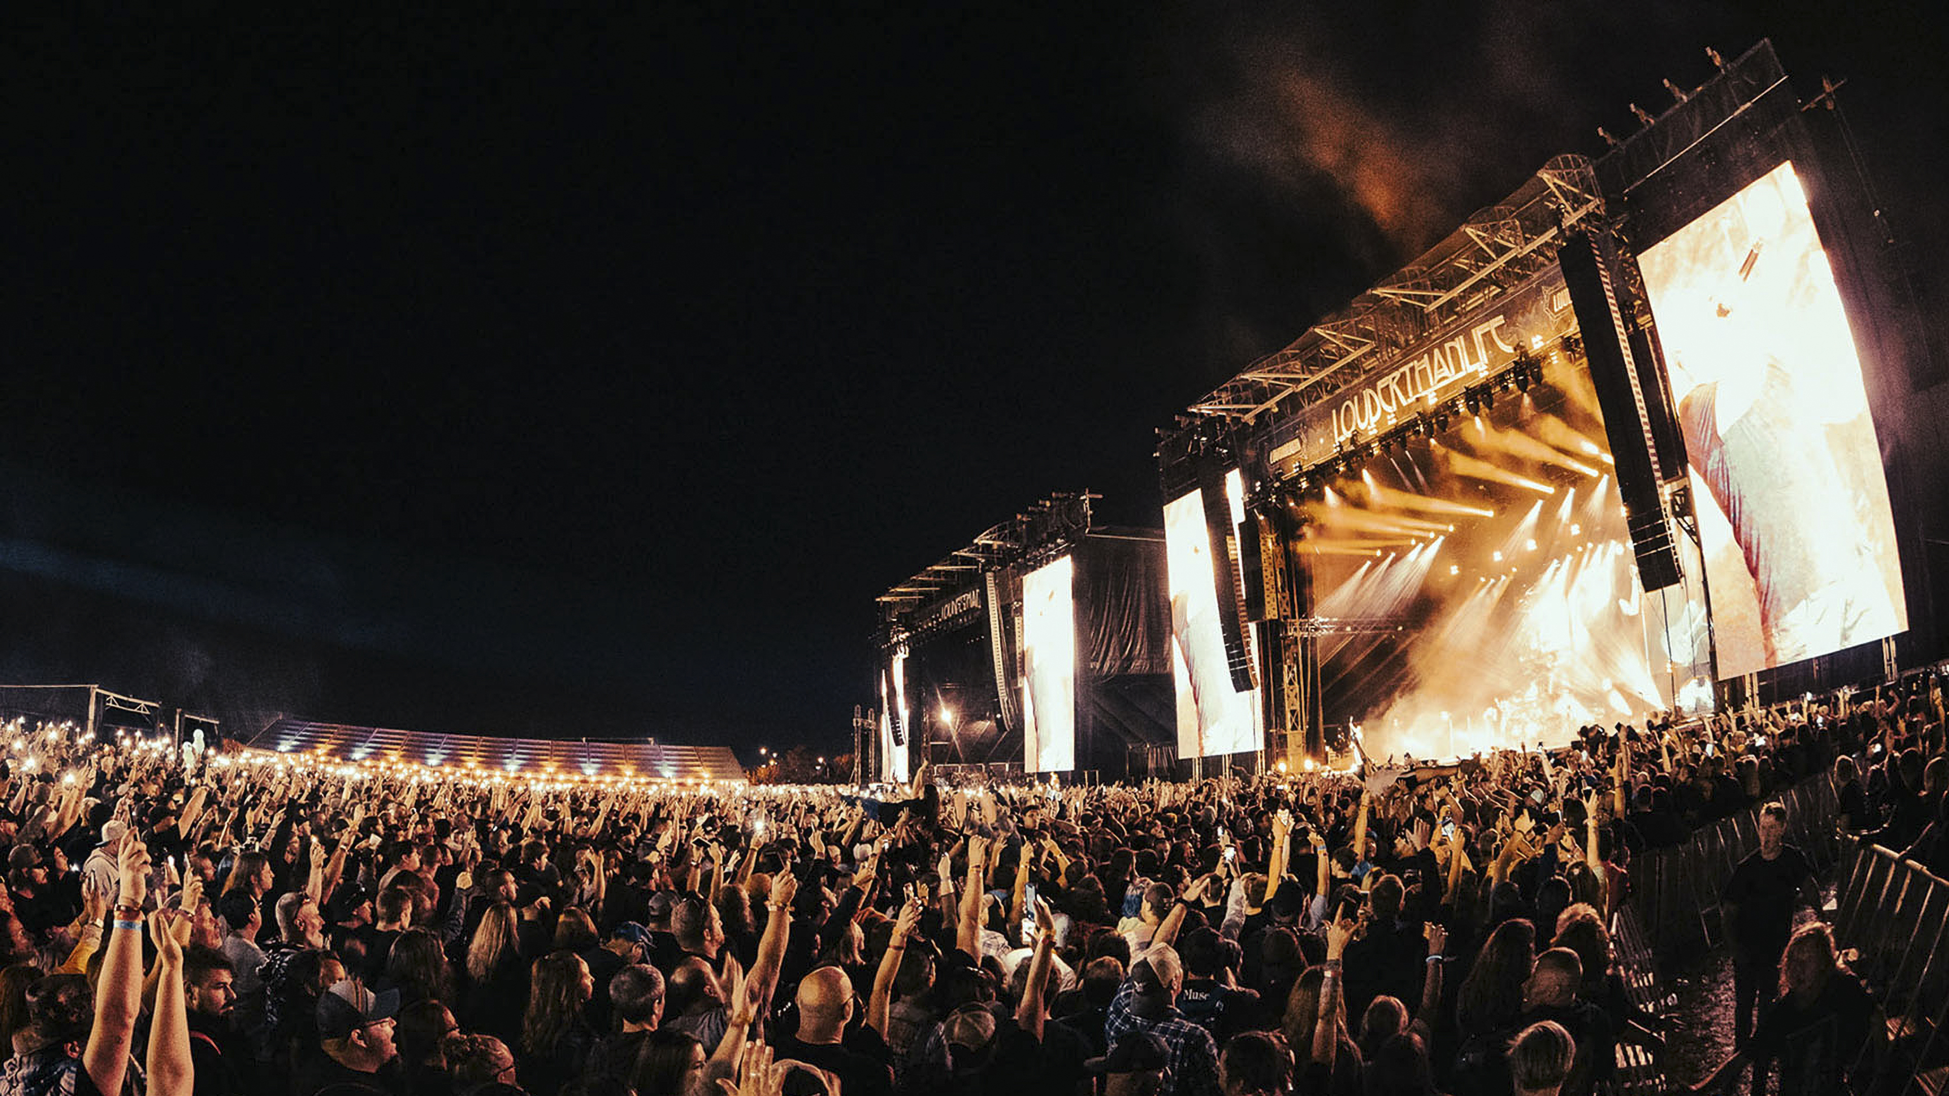
About me & L-Acoustics

Slide 11

I’m hiring!
C++ Software engineer in London
  Product mindset
  UX/UI
  DSP
  Networking
  Interoperability
  Optimisation
  macOS/Windows/Linux Preempt RT

Slide 12

Why this talk?
Invite you to explore and get deeper understanding of the systems you use every day
Show my ❤️ for Linux
  Reasons will become apparent during the talk

Slide 13
What this talk is about
Learn (some) things about Docker
What it is…
How it works…
What it’s for…
⚠️ I’m not a Docker expert
This is definitely NOT a tutorial or a collection of best practices

Slide 14
Outline
Explore
Use case 1: CI server
Use case 2: running a 3rd party audio app on a Linux audio computing platform

Slide 15
Let’s explore! ⛵️

Slide 16
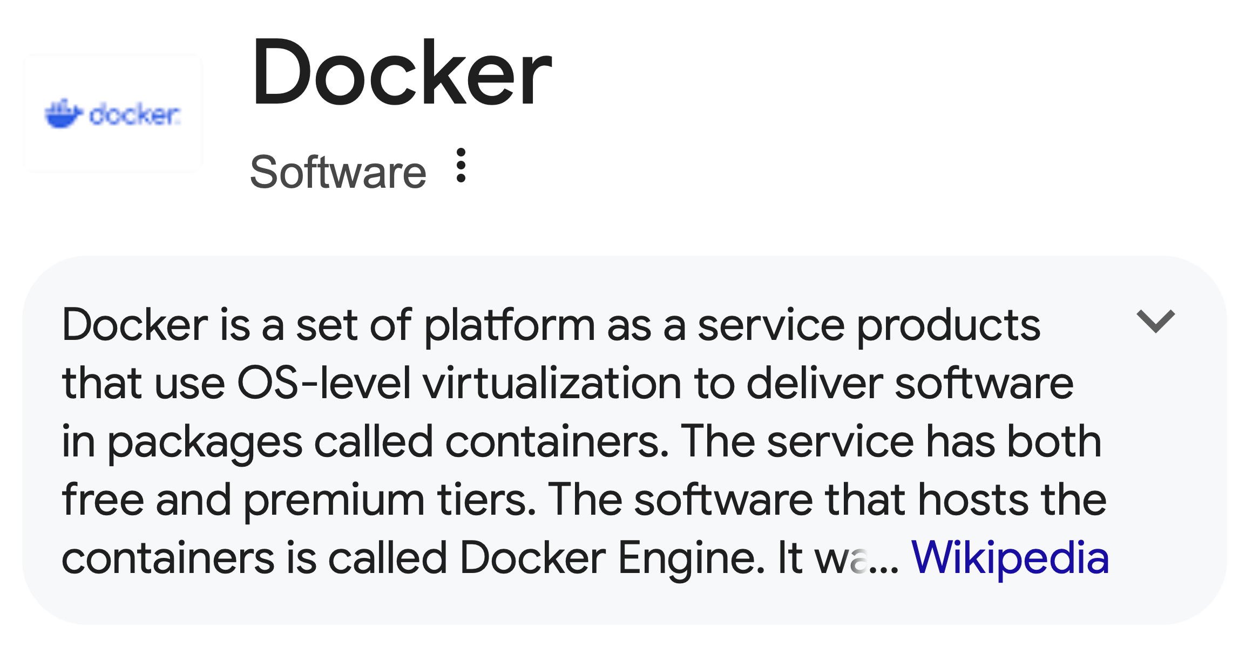
Let’s start at the beginning… ⛵️

Slide 17
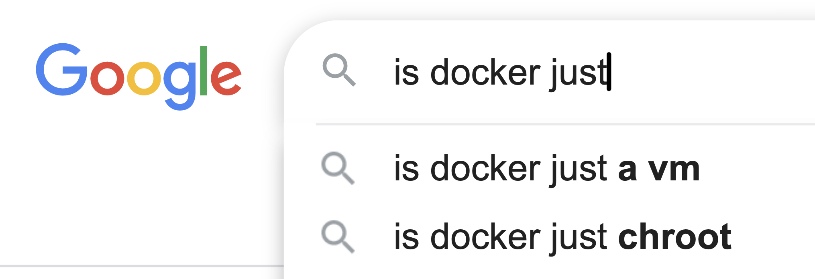
Let’s start at the beginning… ⛵️
We will be answering this….

Slide 18
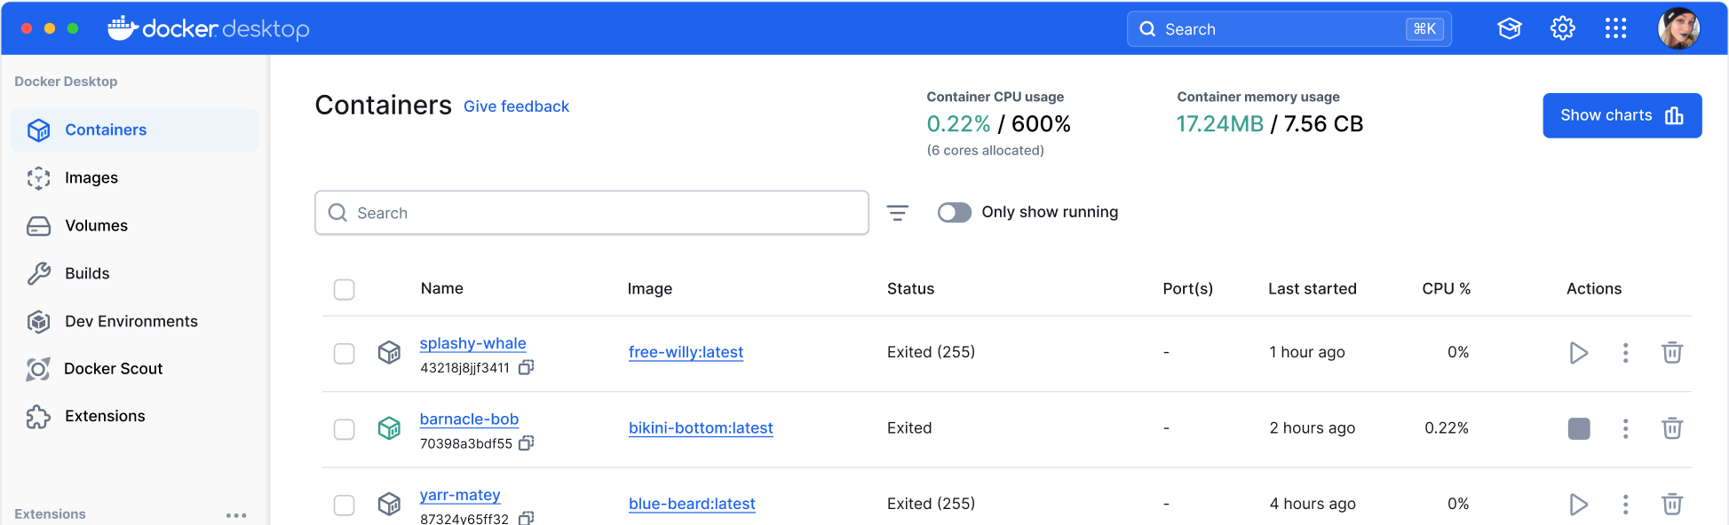
What OS?
“OS level virtualization” 🤔
Docker is mostly Linux software
Docker desktop allows you to run Docker on Windows and macOS

Slide 19

What OS?
Docker also supports Windows containers on Windows
This talk will focus on Linux

Slide 20
Let’s begin! 🏁
olivierpetit@hg-build-03:~$ uname -a
Linux hg-build-03 4.19.0-6-amd64 #1 SMP Debian 4.19.67-2+deb10u2 (2019-11-11) x86_64 GNU/Linux
olivierpetit@hg-build-03:~$ docker run debian:bookworm
Unable to find image 'debian:bookworm' locally
bookworm: Pulling from library/debian
7d98d813d54f: Pull complete
Digest: sha256:e11072c1614c08bf88b543fcfe09d75a0426d90896408e926454e88078274fcb
Status: Downloaded newer image for debian:bookworm
Not much happened…
What’s an image?

Slide 21
Let’s begin! 🏁
olivierpetit@hg-build-03:~$ docker container ls -a
IMAGE COMMAND STATUS
debian:bookworm "bash" Exited (0) 16 seconds ago

Slide 22
Let’s try again!
olivierpetit@hg-build-03:~$ docker run -it debian:bookworm
root@5adbca3e4bdb:/#
We get a shell!
Where are we? 😵‍💫

Slide 23
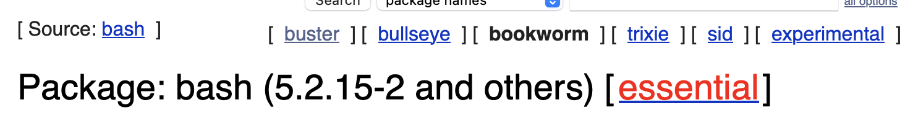
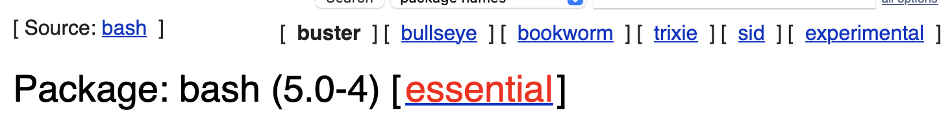
Let’s figure out where we landed 🚀
root@5adbca3e4bdb:/# ls
bin boot dev etc home lib lib64 media mnt opt proc root run sbin srv sys tmp usr var
root@5adbca3e4bdb:/# bash --version
GNU bash, version 5.2.15(1)-release (x86_64-pc-linux-gnu)
olivierpetit@hg-build-03:~$ bash --version
GNU bash, version 5.0.3(1)-release (x86_64-pc-linux-gnu)

Slide 24
Let’s figure out where we landed 🚀
root@5adbca3e4bdb:/# ls /home/
<nothing>
olivierpetit@hg-build-03:~$ ls /home/
ali olivierpetit william

Slide 25
Let’s figure out where we landed 🚀
root@9e89f5aeb8f1:/# ip addr
8073: eth0@if8074
link/ether 02:42:ac:11:00:03
inet 172.17.0.3/16 brd 172.17.255.255 scope global eth0
olivierpetit@hg-build-03:~$ ip addr
3: eno1:
link/ether 4c:52:62:1b:3b:ff
inet 172.19.2.205/24 brd 172.19.2.255 scope global eno1
7: docker0:
link/ether 02:42:68:ff:dd:d6
inet 172.17.0.1/16 brd 172.17.255.255 scope global docker0

Slide 26
Let’s figure out where we landed 🚀
root@9e89f5aeb8f1:/# ps aux
USER PID COMMAND
root 1 bash
root 602 ps aux
That’s not many processes at all 🤔

Slide 27
Let’s figure out where we landed 🚀
olivierpetit@hg-build-03:~$ ps aux
USER PID COMMAND
root 2 [kthreadd]
root 8 [mm_percpu_wq]
root 12 [migration/0]
root 17 [ksoftirqd/1]
...
root 610 /lib/systemd/systemd-logind
jenkins 746 /lib/systemd/systemd --user
systemd+ 24807 /lib/systemd/systemd-resolved
systemd+ 24813 /lib/systemd/systemd-timesyncd
root 1 /lib/systemd/systemd

Slide 28
Let’s figure out where we landed 🚀
root@5adbca3e4bdb:/# uname -a
Linux 5adbca3e4bdb 4.19.0-6-amd64 #1 SMP Debian 4.19.67-2+deb10u2 (2019-11-11) x86_64 GNU/Linux
This is not the right kernel 😮

Slide 29
Let’s start the detective work 🕵️
root@9e89f5aeb8f1:/# mkdir vimWorkDir && cd vimWorkDir && vim&
[1] 603
root@9e89f5aeb8f1:/# ps aux
USER PID COMMAND
root 1 bash
root 603 vim
root 604 ps aux
root@9e89f5aeb8f1:/# ls -l /proc/603/cwd
lrwxrwxrwx 1 root root 0 Nov 10 09:40 /proc/603/cwd -> /vimWorkDir
root@9e89f5aeb8f1:/# echo Hello from the container > hello.txt

Slide 30
… and connect the dots 🐈‍⬛
olivierpetit@hg-build-03:~$ ps aux | grep vim
root 2401 vim
root 2410 grep vim
olivierpetit@hg-build-03:~$ ls -ld /proc/2401/cwd
lrwxrwxrwx 1 root root 0 Nov 10 09:41 /proc/2401/cwd -> /vimWorkDir
olivierpetit@hg-build-03:~$ ls /vimWorkDir
ls: cannot access '/vimWorkDir': No such file or directory

Slide 31
💡 Is a container just a chroot?
root@hg-build-03:~# ls -ld /proc/2401/root
lrwxrwxrwx 1 root root 0 Nov 10 09:42 /proc/2401/root -> /
It’s not 😔

Slide 32
Let’s recap! 📋
Filesystem appears different
Network interfaces appear different
Kernel is the same
Processes in the container can be seen from the host
  But with different PIDs…
Processes from the host can’t be seen from the container

Slide 33
A bit more research 🔬
root@9e89f5aeb8f1:/# mount
overlay on / type overlay (rw,relatime,lowerdir=/var/lib/docker/overlay2/l/ES6UDBXH576UFK2GFV6IN3VZSZ:/var/lib/docker/overlay2/l/BBOT3TZQNCFTC7NASDDJ25LJLS,upperdir=/var/lib/docker/overlay2/77c9e1c71dee8c6d66e248716b176d161ac940dabdbe66368e0433aa89d2d57d/diff,workdir=/var/lib/docker/overlay2/77c9e1c71dee8c6d66e248716b176d161ac940dabdbe66368e0433aa89d2d57d/work)
That’s kinda weird 🤔

Slide 34
A bit more research 🔬
olivierpetit@hg-build-03:~$ mount
/dev/sda2 on / type ext4 (rw,relatime,errors=remount-ro)
…
overlay on /var/lib/docker/overlay2/77c9e1c71dee8c6d66e248716b176d161ac940dabdbe66368e0433aa89d2d57d/merged type overlay (rw,relatime,lowerdir=/var/lib/docker/overlay2/l/ES6UDBXH576UFK2GFV6IN3VZSZ:/var/lib/docker/overlay2/l/BBOT3TZQNCFTC7NASDDJ25LJLS,upperdir=/var/lib/docker/overlay2/77c9e1c71dee8c6d66e248716b176d161ac940dabdbe66368e0433aa89d2d57d/diff,workdir=/var/lib/docker/overlay2/77c9e1c71dee8c6d66e248716b176d161ac940dabdbe66368e0433aa89d2d57d/work)

Slide 35
That’s promising 🤩
root@hg-build-03:~#
cd /var/lib/docker/overlay2/l/BBOT3TZQNCFTC7NASDDJ25LJLS
root@hg-build-03:/var/lib/docker/overlay2/l/BBOT3TZQNCFTC7NASDDJ25LJLS# ls
bin boot dev etc home lib lib64 media mnt opt proc root run sbin srv sys tmp usr var

Slide 36
That’s promising 🤩
root@hg-build-03:/var/lib/docker/overlay2/l/BBOT3TZQNCFTC7NASDDJ25LJLS# ./bin/bash
./bash: /lib/x86_64-linux-gnu/libc.so.6: version `GLIBC_2.33' not found (required by ./bin/bash)
./bash: /lib/x86_64-linux-gnu/libc.so.6: version `GLIBC_2.36' not found (required by ./bin/bash)
./bash: /lib/x86_64-linux-gnu/libc.so.6: version `GLIBC_2.34' not found (required by ./bin/bash)

Slide 37
Oh actually it makes sense! ✋
Dynamic liking is the default on Linux distributions
👍 Smaller distribution footprint
👍 Easier security/bugfix patches deployment
👎 A lot of maintenance required
👎 You can’t move an executable from one distribution to another
👎 You are stuck with the version provided in your package manager

Slide 38
Let’s just try one more thing… 👀
root@hg-build-03:/var/lib/docker/overlay2/l/BBOT3TZQNCFTC7NASDDJ25LJLS# chroot .
root@hg-build-03:/# ./bin/bash --version
GNU bash, version 5.2.15(1)-release (x86_64-pc-linux-gnu)
This works 🥳

Slide 39
Let’s find our data! 🔎
root@hg-build-03:~# cd /var/lib/docker/overlay2/77c9e1c71dee8c6d66e248716b176d161ac940dabdbe66368e0433aa89d2d57d/diff.
root@hg-build-03:/var/lib/docker/overlay2/77c<...>d57d/diff# ls
etc hello.txt root tmp usr var vimWorkDir
root@hg-build-03:/var/lib/docker/overlay2/77c<...>d57d/diff# cat hello.txt
Hello from the container
root@hg-build-03:/var/lib/docker/overlay2/77c<...>d57d/diff# echo "Hello From the host" >> hello.txt
root@9e89f5aeb8f1:/# cat hello.txt
Hello from the container
Hello From the host

Slide 40
How does this work? 😮
olivierpetit@hg-build-03:~$ ptree
systemd─┬─....
├─dockerd───22*[{dockerd}]
├─containerd─┬─containerd-shim─┬─bash───vim
│ │ └─8*[{containerd-shim}]
│ └─19*[{containerd}]
What is this containerd? 🤔

Slide 41
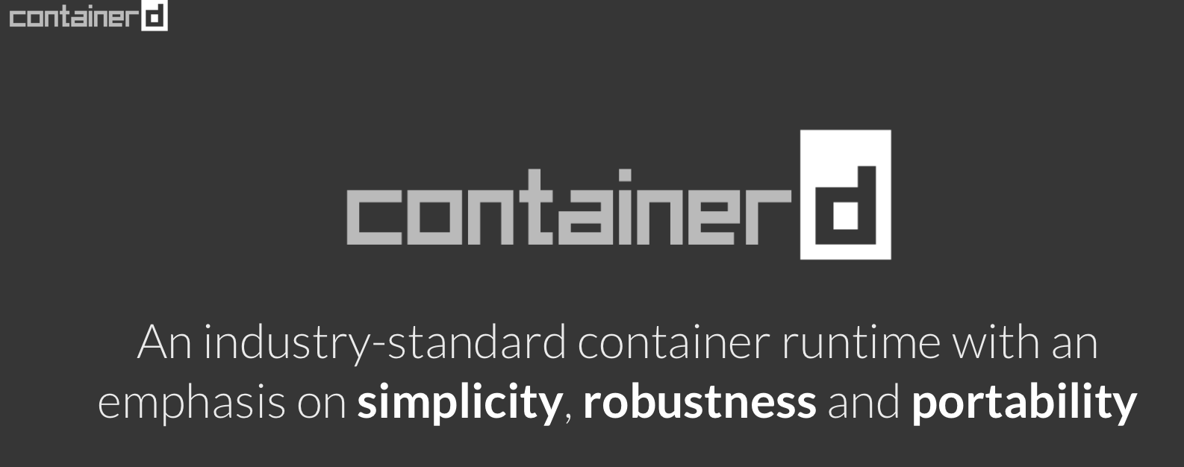
Finally connecting everything 🙌

Slide 42
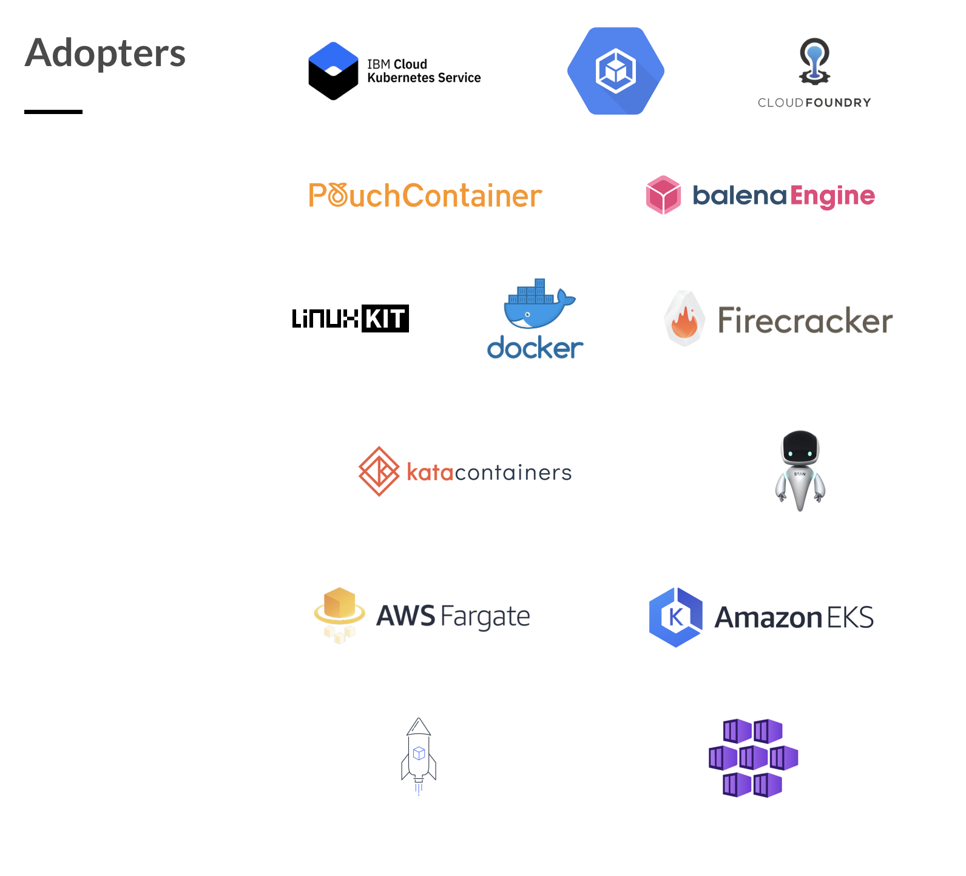
Finally connecting everything 🙌

Slide 43
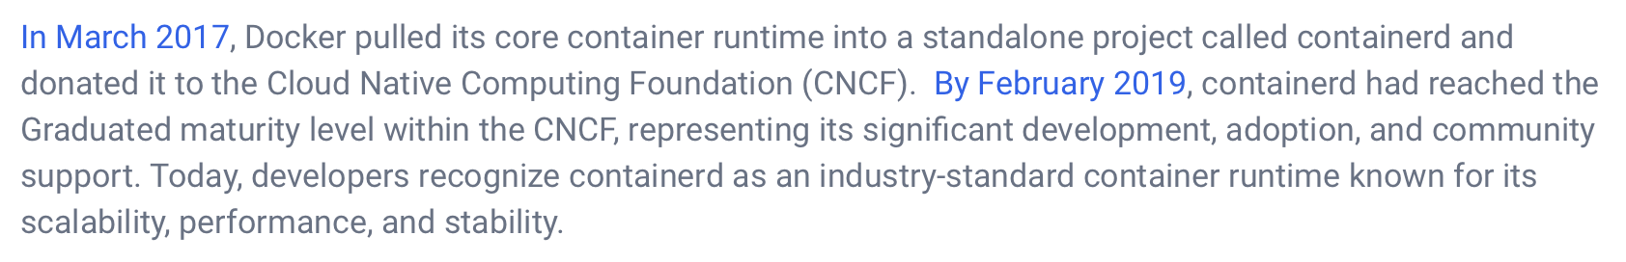
Finally connecting everything 🙌

Slide 44
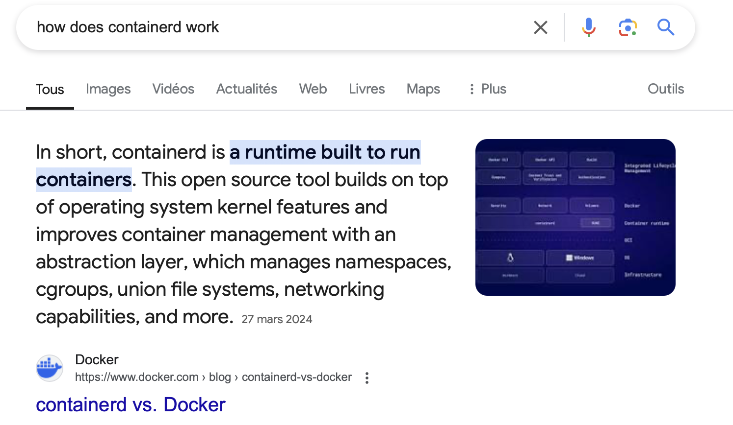
Finally connecting everything 🙌

Slide 45
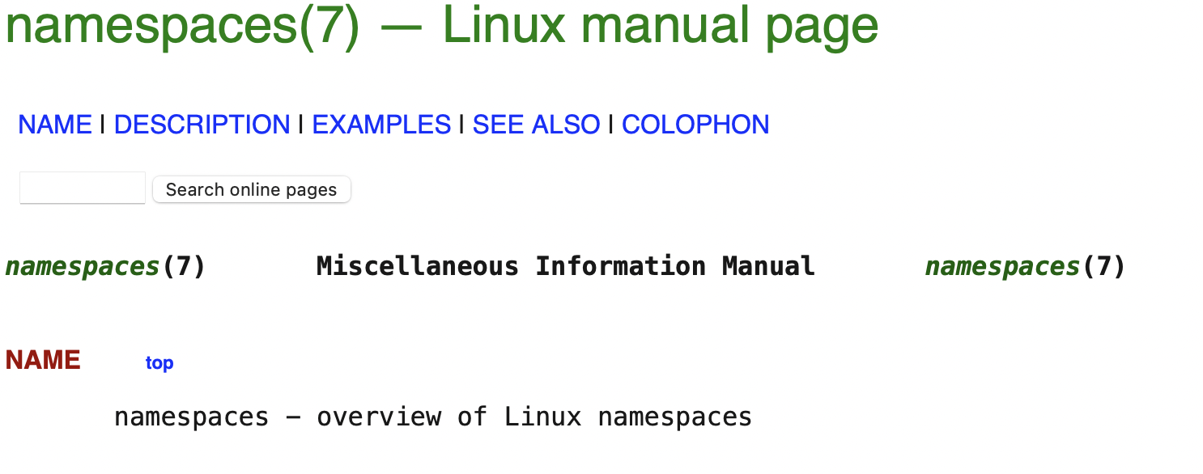
Namespaces? 🤯

Slide 46
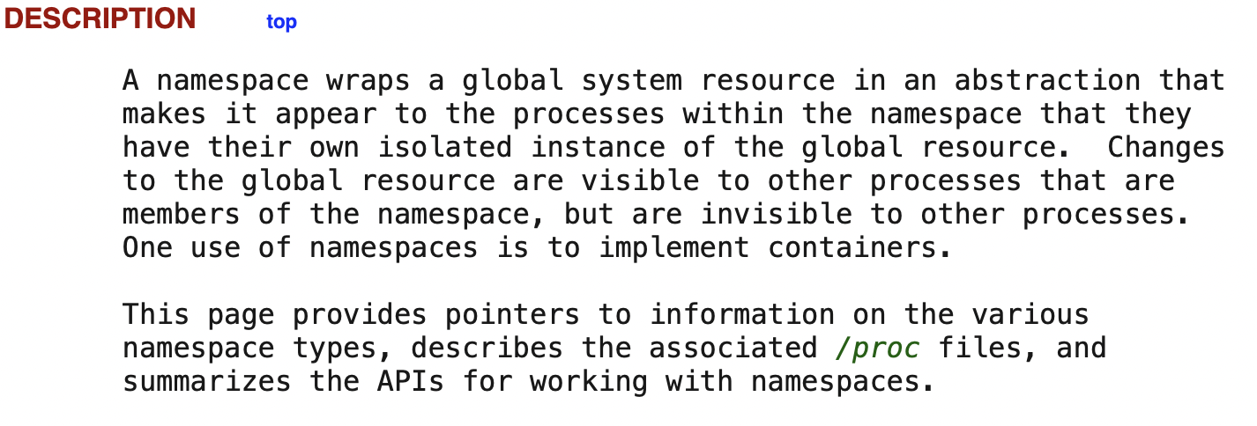
Namespaces? 🤯

Slide 47
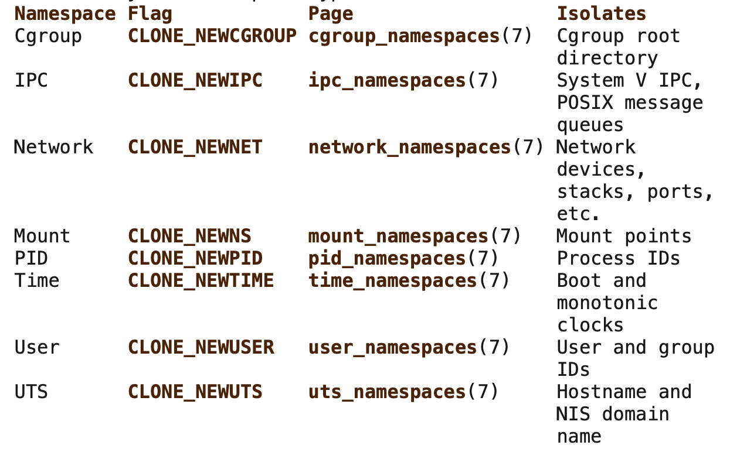
Namespaces? 🤯

Slide 48
Namespaces? 🤯
# The host bash session
root@hg-build-03:~# ls -l /proc/2728/ns/pid
/proc/2728/ns/pid -> 'pid:[4026531836]'
root@hg-build-03:~# ls -l /proc/2728/ns/mnt
/proc/2728/ns/mnt -> 'mnt:[4026531840]'
# The host systemd-logind
root@hg-build-03:~# ls -l /proc/610/ns/pid
/proc/610/ns/pid -> 'pid:[4026531836]’
# Vim running in the container
root@hg-build-03:~# ls -l /proc/2401/ns/pid
/proc/2401/ns/pid -> 'pid:[4026532532]'
root@hg-build-03:~# ls -l /proc/2401/ns/mnt
/proc/2401/ns/mnt -> 'mnt:[4026532529]'

Slide 49
Recap 🤓
Why?
Distribute an application with all its dependencies on Linux, to avoid the Linux version of DLL-hell

Slide 50
Recap 🤓
How?
Leverage several Linux kernel features
  namespaces
  overlayfs
  cgroups

Slide 51
Recap 🤓
Why is this better than a VM?
No hardware virtualisation needed
No reservation of system resources
No kernel/OS to boot when launching a container
Fast and light 😎
Awesone tooling 💥

Slide 52
Intermission

Slide 53
Intermission
Docker/containers are an abstraction
Law of Leaky Abstractions
“All non-trivial abstractions, to some degree, are leaky.”
Joel Spolsky, 11/11/2002
https://www.joelonsoftware.com/2002/11/11/the-law-of-leaky-abstractions/

Slide 54
Docker for a CI system

Slide 55
Docker for a CI system
Create an environment to build a Linux executable for a target distribution, without having to manually install all dependencies
Use this environment as part of a CI system

Slide 56
Custom image 🛠️
Dockerfile: recipe to build a Docker image 😋
FROM debian:buster as base
RUN apt-get update && apt-get -qq -y install \
build-essential \
tar \
llvm \
lldb \
clang
…

Slide 57
Custom image 🛠️
ARG CMAKE_VERSION=3.29
ARG CMAKE_BUILD=1
RUN mkdir ~/cmake-install \
&& cd ~/cmake-install \
&& wget https://github.com/Kitware/CMake/releases/download/v$CMAKE_VERSION.$CMAKE_BUILD/cmake-$CMAKE_VERSION.$CMAKE_BUILD.tar.gz \
&& tar -xzvf cmake-$CMAKE_VERSION.$CMAKE_BUILD.tar.gz \
&& cd cmake-$CMAKE_VERSION.$CMAKE_BUILD/ \
&& ./bootstrap \
&& make -j$(nproc) \
&& make install \
&& rm -rf ~/cmake-install

Slide 58
Custom image 🛠️
ENV USERNAME=my-user
ENV PASSWORD=xxxxx
RUN useradd -rm -d /home/$USERNAME -s /bin/bash -g root -G sudo -u 1000 $USERNAME
RUN echo "$PASSWORD\n$PASSWORD" | passwd $USERNAME
RUN echo '%sudo ALL=(ALL) NOPASSWD:ALL' >> /etc/sudoers
WORKDIR /home/my-user
USER $USERNAME

Slide 59
Custom image 🛠️
RUN mkdir /home/my-user/my-project
ENTRYPOINT ["/home/my-user/mnt/my-project/myEntrypoint.sh"]
FROM base as production
FROM base as development
RUN sudo apt-get update \
&& sudo apt-get -qq -y install \
rsync

Slide 60
Custom image 🛠️
Building the image…
docker build --progress=plain \
-f <YourDockerfile> . \
--target production \
--tag my-cool-build-image:latest

Slide 61
Building 🏗️
Run the container performing the build
docker volume create my-project-build
docker volume create vcpkg-cache-buster-gcc12
docker run --rm
--volume "${source_root}/:/home/my-user/mnt/my-project:ro" \
--volume my-project-build:/home/my-user/my-project/_build \
--volume vcpkg-cache-buster-gcc12:/home/my-project/.vcpkg_cache\
my-cool-build-image:latest

Slide 62
Harvesting 🚜 and cleanup 🧹
Extracting the build
CID=$(docker run -d -v my-project-build:/_build --entrypoint /bin/true my-cool-build-image)
docker cp $CID:/_build/Install ./_build
docker rm $CID
docker volume rm my-project-build

Slide 63
The CI image 🏭
Create a custom Jenkins docker image to run our build image
FROM jenkins/inbound-agent:3148.v532a_7e715ee3-4-jdk17

Slide 64
The CI image 🏭
This image will need to call docker to run the build image
This is known the “Docker in Docker” problem
RUN curl -fsSL https://download.docker.com/linux/debian/gpg | apt-key add -
RUN add-apt-repository \
"deb [arch=amd64] https://download.docker.com/linux/debian \
$(lsb_release -cs) \
stable"
RUN apt-get update -qq \
&& apt-get -y install docker-ce docker-compose-plugin
RUN groupadd -f docker
RUN usermod -aG docker jenkins
RUN newgrp docker

Slide 65
The CI image 🏭
This image will need to call docker to run the build image
This is known the “Docker in Docker” problem
DOCKER_GROUP=$(stat -c '%g' /var/run/docker.sock)
docker run –rm --group-add $DOCKER_GROUP
-v /var/run/docker.sock:/var/run/docker.sock \
-v ~/agent_workspace:/home/jenkins/agent \
-v ~/.ssh:/home/jenkins/.ssh:ro \
--net=host \
my-custom-jenkins-image:latest \

Slide 66
The CI image 🏭
This won’t be enough 🥺
--volume "${source_root}/:/home/my-user/mnt/my-project:ro”
`source_root` should be a path on the host system…
… but the call running the build container now runs in the Jenkins containers, which does not know where its workspace resides on the host
The Law of Leaky Abstractions got us…

Slide 67
The CI image 🏭
Workaround 😬
Add the following when starting your Jenkins container:
-e JENKINS_WORKDIR_IN_HOST=/home/jenkins/agent_workspace
-e JENKINS_WORKDIR_IN_CONTAINER=/home/jenkins/agent/workspace
Add the following in the CI script staring the build container
if [ -z "$JENKINS_WORKDIR_IN_HOST" ]; then
source_root=$(pwd)
else
workspace_path=$(realpath --relative-to="$JENKINS_WORKDIR_IN_CONTAINER" "$(pwd)")
source_root="$JENKINS_WORKDIR_IN_HOST/workspace/$workspace_path"
fi

Slide 68
Running audio applications using Docker 🔊
Using the JACK audio server

Slide 69
Not much to say… 😌
Start JACK server on the host system, which will talk to your alsa driver to access the audio hardware
Mount /dev/shm into the container running the audio app
Finetune threads realtime priorities and CPU affinities as usual.

Slide 70

References
LiveOverflow - How Docker Works – intro to namespaces
https://www.youtube.com/watch?v=-YnMr1lj4Z8
Jake Wright – Learn Docker in 12 minutes
https://www.youtube.com/watch?v=YFl2mCHdv24
To go further:
Docker compose: https://docs.docker.com/compose/

